Slide 1
Immunity
By : Naya Al-Qamhawi

Slide 2
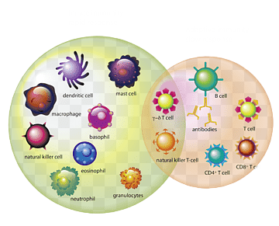
What is the immune system?
The immune system is a complex network of organs, cells and proteins that defends the body against infection, whilst protecting the body's own cells. The immune system keeps a record of every germ (microbe) it has ever defeated so it can recognise and destroy the microbe quickly if it enters the body again.
There are two types of immune systems :
The innate immune system which you are born with.
The adaptive immune system which you develop when your body is exposed to microbes or chemicals released by microbes

Slide 3
Innate immune system
The innate immune system is the body's first line of defense against germs. It responds in the same way to all germs and foreign substances, which is why it is sometimes referred to as the "nonspecific" immune system. It acts very quickly and makes sure that bacteria that has entered the body is detected and destroyed on the spot within a few hours. The innate immune system has only limited power to stop germs from spreading, though.
The innate immune system consists of
Skin that keeps out the majority of pathogens
Stomach acid that destroys pathogens
Enzymes in our sweat and tears that help create antibacterial compounds

Slide 4
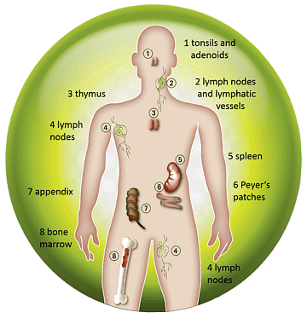
Adaptive immune system
The adaptive immune system takes over if the innate immune system is not able to destroy the germs. It specifically targets the type of germ that is causing the infection. The adaptive immune system is slower to respond than the innate immune system, but it is more accurate. It also has the advantage of being able to "remember" germs, which is also the reason why there are some illnesses you can only get once in your life, because afterwards your body becomes “immune.”
The adaptive immune system is made up of:
T lymphocytes in the tissue between the body's cells
B lymphocytes, also found in the tissue between the body's cells
Antibodies in the blood and other bodily fluids

Slide 5
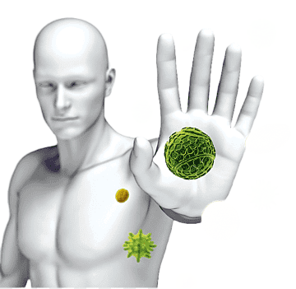
Questions
What the difference between innate and adaptive immunity?
Innate immunity is the body's first line of defence against pathogens, it is the type of immunity you are born with. It is general and non-specific, which means it does not differentiate between types of pathogens. Meanwhile adaptive immunity is developed over the years, is more specific and only fights specific types of pathogens
What do you think would happen to a person if their immune system stopped working?
Your immune system is your body's defense against infections and other harmful invaders. Without it, you would constantly get sick from bacteria or viruses and run the risk of death.
Eat a diet high in fruits and vegetables.
Exercise regularly.
Get adequate amounts of sleep daily.
Take steps to avoid infection, such as washing your hands frequently and cooking meats thoroughly.
Try to minimize stress as much as possible.
What are some ways you think you can help improve your immune system and make it stronger ?

Slide 6
Thank you for listening !

Slide 7
Resources
https://byjus.com/biology/differences-between-innate-and-adaptive-immunity/#:~:text=Innate%20immunity%20is%20the%20body's,to%20diseases%20or%20get%20vaccinated.
https://www.hopkinsmedicine.org/health/conditions-and-diseases/disorders-of-the-immune-system#:~:text=Your%20immune%20system%20is%20your,sick%20from%20bacteria%20or%20viruses.
https://www.health.harvard.edu/staying-healthy/how-to-boost-your-immune-system

