Slide 1
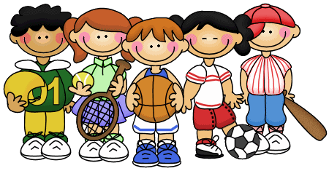
Sports in our school
By: Asim,Zaid,Awn
Notes:
By Asim Zaid Awn

Slide 2
introduction
When we started doing the project first we did the interviews we had to do with students about sports in our school and our PE classes, then we did the Google forms about it and send it to students so they respond to it then we take there answers to know the causes and solutions of the problem, after that we sent it to our teacher, lastly we did the PowerPoint, first we did the introduction in it about what we did, secondly we did the causes and consequences of it, lastly we put the suggestion and solutions of the problem in the last slide. After all we had fun doing it and we found some solutions that might be good for our school and class and make it better.

Slide 3
Causes of the survey
Causes: Its boring.
They don’t like sports.
There is no variety of types of sports like swimming,tennis,football,
Basketball and more.
Other students don't let them to play with them.
They cant play because of an injury or illness or something else.

Slide 4
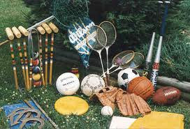
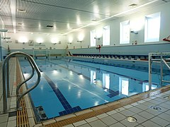
Solutions of the survey
Solutions: Play other activities other than football like basketball,tennis,baseball, swimming and
other.
Have a variety of activities and sports in school like basketball,tennis,baseball,
swimming and other.
If other classmates or student don’t let you play you can ask them or tell a teacher
about it.
if they have an injury and cant play they have to wait till they heal but if they have an illness they could see a doctor or someone that can help them to try to solve there problem.

