Slide 1
Universe
Done by: Natalie zabaneh

Slide 2
What is the universe in your opinion?
What do scientist says:
A galaxy is a vast island of gas, dust and stars in an ocean of space. Typically, galaxies are millions of light-years apart. Galaxies are the building blocks of our universe.
A galaxy can contain hundreds of billions of stars and be many thousands of light-years across. Our own galaxy, the Milky Way, is around 100,000 light-years in diameter. That’s about 587,900 trillion miles, or nearly a million trillion kilometers.

Slide 3
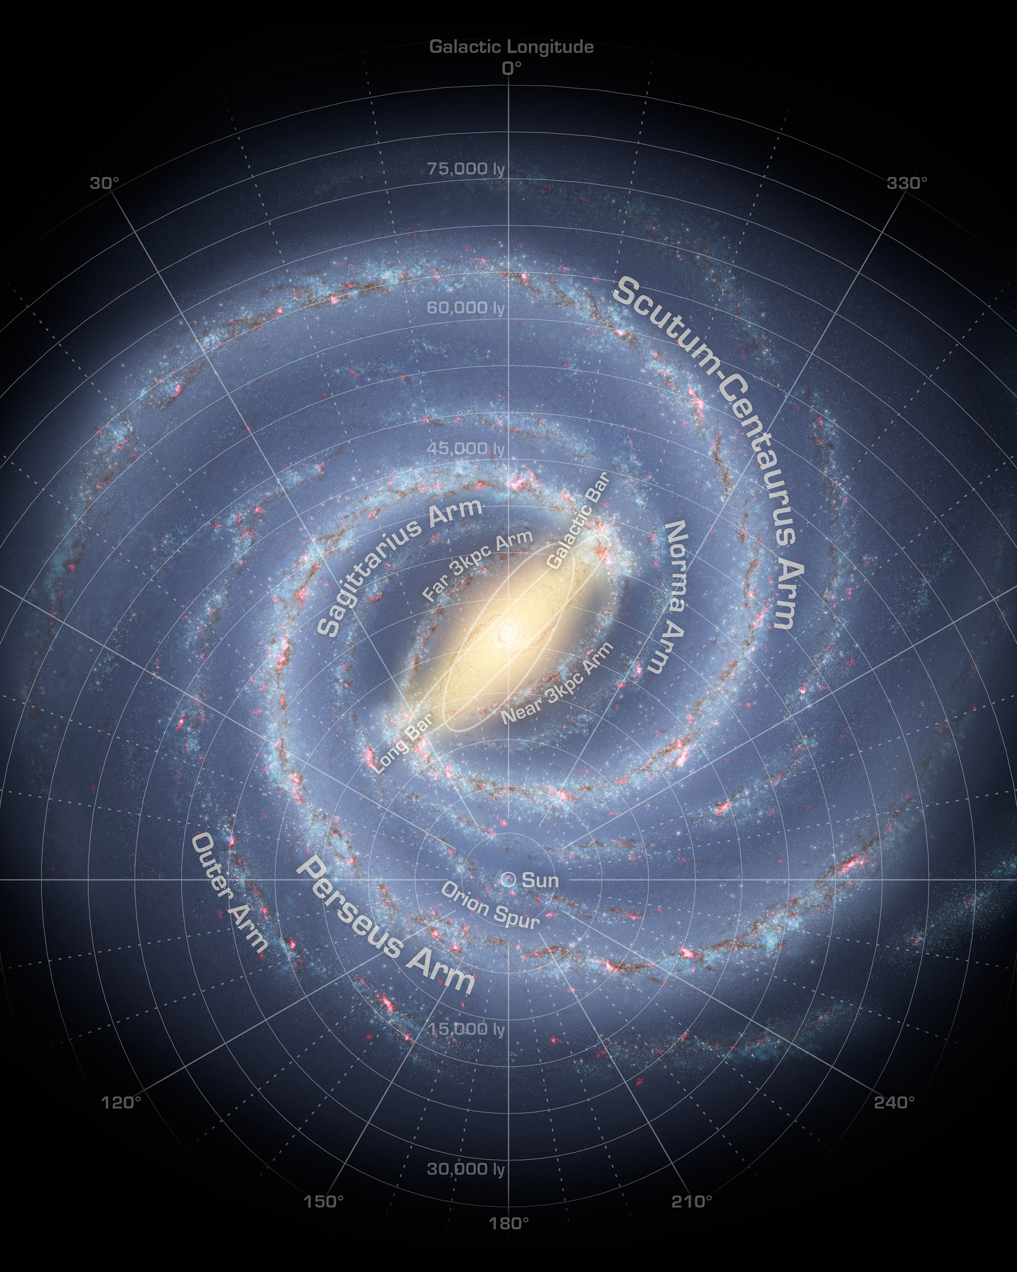
Milky way:
Milky Way Galaxy, large spiral system consisting of several hundred billion stars, one of which is the Sun. It takes its name from the Milky Way, the irregular luminous band of stars and gas clouds that stretches across the sky as seen from Earth.
https://www.youtube.com/watch?v=0La58bUNNzQ

Slide 4
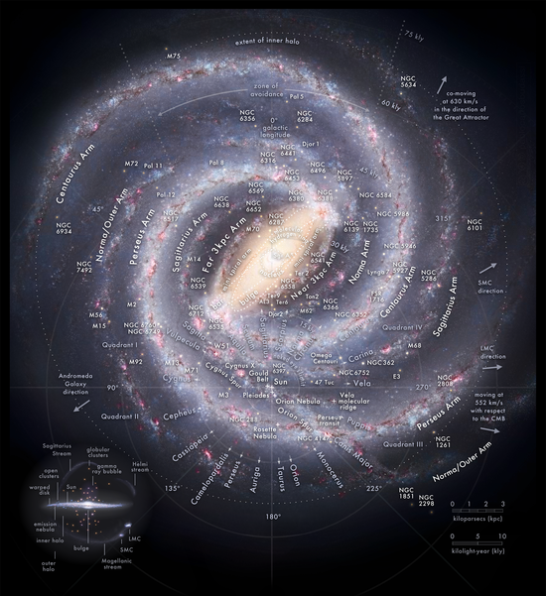
How many planets are in the milky way?
100 billion planets
Astronomers aren't quite sure how many planets are in the Milky Way, given we have only found a few thousand all told, but one NASA estimate suggests it's more than 100 billion planets. How many solar systems there are in the Milky Way is also a mystery, as we are still looking for the planets.
The planets that are know at the moment:
The most well-known planets in our Milky Way are the eight planets of our Solar System, namely Mercury, Venus, Earth, mars, Jupiter, Saturn, Uranus, and Neptune . There are also the five dwarf planets Pluto, Eris, Makemake, Haumea, and Ceres.

Slide 5
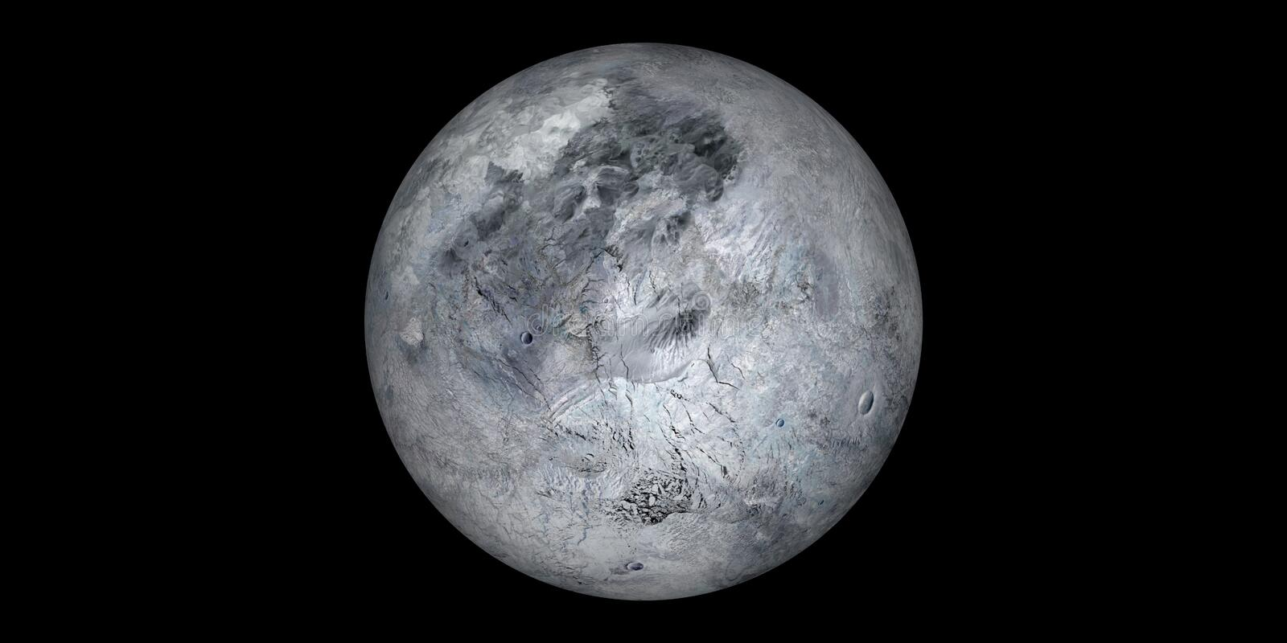
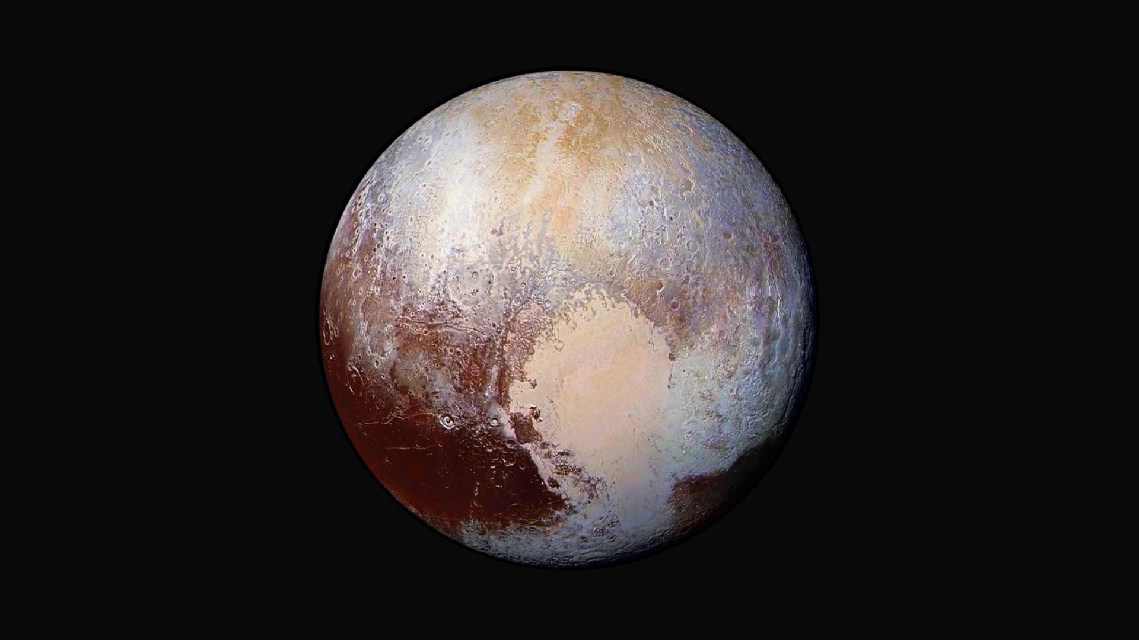
Five facts about each planet:
Pluto
Eris
Pluto was considered a planet until 2006
Sometimes Pluto is closer to The Sun than Neptune
Pluto is smaller than the Moon
A year on Pluto is 248 Earth years
A day on Pluto lasts 153 hours, or about 6 Earth days.
Eris was once thought to be bigger than Pluto.
Initially, Eris was called Xena
Its surface is like Pluto's heart.
A mission to Eris will take a while.
An Eridian day is just slightly longer than Earth's.

Slide 6
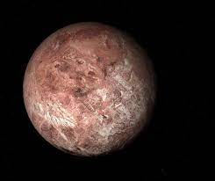
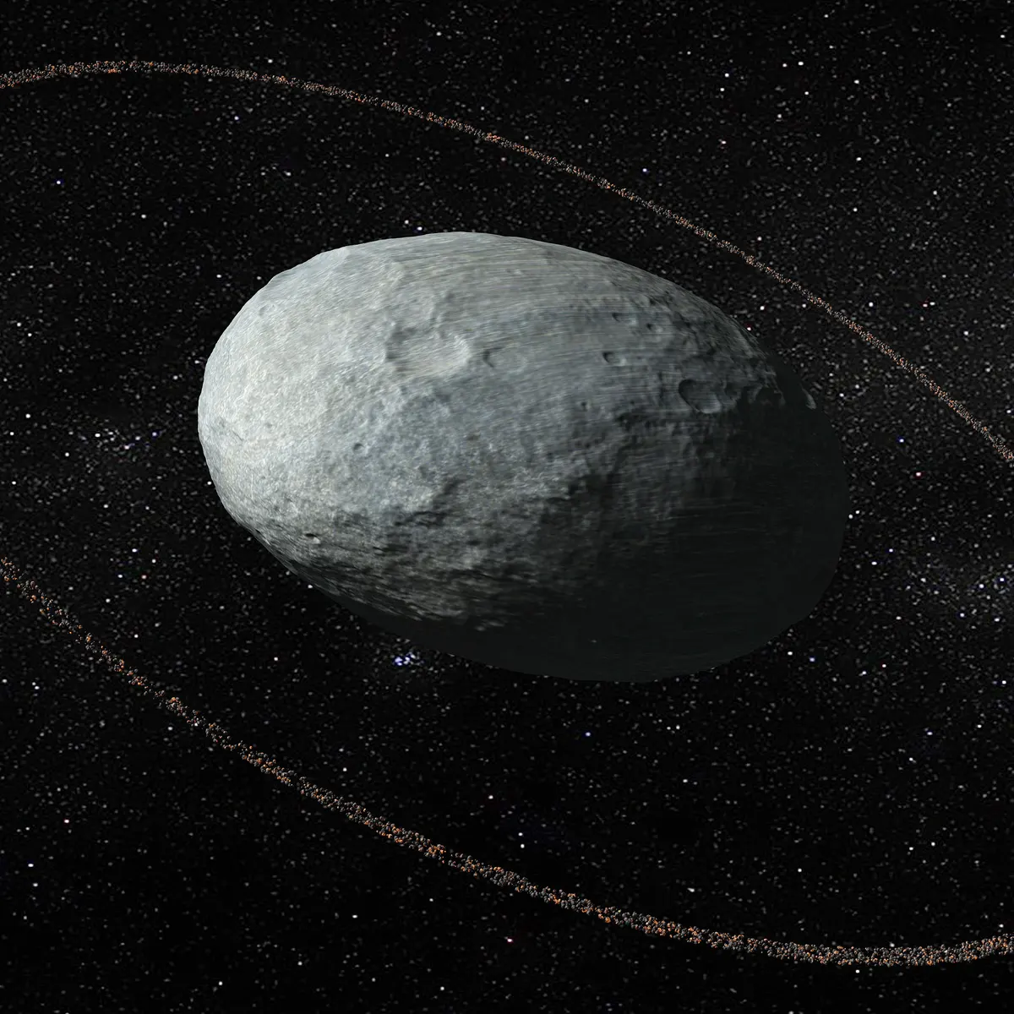
Makemake
Haumea
It’s impressively bright.
Makemake’s surface is volatile.
Its moon was only recently discovered.
Much of makemake remains mysterious.
There are no plans to visit makemake…yet.
Three haumeas could fit side by side in earth.
Haumea’s surface is extremely bright.
Haumea has one of the shortest days in the entire solar system.
High-speed collisions may explain Haumea’s two moons.
One moon has water ice-just like Haumea.

Slide 7
ceres
Ceres was the first object considered to be an asteroid.
Ceres officially became a dwarf planet in 2006.
It is the smallest dwarf planet.
Ceres is located between Mars and Jupiter.
It takes Ceres 4.6 years to go around the sun.

Slide 8
We are not alone
https://www.youtube.com/watch?v=CHiljMMzy2E

Slide 9
Questions part☺
Did you thought that the Universe was this big? why/why not
Do you think that there are more planets in the milky that hasn’t been discovered?
What are your thoughts about the planets that I mentioned in past slides?
At the moment, do have any thoughts about this topic?

Slide 10
Links
https://www.space.com/19915-milky-way-galaxy.html
https://www.britannica.com/place/Milky-Way-Galaxy
https://earthsky.org/astronomy-essentials/definition-what-is-a-galaxy/
https://nineplanets.org/questions/how-many-planets-are-in-the-milky-way/#:~:text=What%20Planets%20are%20in%20the,Makemake%2C%20Haumea%2C%20and%20Ceres
https://www.funkidslive.com/learn/top-10-facts/top-10-facts-about-pluto/
https://www.mentalfloss.com/article/552085/dwarf-planet-eris-facts
https://www.mentalfloss.com/article/519262/facts-about-dwarf-planet-makemake
https://www.mentalfloss.com/article/519236/facts-about-dwarf-planet-haumea
https://15facts.com/facts-about-ceres-the-dwarf-planet/

