Slide 1
Virtual Reality
Done by : Qais Haddad , Hamzeh nihad

Slide 2
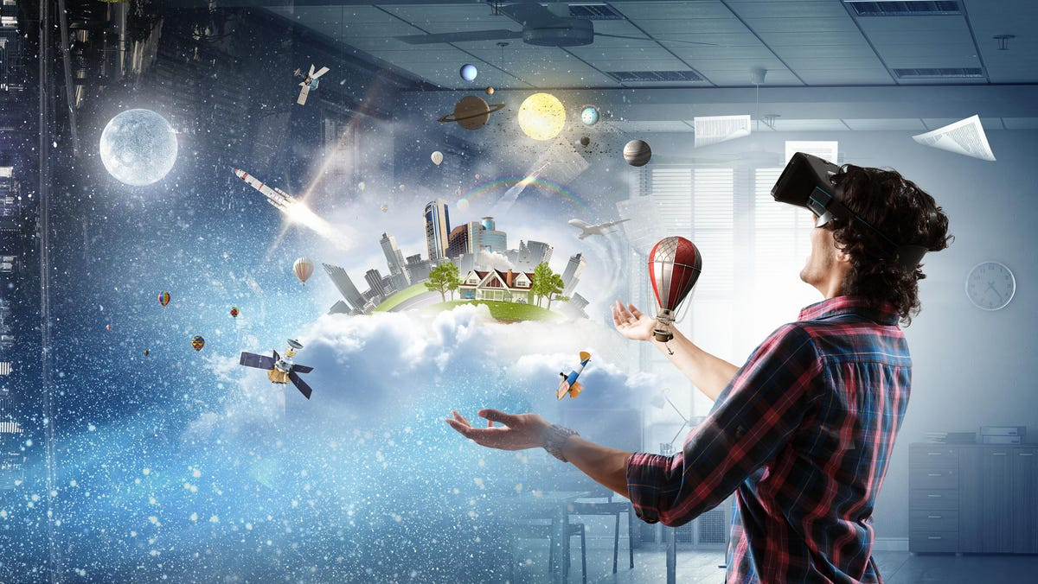
What is virtual reality?
Virtual reality is a simulated 3D environment that enables users to explore and interact with a virtual surrounding in a way that approximates reality, as it is perceived through the users' senses. The environment is created with computer hardware and software, although users might also need to wear devices such as helmets or goggles to interact with the environment. The more deeply users can immerse themselves in a VR environment -- and block out their physical surroundings -- the more they are able to suspend their belief and accept it as real, even if it is fantastical in nature.

Slide 3
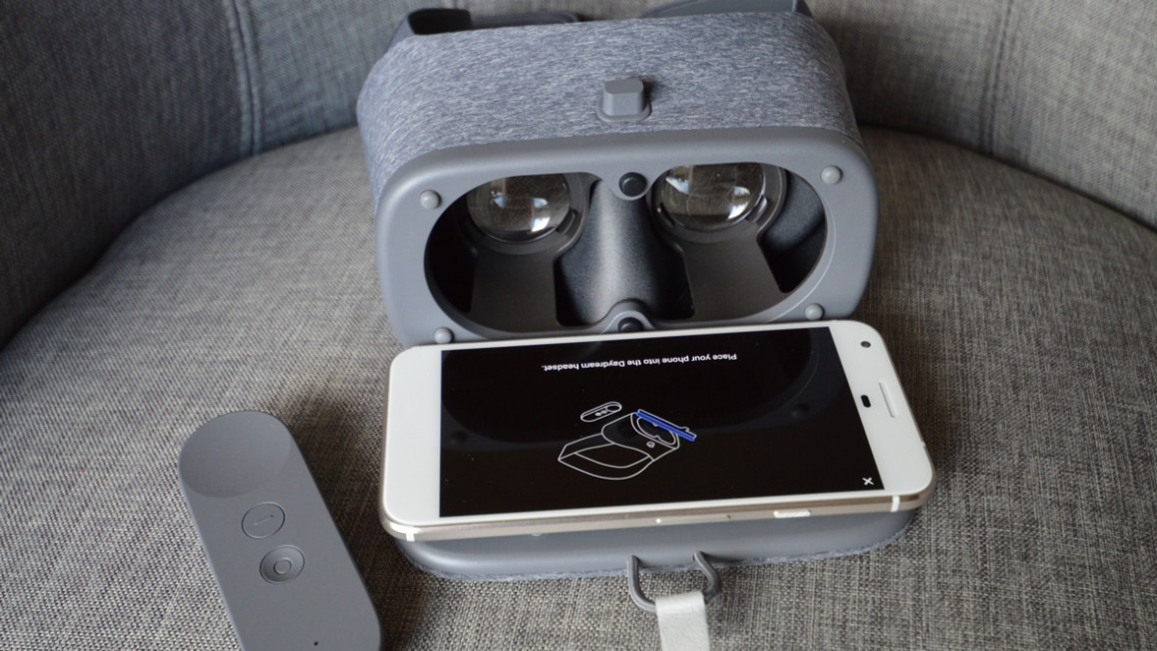
How does virtual reality work?
VR headsets have embedded stereoscopic lenses positioned between a built-in LED screen and eyes, distorting the image so it looks 3-D and real. The headset passes two images through these lenses, one for each eye, similar to our vision.

Slide 4
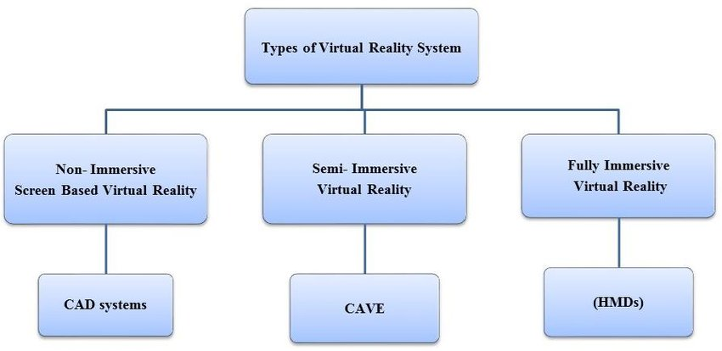
What are the main types of virtual reality?

Slide 5
Advantages of virtual reality
Virtual reality helps in exploring places without actually being there.
The education system has been improved.
It creates a realistic world.
Help in providing training.

Slide 6
Disadvantages of virtual reality
Implementation is expensive.
Only develop technical skills no interaction is there.
Technology is complex.
Impact on the real human body.

Slide 7
Questions?
Give me one advantage of virtual reality?
Give me one disadvantage of virtual reality?
True or False
Virtual reality is a simulated 2D environment
False
Virtual reality creates a realistic world?
True

Slide 8

Thank you!

Slide 9
Resources
https://www.techtarget.com/whatis/definition/virtual-reality
https://www.forbes.com/sites/bernardmarr/2019/07/19/the-important-difference-between-virtual-reality-augmented-reality-and-mixed-reality/?sh=295ce16435d3
https://www.researchgate.net/figure/Types-of-virtual-reality-systems_fig1_315875603
https://www.aplustopper.com/virtual-reality-advantages-and-disadvantages/#Advantages_of_Virtual_Reality
https://www.g2.com/articles/virtual-reality
https://www.wareable.com/vr/how-does-vr-work-explained

