Slide 1
Cybercrime
Rakan , Zaid , alexander

Slide 2
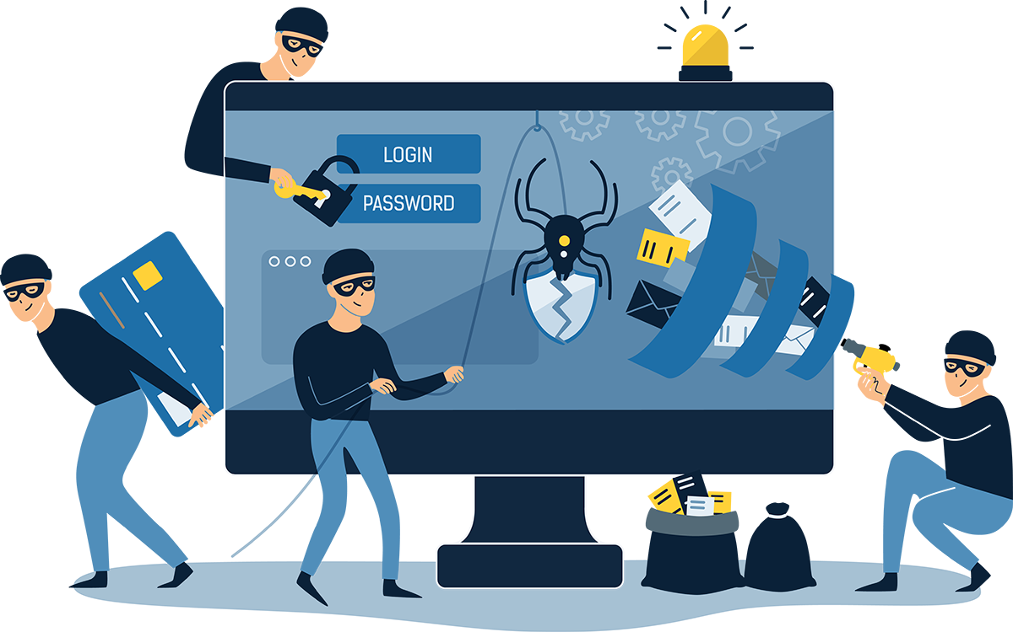
What is Cybercrime
Cybercrime is any criminal activity that involves a computer, networked device or a network.
Most cybercrimes are carried out in order to generate profit for the cybercriminals some cybercrimes are carried out against computers or devices directly to damage or disable them.
Others use computers or networks to spread malware and steal data

Slide 3
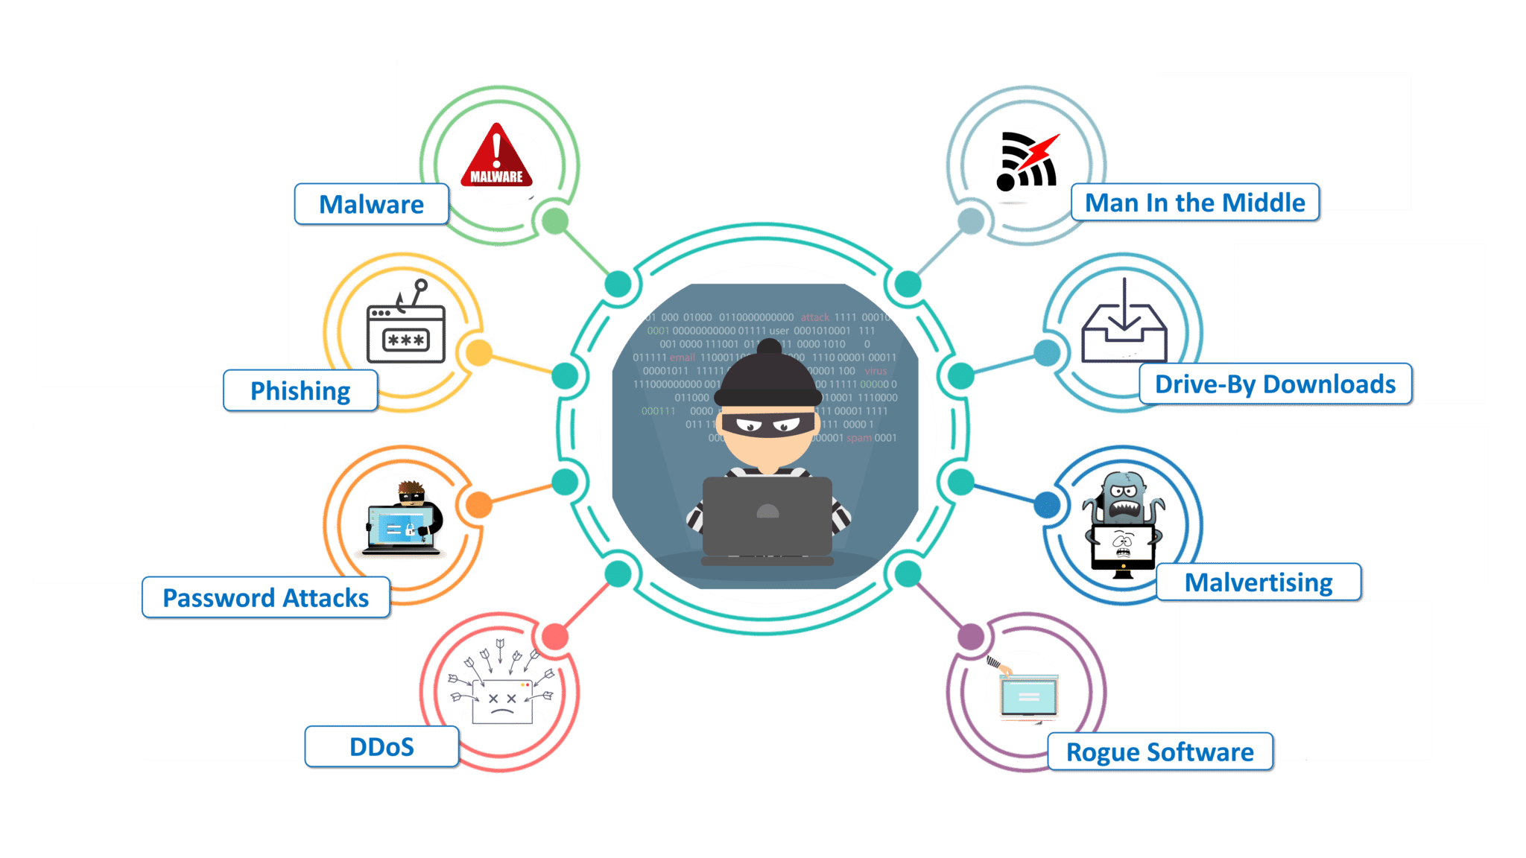
Cybercrime method

Slide 4
Identity theft
Identity theft and identity fraud are terms used to refer to all types of crime in which someone wrongfully obtains and uses another person's personal data in some way that involves fraud or deception, typically for economic gain

Slide 5
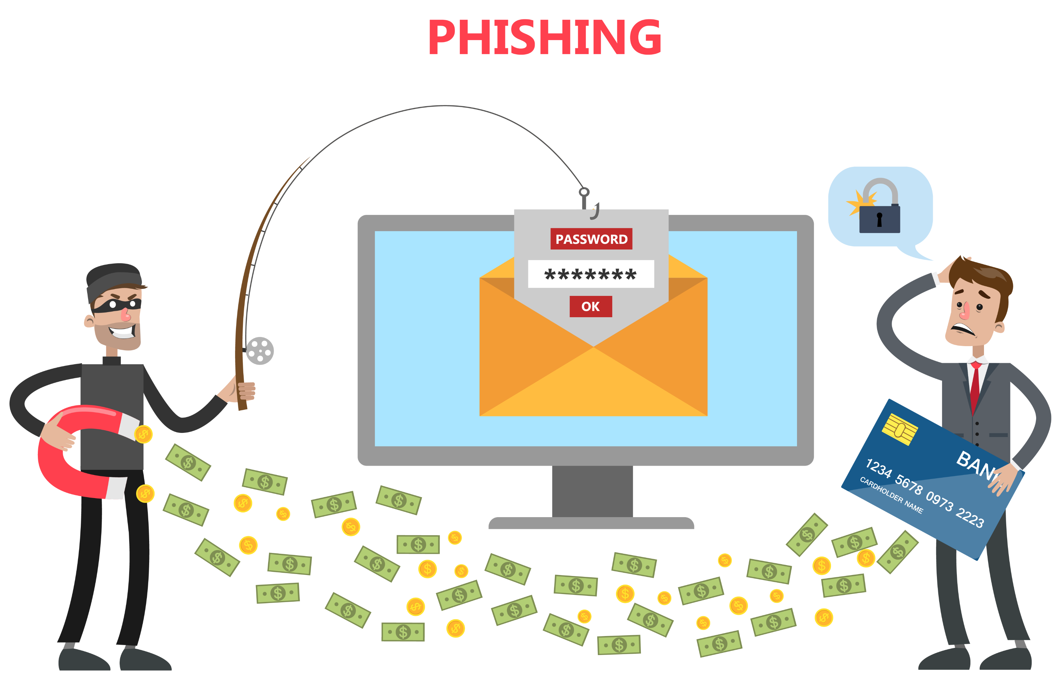
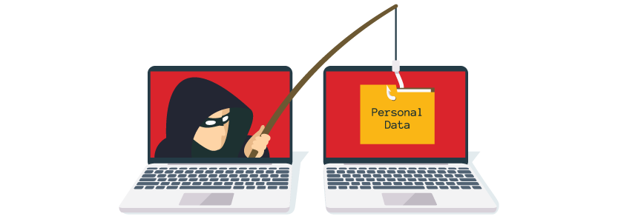
Phishing
Phishing is a method of cybercrime where an attacker sends a fraudulent message designed to trick a person into revealing sensitive information to the attacker or to deploy malicious software on the victim's infrastructure like ransomware. Phishing attacks have become increasingly sophisticated

Slide 6
Hacking
Hacking refers to activities that seek to compromise digital devices, such as computers, smartphones, tablets, and even entire networks. And while hacking might not always be for malicious purposes, nowadays most references to hacking, and hackers, characterize it/them as unlawful activity by cybercriminals—motivated by financial gain, protest, information gathering (spying)

Slide 7
How to protect yourself from Cybercrime
Use an anti-virus software
Keep your software updated
Use strong passwords
Change your passwords regularly
Keep up to date on major security breaches
Contact companies directly about suspicious requests
Do not click on links in spam emails or untrusted websites
Do not give out personal information unless secure

