Slide 1
Staying safe online
By Thalia Zureik and Leen Kurdi

Slide 2
Introduction
Good day students! Today we will discuss internet safety. We are moving in this lesson to teach students how to stay safe online and about what keeping themselves safe online is. Being safe on the internet means avoiding risks and harms that could harm personal information, occur in unsafe communications, or even have a negative impact on one's mental health and wellbeing.

Slide 3
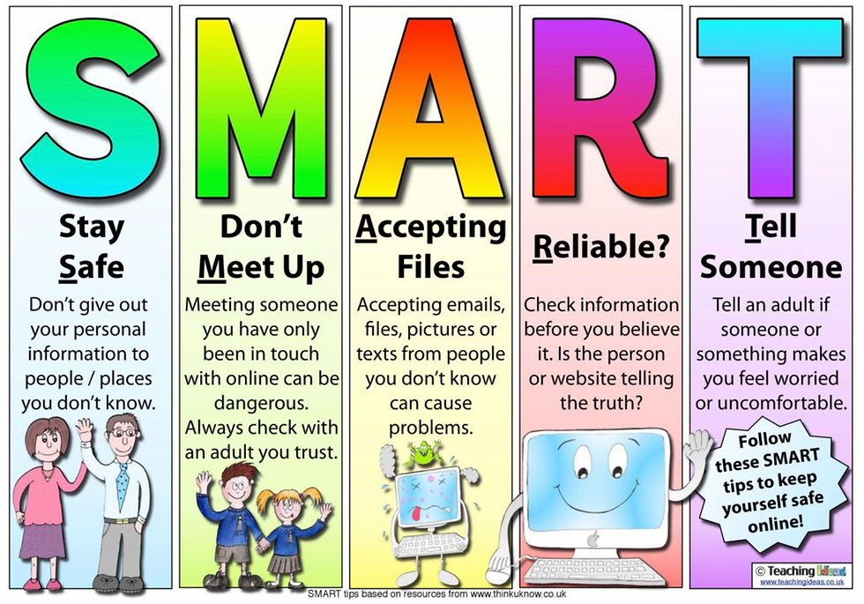
how we should stay safe online
.

Slide 4
What are the benefit of staying safe on the internet?
The majority of people keep a lot of private information on their laptops. Personal information could be stolen or accidentally erased from your computer if you don't manage it correctly when you're online. There are countless ways for your computer to be attacked online.

Slide 5
The effect of staying safe on the internet
Staying online will make allow people to be safer from cyber issues because if those problems get out of hand, it could be harder for people to use the internet. Now that we have those issues are under control, life is safer in the time of cyber difficulties.

Slide 6
10 tips to stay safe on the internet
Get the latest anti-virus and firewall software.
Update your internet browser.
Create a strong and easy-to-remember password.
Use a different password to the one you use for other services.
Change your password on a regular basis.
Never share your password.
Don’t let your browser remember your log on details.
don’t reply to people you don’t know.
Learn to spot fake emails and websites.
Avoid online fraud and con tricks.

Slide 7
A video to summarize this topic
https://youtu.be/yrln8nyVBLU
Questions to check your understanding
What are 2 ways of staying safe online?
Why is it important to stay safe on the internet?

Slide 8
Resources
https://o.uk/post/staying-safe-online-top-tips
https://nationalonlinesafety.com/wakeupwednesday/what-is-online-safety#:~:text=Being%20safe%20online%20means%20individuals,their%20mental%20health%20and%20wellbeing.
https://www.nidirect.gov.uk/articles/staying-safe-online#:~:text=Most%20people%20store%20a%20lot,of%20ways%20over%20the%20internet.

