Slide 1
Tennis
By: Sulaf Abu Latif

Slide 2
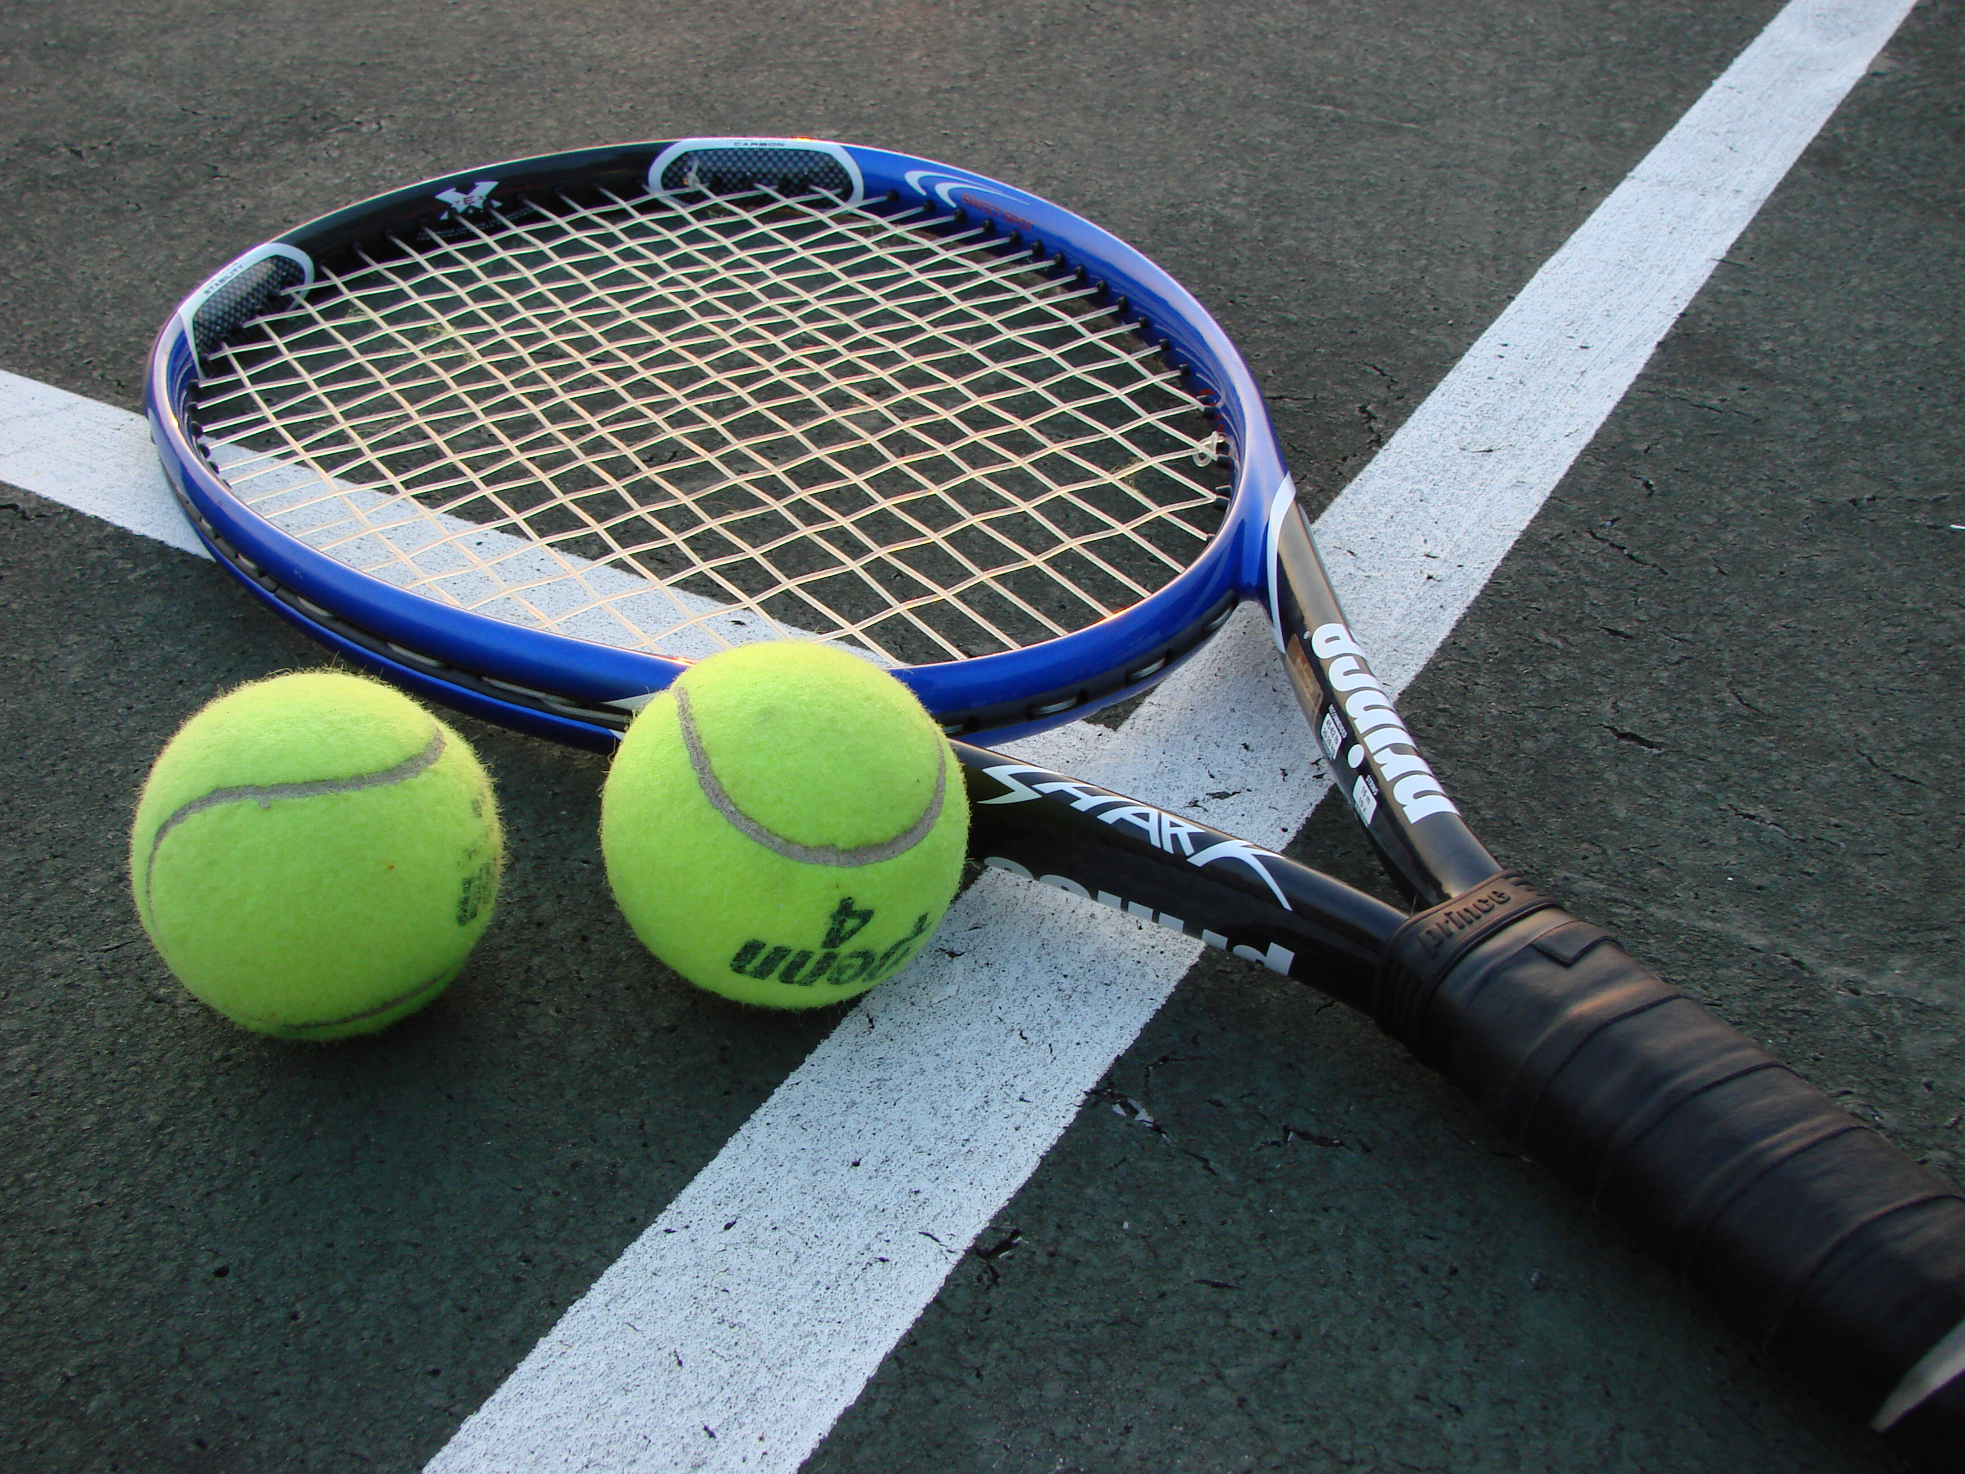
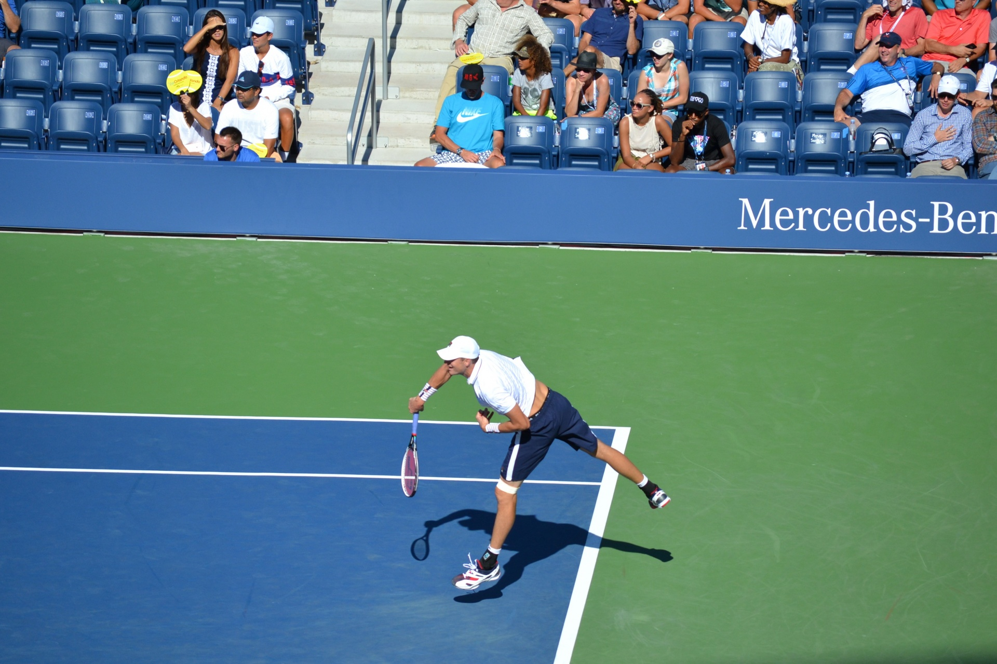
What is Tennis?
Tennis is a sport that is played using a racket and a tennis ball.

Slide 3
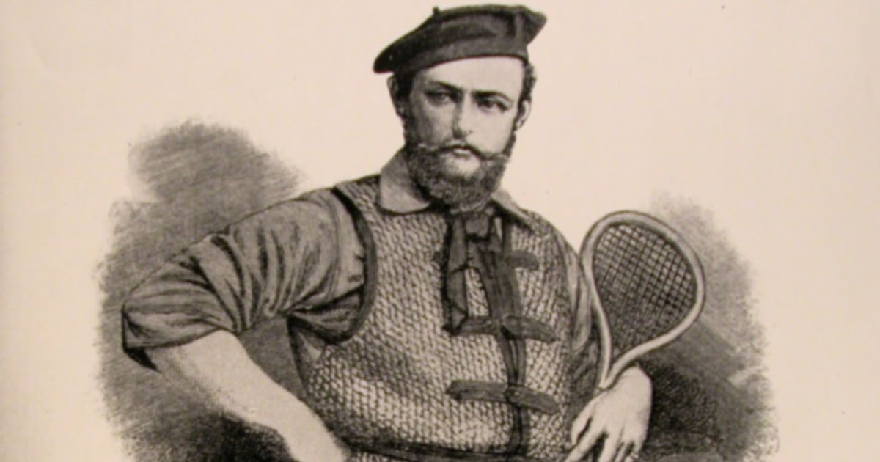
Who invented tennis
Major Walter Clopton Wingfield was the person who invented tennis in 1873 He published the first book of rules that year and took out a patent on his game in 1874.

Slide 4
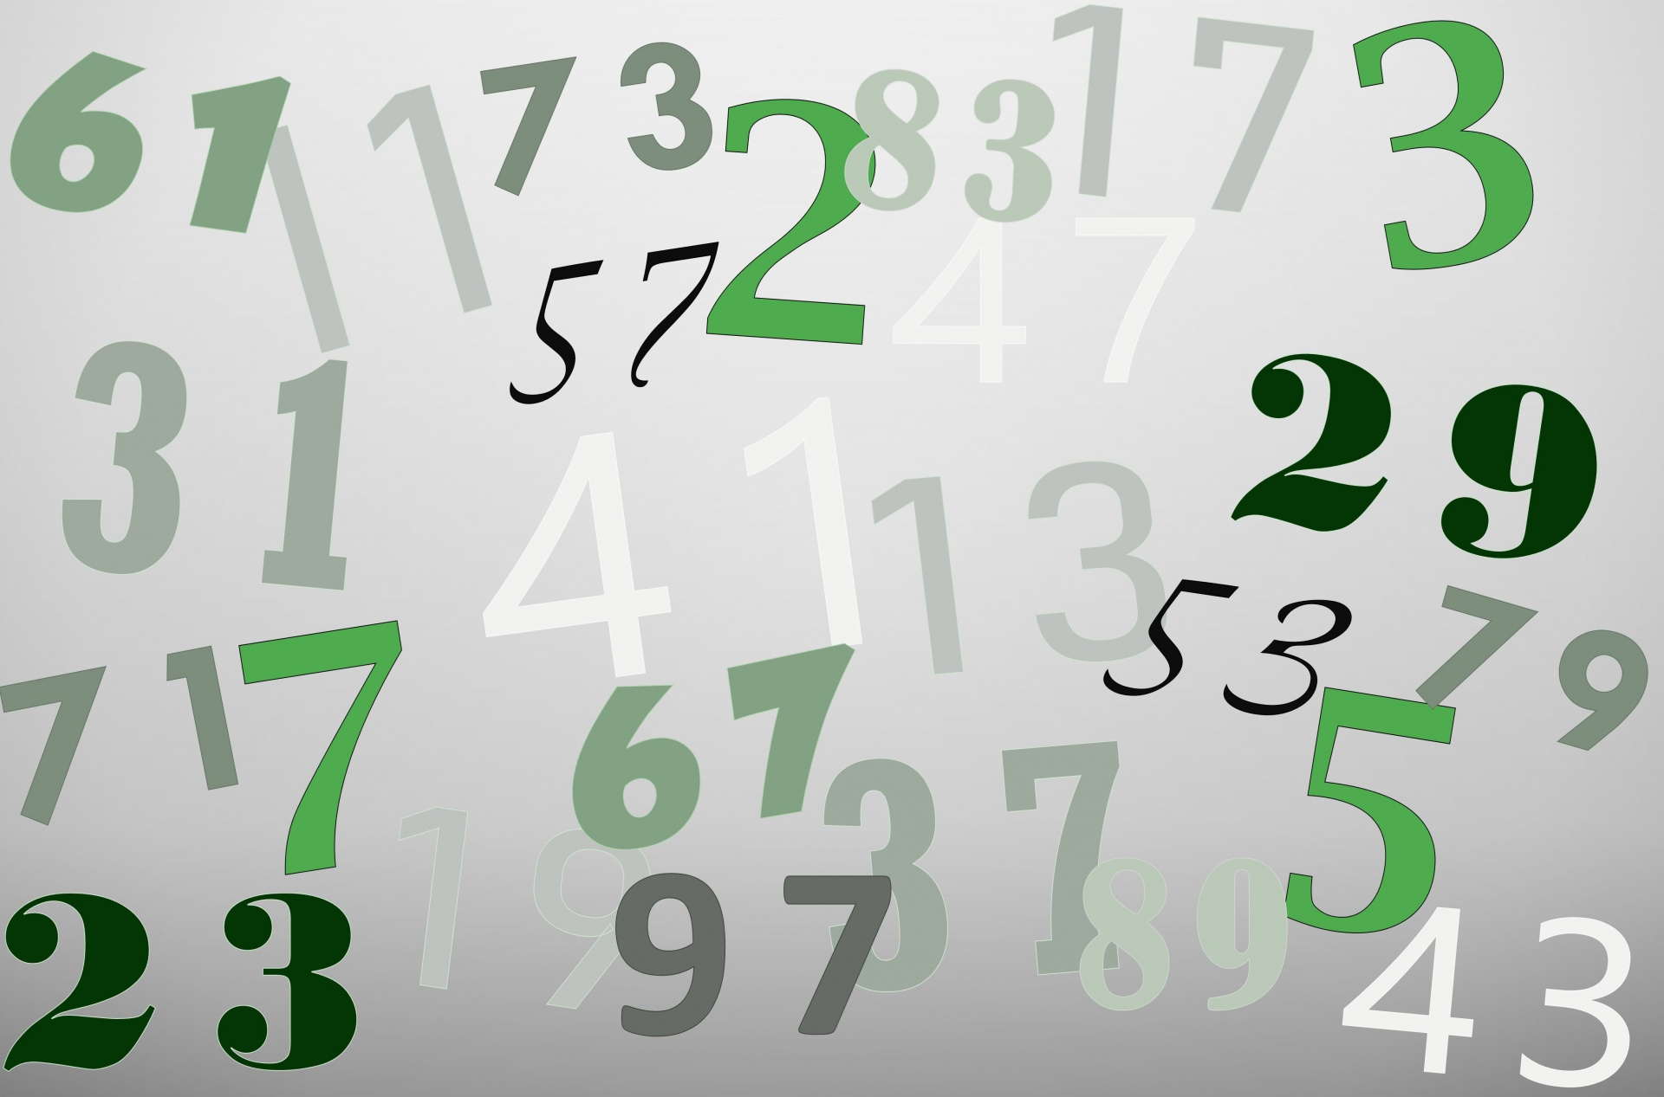
How are Points Counted?
In tennis there are usually 3 sets played, each set is made out of 6 games, if the player wins 6 games in the 1 set they would win the set. The player who
For the player to win a game they would have to win 4 points in the game. At the beginning of each game the score would be love all which means that none of the players got any points (love means 0). If one of the players gets a point it would count as 15, then 30, then 40, and then they take the game.

Slide 5
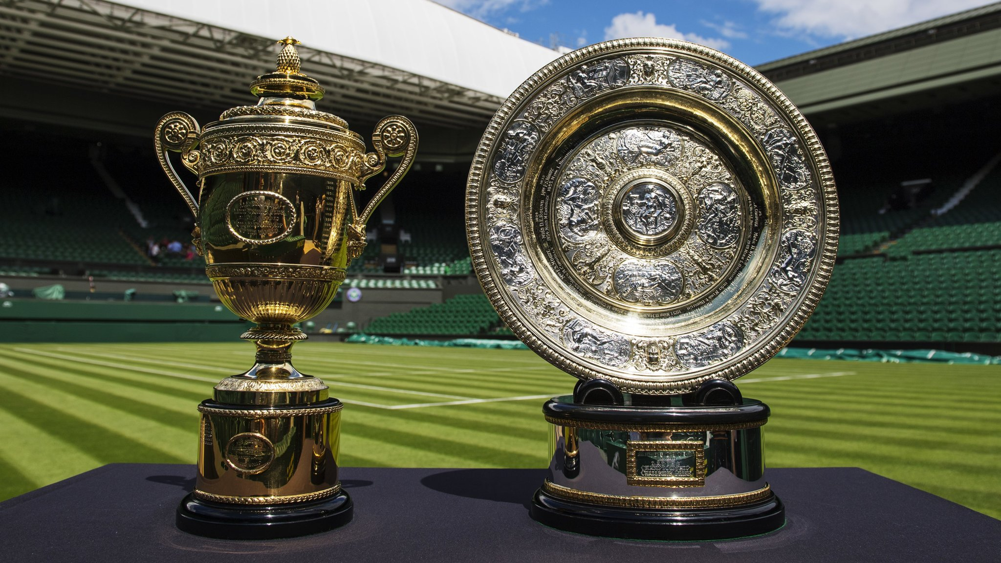
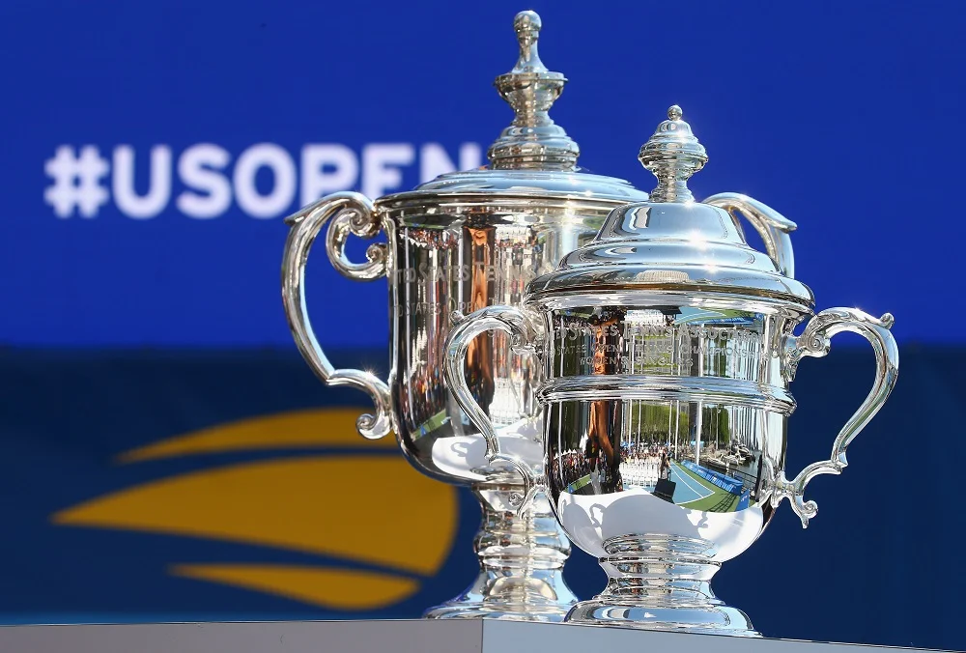
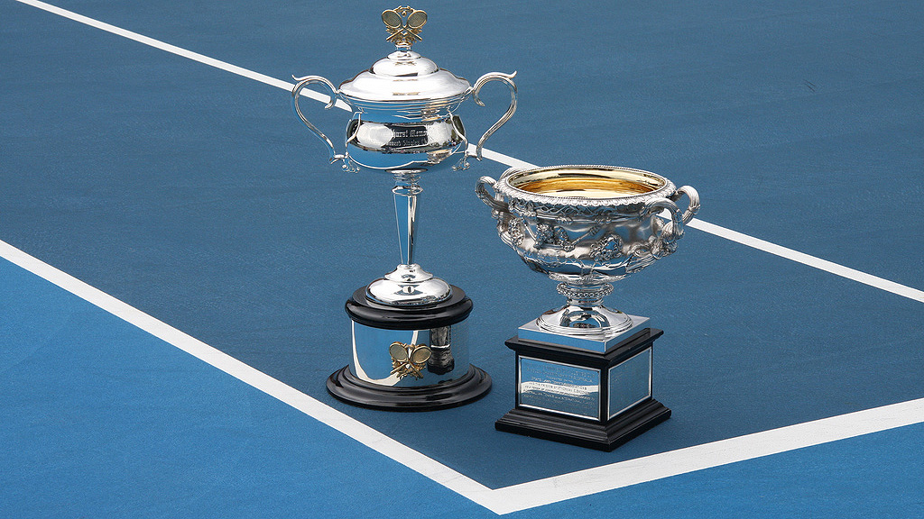
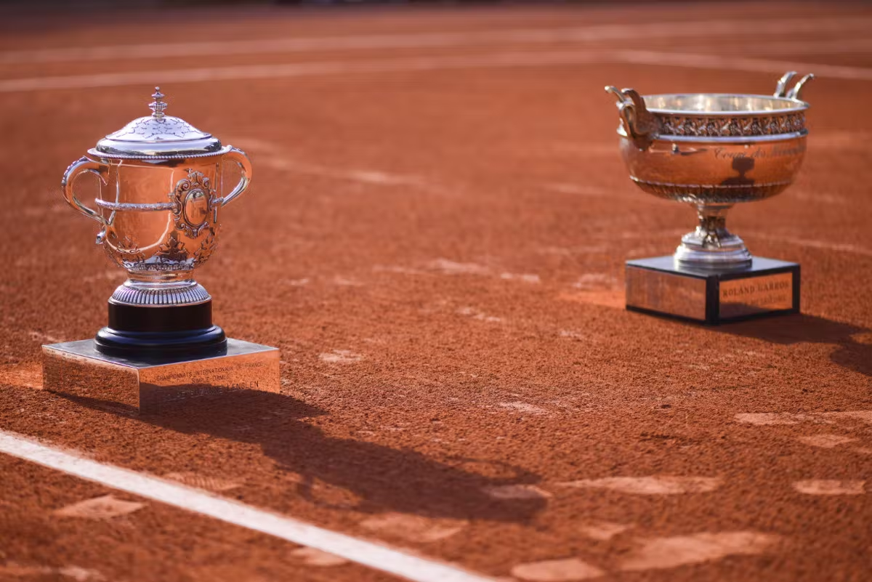
What are Grand Slams
A Grand Slam are the most important tournaments of tennis. There are four Grand Slams Roland Garros, Wimbledon, US Open, and Australian Open.

Slide 6
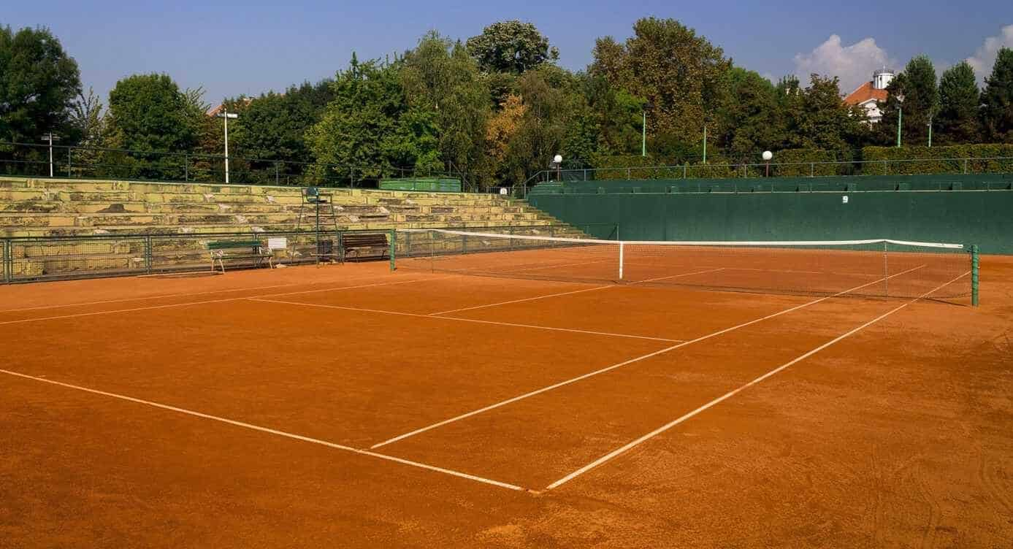
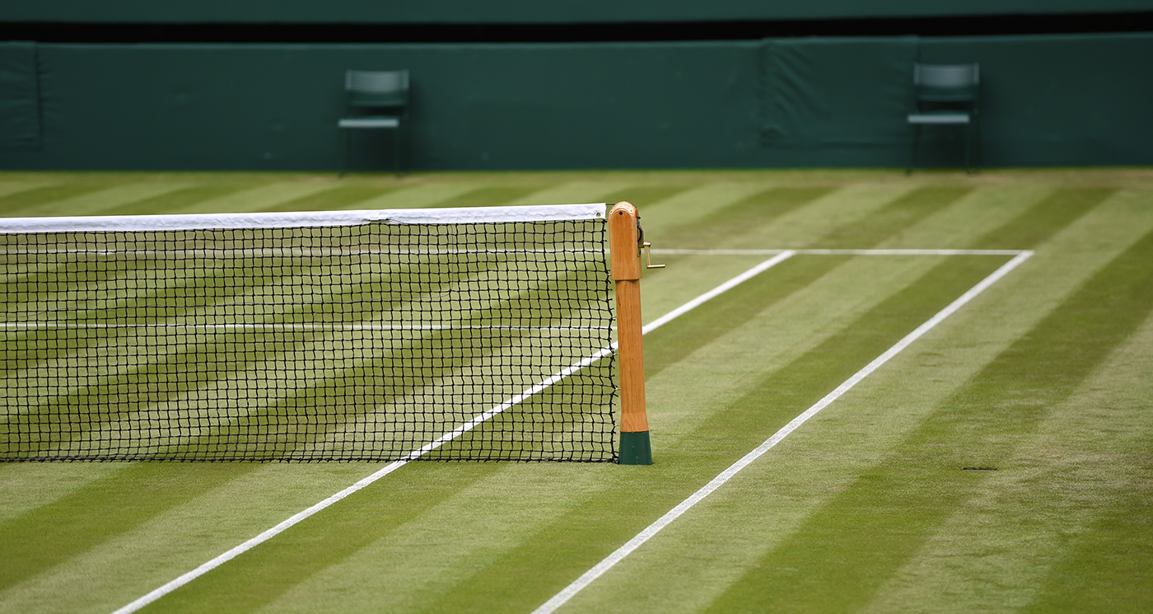
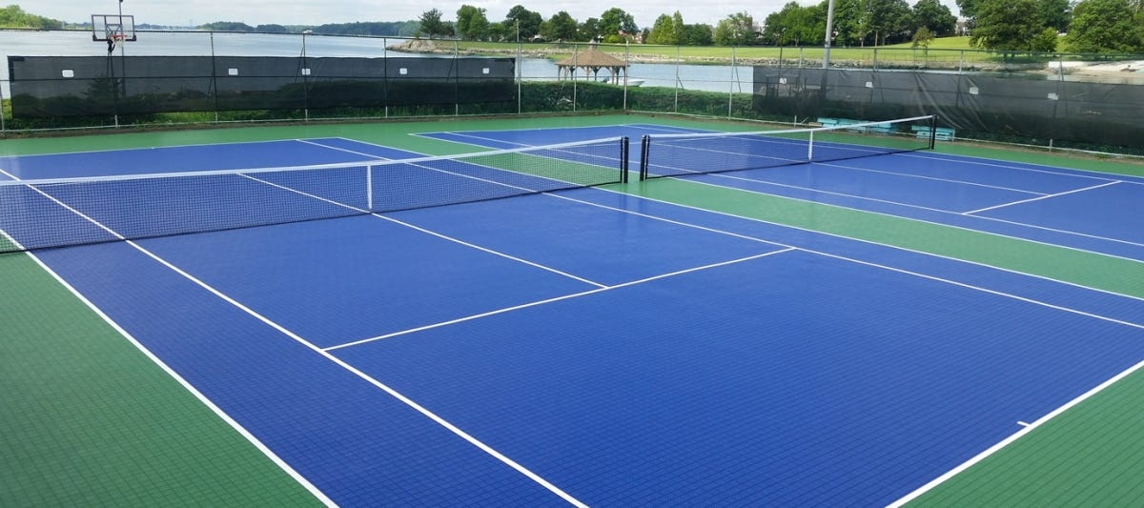
Types of Tennis Courts
There are 3 types of tennis courts which are hard court, clay, and grass tennis court. Each court is different.

