Slide 1
History Class: WW2
By: Rawad Abu Mwais, Omar Al Zagha and Faris Sawalha

Slide 2
Today we will be talking about the second World War, also known as WW2. For an introduction, we will be talking about how WW2 happened, what happened in it and how it ended. At the end of the class we will be asking a few students questions to see there understanding.

Slide 3
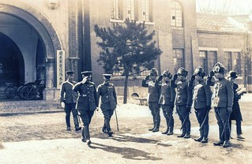
What is WW2?
World War II was a global conflict that lasted from 1939 to 1945 and involved most of the world’s most powerful countries, organized into two opposing military alliances: the Allies and the Axis. The war caused the deaths of millions of people and changed world history, leading to the emergence of the United States and the Soviet Union as superpowers and the formation of the United Nations.

Slide 4
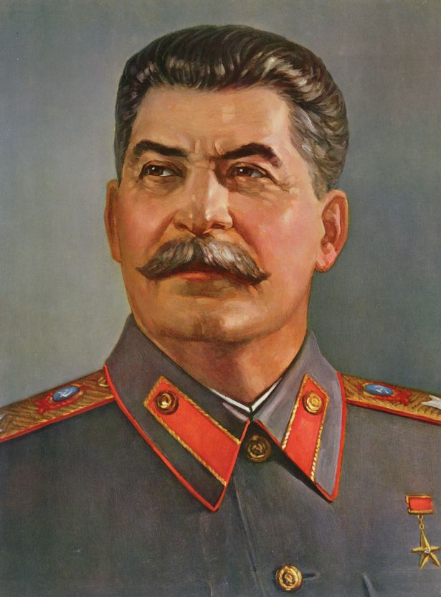
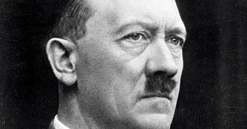
What started WW2?
WW2 started on the first of September 1939, when Nazi Germany, led by Adolf Hitler, invaded Poland. This made Britain and France declare war on Germany two days later. The war was fueled by a variety of factors, including unresolved tensions from World War I. The conflict became greater as more countries became involved and alliances shifted, leading to a global conflict that lasted six years.

Slide 5
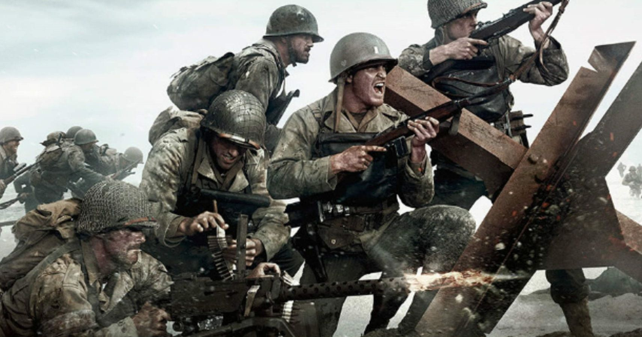
What happened during WW2?
In 1939, Hitler invaded Poland splitting it with former Soviet Union. Nazi Germany went on to invade more European countries, which led to the holocaust which was a genocide towards European Jews, killing approximately 6 million Jews in total. Nazi Germany broke the peace treaty with Soviet Union and decided to attack it, this made the Soviet Union and other invaded countries to launch attacks on Nazi Germany.

Slide 6
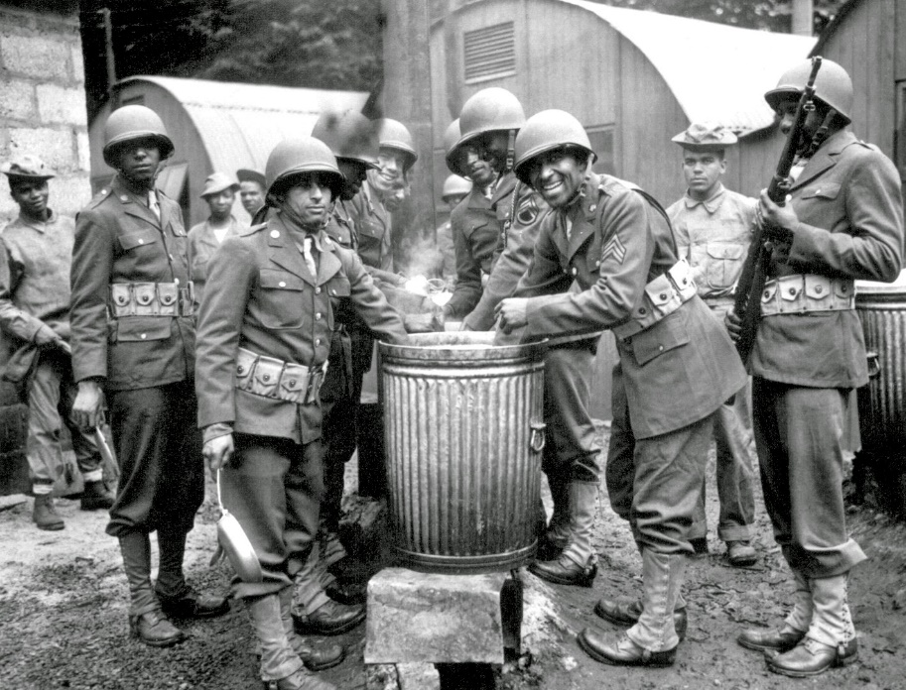
How did WW2 end?
In 1945, the allied powers (U.S.A, Great Britain and Soviet Union) decided to attack the axis powers from all sides which caused Nazi Germany to shrink down into a small country, which meant a loss for Hitler and his army so in the 30th of April 1945, Hitler shot himself in the head following his death his wife took a capsule of cyanide which caused her death.

Slide 7
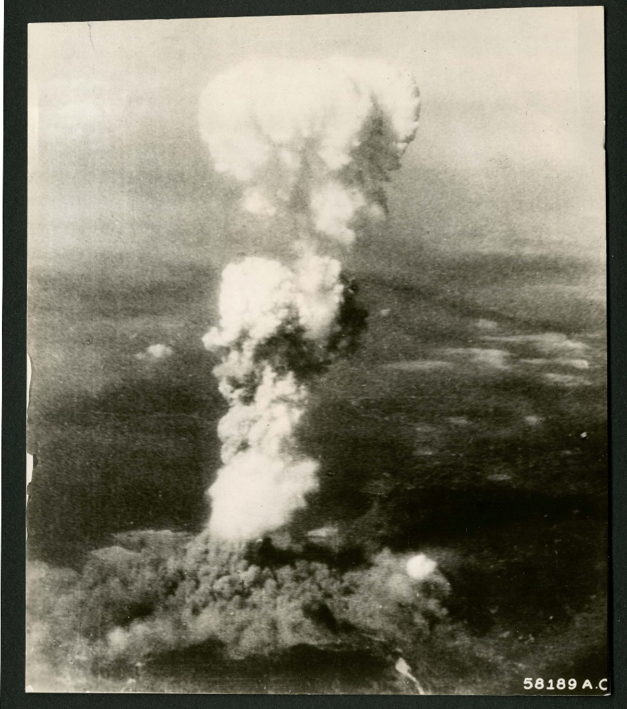
After Hitler’s Death
The U.S.A dropped 2 atomic bombs over the Japanese cities, Hiroshima and Nagasaki which caused over 170K deaths.
In September the 2nd 1945 the allied powers won WW2 and Europe slowly recovered from the world wars.

Slide 8
Questions time!
Q1. What year did world war 2 start?
Answer: 1939
Q2. What year did world war 2 end?
Answer: 1945
Q3. How did world war 2 start?
Answer: Nazi Germany invaded Poland along with the USSR lead by joseph Stalin.

Slide 9
Thank you for listening to todays class!
This concludes our lesson about World War 2! If you have any questions feel free to ask any one of the teachers who explained this lesson now.

