Slide 1
Galaxies and universes
By Yasmeen Al-Salman
8E

Slide 2
What are stars
Stars are huge balls of gas that give out light, we see the stars flicker its not because the star is not constant its because the light changes direction through the atmosphere, stars are the only object we see at night.
The biggest star is UY Scuti.
There approximately 2 trillion stars in a galaxy

Slide 3
What are galaxies
A galaxy is any of the systems of stars and interstellar matter that make up the universe.
Galaxies are vast cosmic islands of stars, gas, dust, and dark matter held together by gravity. All the stars we see in the night sky are in our own Milky Way Galaxy. we'd state there are 170 billion galaxies in our Universe. But we know more than that, and our modern estimate is even grander: two trillion galaxies.
The closest known galaxy to us is the Canis Major Dwarf Galaxy.
https://www.youtube.com/watch?v=aNpjckf8DhQ
https://www.youtube.com/watch?v=O57DyNMRGY8

Slide 4
What is a universe
The Universe is thought to consist of three types of substance: normal matter, 'dark matter' and 'dark energy'. The universe is everything. It includes all of space, and all the matter and energy that space contains. It even includes time itself and, of course, it includes you. Earth and other planets too.
Our universe began with an explosion of space itself - the Big Bang. Starting from extremely high density and temperature, space expanded, the universe cooled, and the simplest elements formed. Gravity gradually drew matter together to form the first stars and the first galaxies.
The universe is infinite which means that there is no edge or end to it.
Our universe is called the Cosmo it’s the universe we live in right now.

Slide 5
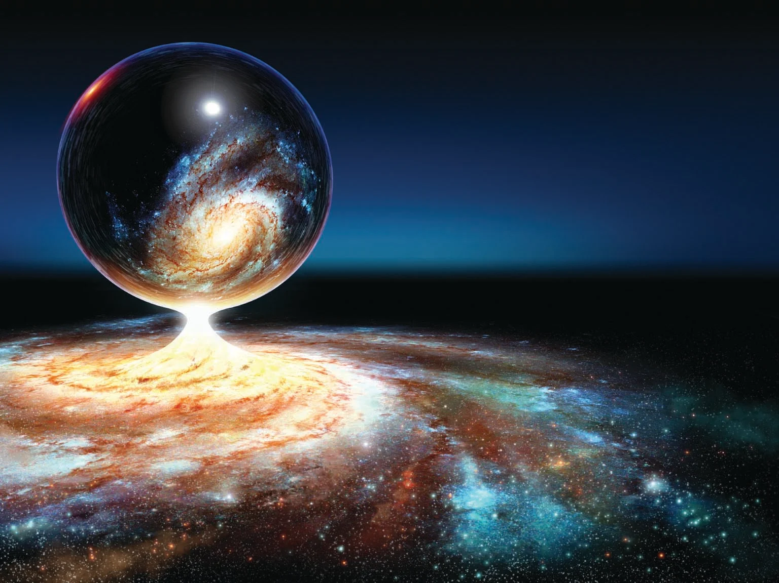
Universe
the expansion of the universe will continue forever. The prevailing theory is that the universe will cool as it expands, eventually becoming too cold to sustain life. For this reason, this future scenario once popularly called "Heat Death" is now known as the "Big Chill" or "Big Freeze".
the universe operates with 10 dimensions.
https://www.youtube.com/watch?v=HdPzOWlLrbE

Slide 6
Universe and galaxies
What is the difference between a universe and a galaxy
A galaxy is a huge collection of gas, dust, and billions of stars and their solar systems, all held together by gravity.
The Universe is all of space, matter, energy, time, and its contents, including planets, stars, galaxies, and all other forms of matter and energy.

Slide 7
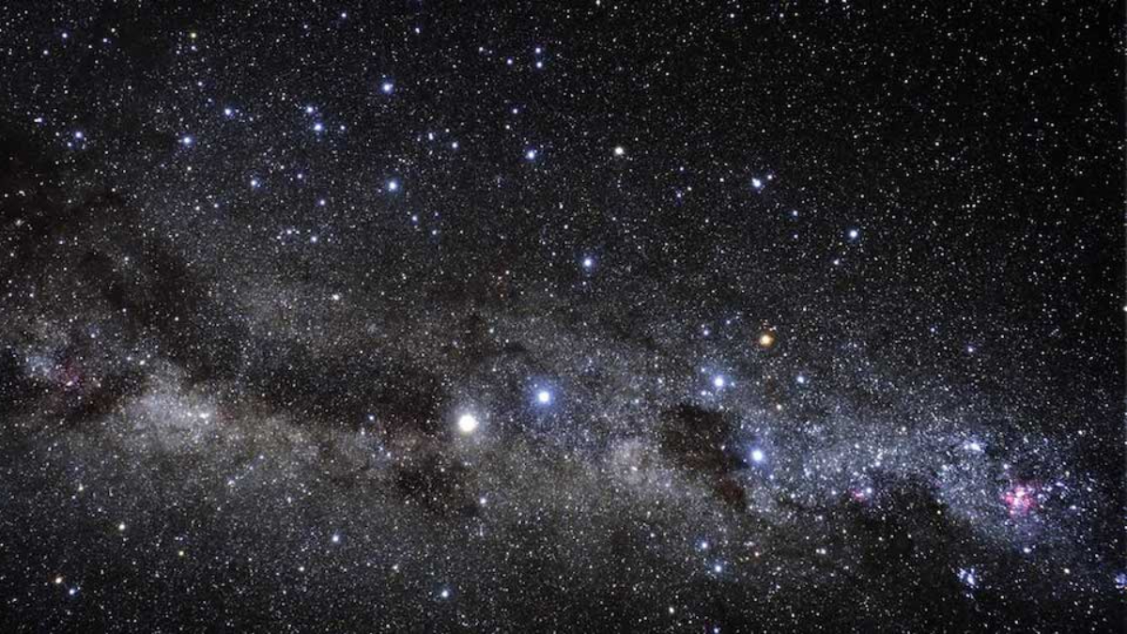
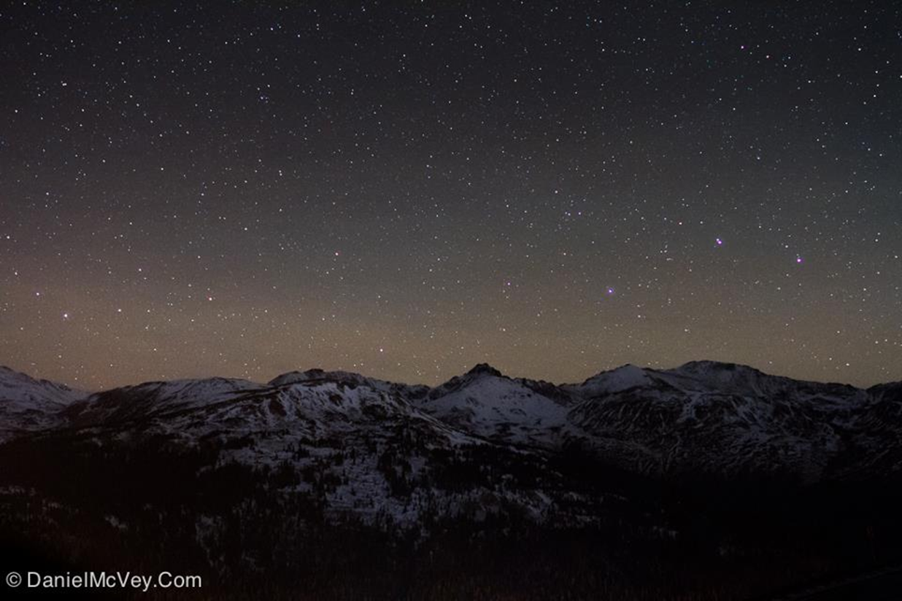
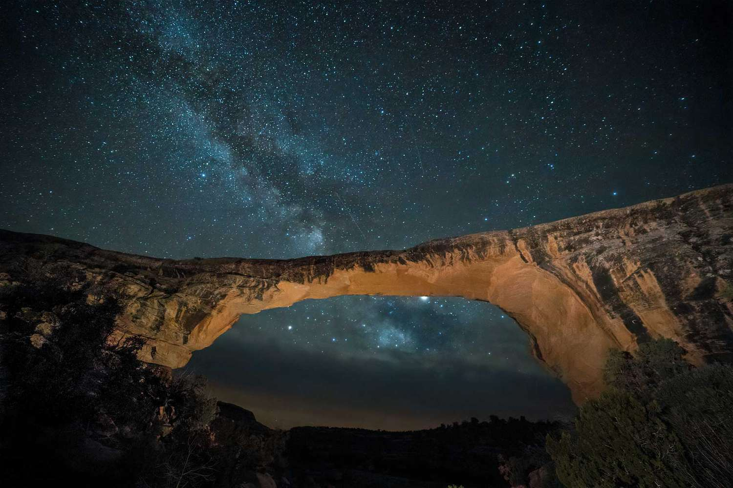
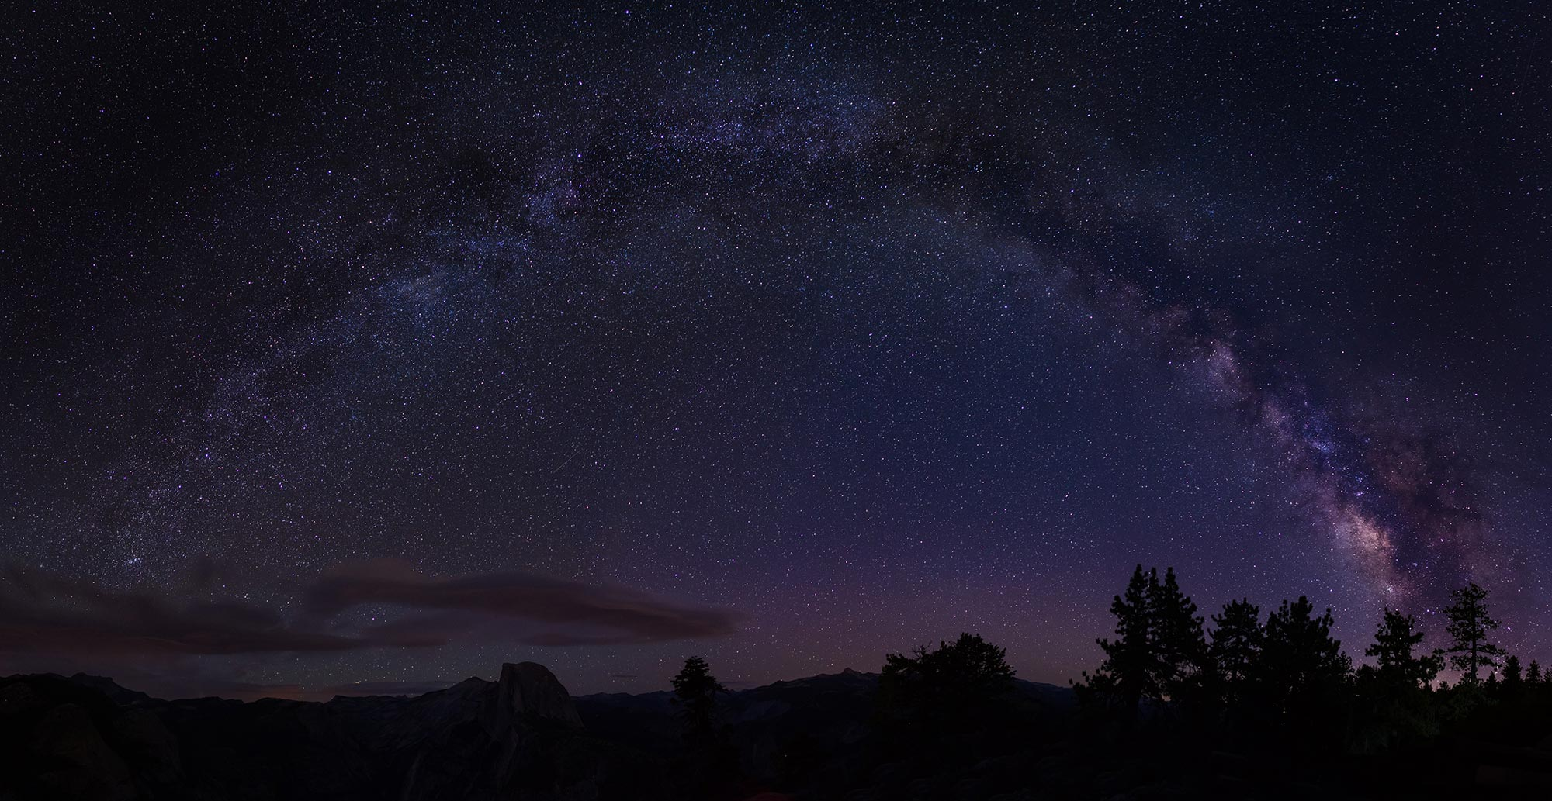
The stars

Slide 8
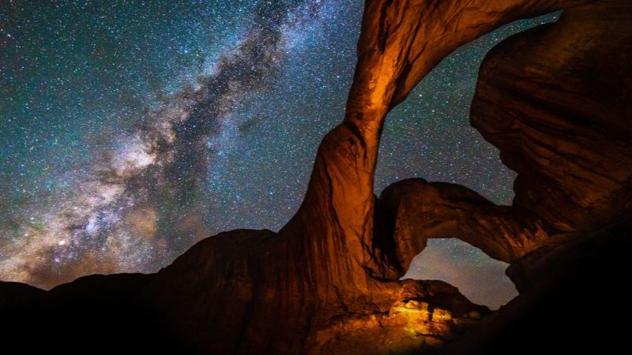

Slide 9
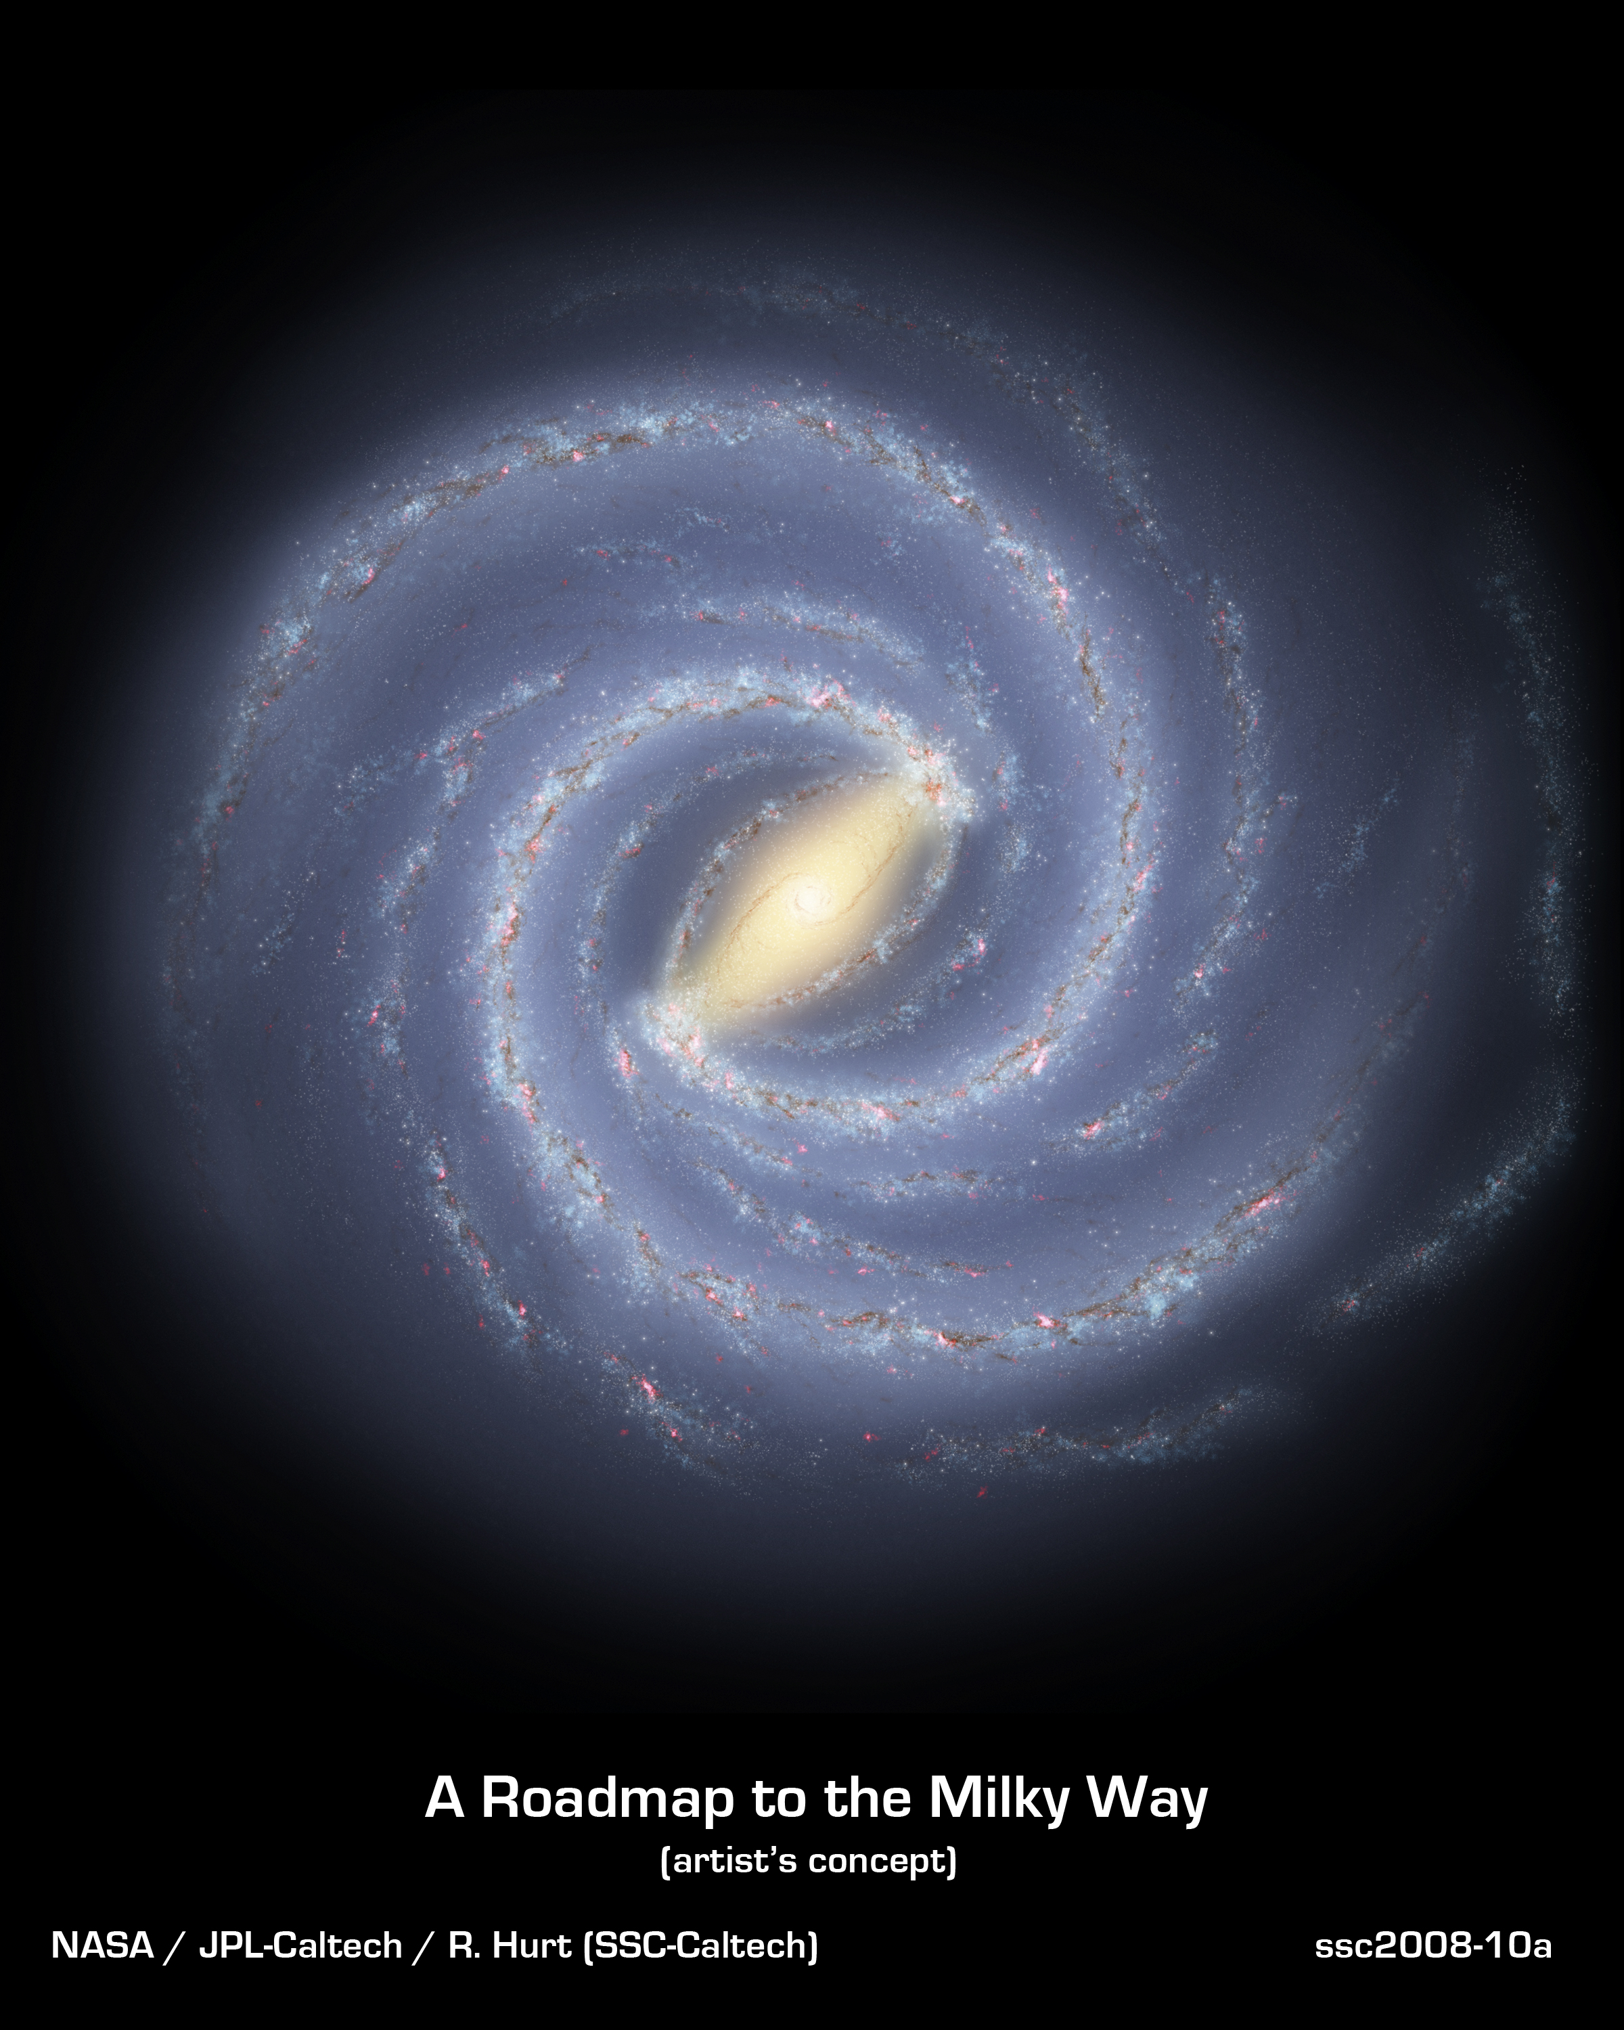
Our milky way
Our milky way

Slide 10
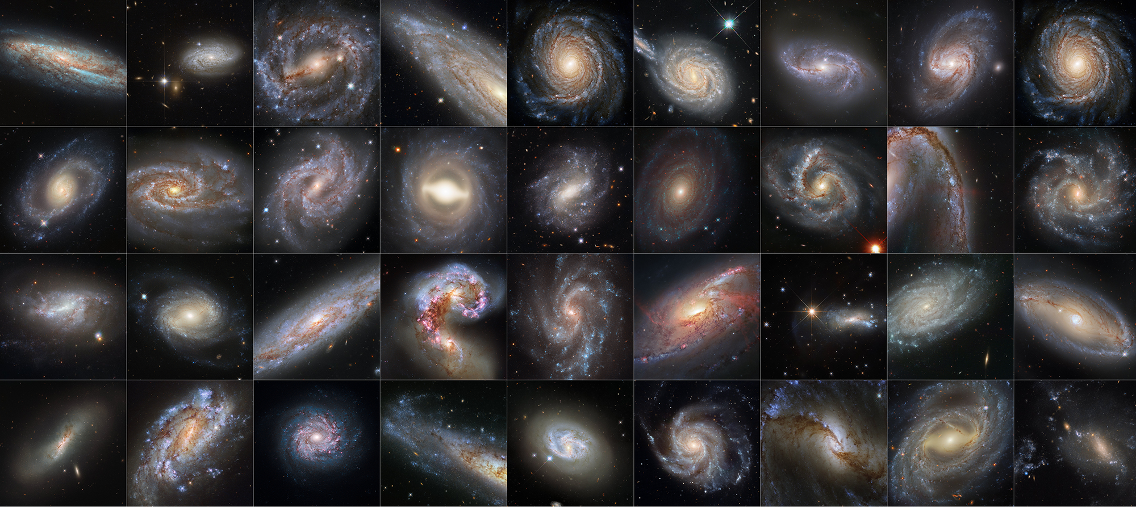
Other galaxies found by Nasa

Slide 11
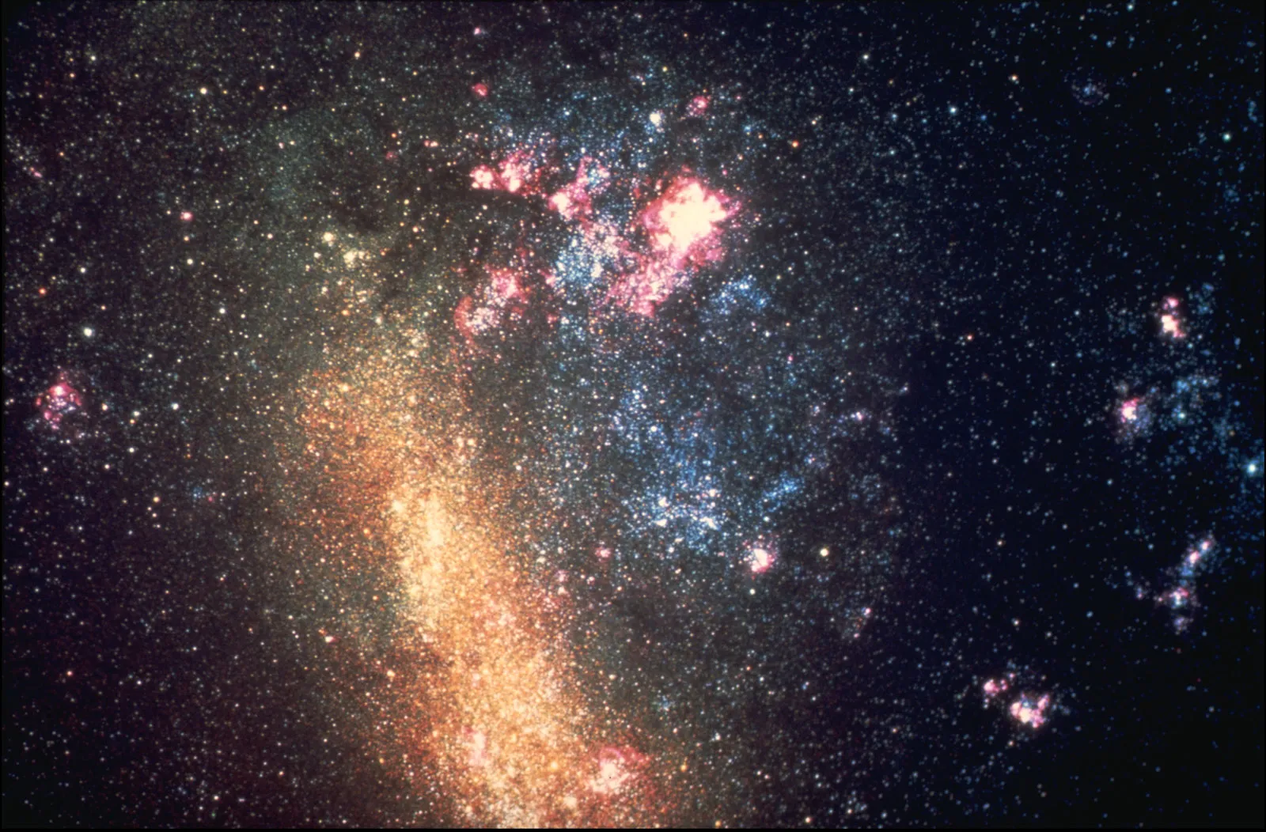
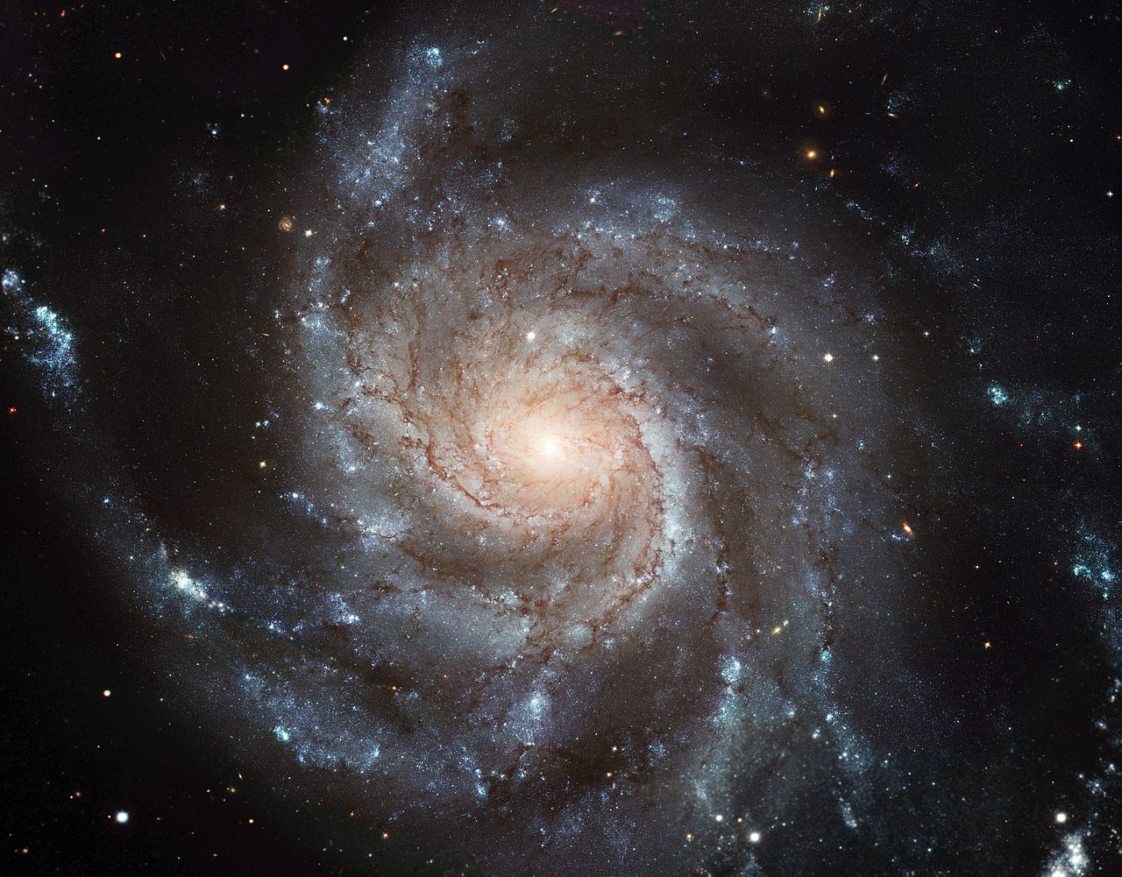
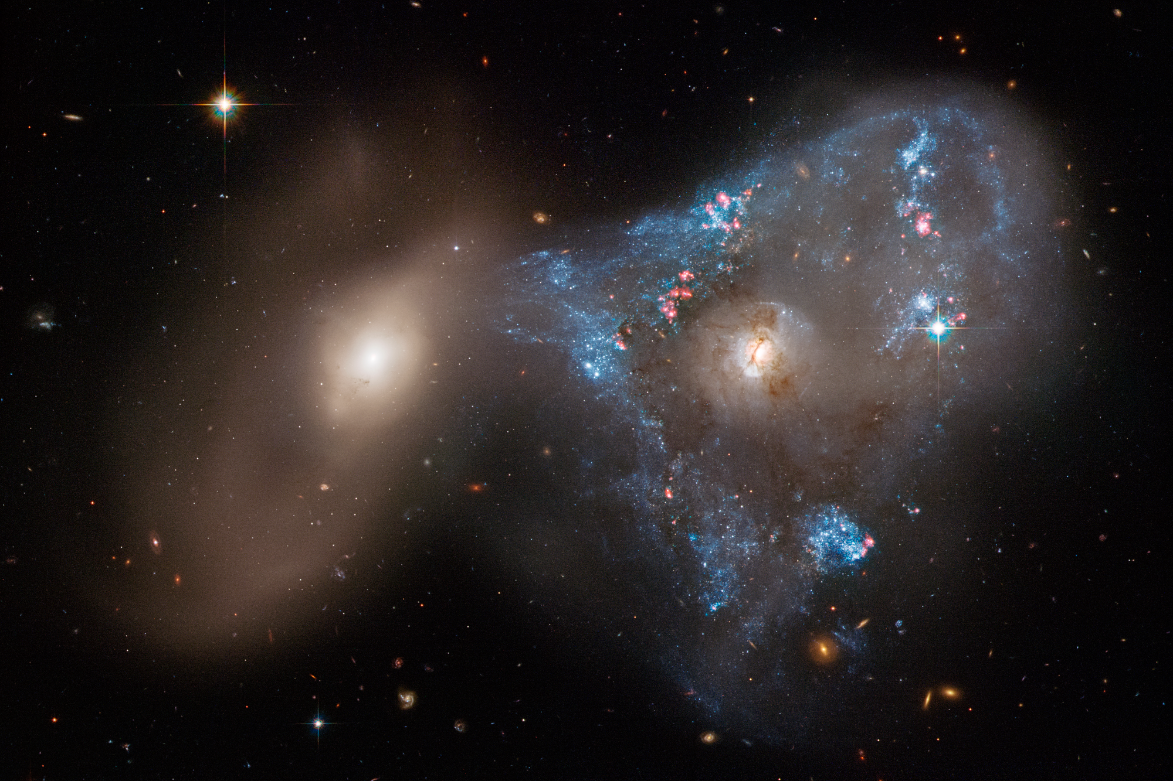
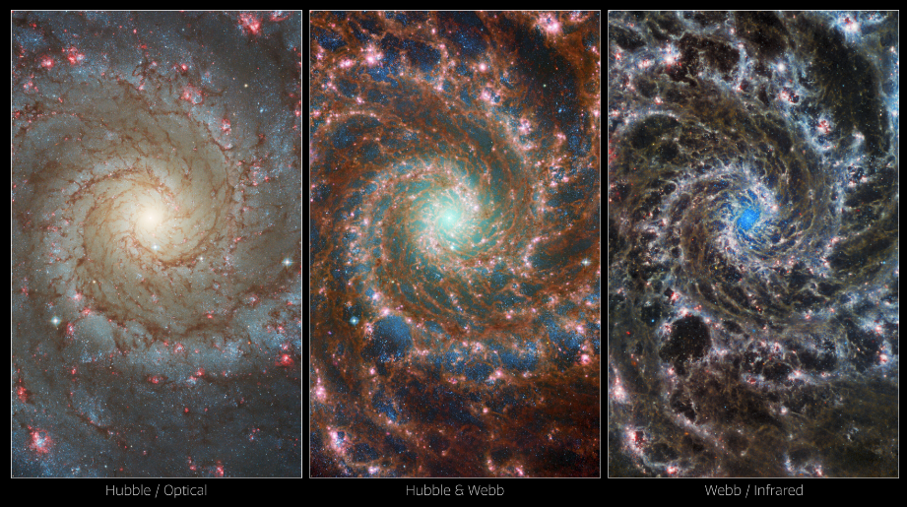
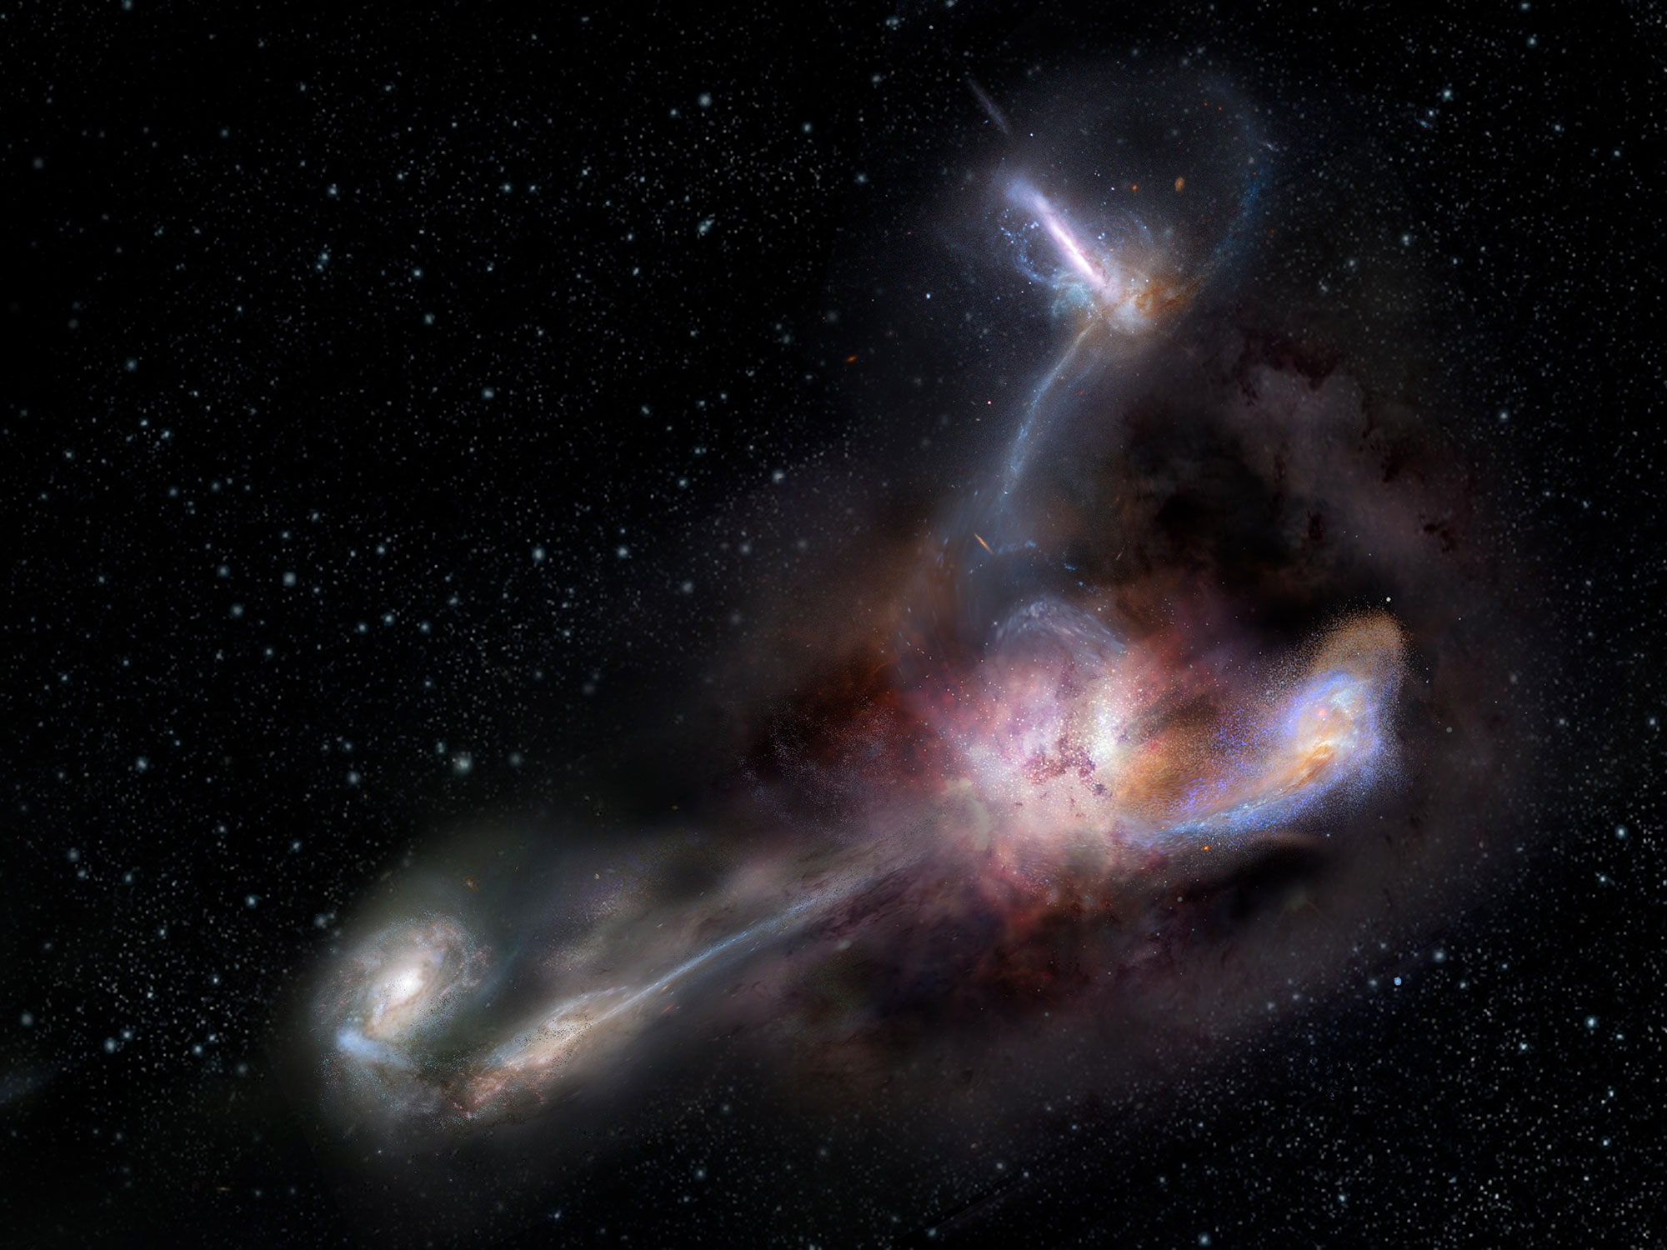
Other galaxies

Slide 12
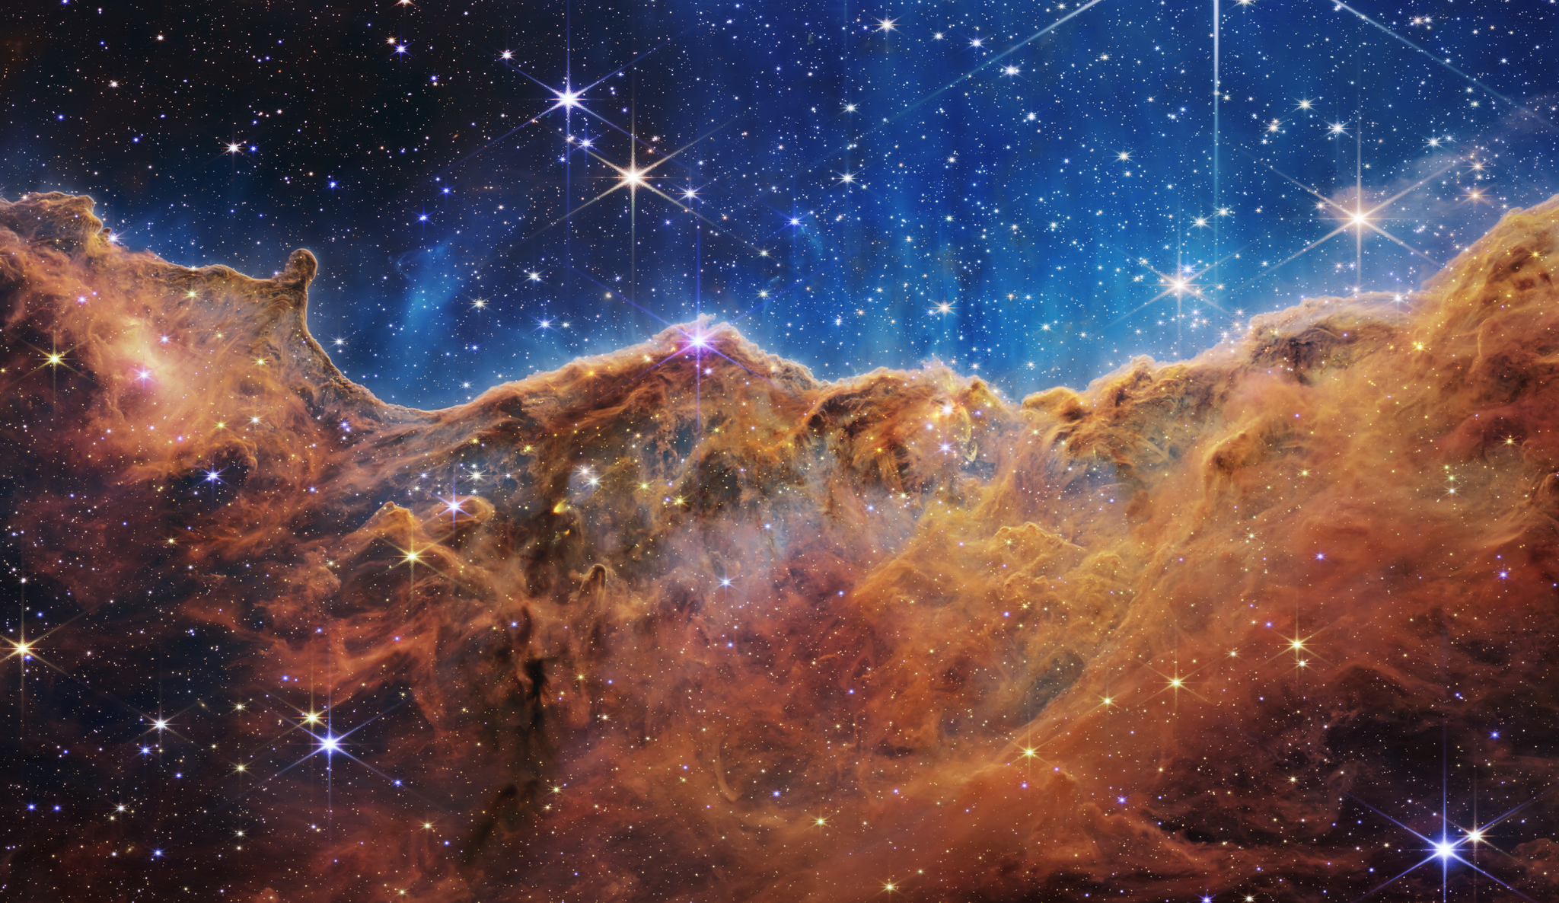

Slide 13
Questions
How did our Universe begin and how will it end?
What is the Structure and Behavior of Matter Under Extreme Conditions?
What is our universe called?
How many stars are there in a galaxy?
What is the universe made of?

