Slide 1
Mutations
By Ghassan Barghouth & Eliana Barghouth

Slide 2
Definition of mutations
Mutations can result from DNA copying mistakes made during cell division. Mutations can be harmful, beneficial, or have no effect.

Slide 3
Harmful mutations
Its decreases the fitness of the organism and may cause genetic disorders or cancer. Some harmful may not appear in the body.

Slide 4
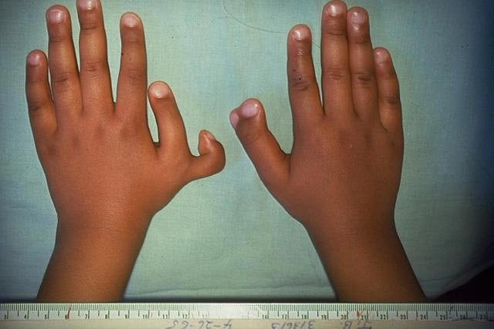
Examples of harmful mutations

Slide 5
Beneficial mutations
It has a positive effect and increase the fitness of the organism. They lead to new versions of proteins that help organisms adapt to changes in their environment. And passed down from generations, increasing chances for the offspring to survive.

Slide 6
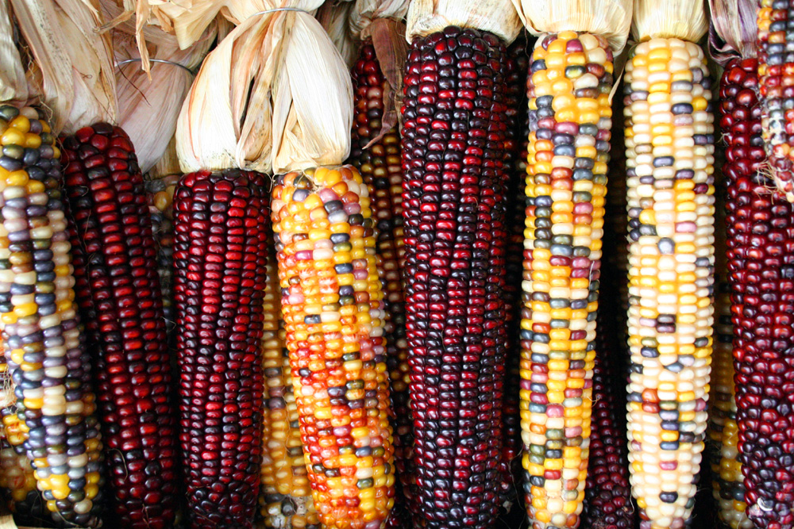
Examples of beneficial mutations

Slide 7
Mutations that have no effect
The majority of mutations have neither negative nor positive effects on the organism in which they occur. These mutations are called neutral mutations.

Slide 8
Examples of mutation that has no effect

Slide 9
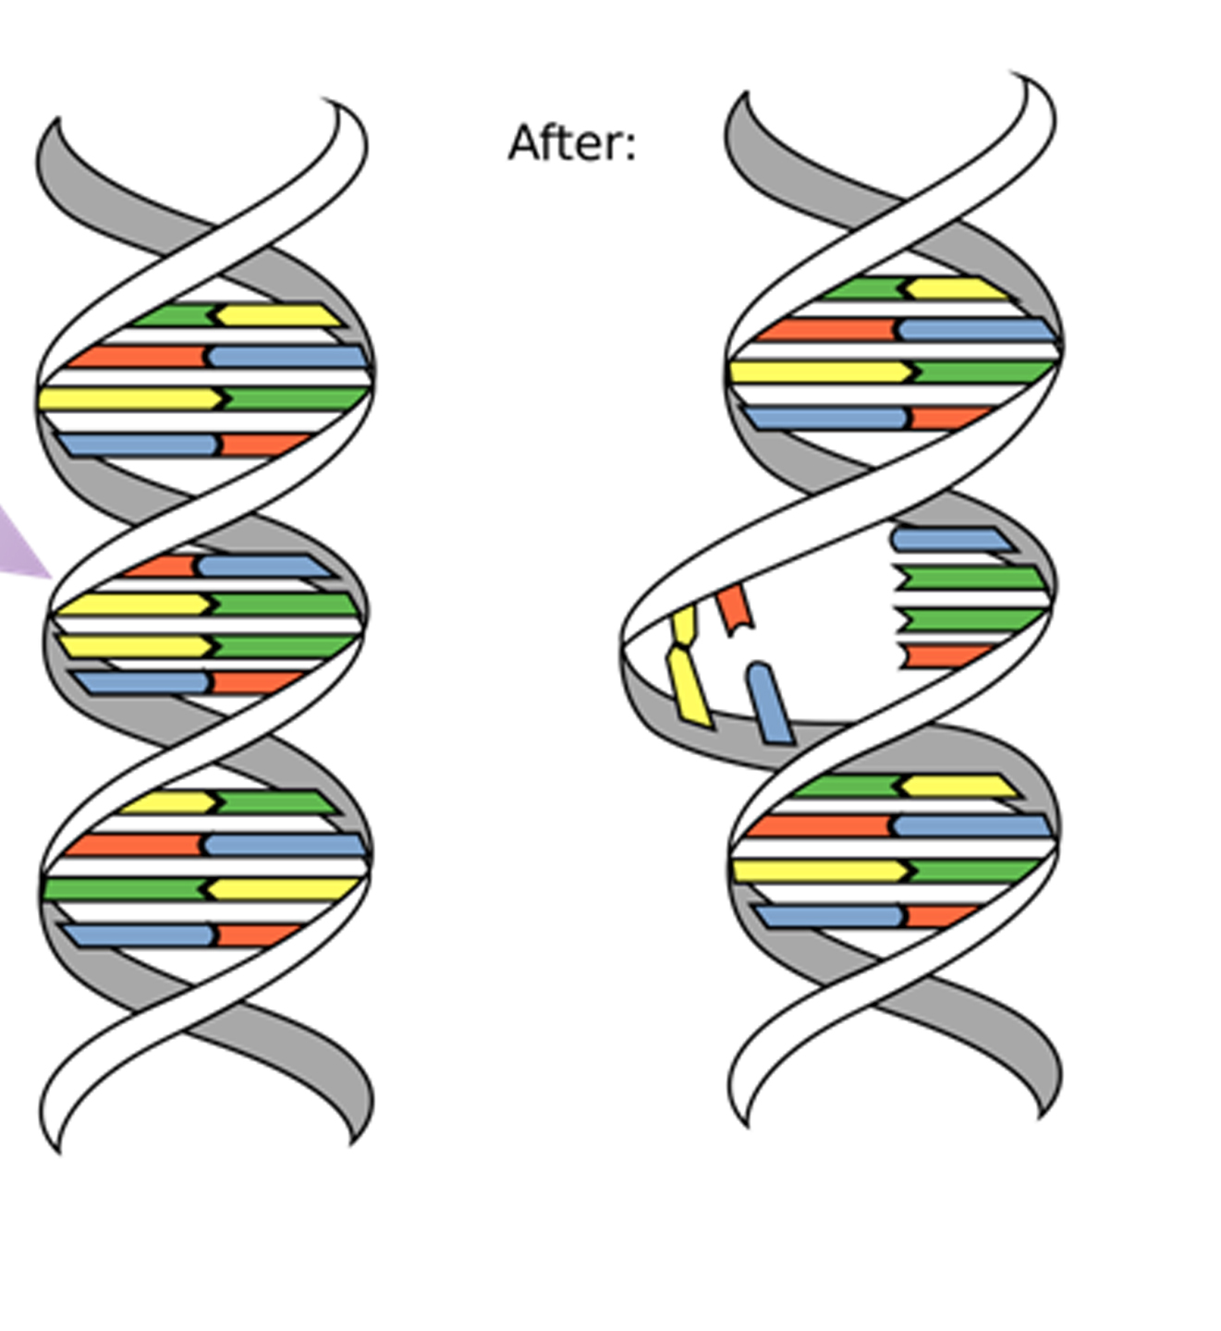
Is mutations important?
Before:
Yes, because it creates a new DNA sequence for a particular gene, creating a new allele. And help scientist discover new types of gene. But on the other hand it may be useless, and have a big effect on the offspring.

Slide 10
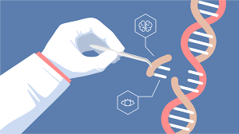
Can mutations be removed?
Yes it can be removed using CRISPR, which offers an easy way to snip out mutated DNA and replace it with the correct sequence gene.

Slide 11
QUESTIONS
To check your understanding we've made a kahoot!
https://create.kahoot.it/share/mutations/195cf8da-d259-43cc-afc2-8caf85ed729b

Slide 12
Which one is a harmful mutation?
A.
B.

Slide 13
Which one has no effect mutation?
A.
B.

Slide 14
citation
Libretexts. (2021, March 6). 4.10: Mutation effects. Biology LibreTexts. Retrieved March 19, 2023, from https://bio.libretexts.org/Bookshelves/Introductory_and_General_Biology/Book%3A_Introductory_Biology_(CK-12)/04%3A_Molecular_Biology/4.10%3A_Mutation_Effects#:~:text=Harmful%20mutations%20may%20cause%20genetic,blocks%20ducts%20in%20digestive%20organs.
Take online courses. earn college credit. Research Schools, Degrees & Careers. Study.com | Take Online Courses. Earn College Credit. Research Schools, Degrees & Careers. (n.d.). Retrieved March 19, 2023, from https://study.com/academy/lesson/beneficial-mutations-examples-effects.html#:~:text=as%20beneficial%20mutations.-,What%20is%20a%20beneficial%20mutation%3F,for%20the%20offspring%20to%20survive.
Displaytitlepopulation genetics of Plant Pathogensmutation. Mutation. (n.d.). Retrieved March 19, 2023, from https://www.apsnet.org/edcenter/disimpactmngmnt/topc/PopGenetics/Pages/Mutation.aspx#:~:text=Mutation%20plays%20an%20important%20role,gene%2C%20creating%20a%20new%20allele.

