Slide 1
THE PLANT
Made by: Tala Tadros.

Slide 2
TABLE OF CONTENTS
01
02
03
Planting a plant
Parts of a flower
Leaf vs stem plants
04
05
06
Cotton plant
Photosynthesis
Plant kinds around the world

Slide 3
PLANTING SEEDS
GERMINATING
TRANSPLANTING
POTTING
The sprouting of a seed, spore usually after a period of dormancy
When a plant or tree removed from one location and reset in the ground at another
Planting a plant in a pot.

Slide 4
PLANT CARES
PH
WATER
TEMPERATURE
HUMIDITY
The pH range 5.5–6.5 is optimal for plant growth
Rainwater and bottled spring water are the best options.
The perfect temperature for most plants to grow is 21-24 degrees Celsius.
An ideal humidity level for most adult plants is 60% to 70%.

Slide 5
PARTS OF A FLOWER
PETAL
LEAVES
SEEDS
STEM
ROOTS
The leaves collect energy from the Sun and make food for the plant, using photosynthesis.
To attract pollinators and to protect the reproductive parts of a flower.
The part that develops from the ovules after fertilization, to create offspring.
The stem supports the plant above ground, and carries the water and minerals to the leaves.
The roots absorb water and minerals from the soil and anchor the plant in the ground.

Slide 6
Leaf vs stem plants
LEAF PLANTS
STEM PLANTS
Leaf plants have short/ non visible stems whilst it has large leaves which leave more room for photosynthesis and food production. Spinach, lettuce, silverbeet, brussel sprouts and witloof are examples of leaf plants.
It’s the typical plant you see everyday. the stem conducts water, minerals, and food to other parts of the plant; it may also store food, and green stems themselves produce food. Examples are celery, asparagus, rhubarb and turmeric.

Slide 7
THE COTTON PLANT
COTTON
STEM
Where the cotton is obtained. After maturing, the bolls burst open and the seeds covered with cotton fibers can be seen
FLOWER
To support the cotton boll.

Slide 8
THE PHOTOSYNTHESIS
What is it?
How?
Photosynthesis is the process by which plants use sunlight, water, and carbon dioxide to create oxygen and energy in the form of sugar.
Plants take in carbon dioxide and water from the air and soil. Within the plant cell, the water is oxidized, while the carbon dioxide is reduced. This transforms the water into oxygen and the carbon dioxide into glucose.

Slide 9
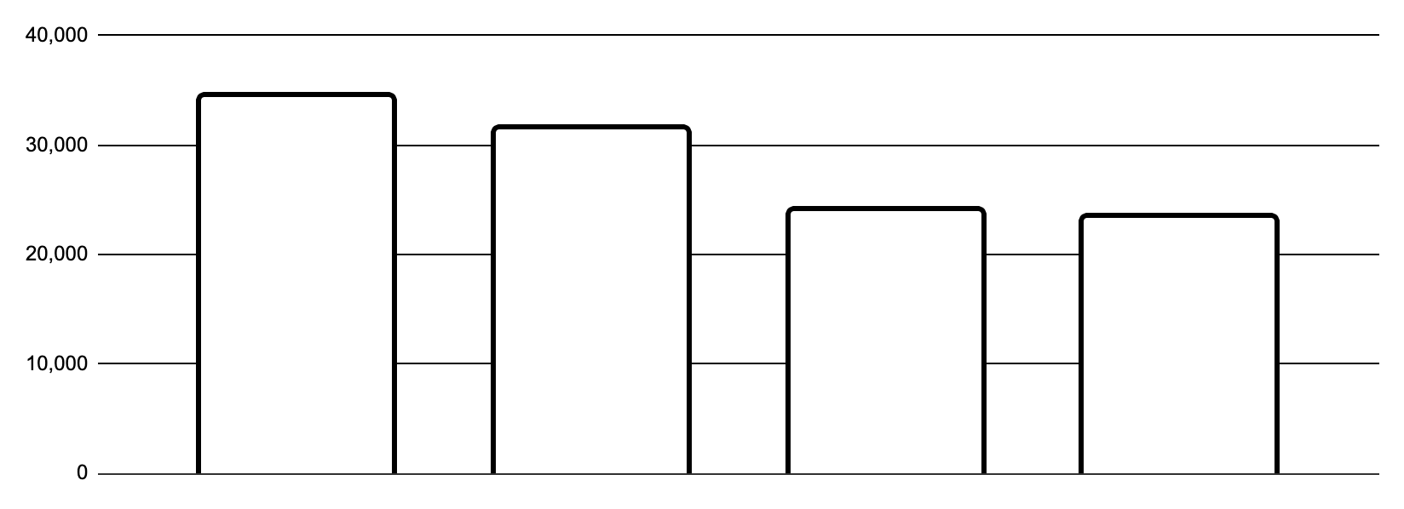
COUNTRIES WITH THE MOST KINDS OF PLANTS IN THE WORLD
BRAZIL
CHINA
COLOMBIA
MEXICO
Different types
It has 34,387 kinds of plants
It has 31,362 kinds of plants
It has 24,025 kinds of plants
It has 23,385 kinds of plants

Slide 10
Questions!
What are the four factors for plant care?
Which 2 countries have the most variety of plants
pH, water, temperature, humidity.
Brail and china.

Slide 11
THANK YOU

