Slide 1
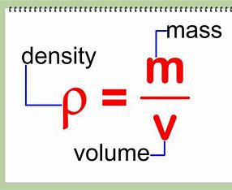
Density in solids
By: Fahed, Basel and Jordan

Slide 2
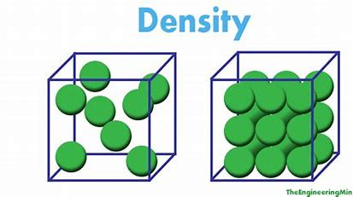
What is density?
Density is the substance's mass per unit of volume. The symbol most often used for density is ,although the Latin letter D can also be used.

Slide 3
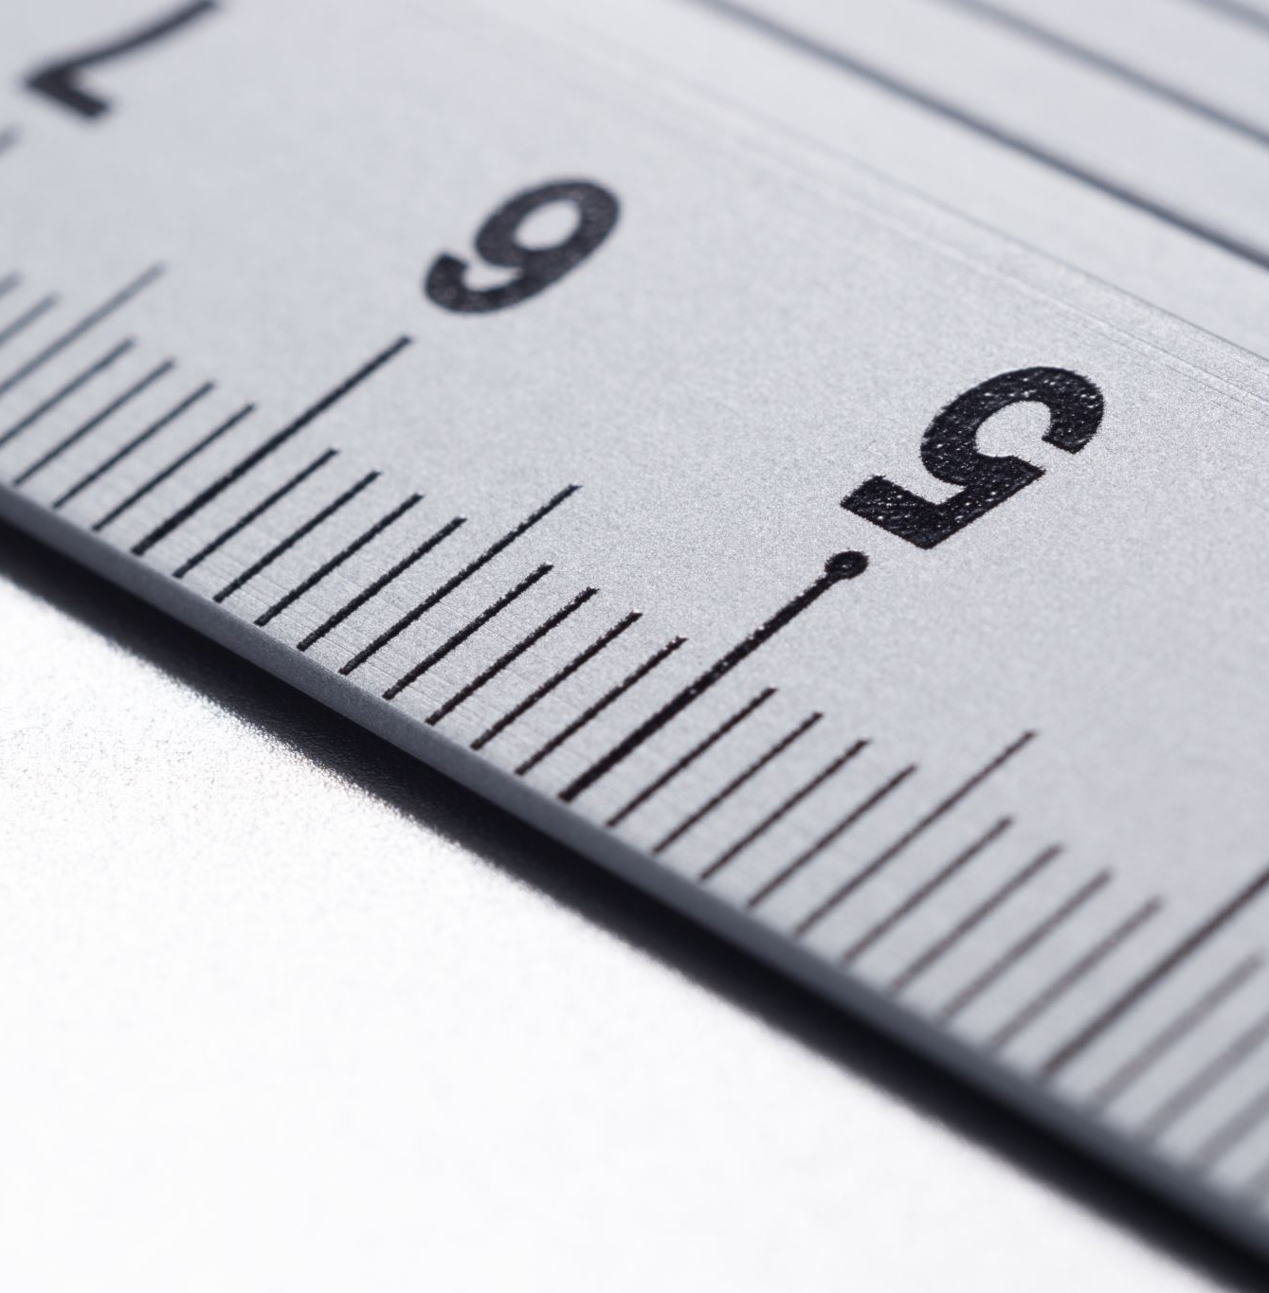
How to calculate density in solids?
To calculate density in solids, you must divide the mass by the volume of an object (D=M/V).
Ex.
An objects weighs 10g and has a volume of 5cm³, calculate the density of the object.
D=M/V = 10/5= 2g/cm³.

Slide 4
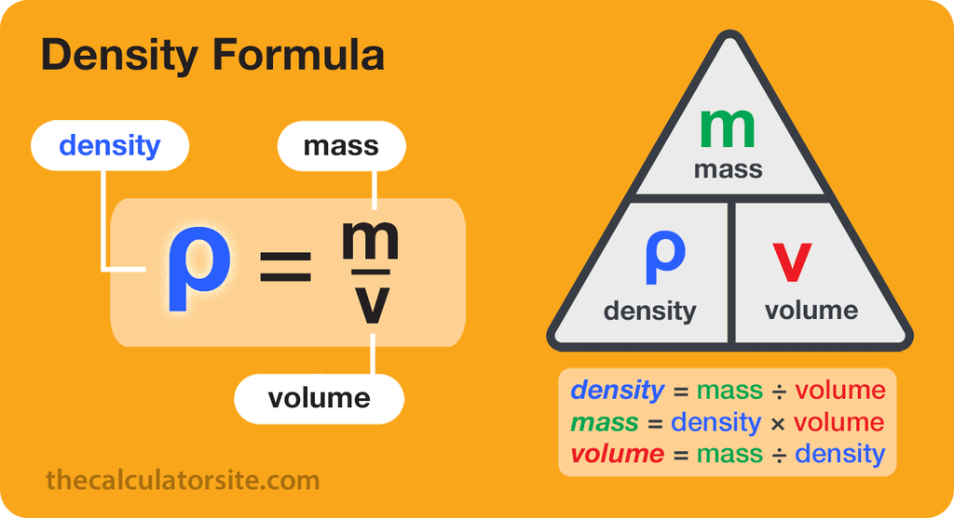
Short video explanation to density in solids.
https://www.youtube.com/watch?v=QXoQbWoIiRE

Slide 5
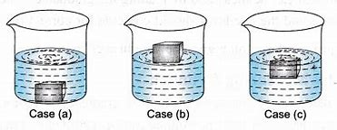
Interactive simulation
‪Density‬ (colorado.edu)

Slide 6
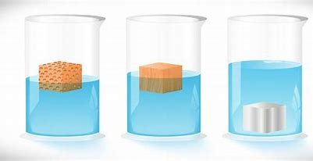
Facts about density:
Density is directly proportional to the mass.
Density is inversely proportional to the volume.
The density of water approximately 1g/cm³.
Ice is one of the few solids that have a lower density than their liquid form.

Slide 7
Questions
Q1. A cube has a mass of 150g, the length of the cube is 10 cm, the width of the cube is 50mm , and the height is 0.03m, calculate the density.
Q2 what is the density of water?
A.1g/cm³.
B.1kg/cm³.
C.1000g/m³.
D.1g/km³.

Slide 8
Conclusion
We learnt how to calculate density.
We learnt about the meaning of density.
We took some examples about solving density.
We learnt some facts about density.

Slide 9
Thanks for listening

