Slide 1
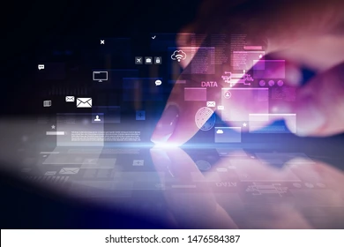
What is Multimedia
By: Tasha Masri

Slide 2
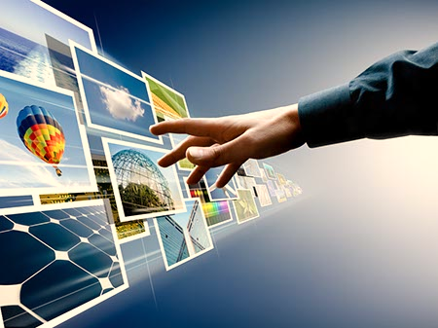
What is Multimedia
Multimedia is a form of communication that uses a combination of different content forms such as text , audio , images, animations, or video into a single interactive presentation, as multimedia is capable of delivering a stronger and more engaging message than standard texts, in contrast to traditional mass media, such as printed material or audio recordings.

Slide 3
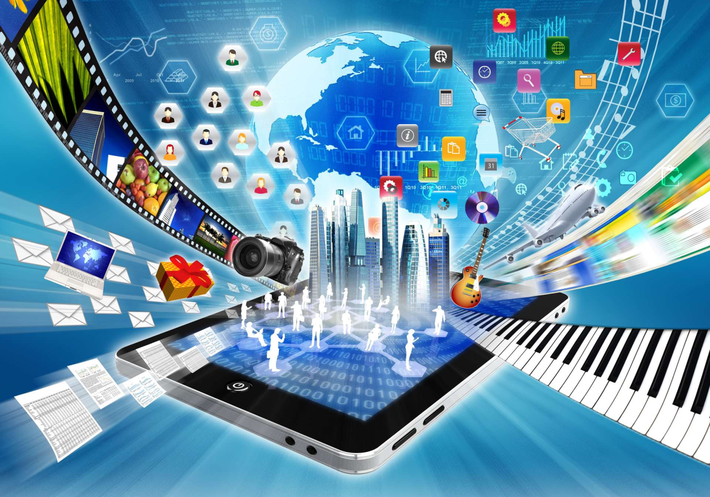
How you use Multimedia in your daily life
Businesses use multimedia in daily life in form of presentations, training, marketing, advertising, product demos, networked communication, etc. It assists them to grab customer's and visitor's attention and effectively share information. Multimedia is a booming industry with vast opportunities in different fields and many more such as:
Education
Science and technology
Effects in movies\animation.

Slide 4
Advantages of Multimedia
One of the main advantages of multimedia is its ability to improve learning and retention.
Enhanced Communication.
Increased Accessibility.
Increased Interactivity.
Improved learning outcomes.
Increased efficiency.
Greater Flexibility.
Greater impact.
Reduces Training Costs.
Easy to Use.

Slide 5
Disadvantages of Multimedia
Production of multimedia is more expensive than others because it is made up of more than one medium.
Production of multimedia requires an electronic device, which may be relatively expensive.
Multimedia requires electricity to run, which adds to the cost of its use.
Host computing power requirement.
Data storage and management requirements.

Slide 6
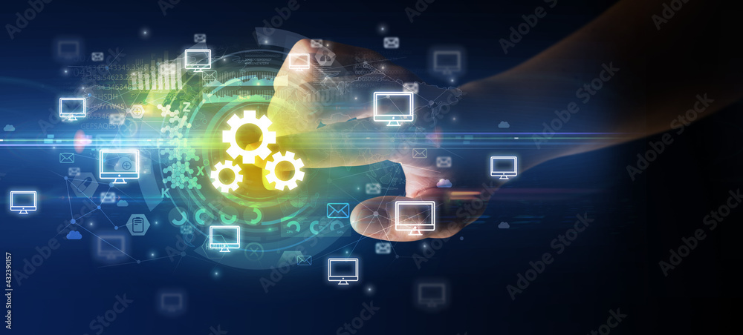
Multimedia in the future
Digital media continues to evolve as new tools emerge, consumers make new demands, and the quality and accessibility of the technologies improve

Slide 7
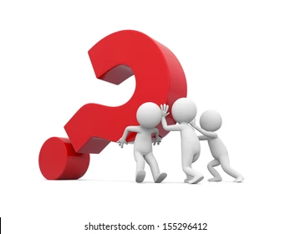
Questions to check your understanding
What is an issue in Multimedia?
What are components of Multimedia?

Slide 8
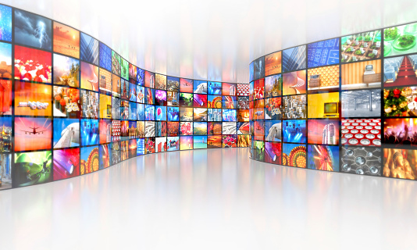
Thank you for listening

