Slide 1
Artificial intelligence
Done by: Saif Jumaian and Jad Gammoh

Slide 2
What is artificial intelligence?
Artificial intelligence(AI), is the study of evolving computer systems leading to helping us do everyday tasks such as humans, it has also helped us in many ways while developing things such as science, translation and many more things which humans couldn’t do on their own

Slide 3
Some of the ways that ai has helped humans
machinery
healthcare

Slide 4
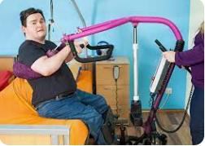
Some of the ways that ai has helped humans
machinery
Though a lot of machines were many by humans, ai has helped us develop them into things that humans could have never made, some of these machines have helped humans in many ways such as learning for people with disabilities.

Slide 5
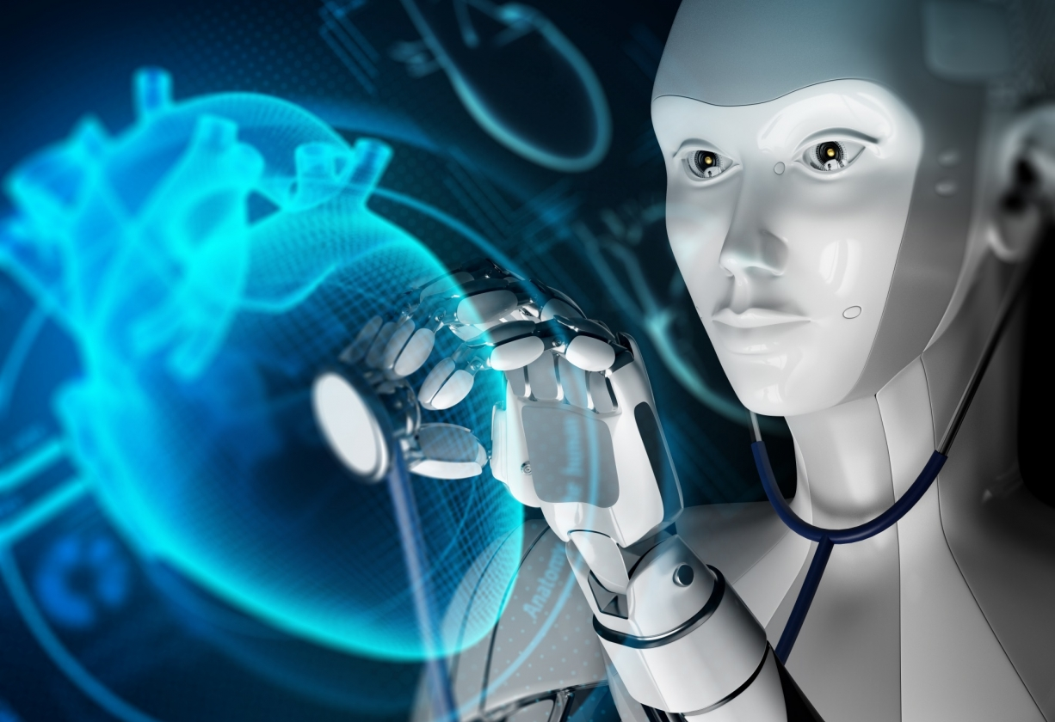
Some of the ways that ai has helped humans
healthcare
Ai has helped in healthcare in many ways such as getting more accurate results to help doctors give the right medication for the safety and health of the patient, also ai in healthcare can be used to help with public health information policy and also coule be able to detect early signs of illnesses.

Slide 6
Thank you for listening

