Slide 1
Biology (computer project)
By ziad Qutaishat

Slide 2
Today we will talk about: Evolution

Slide 3
What is Evolution?
Evolution is when a certain species or race live on with changes in their habitat, making them change along with nature.

Slide 4
Natural selection:
Natural selection plays a big part in evolution. When a habitat changes, so does the organism. However, not all offspring change with their habitat. Therefore, making them incompatible with their habitat, causing them to pass, and leaving the more suited organism.

Slide 5
What happens during Evolution.
When a habitat or surrounding changes on an organism, the organism begins to adapt to the habitat. However, not all organisms are capable of adapting, therefore being considered the weakest of the population, and later on dying. Leaving the stronger to thrive and reproduce.

Slide 6
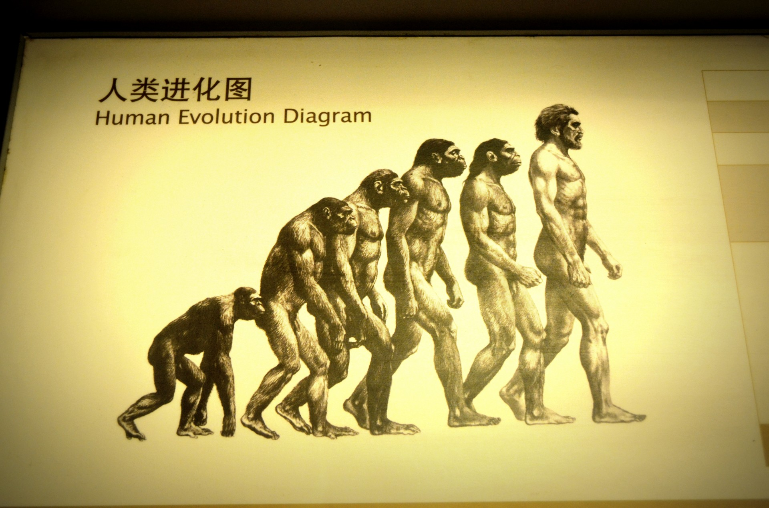
Examples of evolution:
The most controversial debate in modern society is whether humans were created as they are (descending from prophet Adam) or evolving from apes.
The idea of us evolving from apes. Stretching all the way back to 2.4 million years ago when we were known as homo-habilis (roughly translating to handy man), to modern day humans (homo-sapiens).

Slide 7
Questions !

Slide 8
Question 1: What is evolution?:

Slide 9
Question 2: Give me one example of evolution:

Slide 10
Thank you ☺

