Slide 1
calcium deficiency
By : Jana Haddad

Slide 2
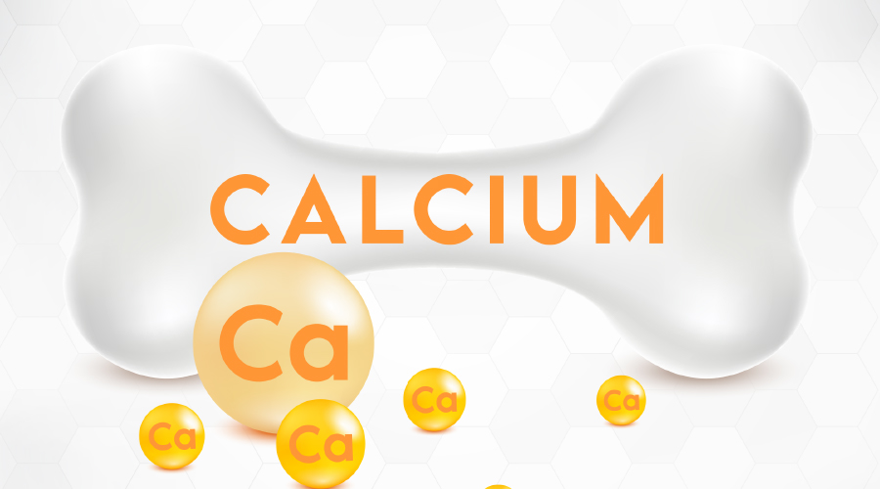
What is iron calcium deficiency
A disorder known as hypocalcemia, also known as calcium deficiency disease, occurs when the blood's calcium levels are low. Long-term calcium deficiency can result in blindness, changes in the brain, dental and cognitive issues, fractures, which weakens the bones, and bone loss.

Slide 3
8 signs of calcium deficiency
weakness
fatigue
muscle cramps or spasms
numbness or tingling, particularly in the fingertips and jawline
muscle spasms mainly in the hands
weak or brittle fingernails
fainting
difficulty swallowing

Slide 4
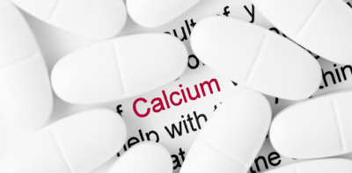
what happens when calcium is low
cramps and painful muscle pain. jerking of the muscles. tingling or numbness in the hands and feet.

Slide 5
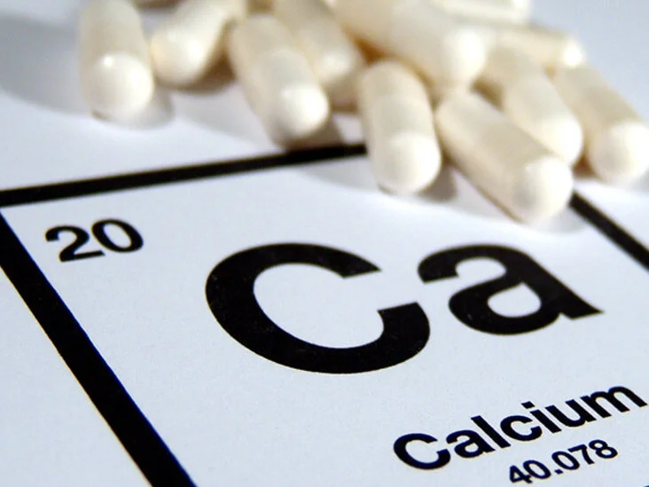
how do u treat low calcium
The primary treatment for people with acute symptomatic hypocalcemia is intravenous (IV) calcium gluconate, whereas daily calcium and vitamin D supplements are used to treat chronic hypocalcemia.

Slide 6
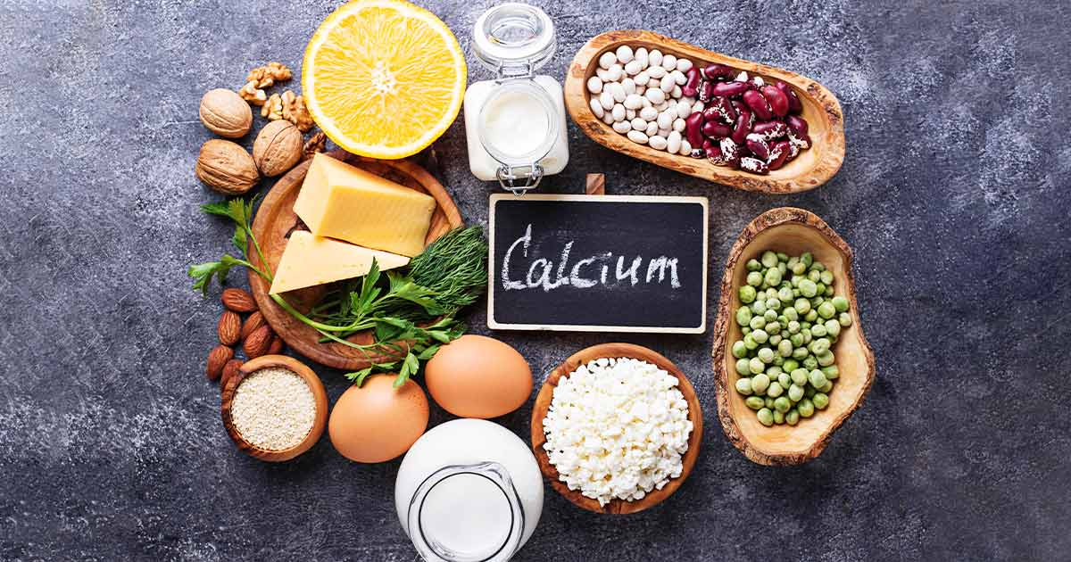
What are foods that have high calsium
Dairy (cow, goat, sheep) and fortified plant-based milks (almond, soy, rice)
Cheese.
Yogurt.
Calcium-fortified orange juice.
Winter squash.
Edamame (young green soybeans); Tofu, made with calcium sulfate.
Canned sardines, salmon (with bones)

