Slide 1
outside space

Slide 2
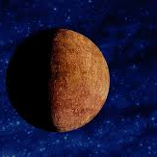
Mercury:Mercury is the smallest planet in our solar system. It's a little bigger than Earth's Moon. It is the closest planet to the Sun, but it's actually not the hottest. Venus is hotter. Along with Venus, Earth, and Mars, Mercury is one of the rocky planets.

Slide 3
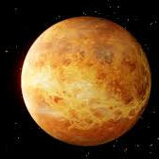
Venus:Venus is the second planet from the Sun and is Earth’s closest planetary neighbor. It’s one of the four inner, terrestrial (or rocky) planets, and it’s often called Earth’s twin because it’s similar in size and density. These are not identical twins, however – there are radical differences between the two worlds.

Slide 4
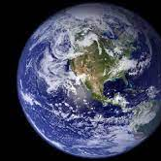
Earth:Earth—our home planet—is the only place we know of so far that’s inhabited by living things. It's also the only planet in our solar system with liquid water on the surface.Our home planet is the third planet from the Sun, and the only place we know of so far that’s inhabited by living things.

Slide 5
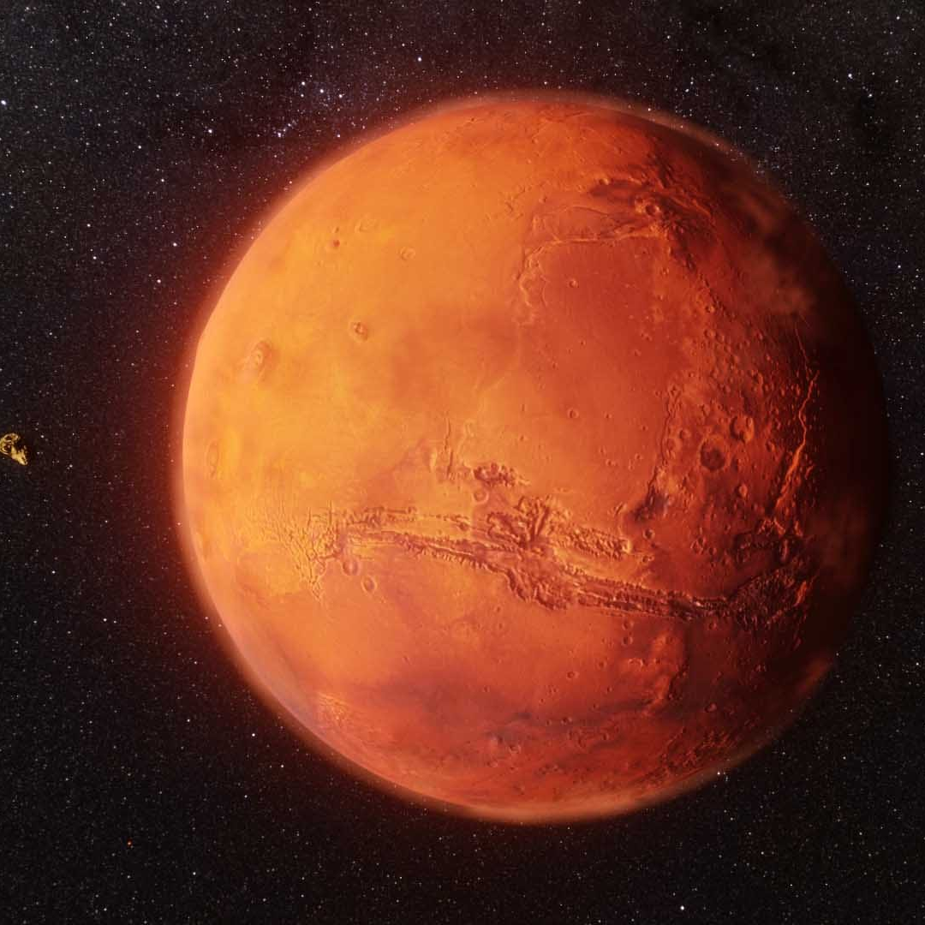
Mars:Mars is the fourth planet from the Sun and the second-smallest planet in the Solar System, larger only than Mercury. In the English language, Mars is named for the Roman god of war. Mars is a terrestrial planet with a thin atmosphere and has a crust primarily composed of elements similar to Earth's crust, as well as a core made of iron and nickel. Mars has surface features such as impact craters, valleys, dunes, and polar ice caps. Mars has two small, irregularly shaped moons, Phobos and Deimos.

Slide 6
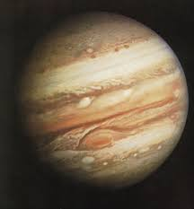
Jupiter:Jupiter is the fifth planet from the Sun and the largest in the Solar System. It is a gas giant with a mass more than two and a half times that of all the other planets in the Solar System combined, and slightly less than one one-thousandth the mass of the Sun. Jupiter is the third brightest natural object in the Earth's night sky after the Moon and Venus, and it has been observed since prehistoric times. It was named after Jupiter, the chief deity of ancient Roman religion.

Slide 7
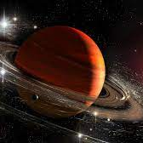
Saturn:Saturn is the sixth planet from the Sun and the second-largest in the Solar System, after Jupiter. It is a gas giant with an average radius of about nine and a half times that of Earth.It has only one-eighth the average density of Earth, but is over 95 times more massive.

Slide 8
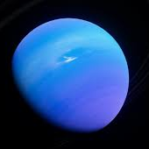
Uranus:Uranus is the seventh planet from the Sun. It is named after Greek sky deity Uranus (Caelus), who in Greek mythology is the father of Cronus (Saturn), a grandfather of Zeus (Jupiter) and great-grandfather of Ares (Mars). Uranus has the third-largest planetary radius and fourth-largest planetary mass in the Solar System.

Slide 9
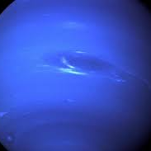
Neptune:Neptune is dark, cold, and very windy. It's the last of the planets in our solar system. It's more than 30 times as far from the Sun as Earth is. Neptune is very similar to Uranus. It's made of a thick soup of water, ammonia, and methane over an Earth-sized solid center.

Slide 10
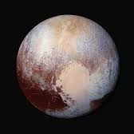
Pluto:Pluto (minor-planet designation: 134340 Pluto) is a dwarf planet in the Kuiper belt, a ring of bodies beyond the orbit of Neptune. It is the ninth-largest and tenth-most-massive known object to directly orbit the Sun.

Slide 12
Mercury,
Venus,
Earth,
Mars,
Jupiter,
Saturn,
Uranus,

