Slide 1
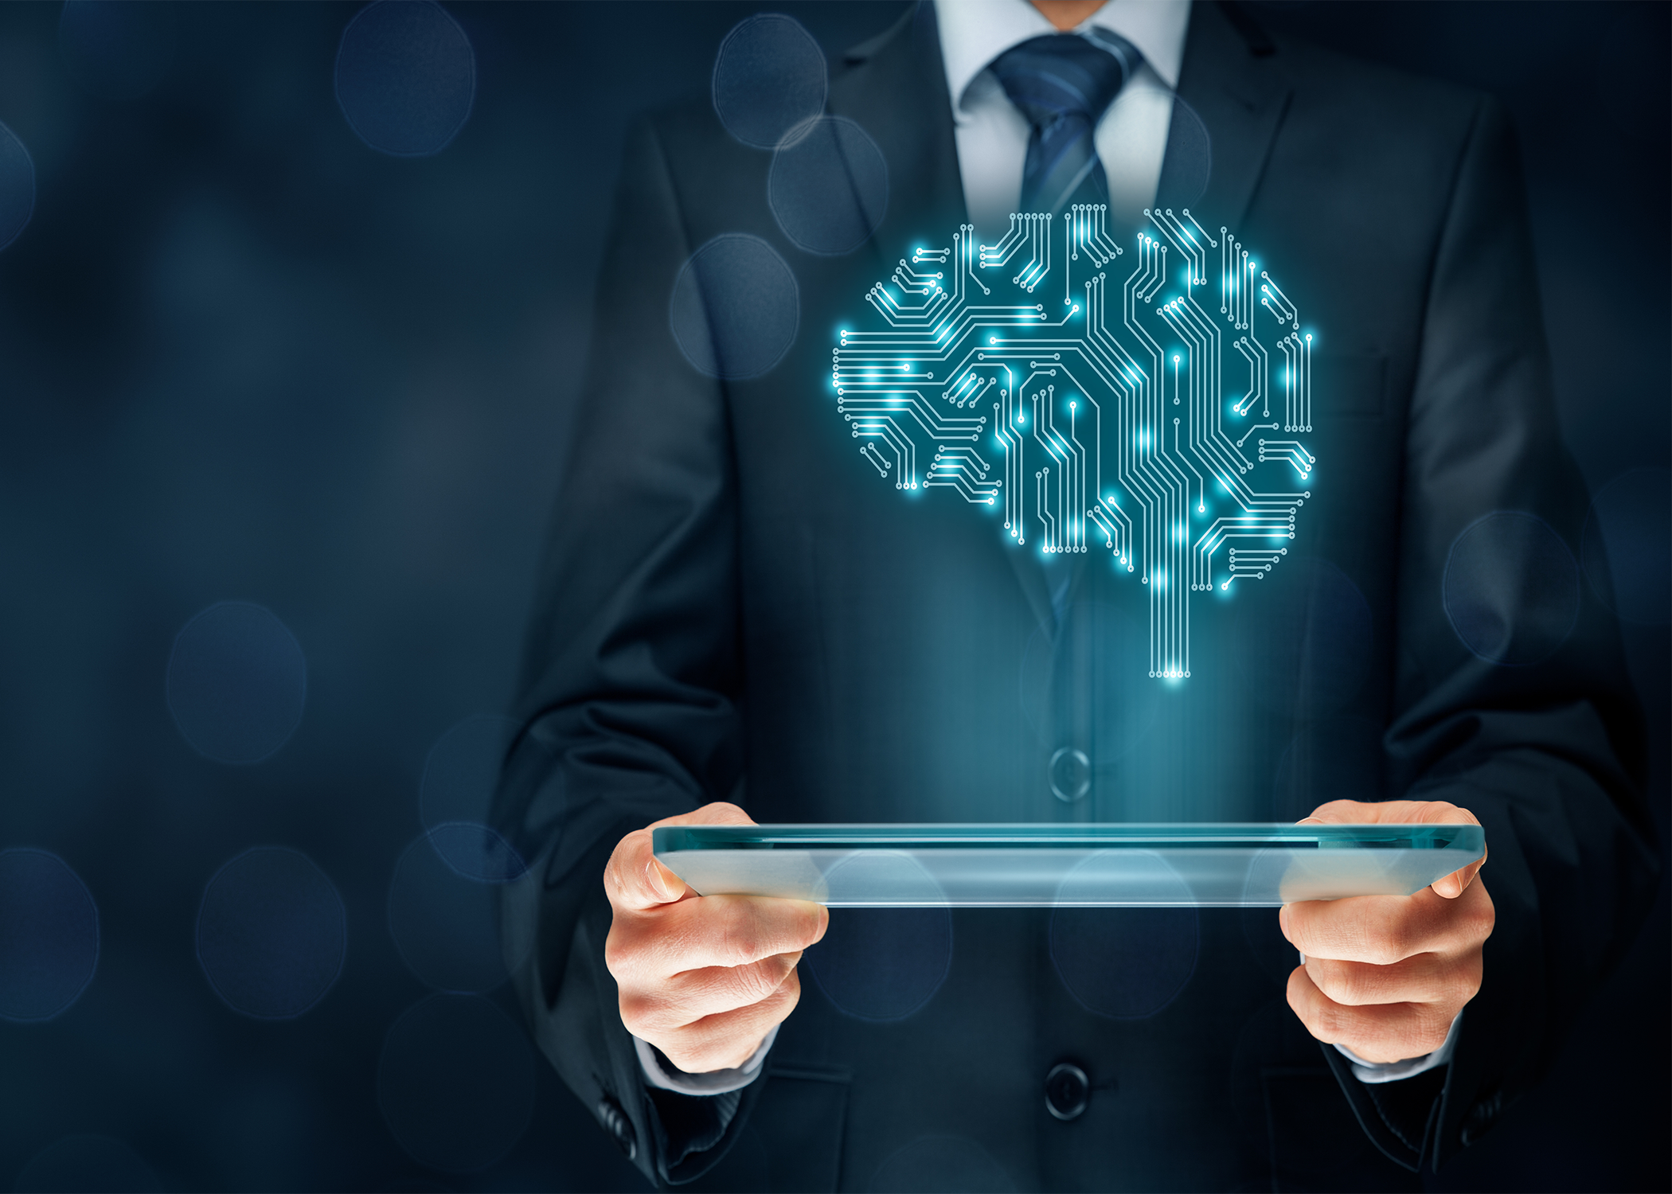
ARTIFICIAL INTELLIGENCE (AI)
By : perla habash

Slide 2
What is AI?
Artificial intelligence is the simulation of human intelligence processes by machines, especially computer systems.

Slide 3
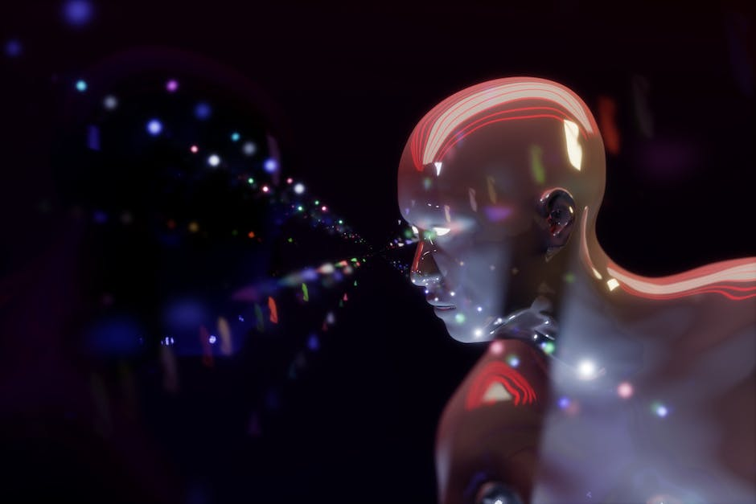
Why you should study about AI
Your abilities will be highly valued . The topic of artificial intelligence is still expanding and is a relatively new technology. Indeed, according to Forbes, positions needing expertise in AI or machine learning are predicted to grow by 71% over the next five years, making AI talents among the most in-demand among employers.

Slide 4
How will it affect us?
Being an expert in AI will give you the ability to question established procedures and alter your general perspective on life. You could advance your career by emphasizing your desire for positive change and your enthusiasm to master the most recent technologies.

Slide 5
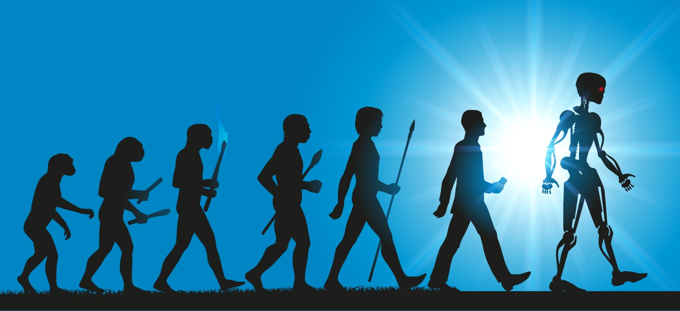
Why must we learn AI?
you could be a Machine Learning Engineer, Software Engineer, Hardware Engineer, Research Engineer, Business Intelligence Developer, and Data Scientist . which are currently some of the most important jobs and will be even more important in the future

Slide 6
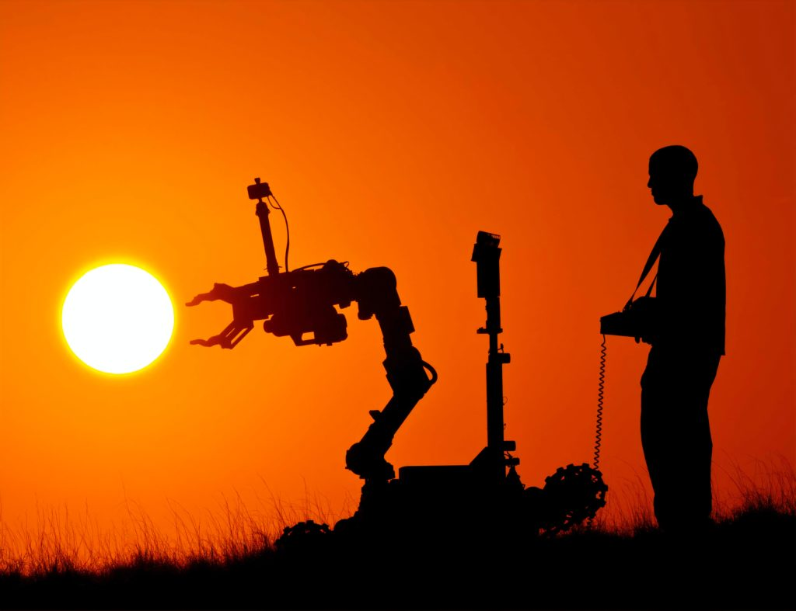
Why will ai be important in the future ?
AI makes it possible to analyze massive data sets and compute find complicated links and patterns, which is previously unheard of.

Slide 7
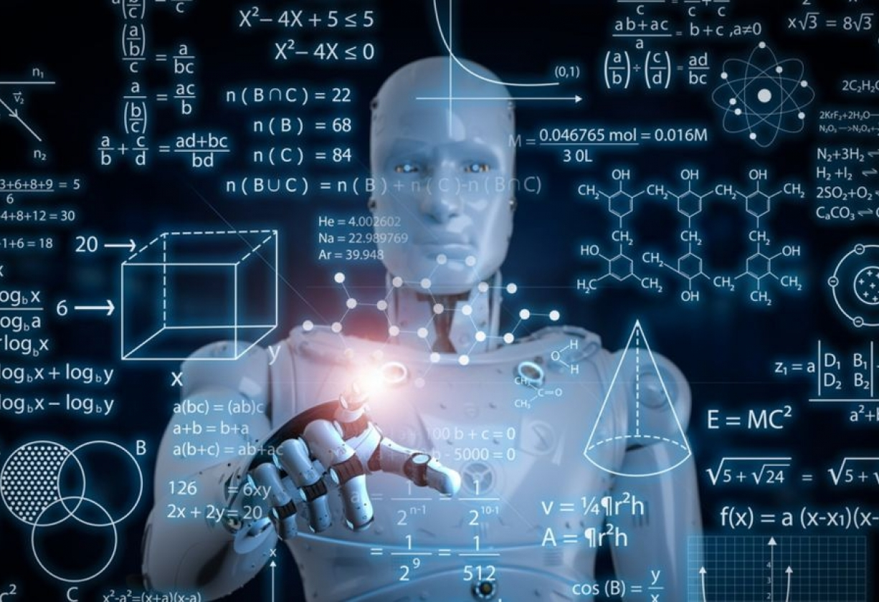
What are the advantages of Artificial Intelligence?
AI reduces the amount of time needed to complete a task.AI makes it possible to complete previously complex jobs without having to spend a lot of money.AI has no downtime and runs continuously, without interruption.AI improves the capacities of people with disabilities.

