Slide 1
Marketing
23/3/2023 7:18PM
Naya Karadsheh 8D

Slide 2
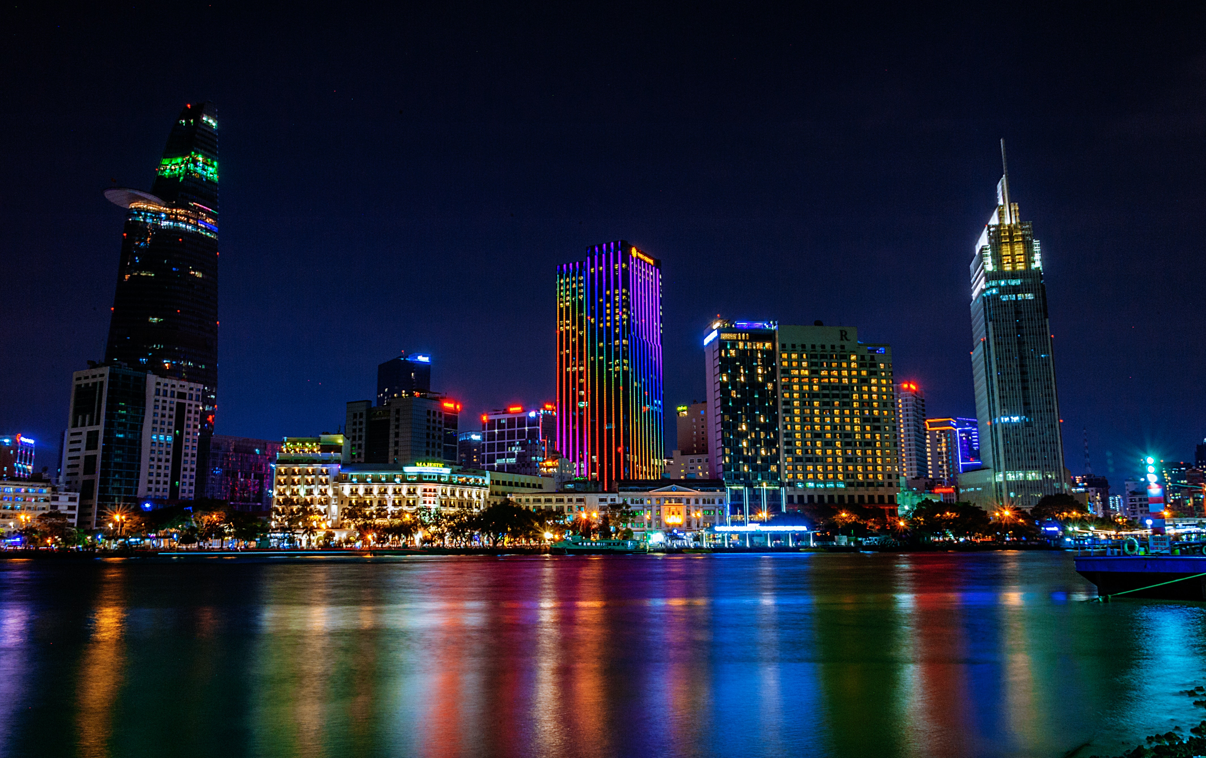
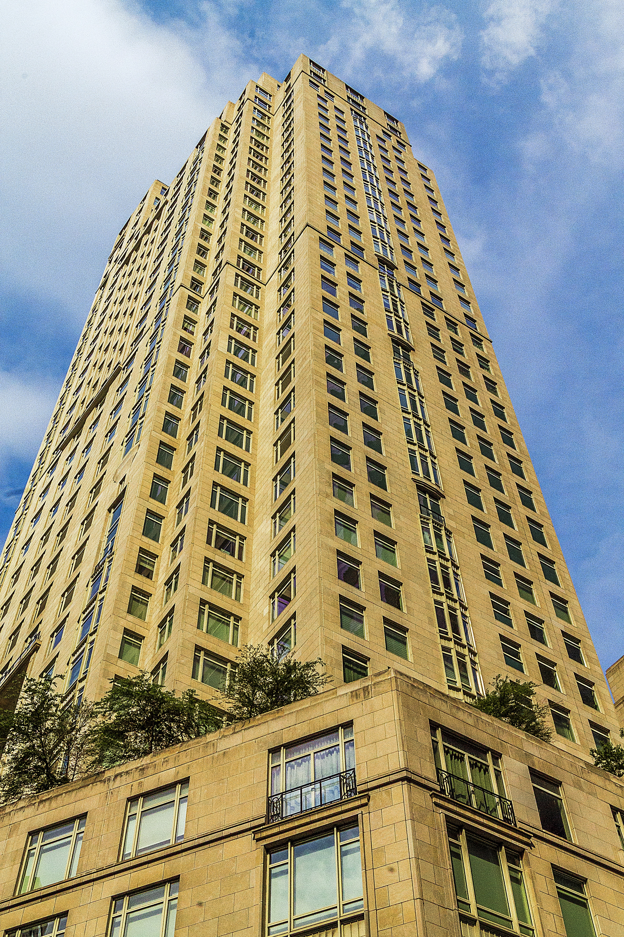
4P’S
Price
Place
Promotion
Product

Slide 3
Introduction
Marketing is an essential part of business, Marketing is the activity, set of institutions, and processes for creating, communicating, delivering, and exchanging offerings that have value for customers, clients, partners, and society at large. It is the most essential part when treating a business, it helps you to promote and build a reputation in order to make your business more successful and well known throughout.

Slide 4
Promotion and Price
Let’s dive in

Slide 5
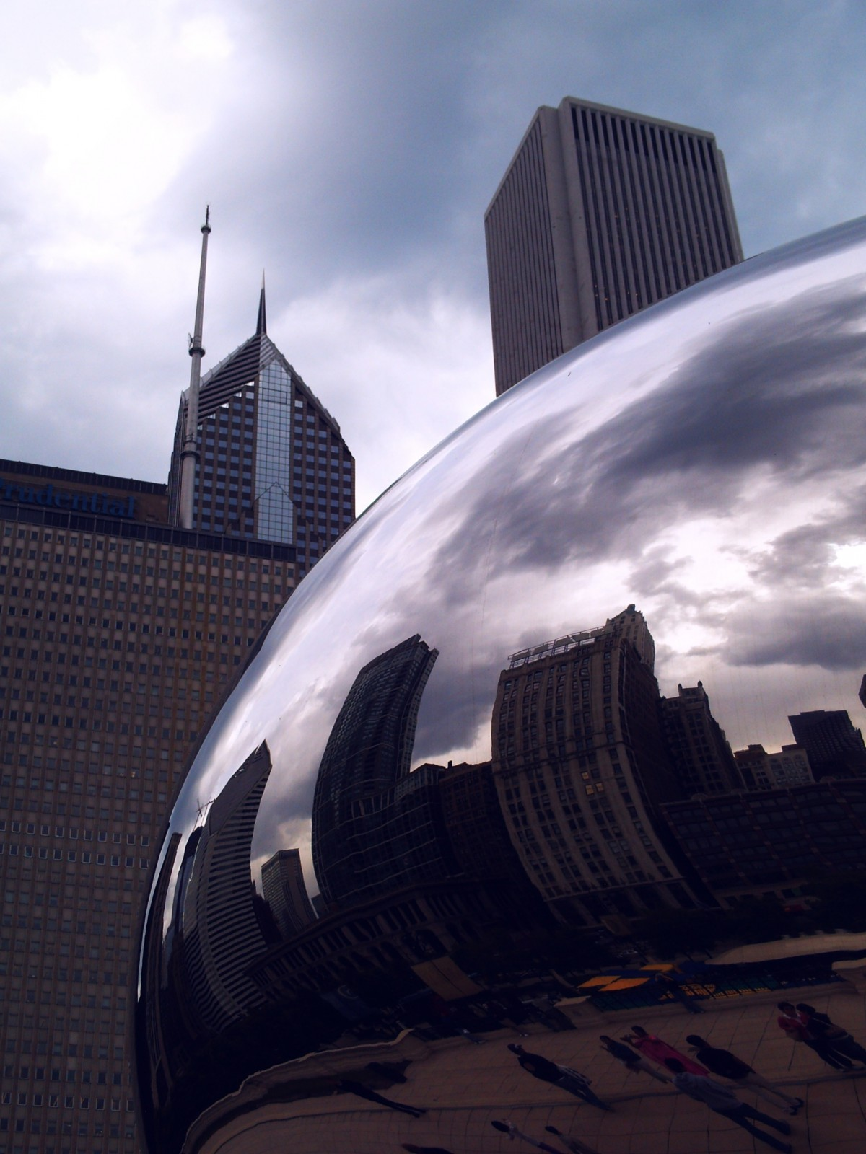
Price
Prices of a business can change overtime depending on their success and motives, if a business decides to increase the price of their services or good then they will have to increase the quality and possibly make offers from time to time to keep customer loyalty and to gain MORE customers overtime.

Slide 6
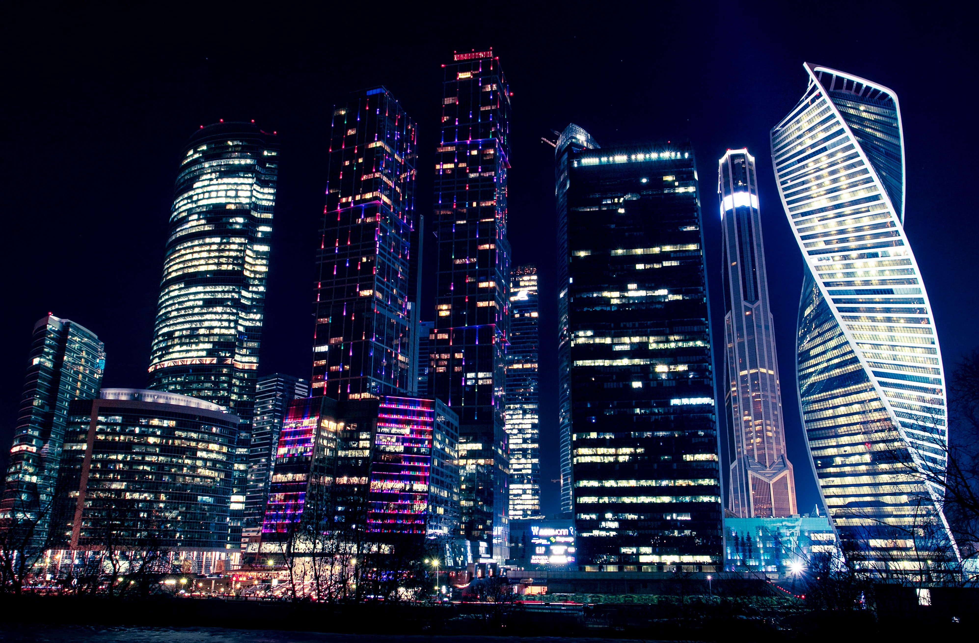
Promotion
Promotion is one of the key things when trying to get your business more customers or a higher reputation. Promotional marketing refers to the process of sharing knowledge about a brand, product, or service through multiple marketing channels to increase brand awareness.
One way to increase brand awareness is putting up advertisements, posters, talk about it on the radio on different channels, phone calls and many more.
Promoting your business could help you to get more customers and reputation faster, which will lead to a successful and on-going business

Slide 7
Product and Place

Slide 8
Product
Product marketing is the process of bringing a product to market. This includes deciding the product's positioning and messaging, launching the product, and ensuring salespeople and customers understand it. Product marketing aims to drive the demand and usage of the product.
Products can be goods or services given by a business to its customers, and if the customers start to like the product more and more, they will eventually become loyal to the business and become loyal customers.

Slide 9
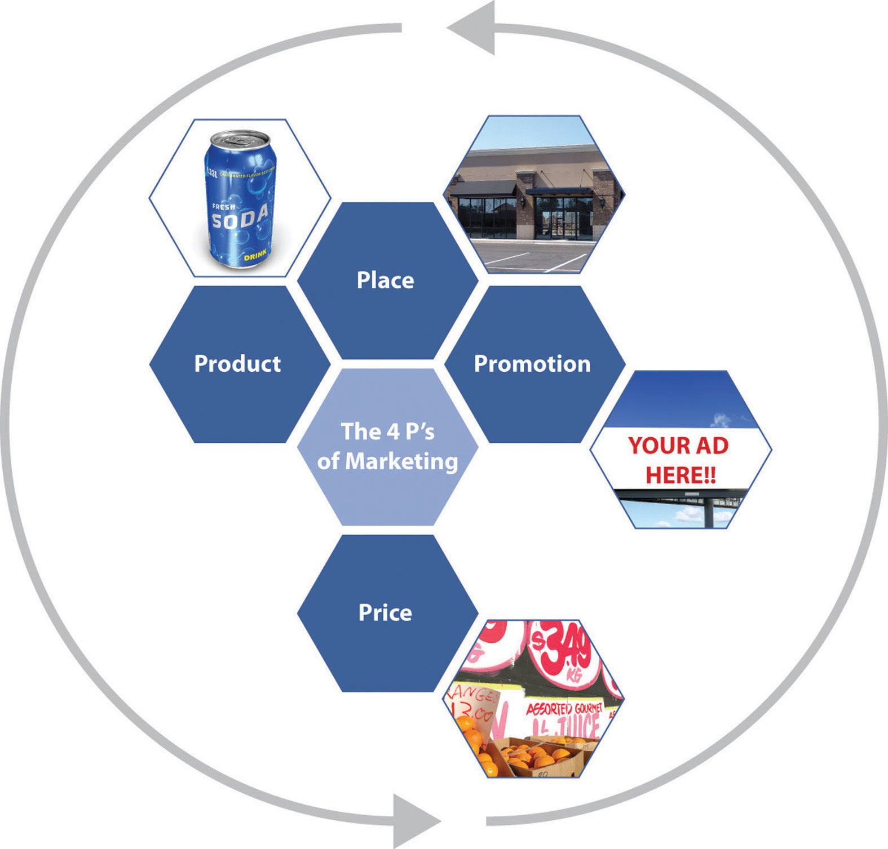
Place
Every market needs to be set in a certain location, but this location needs to help bring customers. Businesses near schools or hotels tend to get more customers, because students and teachers or people staying at hotels LOVE trying new foods and new restaurants, the place where you business is located must also have a good reputation in order to keep bringing customers. A trashy place or somewhere that is almost impossible to find wont get you as much customers and may cause the business to go down, and in rare cases, up but slowly.

Slide 10
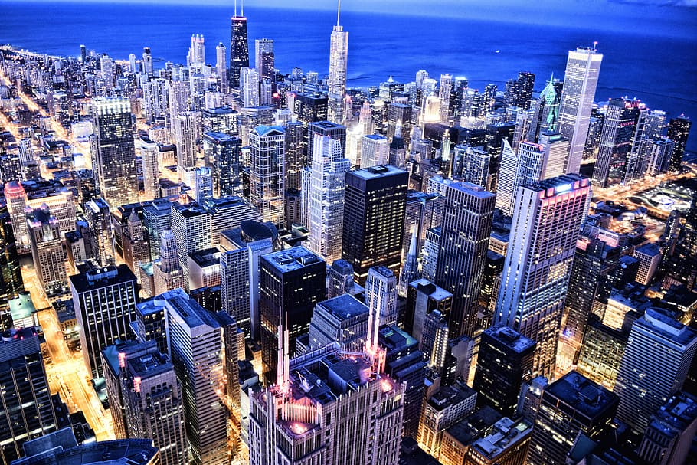
QUESTIONS
What are the 4p’s of marketing?
Name 3 kinds of promotion for your business
Why is place important for a business?
When quality of goods or services increases, which out of 4P’s increases?

Slide 11
Thank You So Much For Listening!
Goodluck on your exams

Slide 12
marketing (promotion) - Google Search
www.google.com
4:16 PM
4 ps of marketing example clothing - Google Search
www.google.com
4:13 PM
marketing place(4PS) - Google Search
www.google.com
4:13 PM
4 ps - Google Search
www.google.com
4:12 PM
marketing placement - Google Search
www.google.com
Sources!
(included source: teachings of MS.Yasmine Qadoumi)
7:00 PM
marketing (price) - Google Searchwww.google.com
6:58 PM marketing (product) - Google Search www.google.com
6:58 PM
marketing (product) - Google Searchwww.google.com
Tuesday, March 21, 2023 6:54 PM marketing - Google Search www.google.com
6:54 PM
marketing - Google Searchwww.google.com

