Slide 1
INDOOR FOOTBALL FIELD
BY GEORGE FAKES

Slide 2
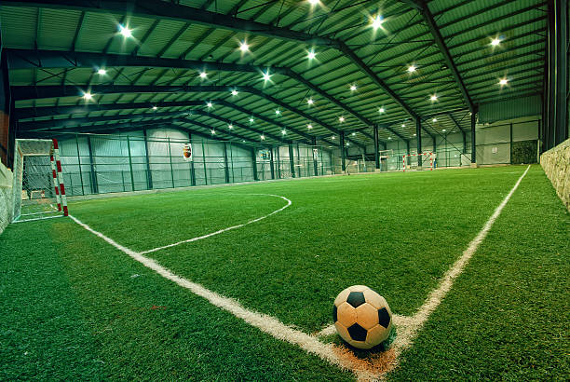
Indoor football field
Football considered now one of the worlds most popular sports.
It is played nearly in every country.
Indoor football is a version of football that is played in an indoor walled area.

Slide 3
How will it affect the school
It will affect both the school and students.
For students by: motivation, reduce the stress, playing with other people in teamwork, increase productivity.
For school in general: they can rent the football field after school hours or make events in the field.

Slide 4
Advantages of indoor field
Reduce the risk of Injury and it is more safety.
You can play anytime and in all weather conditions.
It can be rent after school hours.
You can rent it for different events and make business.

Slide 5
Disadvantages of indoor field
It costs a lot and needs special requirements.
It needs large space.

Slide 6
Prices of required materials for the indoor field
Football grass carpet(9.99$ per1000 Square Meters)
Football goal and net (50$)
Led Lightening ($700 per one led)
Wall boards and panels(1000$ per feet)
It will cost around $150,000-$180,000

Slide 7
Resources
https://dublinindoorfootball.ie/7-advantages-of-an-indoor-football-pitch-2/
https://udcsports.com/6-types-of-equipment-every-new-football-field-needs/
https://turffactorydirect.com/2021/02/08/the-average-cost-for-an-artificial-turf-football-field/
https://gensteel.com/price-your-building-online/
https://www.istockphoto.com/photo/indoor-soccer-football-field-gm520999573-37591580

Slide 8
Thank you

