Slide 1
Density
Mariana, Haya, Yasmine
8D

Slide 2
Density
Mariana, Haya, Yasmine
8D

Slide 3
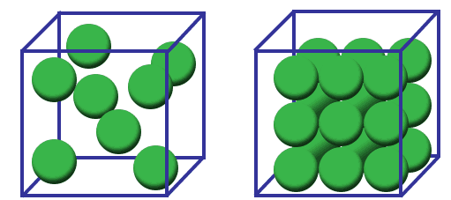
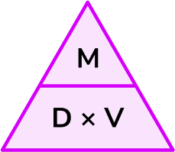
What is density?
Density is the mass of a unit volume of a material substance.
We measure density by dividing the mass by the volume
(d = m / v).

Slide 4
Why is density important to measure?
Density is an important concept because it helps us identify substances when comparing its density to the density of a known material.
Knowing density of substances is also important to help us predict their behavior in relation to other materials

Slide 5
What is mass?
Quantity representing the amount of matter in an object.
The mass of an object will always stay the same.
The standard unit of mass in the International System (SI) is the kilogram (kg) or gram (g).

Slide 6
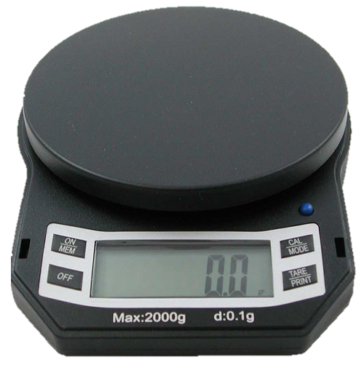
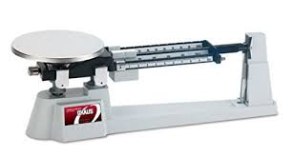
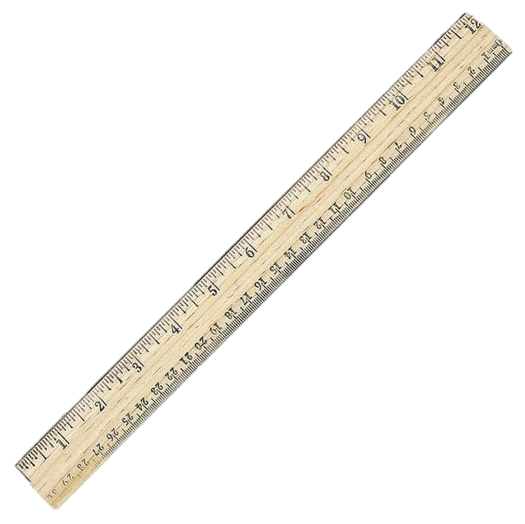
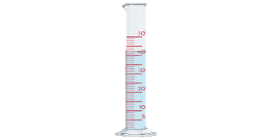
How to measure mass?
We measure mass using a scale or a balance or a triple beam balance.

Slide 7
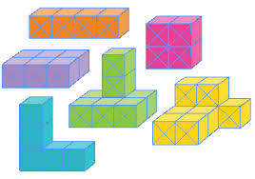
What is volume?
Volume is how much space an object or substance takes up .
measured in cubic units. The SI unit of volume is the cubic meter (m³) or cubic centimeter (cm³).

Slide 8
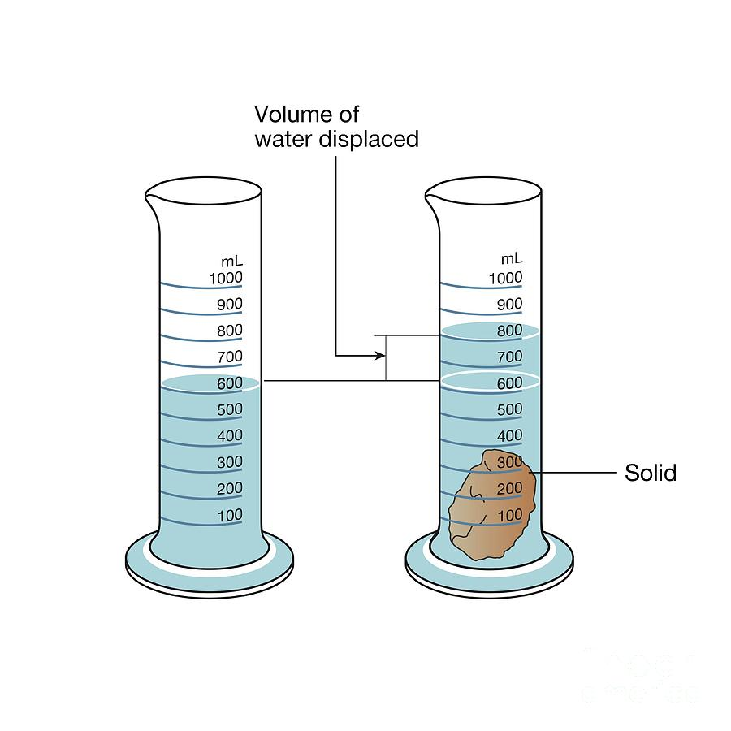
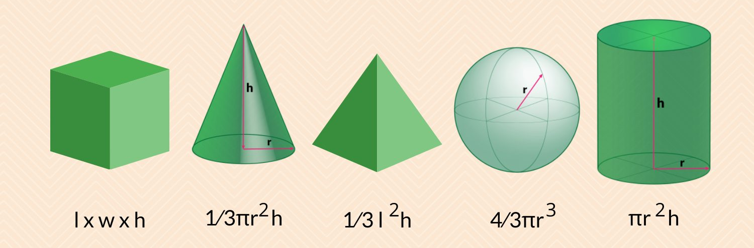
How to measure volume?
We measure volume by:
Regular shape: using a ruler to take dimensions (length, width, and height) then multiplying them
Irregular shape: by dividing the shape into regular shapes or by using measuring cylinder and water displacement.

Slide 9

How to Calculate Density of a Solid Object | Real Example – YouTube
Density explanation video:

Slide 10
Density simulation:
https://phet.colorado.edu/sims/html/density/latest/density_en.html

Slide 11
Quiz time
https://create.kahoot.it/share/density-quiz/5b7356cc-92f6-4d1a-8dcf-4a52df66bc19

Slide 12
Thank you!

