Slide 1
Swimming Pool
By Ahmad Alkhateeb, Thalia Zureik

Slide 2
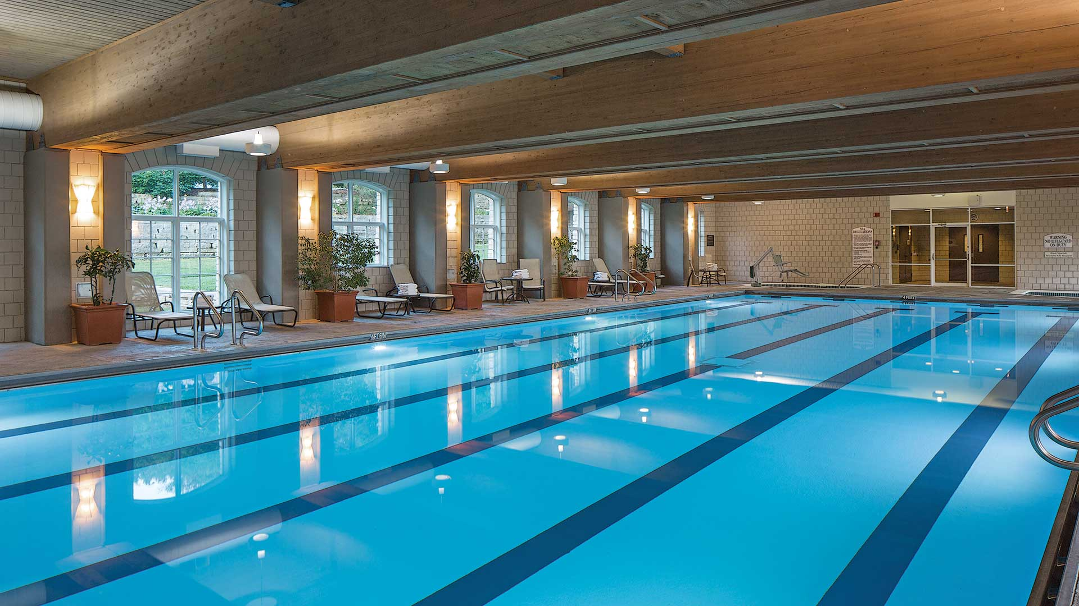
Introduction
We decided to add a pool to NOS because of the many health benefits of swimming and because we believe that everyone will benefit from new methods of exercise!

Slide 3
What are the consequences of swimming
Advantages:
Increases health.
Boosts cardiovascular system.
Boosts your mood.
Strengthens your muscles.
Disadvantages:
Fatigue and tiredness.
Costly to install pool common injuries.
Open to harmful pool chemicals.
Risk of drowning.

Slide 4
Location of the pool
We have decided to implement this pool under the basketball court in the big room as was suggested by the results of the survey

Slide 5
Financing the pool
The average cost of installing an in ground pool is $35,000, but it can range from $28,000 to $55,000, and even up to $65,000 for special customizations and extra features. We will raise money from fund raisers and donations to be able to pay for all of the costs.

Slide 6
Citations
https://fitactiveliving.com/disadvantages-of-swimming/
https://www.betterhealth.vic.gov.au/health/healthyliving/swimming-health-benefits
https://www.healthline.com/health/benefits-of-swimming
https://www.forbes.com/home-improvement/pool/inground-pool-cost/#:~:text=The%20cost%20to%20install%20an,to%20%241%2C800%2C%20according%20to%20HomeGuide.
https://www.investopedia.com/articles/personal-finance/050815/swimming-pools-costs-vs-longterm-value.asp#:~:text=HomeAdvisor%20estimates%20that%20the%20cost,%24500%20to%20%244%2C000%20every%20year.&text=You%20can%20cut%20down%20the,go%20with%20a%20smaller%20pool.
https://swimcompetitive.com/swimming/disadvantages/
https://blog.myswimpro.com/2017/11/10/recovery-for-swimmers-what-you-need-to-know/#:~:text=Can%20You%20Swim%20Every%20Day,is%20fresh%20for%20each%20workout.

