Slide 1
HUMAN REPORDUCTION

Slide 2
INCLUDED TOPICS
01
02
03
04
INTRODUCTION
BABIES
WHAT MAKES US DIFFERENT
DNA & CHROMOSOMES

Slide 3
INTRODUCTION
Human reproduction happens when a sperm fertilizes an egg. The sperm comes from the male and the egg comes from the female. Although sperm and eggs both come from humans, they have different characteristics.

Slide 4
Sperm
Egg
Tail for rapid movement.
Streamlined head to penetrate the egg.
Nucleus for fertilization.
Jelly layer to attract sperms.
Fat stores to feed future zygote.
Nucleus for fertilization.

Slide 5
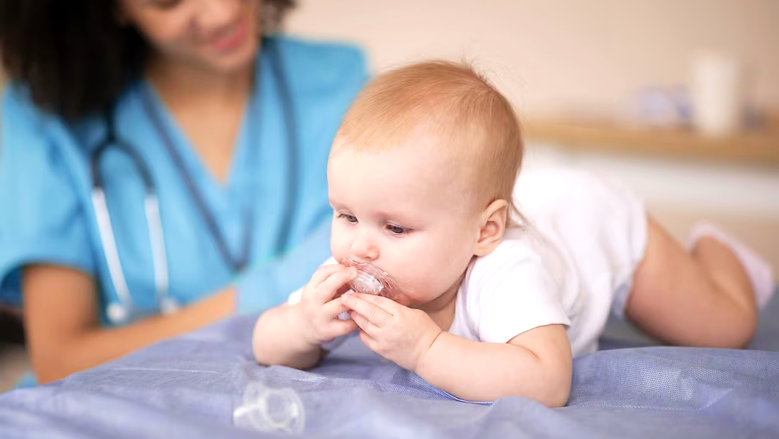
HUMAN REPORDUCTION
RESULT US WITH BABIES.

Slide 6
BABIES
Babies are small humans. But of course, they were way smaller than that. Babies were initially a zygote, with time, they formed to embryos and staged more afterwards. Sometimes, babies come as pairs. Either identical or unidentical. Identical babies are called this way for looking the same. This occurs due to genetics.

Slide 7
WHAT MAKES US DIFFERENT?
Most of the time, identical twins become less alike growing up. This is because of genetics and environmental factors. When they were young, they looked so similar. Over time, they adapted to their surroundings and changed. You can notice they are twins due to their common characteristics all of these are genetic factors. Genetic factors are since birth factors. Environmental factors are factors that are being changed due to the environment they are exposed to.

Slide 8
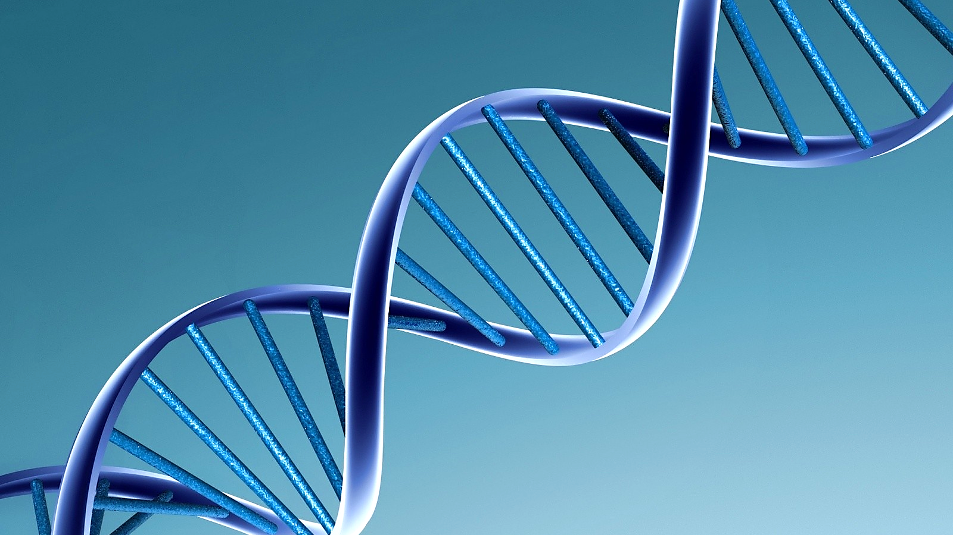
OUR CHARACTERISTICS ARE CONTROLLED BY DNA

Slide 9
DNA & CHROMOSOMES.
DNA are in chromosomes. We all have 46 chromosomes. Some people have more or less, but this goes to a deeper topic, for short you can call it some mistake with chromosomes. DNA, a molecule in everybody’s body, controls how we appear. Each sperm and egg of male and female have different DNA. That’s why you and your sibling have different features. For example, your sibling can have a straight nose and you have a button nose.

Slide 10
Thank you

