Slide 1
Natural disaster
by: Shadi and nassar
grade 8 a

Slide 2
What are natural disasters?
Natural disaster, any calamitous occurrence generated by the effects of natural, rather than human-driven, phenomena that produces great loss of human life or destruction of the natural environment, private property, or public infrastructure. A natural disaster may be caused by weather and climate events or by earthquakes, landslides, and other occurrences that originate at earth’s surface or within the planet itself. No spot on Earth is immune from a natural disaster; however, certain types of disasters are often limited to or occur more frequently in specific geographic regions.

Slide 3
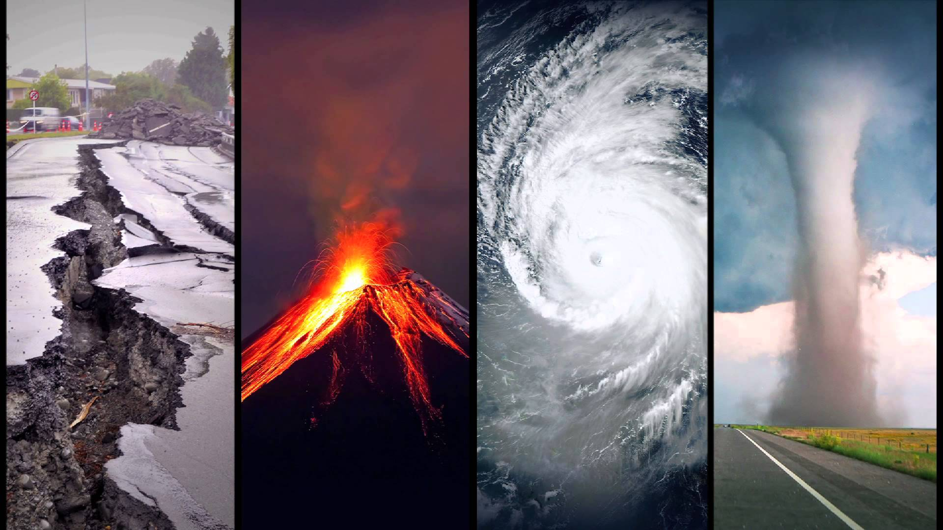
Types of natural disasters
Earthquakes
Volcano
Tsunami
Tornado
Wildfire

Slide 4
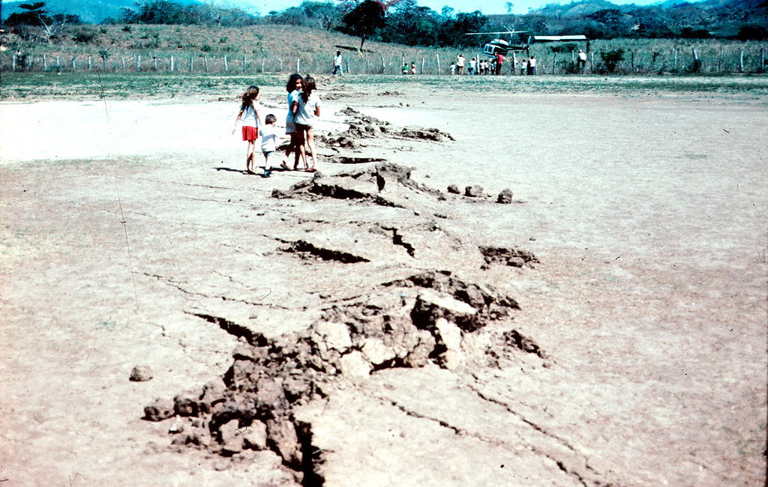
Earthquakes
Earthquakes are seismic events that generate waves that shake the ground. They are caused by the sudden release of energy stored in Earth's crust.

Slide 5
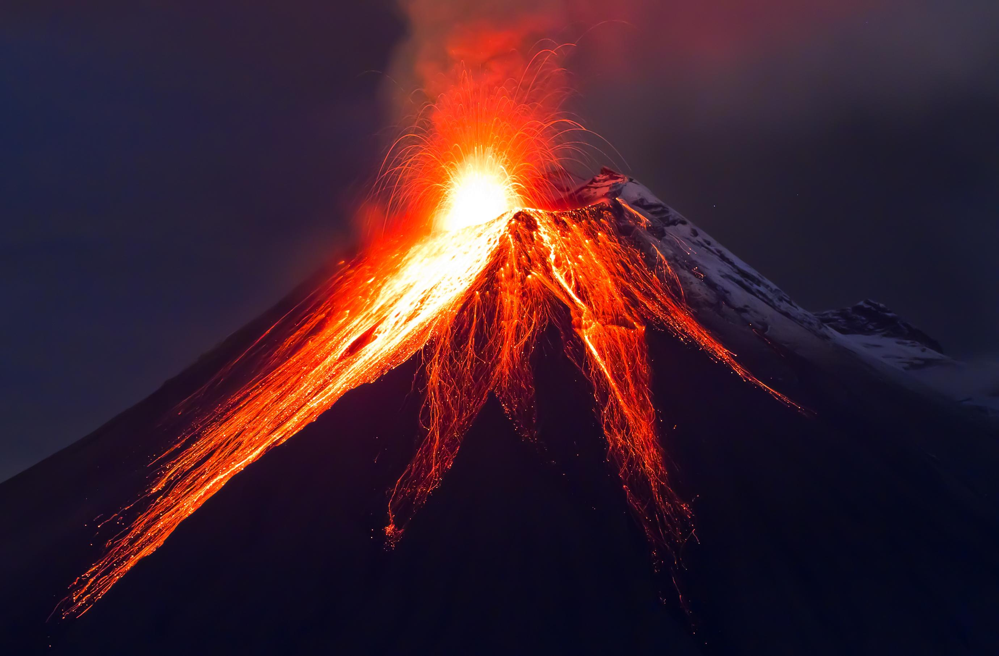
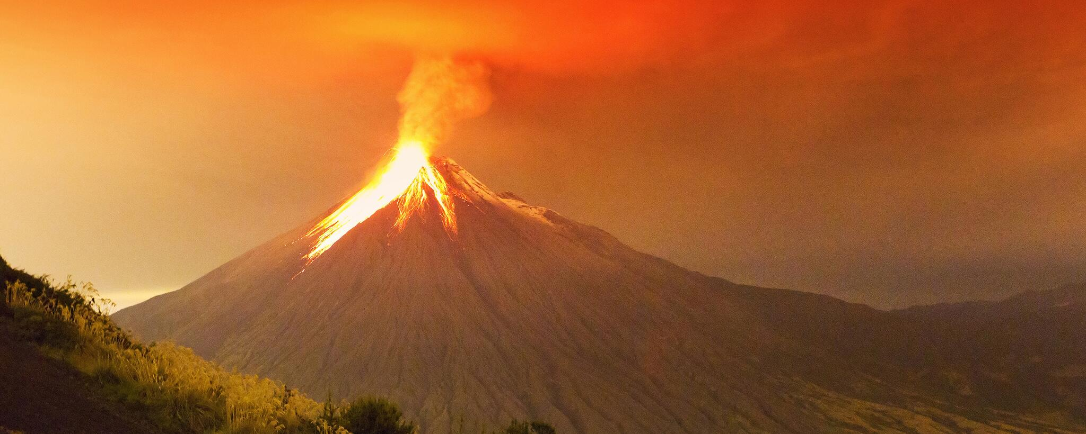
Volcano
A volcano is a rupture in the crust of a planetary-mass object, such as Earth, that allows hot lava, volcanic ash, and gases to escape from a magma chamber below the surface. And most are found underwater.

Slide 6
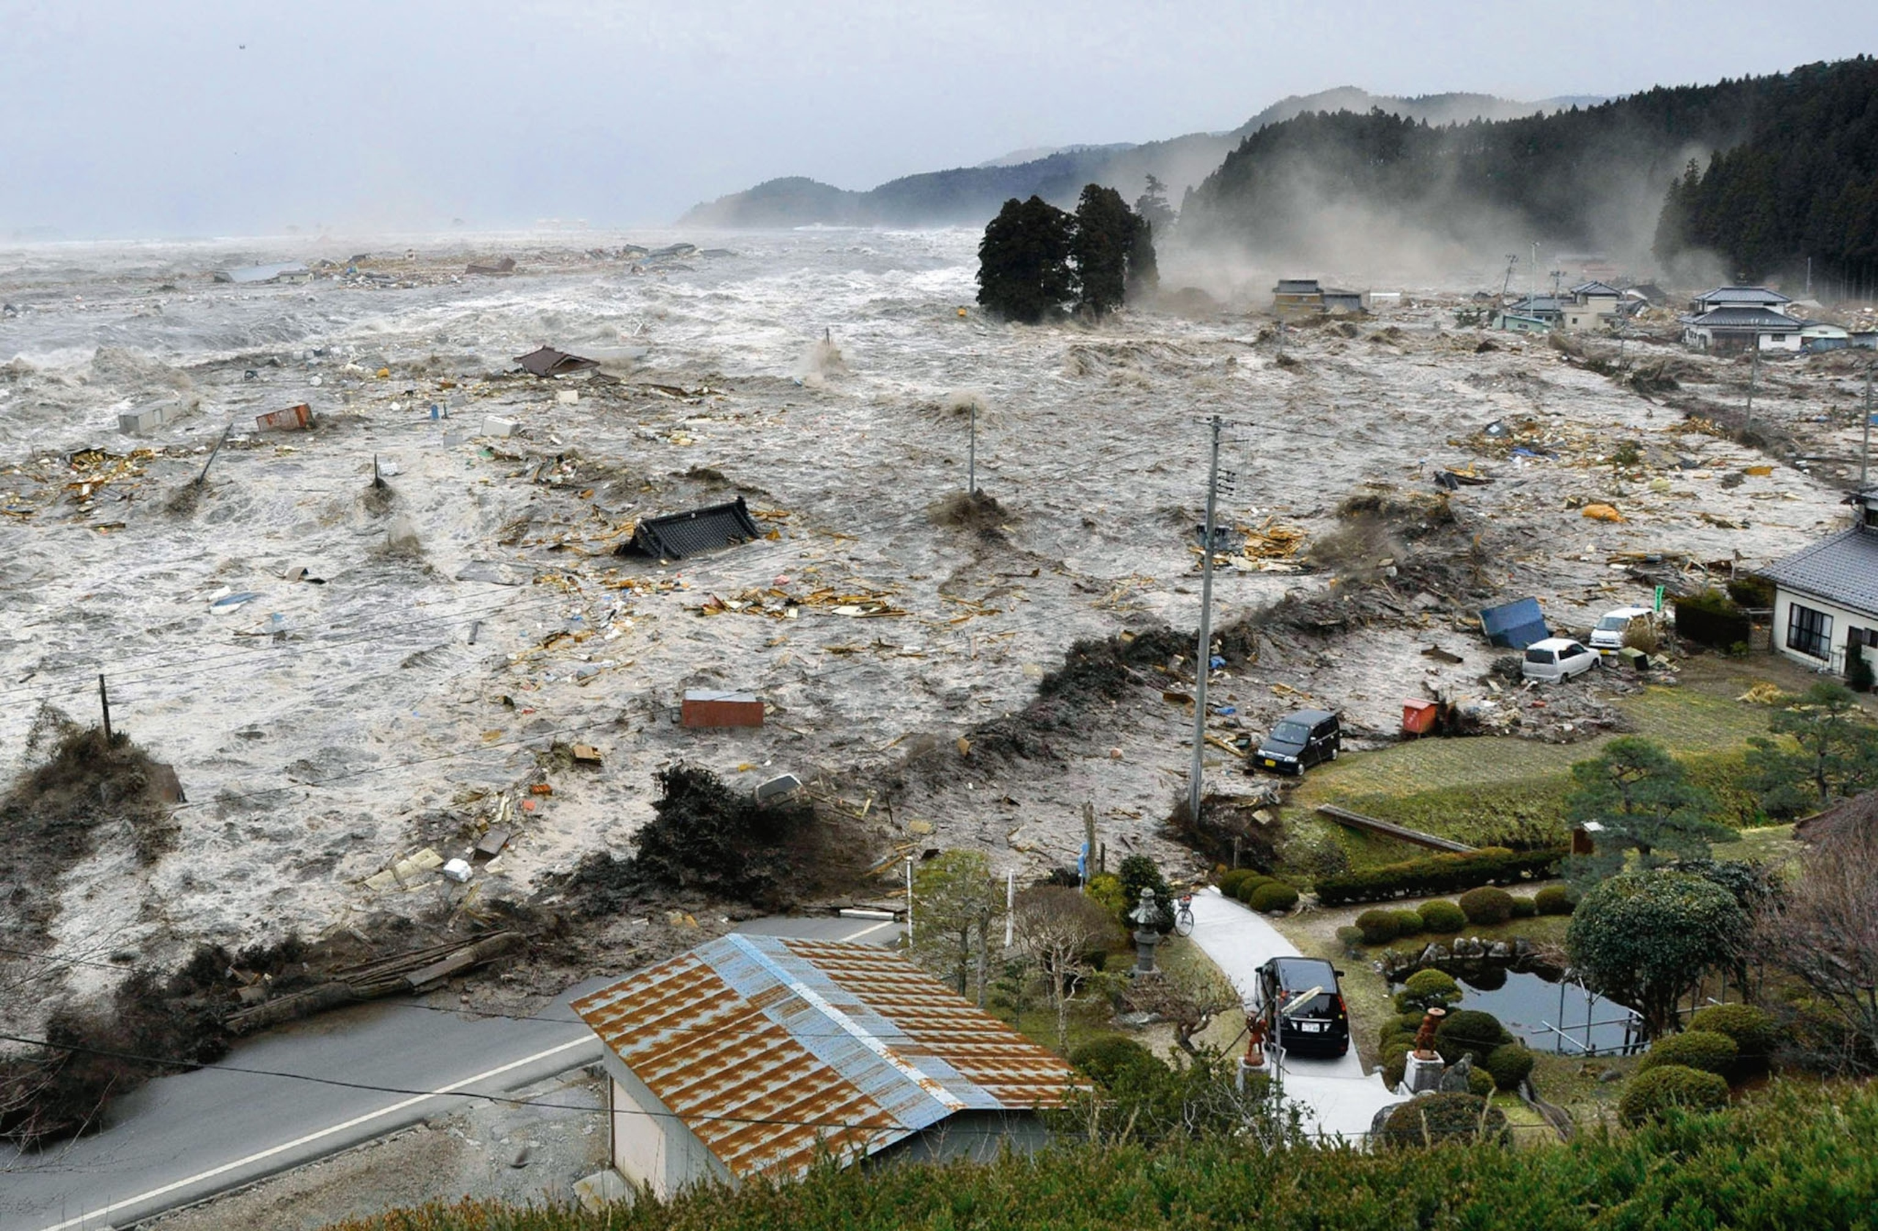
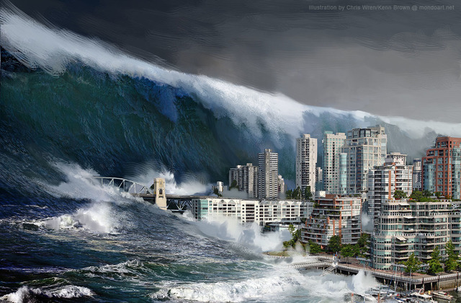
Tsunami
A tsunami is a long, high sea wave or a series of waves caused by a disturbance in the ocean

Slide 7
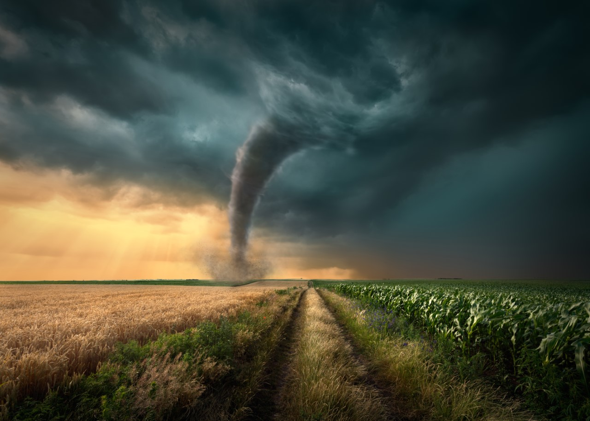
Tornado
Tornadoes are vertical funnels of rapidly spinning air. Their winds may top 250 miles an hour and can clear a pathway a mile wide and 50 miles long. Also known as twisters, tornadoes are born in thunderstorms and are often accompanied by hail.

Slide 8
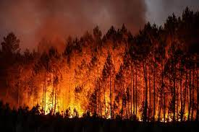
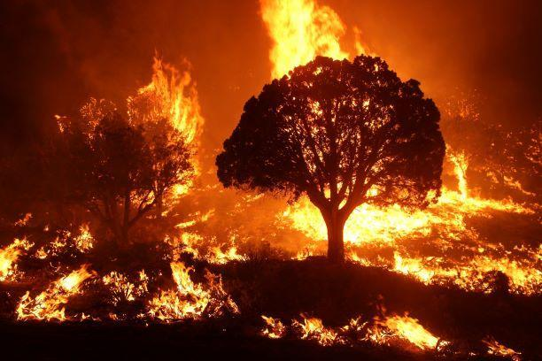
Wildfire
A wildfire is an unplanned fire that burns in a natural area such as a forest, grassland, or prairie. Wildfires are often caused by human activity or a natural phenomenon such as lightning, and they can happen at any time or anywhere.

Slide 9
QUIZ!!!
What are the causes of tsunami??
What is tornado?
What are the types of natural disasters we talked about?
Give an example of natural disaster we didn’t mention

