Slide 1
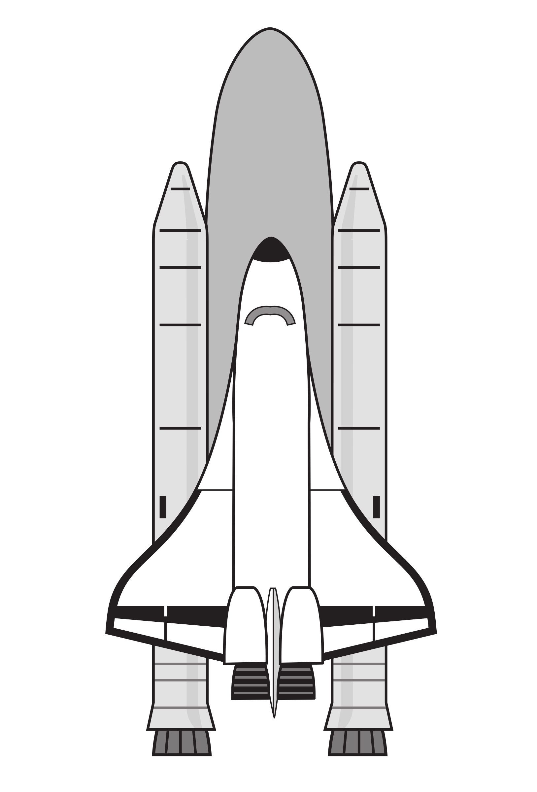
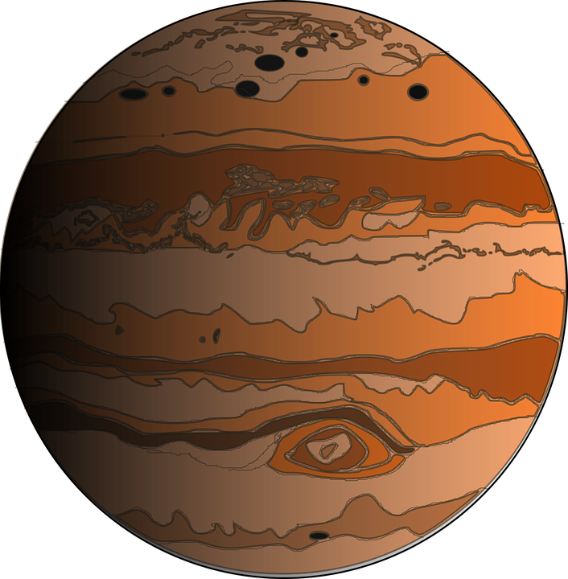
Solar System

Slide 2
Objectives:
Understand what the solar system is.
Identify the inner of the solar system.
Memorize the 8 planets.

Slide 3
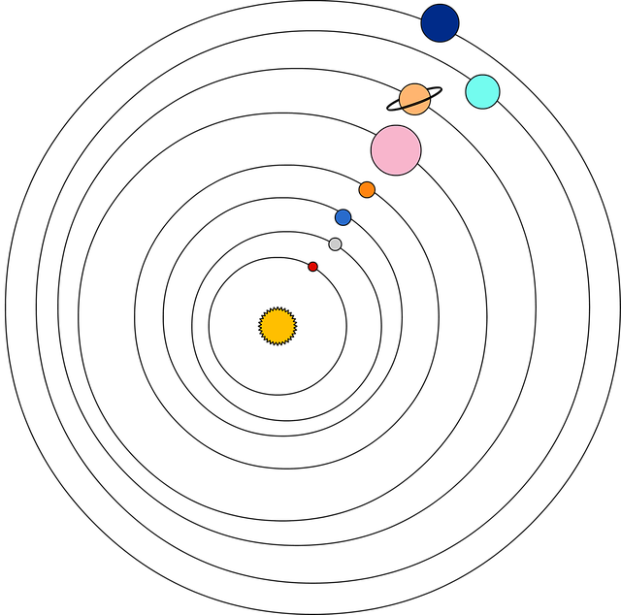
What is the Solar System
It is the gravitationally bound system of the sun and the objects that orbit it. It formed 4.6 billion years ago from the gravitational collapse of a giant interstellar molecular cloud.
https://www.youtube.com/hashtag/drbinocsshow

Slide 4
Sun
The Sun is the Solar System's star and by far its most massive component. Its large mass, which comprises 99.86% of all the mass in the Solar System, produces temperatures and densities in its core high enough to sustain the nuclear fusion of hydrogen into helium. This releases an enormous amount of energy, mostly radiated into space as electromagnet radiation peaking in the visible night.
This Photo by Unknown Author is licensed under CC BY-NC

Slide 5
Inner Solar System
The inner Solar System is the region comprising the terrestrial planets and the asteroid belt.
Inner planets
The four terrestrial or inner planets have dense, rocky compositions, few or no moons, and no ring systems.

Slide 7
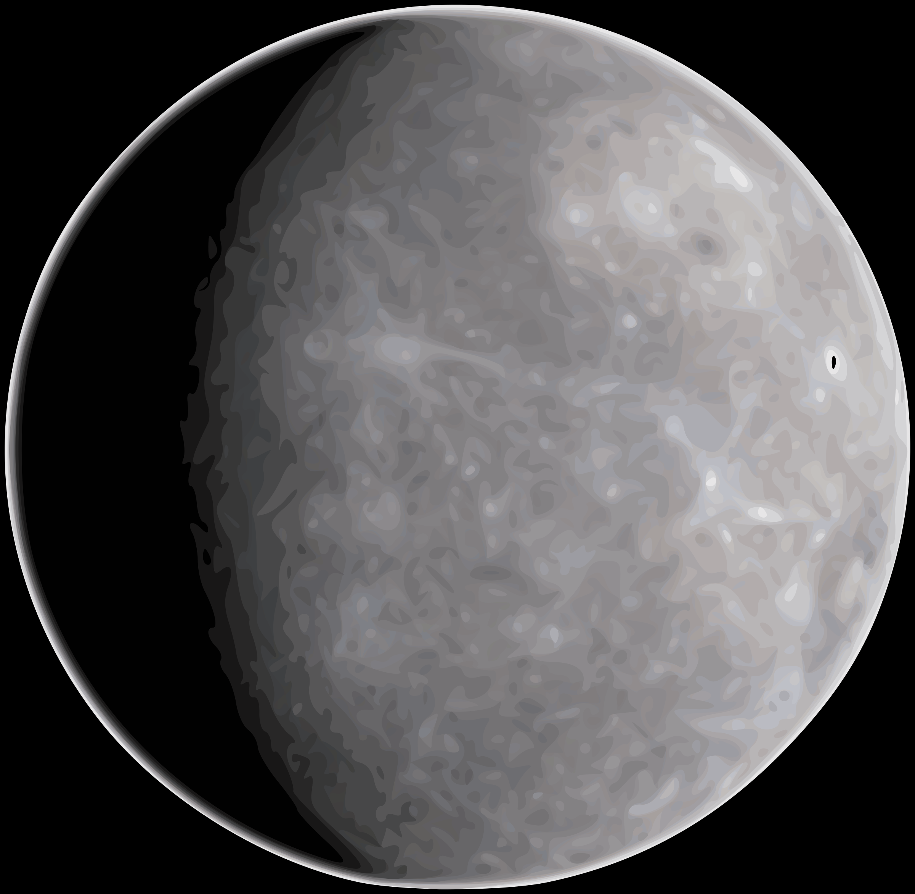
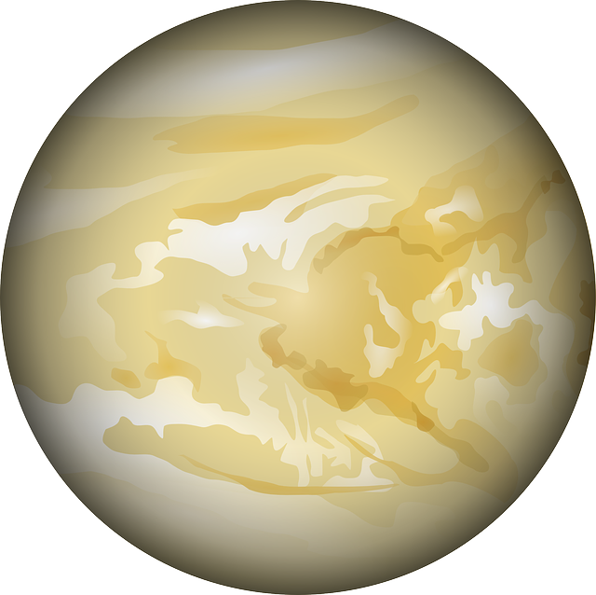
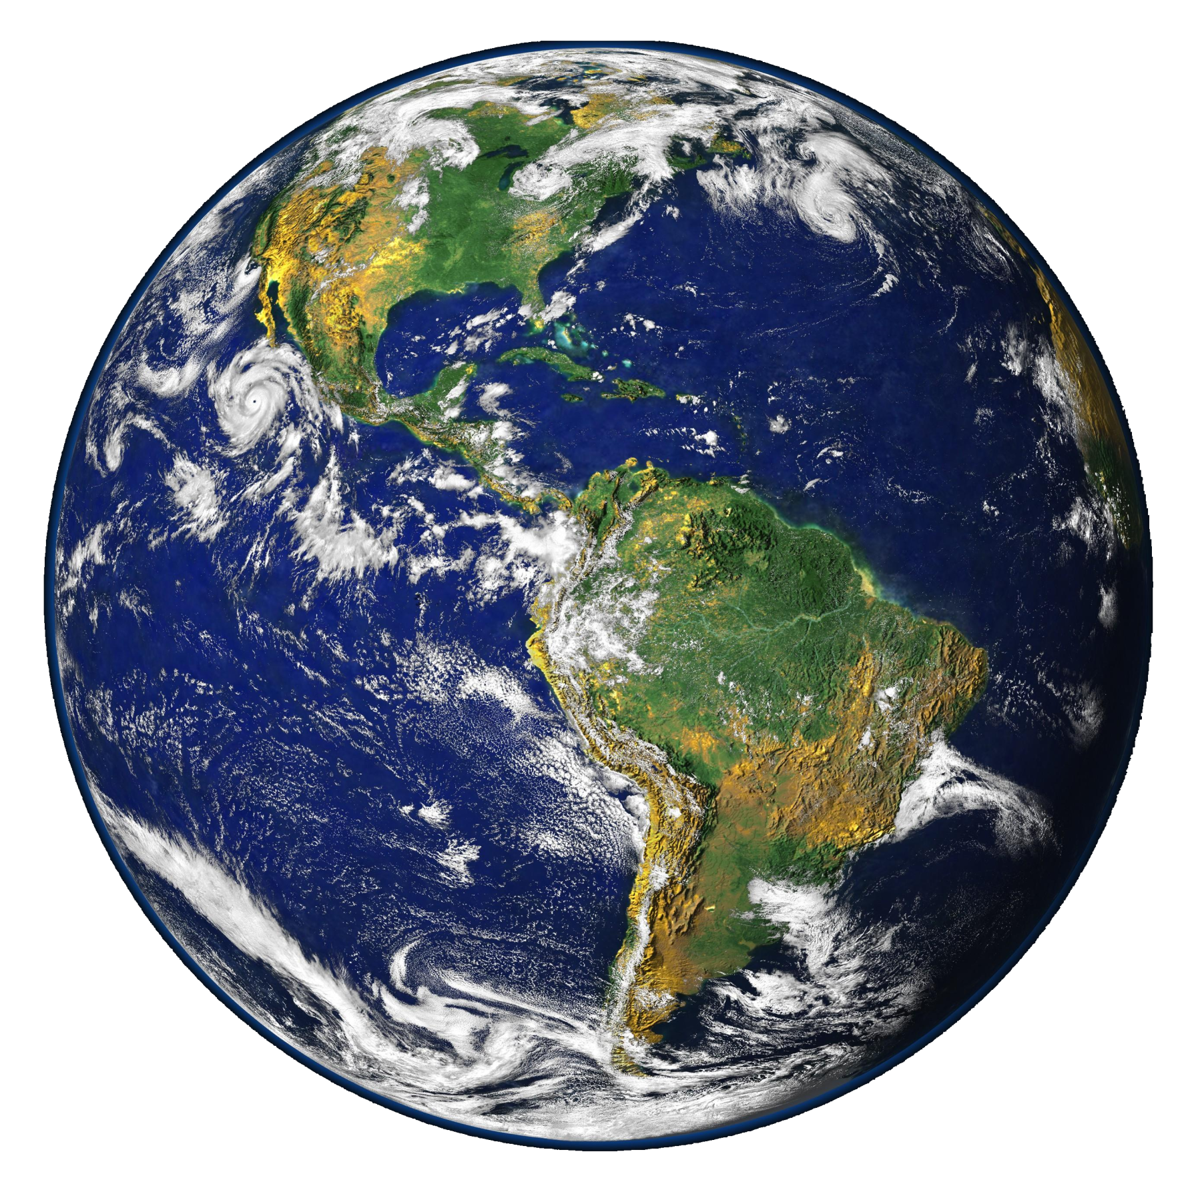
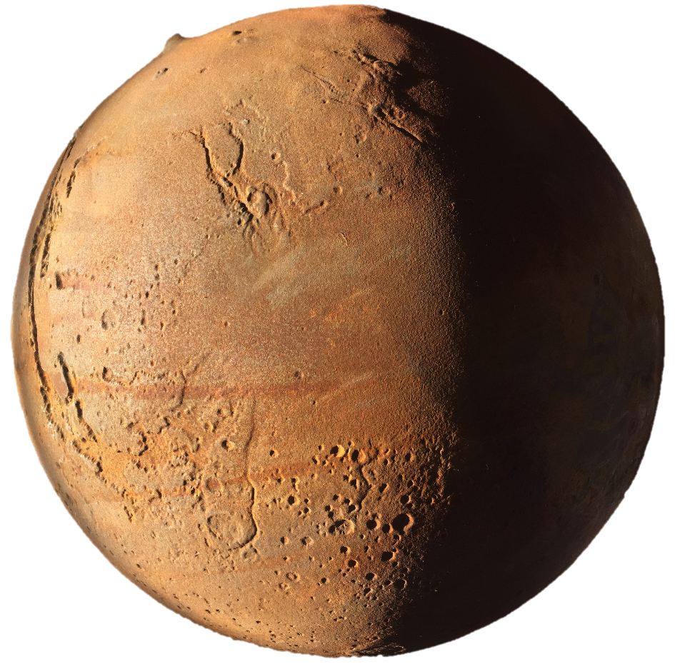
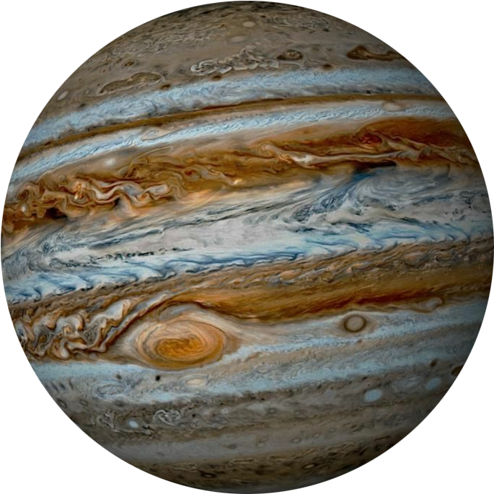
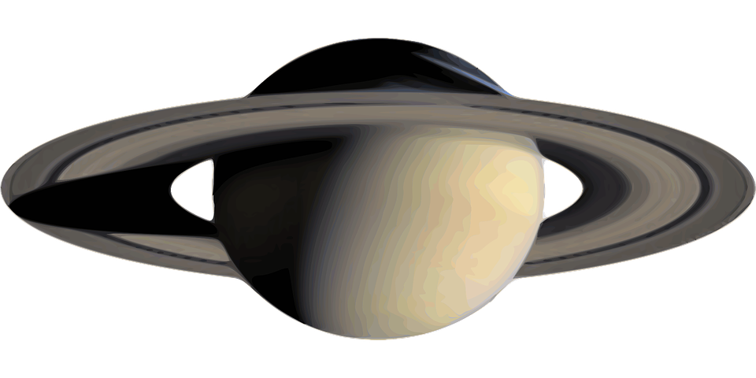
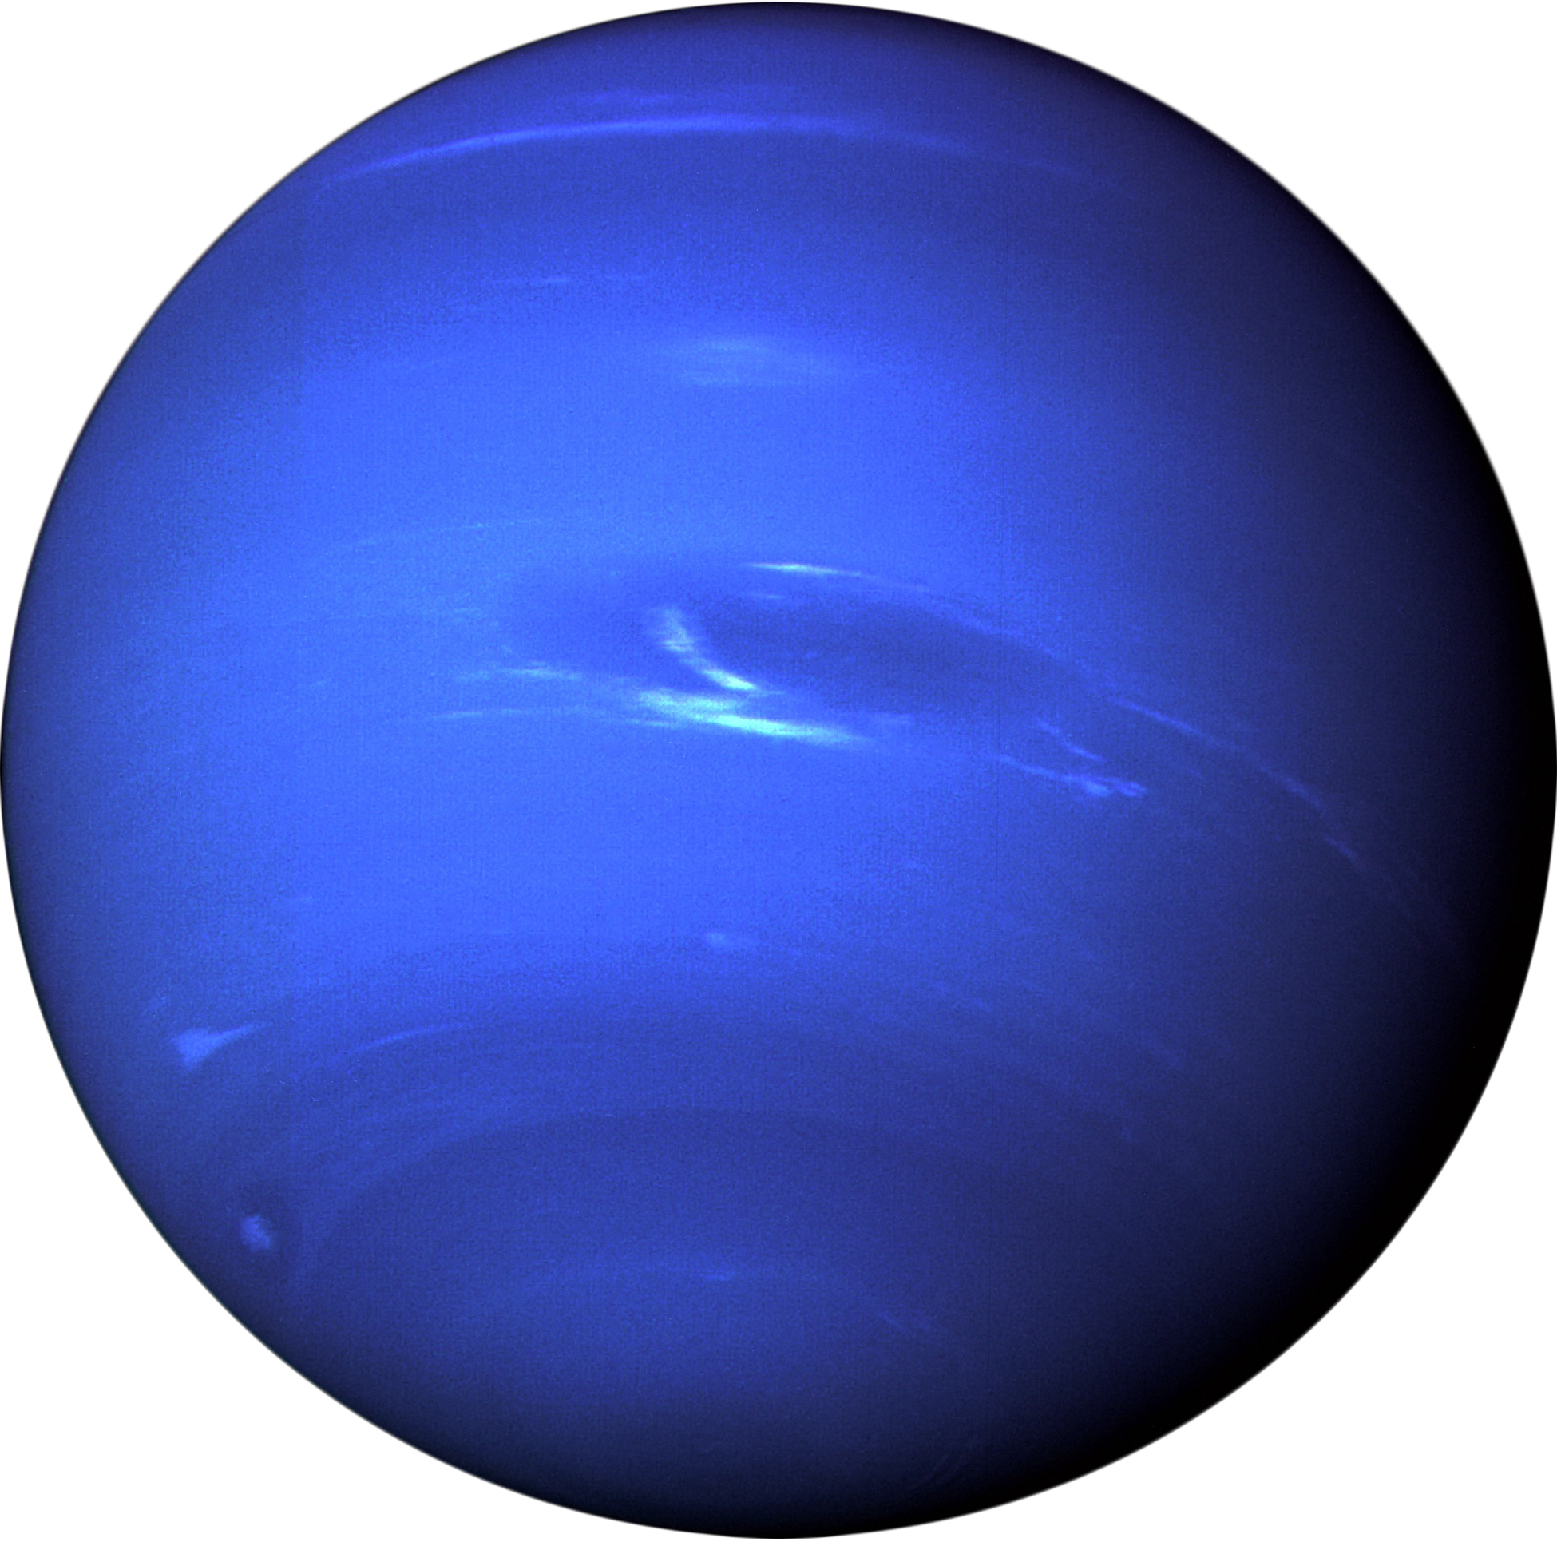
The 8 planets
Mercury
Venus
Earth
Mars
Jupiter
Saturn
Uranus
neptune

Slide 8
Easy quiz
Why is it called the solar system?
How many planets are there in a solar system?
How was the solar system created?

