Slide 1
ALLELES
By: Sarah Zreiqat

Slide 2
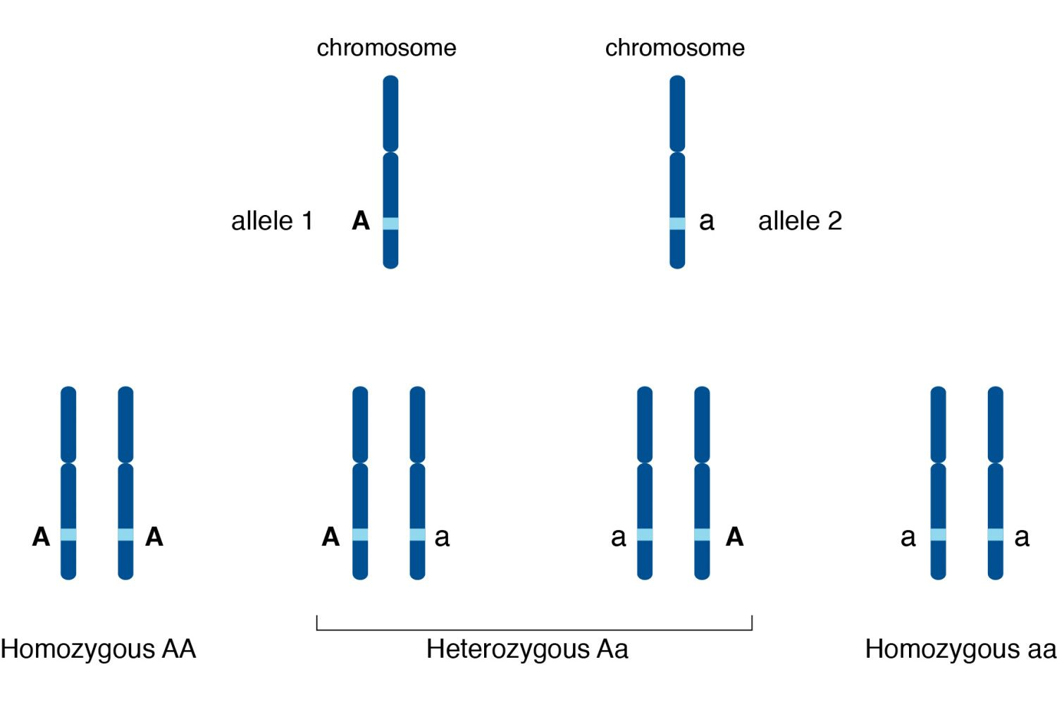
ALLELES
________________________________________________________________
In this PowerPoint we are going to be talking about the biological alleles or alleles, what the are and how can we identify them.

Slide 3
what is the difference between alleles and genes?
________________________________________________________________
Gene is defined as a section of DNA that encodes for a certain trait. An allele is defined as a variant form of a gene.
It determines an organism's genotype.
A genotype is the unique order of genes its can resemble in lower case letters like “bb”, “rr” and it can be represented in upper case letters like “BB” and “RR”.
Depending on if the allele is recessive (weak gene) it is represented in lower case letters but if the allele is dominant (strong gene) it is represented in upper case letters
A phenotype is the gene that shows as a trait or characteristic on an organism for example the color of the eyes.

Slide 4
How does an organism adapt a trait from its parents?
________________________________________________________________
depending if the allele is dominant “BB” it will collect the stronger gene,
But if it has a recessive gene “rr” it will collect the weaker gene there are
Possibilities.
Dominant genes : “BB” or if it has one dominant and one recessive the
Stronger gene will still appear “Bb”
Recessive: if the gene has two recessive genes “rr” the weaker gene will
Appear.

Slide 5
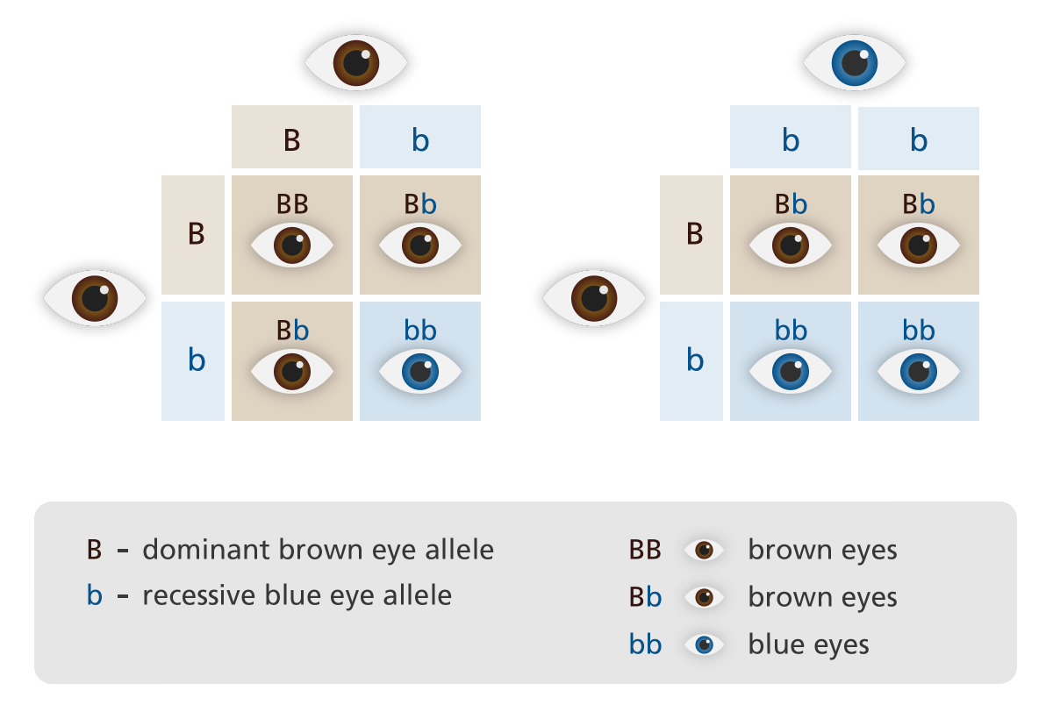

Slide 6
Since blue eyes are a weak gene (recessive gene) it is not common to have them as a trait among people, unlike brown eyes are dominant (strong gene) which means it is very common.

Slide 7
Questions!
Q1. What is the difference between recessive and dominant alleles?
Q2. De-attached earlobes are dominant genes, what is the genotype of a child that has de-attached earlobes?
________________________________________________________________

Slide 8
Questions!
Q1. What is the difference between recessive and dominant alleles?
Q2. De-attached earlobes are dominant genes, what is the genotype of a child that has de-attached earlobes?
________________________________________________________________
Dominant alleles are strong genes (common) while recessive are weak genes (uncommon)

Slide 9
Questions!
Q1. What is the difference between recessive and dominant alleles?
Q2. De-attached earlobes are dominant genes, what is the genotype of a child that has de-attached earlobes?
________________________________________________________________
Dominant alleles are strong genes (common) while recessive are weak genes (uncommon)
"DD" or "Dd"

Slide 10
Resources:
________________________________________________________________
https://worldpopulationreview.com/country-rankings/eye-color-percentage-by-country
https://www.genome.gov/genetics-glossary/
And resources are taken from the biology book

Slide 11
Thank you!

