Slide 1
why some students don’t play sports
By: Sanad/Ghazi/Yazan

Slide 2
Introduction
We did a survey and interviews for the students then we asked them questions, the questions were: what are the causes that the students don’t like to play sports and how can the school solve this issue, then we will collect all the answers and solutions and then send them to the school so that the school will do what their students asked for.

Slide 3
Causes why some students don’t play sports in school
Causes
How to solve the causes
There are no swimming pools and a lot of students prefer to swim
There is not enough equipment so that everyone can enjoy playing sports
Also there are many students who prefer other sports like tennis
Build a swimming pool so that the students can swim in it
buy enough equipment for the students
They need to buy equipment and find the space to build the court

Slide 4
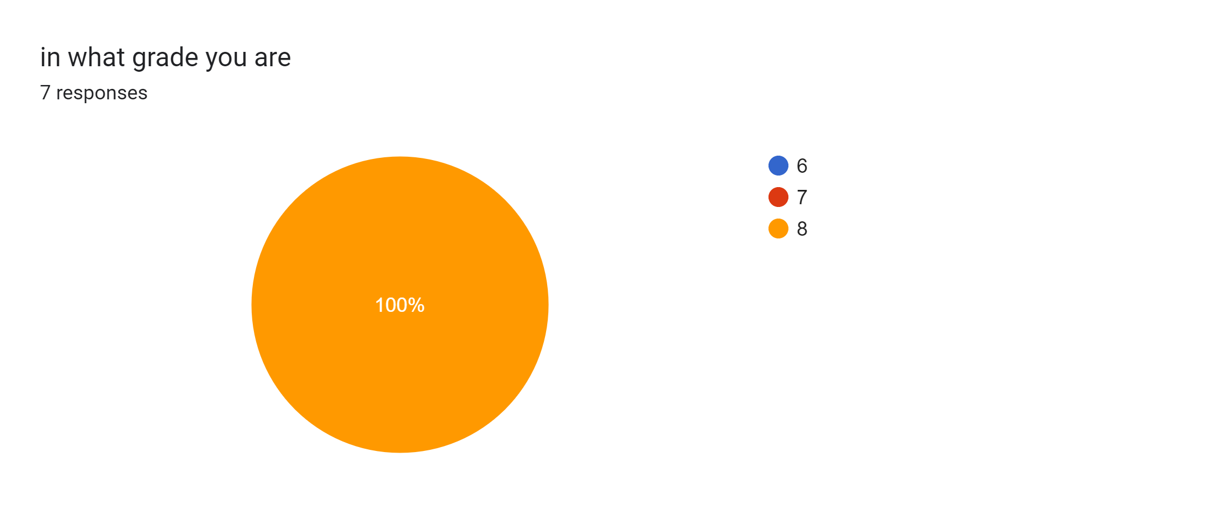
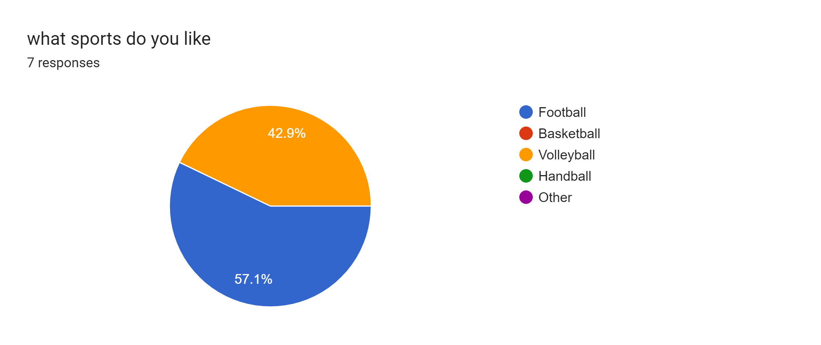
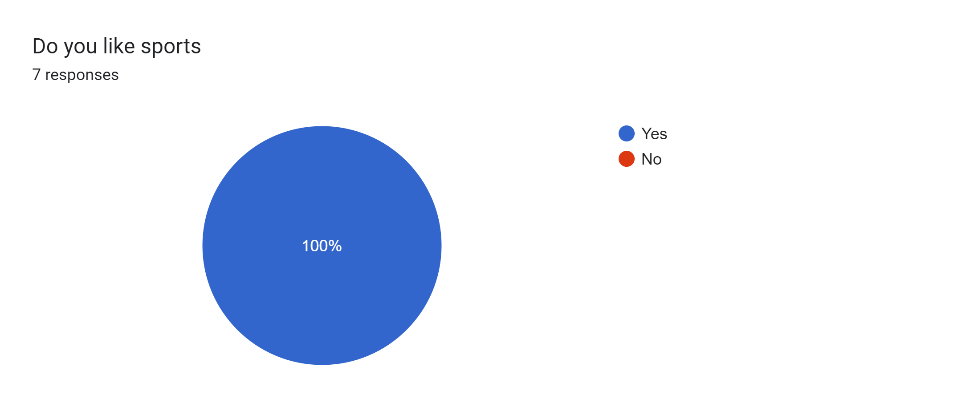
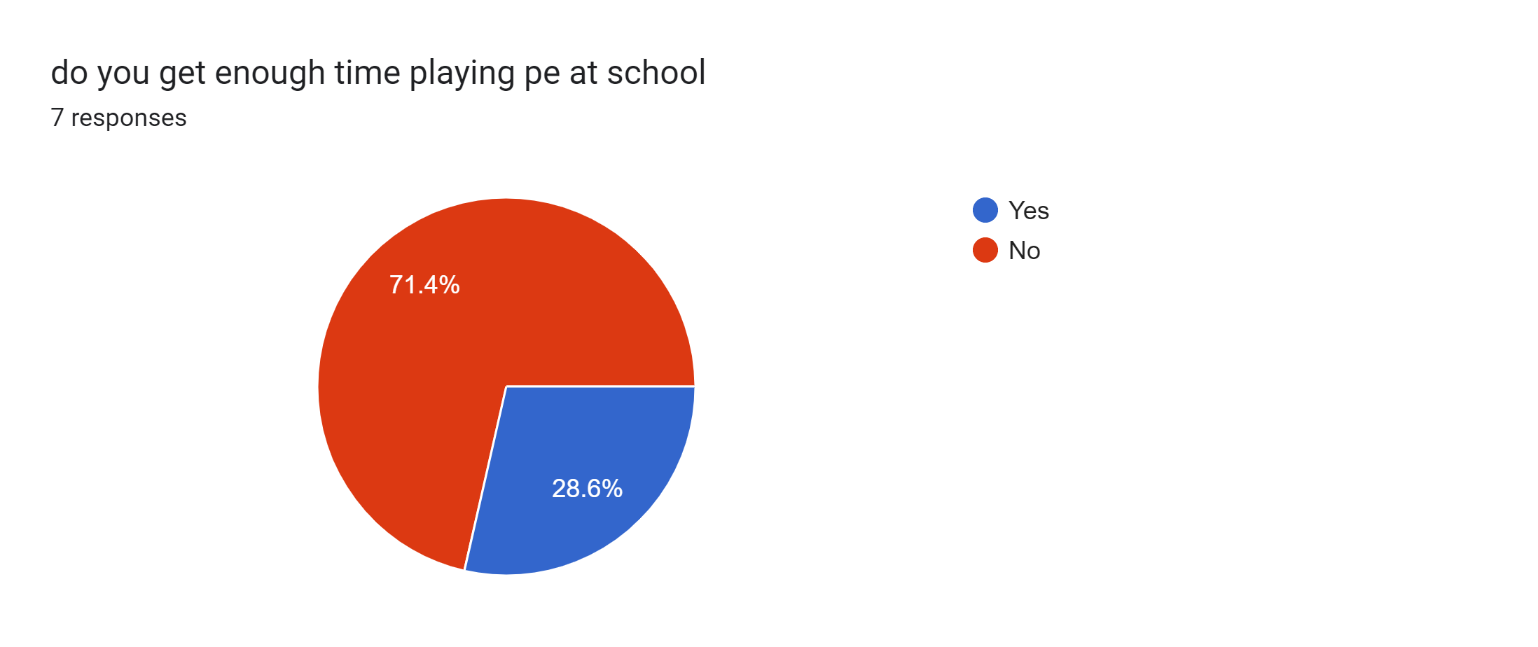

Slide 6
https://docs.google.com/forms/d/e/1FAIpQLSclTHo_p5ZSjPxuYG79AFYElckxKgakJVY2xqyrN4KRCuFX5A/viewform?usp=sf_link

