Slide 1
Making a football field for the National Orthodox School
By George Fakes, and Ziad Qutaishat 8F.

Slide 2
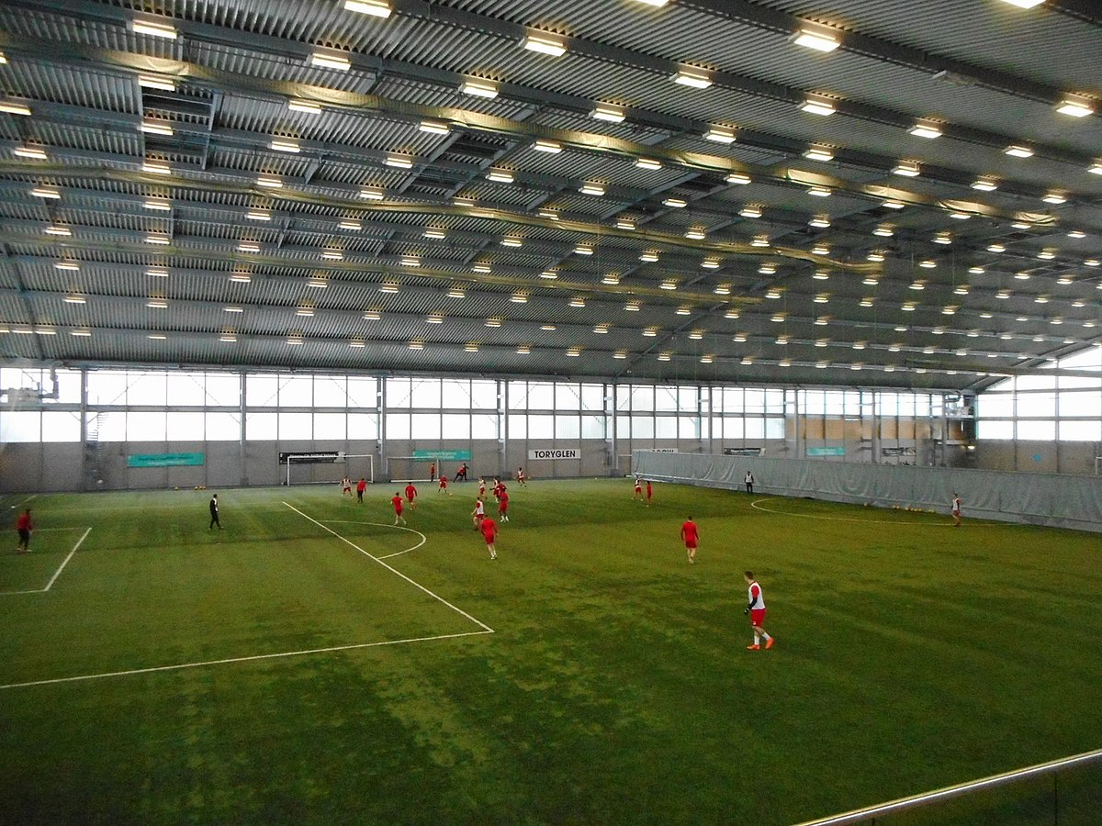
What is our vision?
Our vision is to build an indoor football pitch in the national orthodox school shmeisani. And in our belief doing so contributes more positive than negative qualities to the school.
like this one ->

Slide 3
What made us want to speak about this?
Usually around the end of the first semester, and the beginning of the second semester, the weather doesn’t allow us to play outdoor sports we love (such as football). And being the most well known and loved sport, it would be best if we built an indoor football pitch.

Slide 4
Advantages of building an indoor football field:
Football would be more accessible during harsh weather conditions (i.e. rain, hail, extreme heat/sunlight).
P.E lessons would be more immersive and contained, due to the simple and stress-free atmosphere.
It can be rented after school hours or used in tournaments.

Slide 5
Disadvantages of building an indoor football field:
It’s not cheap to build.
If we were to make this, we would make it in the 6-12 courtyard. And if we were to build it, we would need more space (causing us to tear down previous school sites [i.e the indoor basketball court, or the green football pitch])

Slide 6
How can we achieve this?
If we were to think, making a football pitch isn’t too cheap and easy to build.
Which is why the only way we can build this is if we make a sort of donation page to raise enough money to fund our project.

Slide 7
Who would benefit from the extra football pitch?
The school’s little league.
The school’s football team.
Students during P.E classes.
People who are willing to rent a field after school hours.

Slide 8
All students that have done the survey would like an indoor football pitch (as of now)

Slide 9
As of now: 78% of students have a slight feeling that there could be a possibility/probability to build a separate football pitch

Slide 10
Overall,
We think it’s a great idea (which isn’t impossible to accomplish) and there seems to be more positive than negative attributes, and we hope to see this idea happen in front of our own two eyes.

Slide 11
Thank you for your time. ☺

Slide 12
Links:
https://docs.google.com/forms/d/1K-2Kmh84iSnC7s-C7NOrGitLZgn9tZRGunOSJ-EGrxU/edit#responses

