Slide 1
Lesson: Iron deficiency
SCHOLASTIC YEAR: 2022-2023
GRADE 8 CS
By Gianna Kassabian

Slide 2
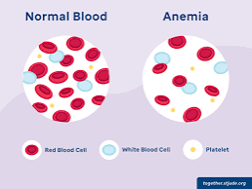
What is iron deficiency?
Iron deficiency (anemia) is a lack of iron in the body that leads to a reduction in the number of red blood cells.
Iron is used to produce red blood cells, which help store and carry oxygen in the blood.

Slide 3
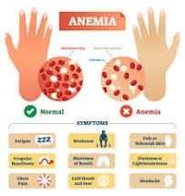
What happens when your iron is low?
Without enough iron, your body can't produce enough hemoglobin, which is a substance in red blood cells that enables them to carry oxygen (hemoglobin).
As a result, iron deficiency anemia may leave you tired and short of breath.

Slide 4
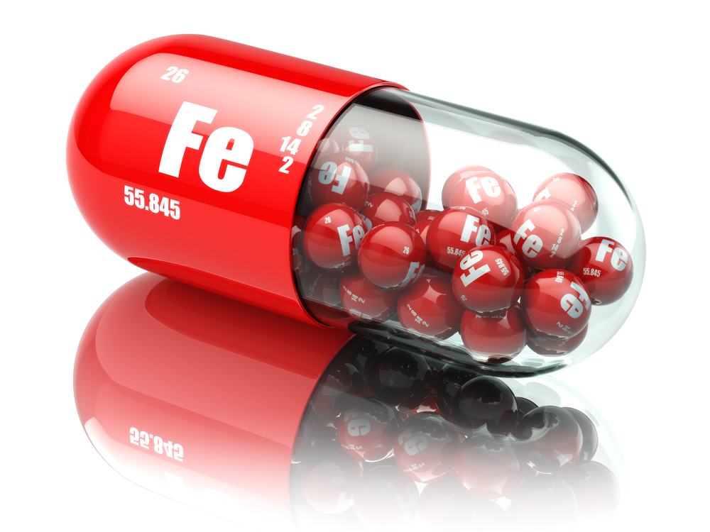
How do you treat iron deficiency?
You can treat iron deficiency (anemia) by taking iron supplements.
Most people take 150 to 200 milligrams each day, but your doctor will recommend a dose based on your iron levels.
Taking vitamin C helps your body absorb the iron.
By adding iron-rich foods to the diet.

Slide 5
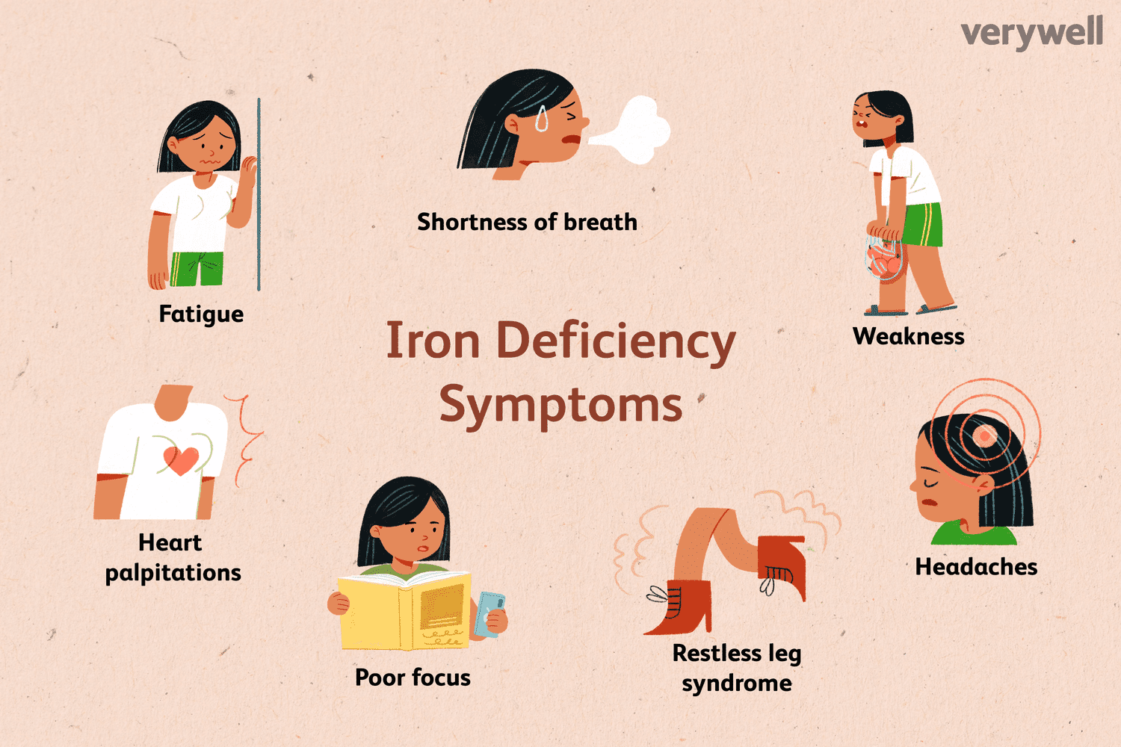
What are the symptoms of having low iron?
Extreme tiredness
Weakness
Pale skin
Headache, dizziness or lightheadedness
Cold hands and feet
Brittle nails
Poor appetite

Slide 6
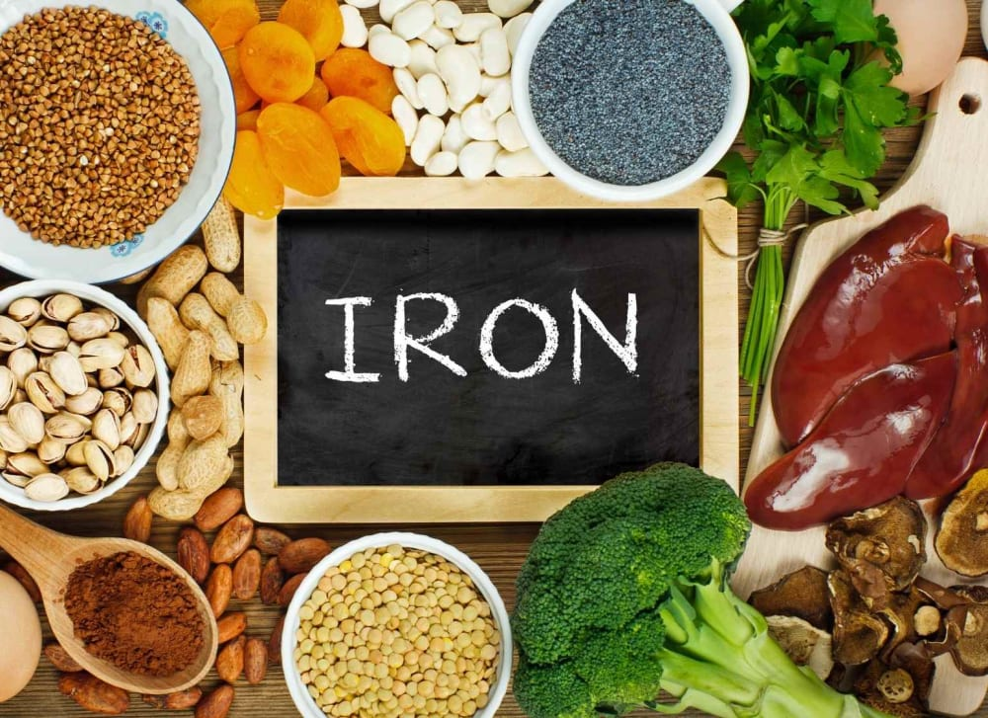
What are some Foods that are high in iron?
Red meats
Seafood
Spinach
Eggs
Dried fruits

Slide 7
Check your understanding:
How can you prevent iron deficiency?
What happens when your iron is low?
Please watch this YouTube video about Anemia: https://youtu.be/6RbuFyt5Wpo

