Slide 1
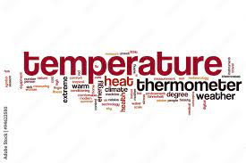
Temperature
By: Rajai, Jaafar and Sanad.

Slide 2
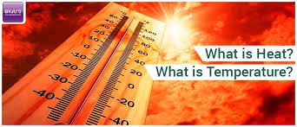
What is Temperature?
The temperature of a thing determines how hot or cold it is. Temperature is what we mean when we talk about something feeling hot or cold.
We can determine how much heat or energy an item contains by measuring its temperature. We feel heat on our hands and faces when a cup of water is boiling because its highly active particles are moving around extremely fast. The energy content of colder things is lower. These particles have far less activity.

Slide 3
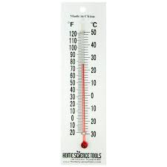
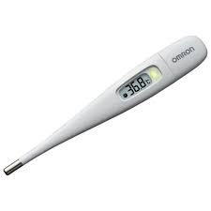
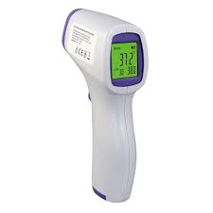
how can temperature be measured and how is it useful?
A thermometer is an instrument that measures temperature. It can measure the temperature of a solid such as food, a liquid such as water, or a gas such as air. The three most common units of measurement for temperature are Celsius, Fahrenheit, and kelvin.
The measurement of body temperature can help detect illness. It can also monitor whether or not treatment is working. A high temperature is a fever.

Slide 4

What is the effect heating the state of matters?
When a solid is heated to a certain point, it melts and becomes liquid. The bonding forces that keep particles in a solid securely in place are defeated when the particles in a solid accumulate enough energy.
The particles usually begin to migrate during melting while sticking close to their nearby neighbors before moving more freely. The specific temperature at which this transformation takes place for pure substances is known as the substance's melting point.

Slide 5
How much Heat does it take to raise the temperature of an object?
It depends on 3 things:
  The mass of the object. The greater the mass the more particles need to be heated.
  What it is made of. The particles in different materials have different masses and act differently to heat.
  The temperature change that you want. For a bigger temperature change you need to get all the particles moving or vibrating even faster.

Slide 6
Questions for students
What is kelvin?
Kelvin is a unit of measurement for temperature.
Continue the sentence:
The temperature of an object determines how____________.
Hot or cold it is

