Slide 1
Electric circuits
Made by: saif fashho and sami abbasi

Slide 2
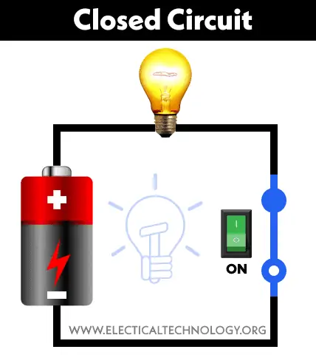
What is a circuit?
A circuit is a complete path around which electricity can flow. It must include a source of electricity, such as a battery. Materials that allow electric current to pass through them easily, called conductors, can be used to link the positive and negative ends of a battery, creating a circuit.

Slide 3
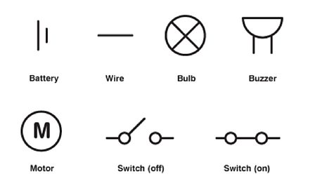
What is a circuit made up of?
A circuit is made up of a wire, a cell ,a battery ,a lamp, a switch, a buzzer and a motor.

Slide 4
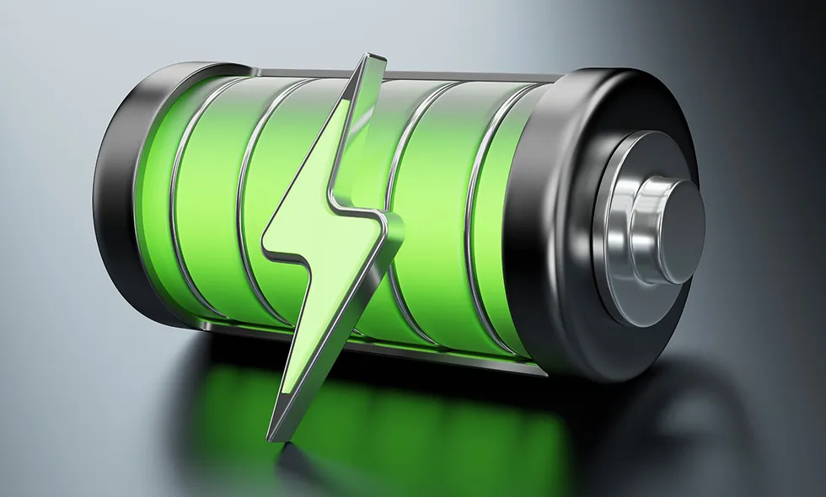
What does a cell contain?
A cell has a positive and a negative terminal. If you connect cells together in a battery it will work but if you connect them to the same sides it will not work.

Slide 5
How can you measure current?
You can measure current using ammeter in amperes (A) smaller currents are measured in milliamps(mA) 1mA is =to 0.001A.
The circuits symbol for ammeter is

Slide 6
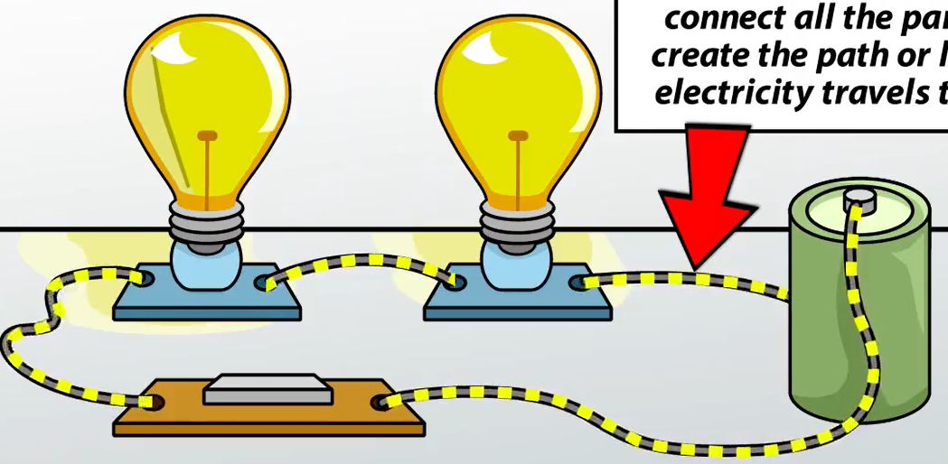
What is a single loop called ?
a circuit with a single loop is called a series circuit.
In a series circuit if one lamp breaks then all lmaps will go out(break).

Slide 7
What is a circuit ?
A circuit is a complete path around which electricity can flow. It must include a source of electricity, such as a battery.
A circuit contains multiple pathways, or branches. Each device in a circuit is on a separate branch. The current flowing through a circuit divides as it reaches each branch.

Slide 8
What does 1mA equals to ?
0.01A 0.001A

Slide 9
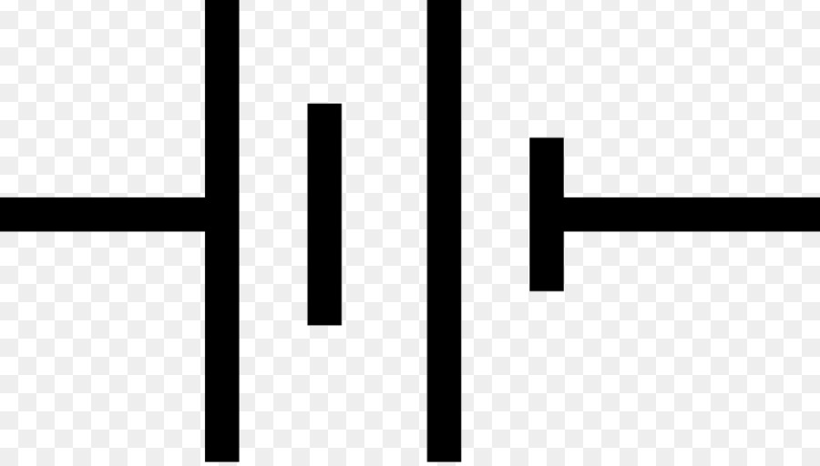
Which one is the symbol for a cell?

Slide 10
3
2
1

Slide 11
1
3
2

Slide 12
This is a circuit simulation
https://phet.colorado.edu/sims/html/circuit-construction-kit-dc-virtual-lab/latest/circuit-construction-kit-dc-virtual-lab_en.html

