Slide 1
PE Classes
Fawzi and Rakan

Slide 2
Introduction
In this PowerPoint we will talk about adding more PE classes in a week.
We think having one PE class is little amount because PE classes will help students in their mental and physical health.
sports is a very crucial point in the student’s academic performance
Do you think having a PE class rather than having a music/ drama. Most people chose to have a PE Classes instead of music/drama

Slide 3
Causes
Exercises are healthy for your body
It helps with people’s mental and physical health
Students don't get enough exercises
Releases stress
Not enough classes of PE
More fun for students

Slide 4
Advantages
Inspires Self-Discipline
Improves peer relationships
Provide stress relive
Teaches goal setting
Helps Students Achieve Better Grades
Makes the students healthier

Slide 5
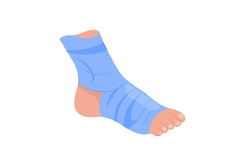
Consequences
Eats into the study time
Students may get injured
There is a potential for bullying
Disable children may be disadvantaged
It will cost the school lots of money to maintain

Slide 6
How will we make this happen
We will add more PE teachers
Build a second football field
We will fix the ground of the indoor basket ballcourt
This will be very expensive but it will benefit our students a lot.
We could make fundraisers to get money that we will use to make
this happen

Slide 7
Everyone voted that we should add more classes and 2 was the most voted option.

Slide 8
80% of people voted to get the choice between music/drama and PE.

Slide 9
