Slide 1
Simulation
Created by: Maya Wardat, Katia Haddad, and Cynthia Nino

Slide 2
What is simulation?
A simulation is a model that mimics the operation of an existing or proposed system, providing evidence for decision-making by being able to test different scenarios or process changes.

Slide 3
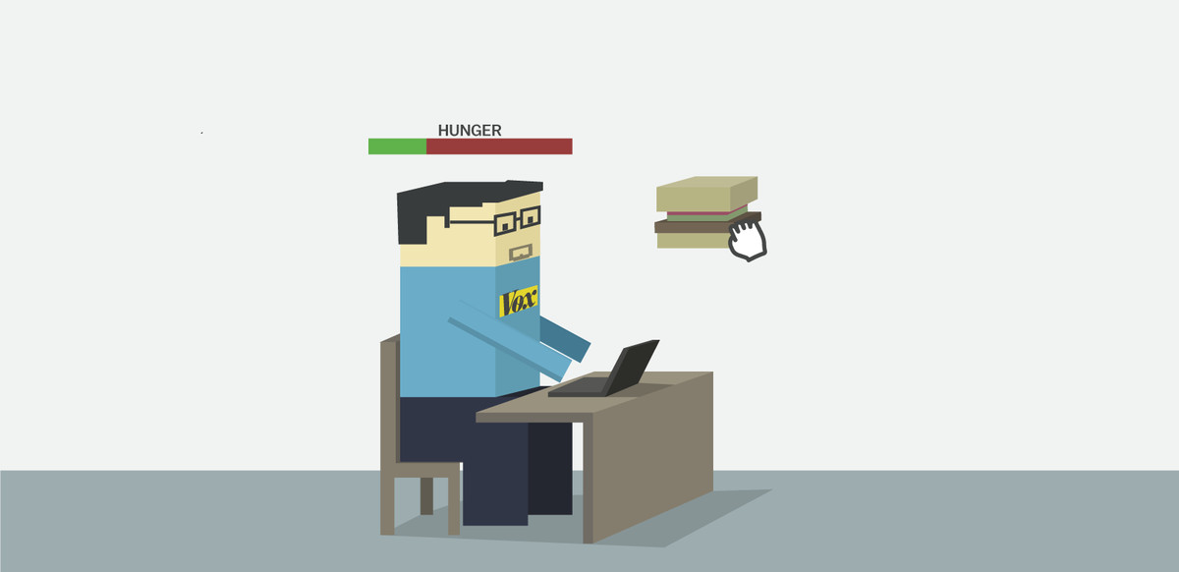
Why is simulation used?
Simulation is used to evaluate the effect of process changes, new procedures, and capital investment in equipment. Engineers can use simulation to assess the performance of an existing system or predict the performance of a planned system, comparing alternative solutions and designs.

Slide 4
Advantages of simulation:
Simulation allows you to explore 'what if' questions and scenarios without having to experiment on the system itself. It helps you to identify bottlenecks in material, information and product flows. It helps you to gain insight into which variables are most important to system performance.

Slide 5
Disadvantage of simulation
The main disadvantage of simulations is that they aren't the real thing. People may react differently when faced with situations in the real world. For example, they are more likely to panic if there is a real danger. With the increase of virtual worlds, people are becoming more familiar with simulation.

Slide 6
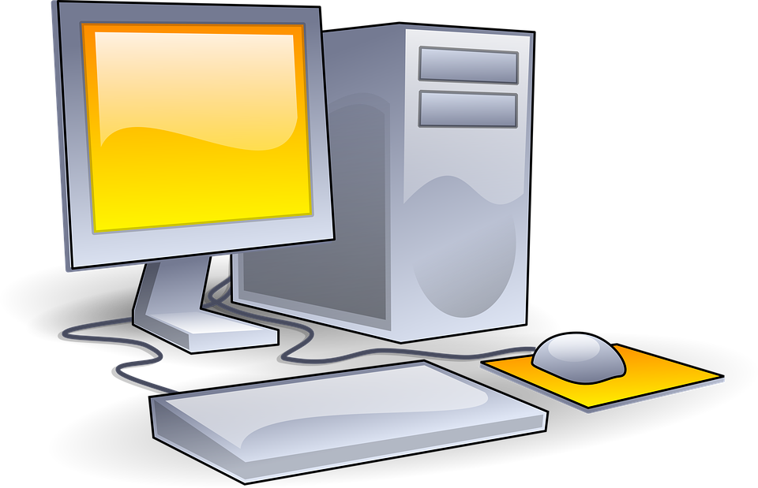
Types of simulations
1. Monte Carlo / Risk Analysis Simulation
2. Agent-Based Modeling & Simulation
3. Discrete Event Simulation
4. System Dynamics Simulation Solutions

Slide 7
THANK YOU

