Slide 1
Making football field bigger
Done by: Saif Jumaian, Jad Gammoh

Slide 2
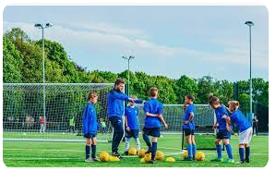
Many people enjoy playing football during physical education class, but occasionally there isn't enough space for everyone to play because it is too small, so Making the football field bigger could help the school in many ways, benefiting everyone and a lot of other things that we will be discussing in the following slides. saif
introduction

Slide 3
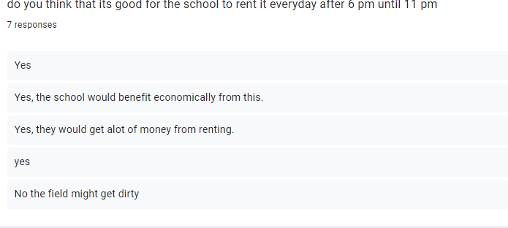
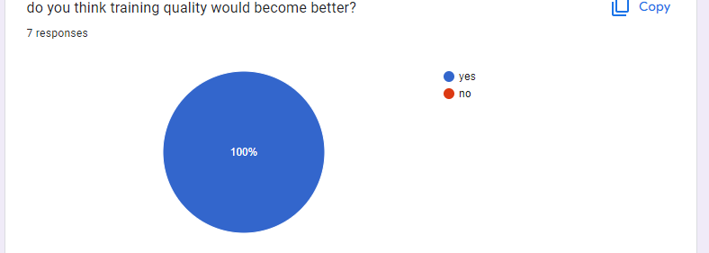
we made a survey asking boys about how this would help the school and most of the results were people saying this would help the school economically in many ways such as making the money back by renting it from 6 until 11 pm. jad A lot of people also said that this would improve training because if we make the field bigger it could lead to bigger chances of making the football team bigger and also hosting school tournaments in the field jad
Peoples opinions on the project

Slide 4
The school can make profit in many ways to make the money from the cost of expanding in ways such as renting it out(previously mentioned)and also previously mentioned making tournaments and making an entry ticket with the price being about 3 jds per person and the profit from this could go to developing the school or making another field for 1-5th graders saif
How the school could profit from this

Slide 5
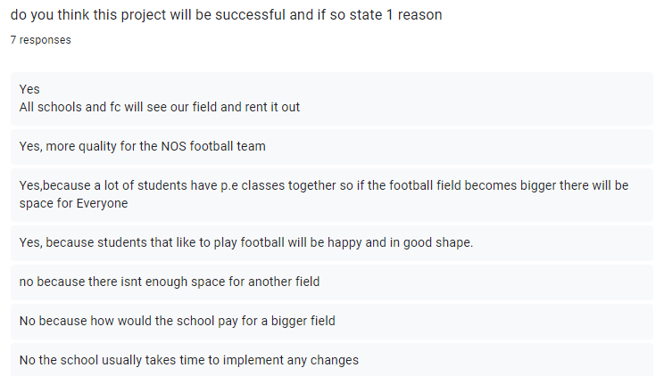
Advantages:
More people can play in pe
Can be rented out
Could be profitable in the long run
Better training
jad
Disadvantages:
Renting it out could make it dirtier
May not be able to be expanded
May not be profitable
saif

