Slide 1
Adding swimming pools to NOS
By: Jana Haddad, Mario

Slide 2
Introduction
Stay chill and take a swim
We concluded from our extensive research that the majority of pupils would favor having a swimming pool and an after-school training club. We are here to make sure that after hearing about this idea to build a swimming pool to aid in student entertainment and boost their hobbies, after seeing the pool and safety you will 100% be convinced. We will provide life guards any many other help to assure everyone will swim without any risks.

Slide 3
Advantages and Importance of swimming
Boost your cardiovascular system.
Take care of your health.
Strengthen your muscles.
High health impact, low body impact.
Increase your flexibility.
Boost your mood and relieve stress.
Get a better night's sleep.
Work out without being out of pocket.

Slide 4
Disadvantages of swimming
Not everyone knows how to swim
Not 100% sanitary
Could be dangerous
People with special diseases could drown, get injured.
Injuries could happen to students

Slide 5
Ways of over comming any disadvantages
We will provide lessons and floaties
We will add chlorine every 2 days to assure the pool is as sanitary it could get without causing skin irration because of too much chlorine.
We will hire a life guard to assure no one gets hurt.
People with special diseases can take 5 minuets or longer to rest to assure all students swim without any risks.

Slide 6
How much it will cost
The cost will between $40,000 and $200,000 to build an indoor pool and if u want to hire someone to clean it every month it will cost 90-170$ a month
we will raise money in bake sales ,fundraiser, and after school activities

Slide 7
location
We think that the best location for the pool would be under the basket ball arena and it would be better and it will be indoor so its suitable for all weathers and everyone would be comfortable swimming there

Slide 8
Here are the results for the servey

Slide 9
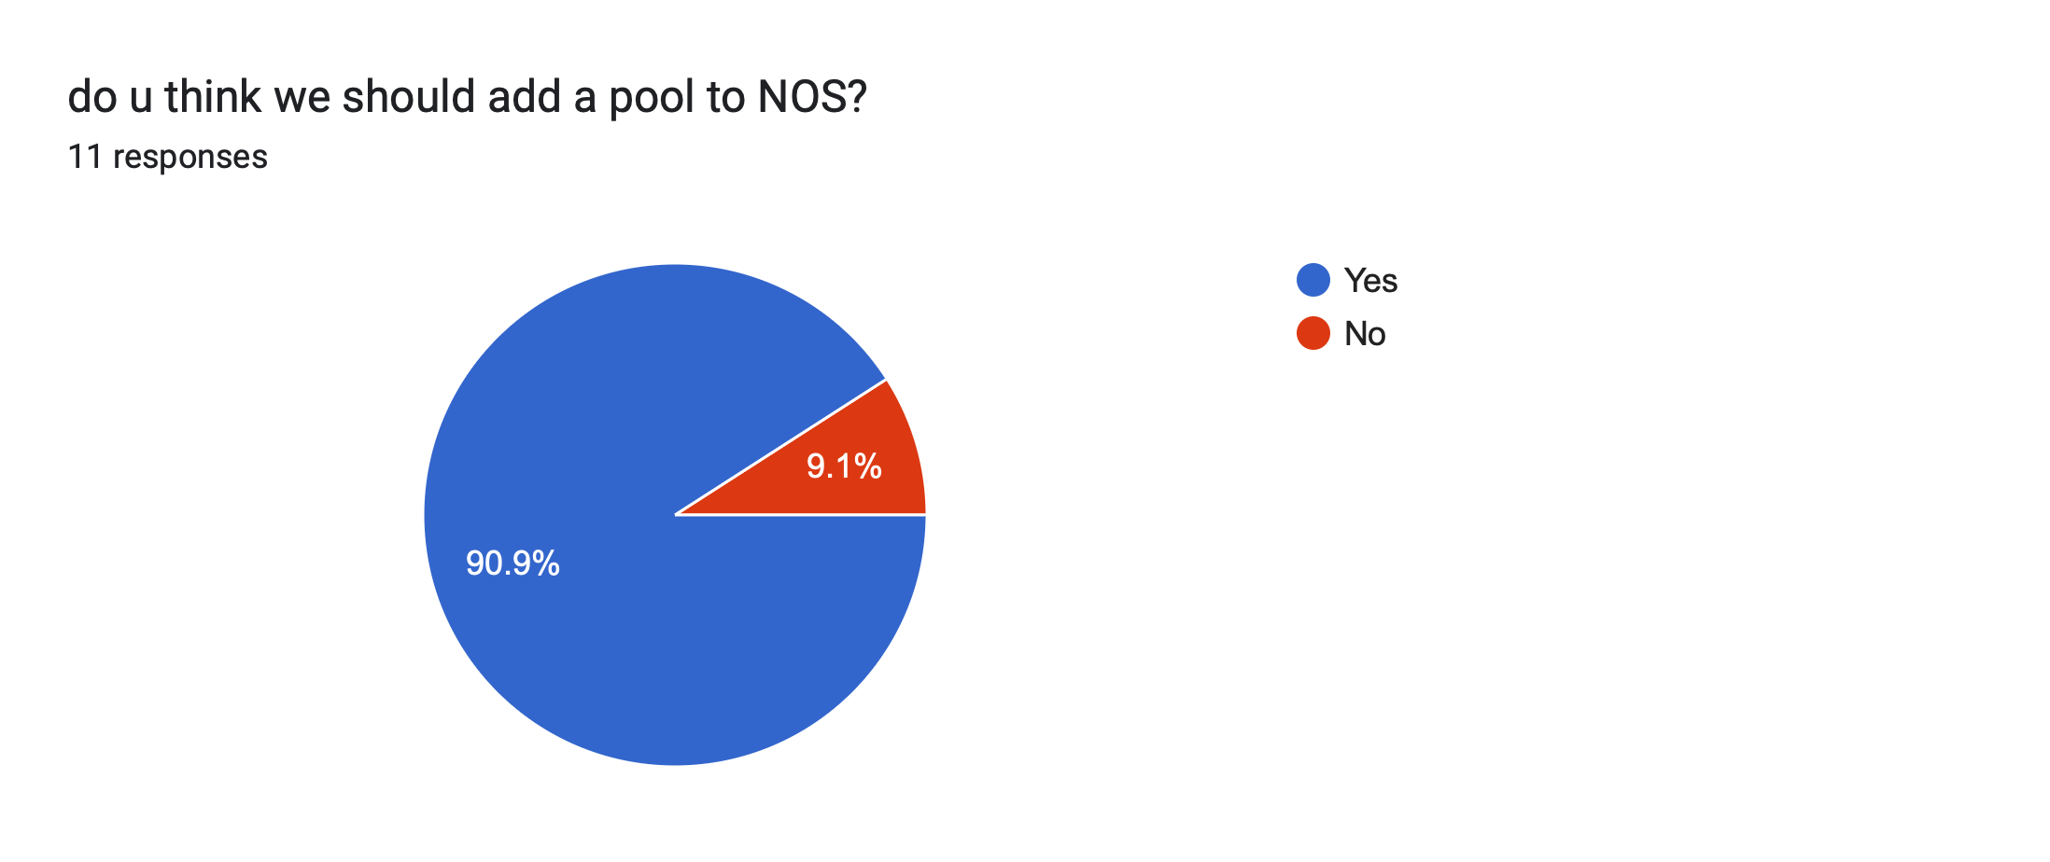

Slide 10
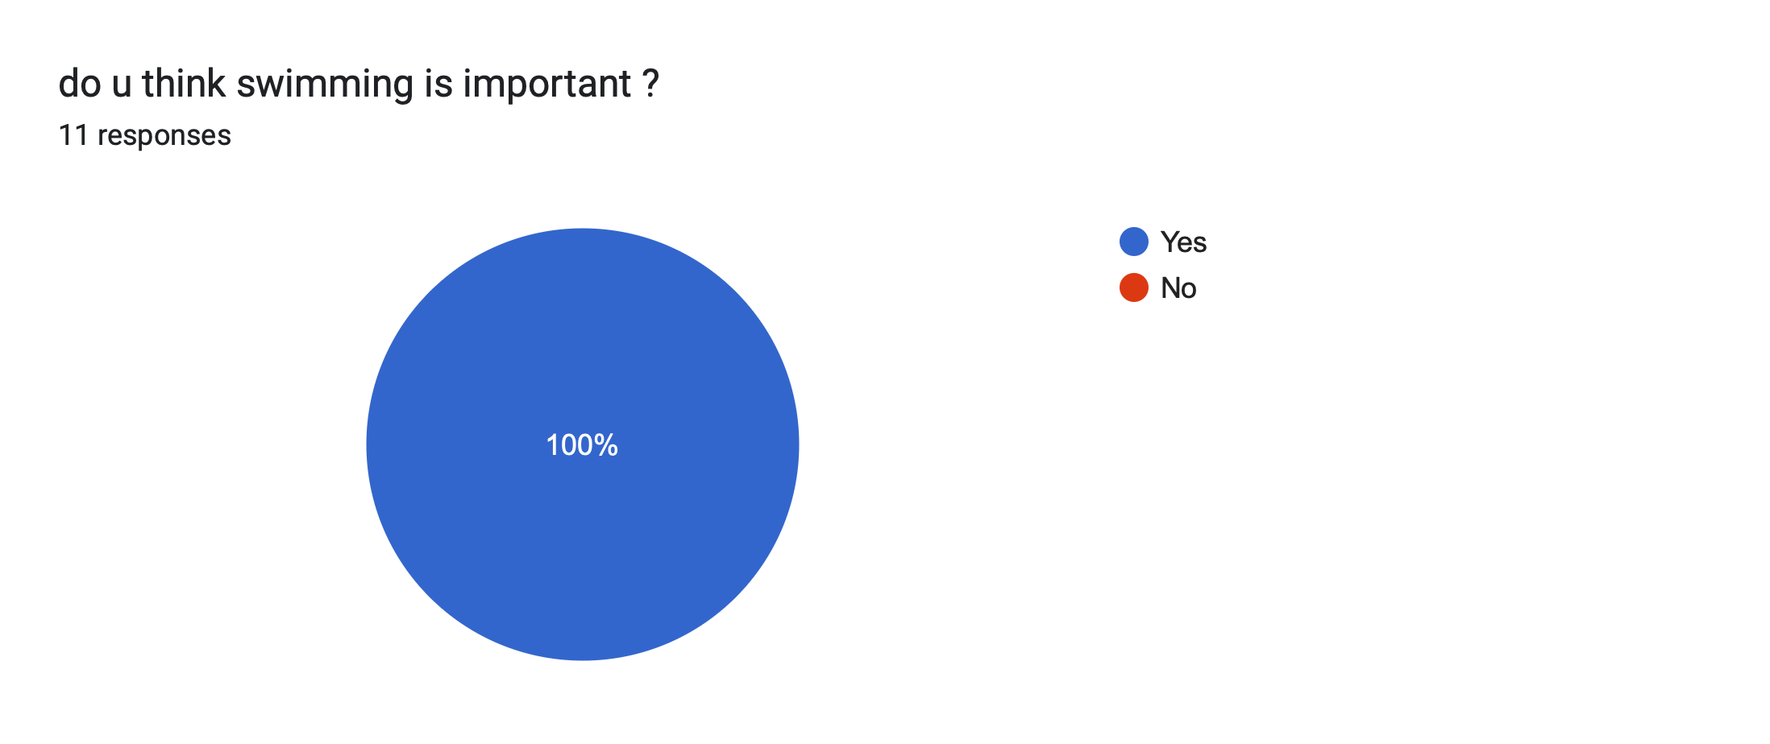

Slide 11
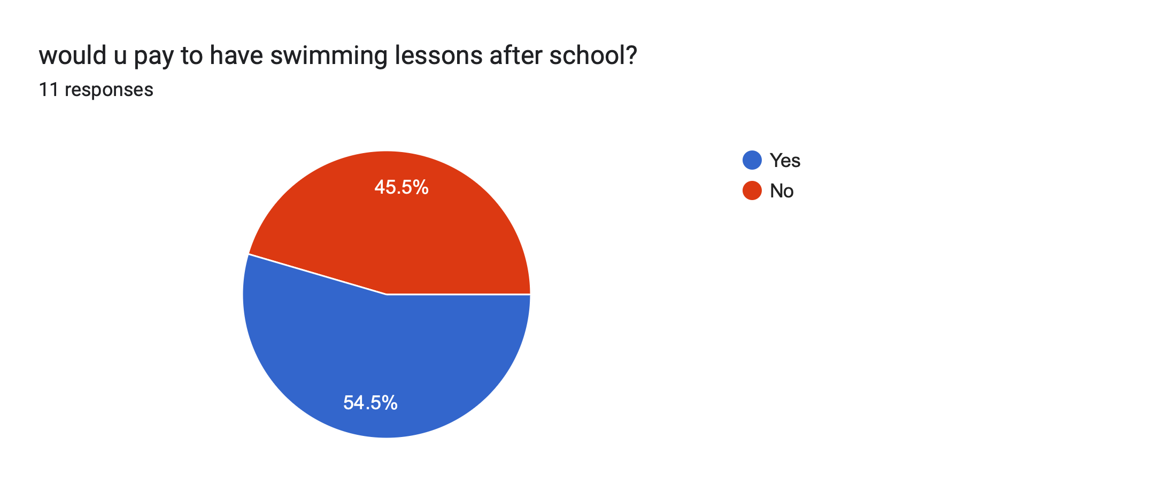

Slide 12
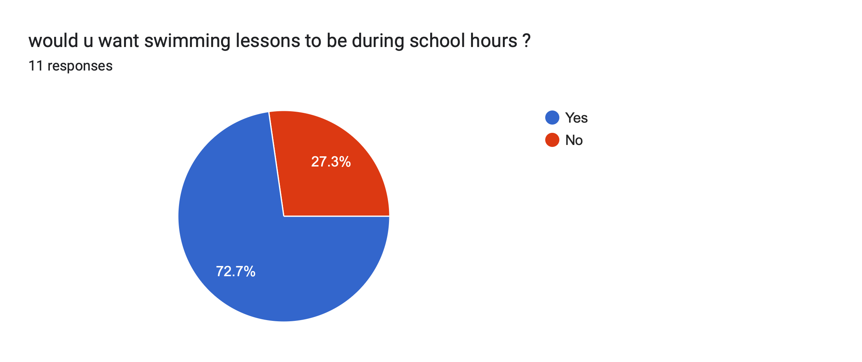

Slide 14
Conclusion
After all this information I think it is really important to add a pool in national orthodox school, the pool will be for all ages ,it will be used during school hours and after school hours to train the students, improove their health, Strengthen your muscles , and many more .

Slide 15
Resources
https://www.healthline.com/health/benefits-of-swimming
https://www.sportsver.com/15-disadvantages-and-risks-of-swimming-stay-informed/
https://www.forbes.com/home-improvement/pool/inground-pool-cost/
https://www.sportsver.com/15-disadvantages-and-risks-of-swimming-stay-informed/

Slide 16
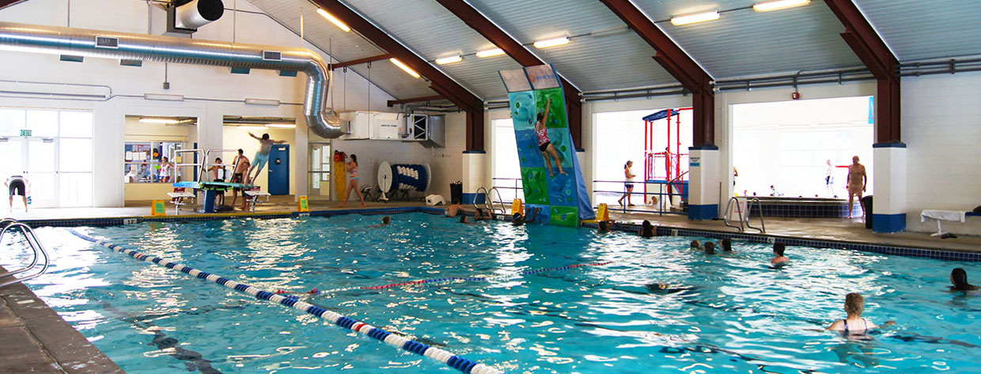
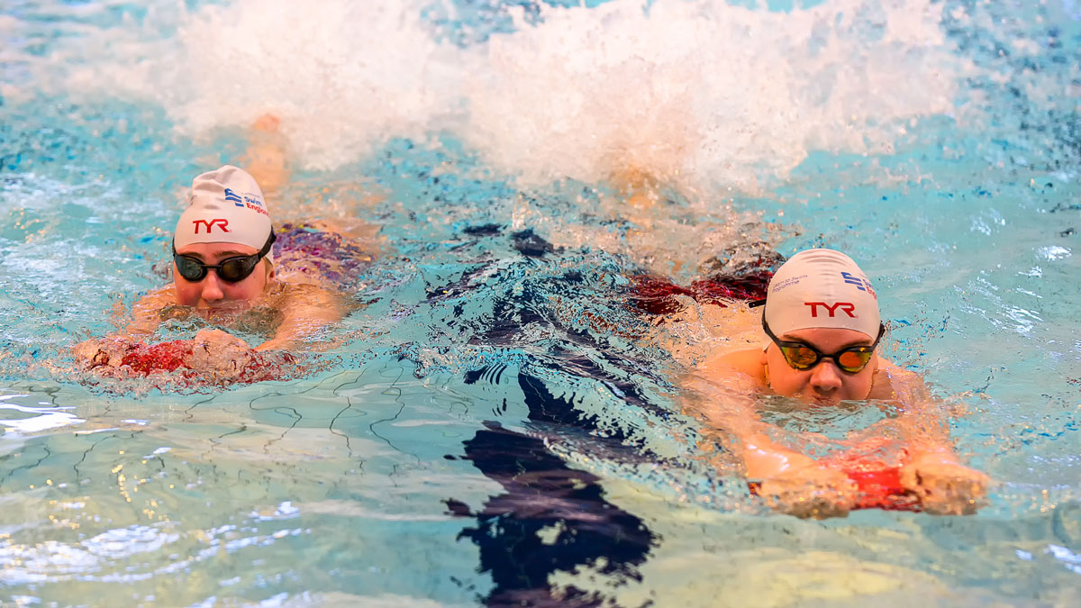
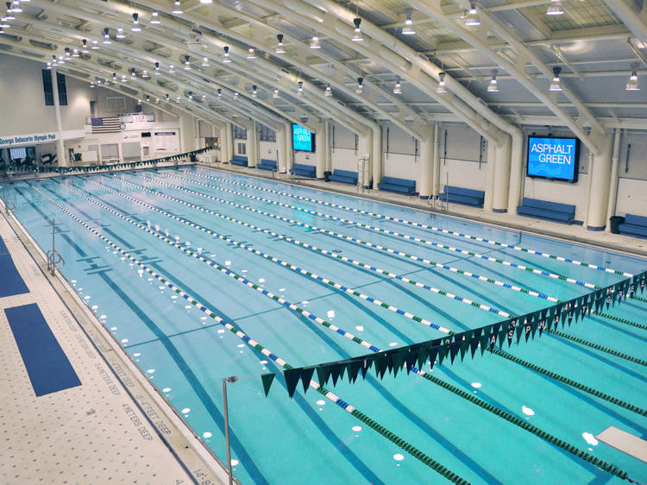
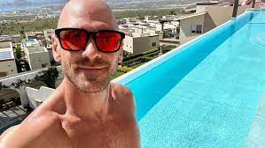
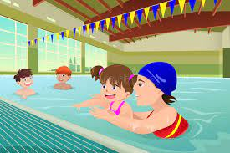
Thank you for listening

