Slide 1
Sports for all
By: maria, NATALIE , LEEN
8A

Slide 2
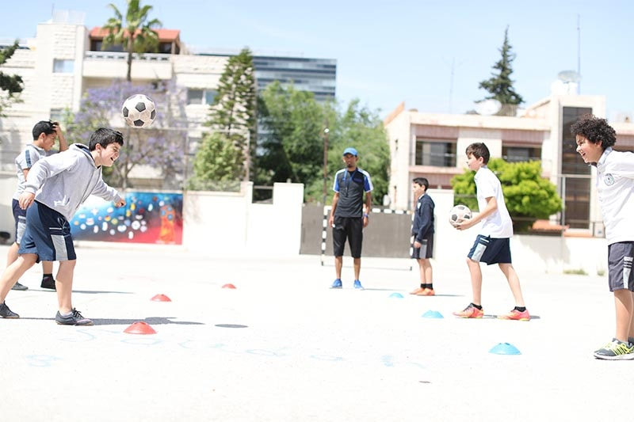
SPORTS
In general all students play sports every week but not all of them love playing it, we did the google form on maria’s laptop and we finished it in one class, leen did one interview and maria two and natalie also two, the google form had 15 responds to it, and we all did the ppt together in classroom . The students thinks that sport in P.E classes are fun but need some improvements.

Slide 3
Causes
Some students don’t like PE classes because their favorite sport is not available in our school and needs some improvements or they are insecure about their bodies, they might be lazy too or they don’t have a partner to play with so they sit alone in P.E classes waiting for the class to be done.

Slide 4
Solutions
School should add the sports that the students want, the school should provide gym so the students could get better bodies so they wont be insecure, teachers should make groups so no one sit alone in P.E classes.

Slide 5
The survey
https://docs.google.com/forms/d/e/1FAIpQLSfAL-hWNL9AdvpYWKi-UNzmBI_dYiZMTbf3rdw7MEol4ZYsEw/viewform?usp=sf_link

