Slide 1
SPORTS FOR ALL
BY: meera wardat / Jessica azrai / natalie zabaneh

Slide 2
CHALLENGE 3
we interviewed students and inquired them about sports,
to observe their interests and opinions about it and count among
suggestions to improve sports at school.
Last but not least we created a google survey that students responded to reasons about the causes of lacking accuses to sports and suggestions to better it.

Slide 3
PROBLEMS/CAUSES | SOLUTIONS/SUGGESTIONS
1- not all sports are avalible at school | 1- include varieties of sports at school
2- bad equipment | 2- purchase new equipment that are high quality
3- the fields and sports room are not equal to size with the right measurements | 3- revamp the fields and secure them equally to the real measurements

Slide 4
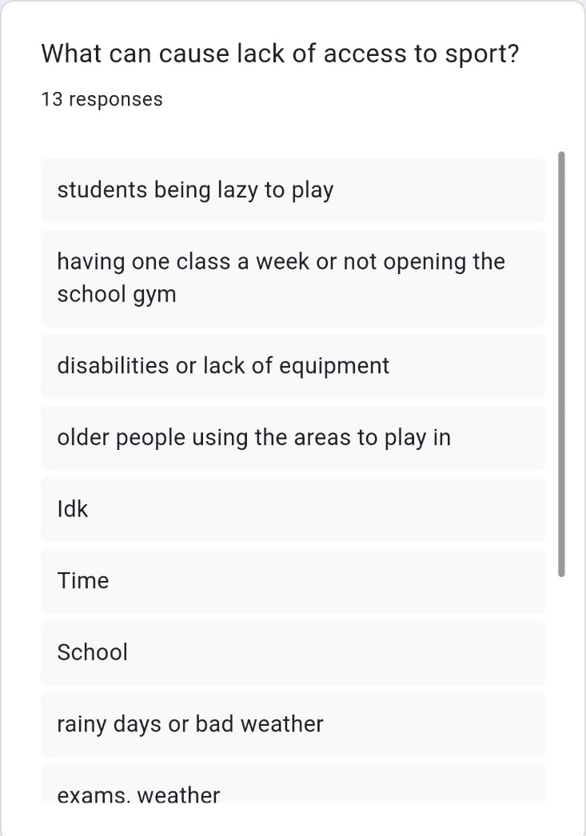
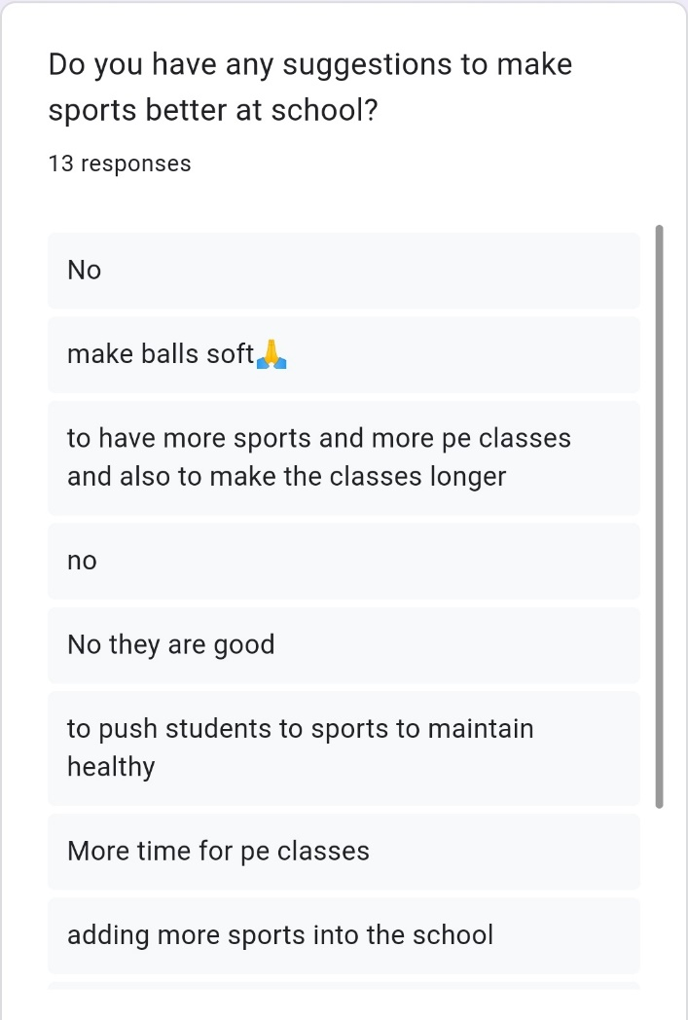
THE SERVEY

Slide 5
THANK YOU
BY: meera wardat / natalie zabaneh / Jessica azrai

