Slide 1
Presented by: Talin Habash, Hind Habash and Christine Hanania

Slide 2
INTRODUCTION
Water shortage is one of Jordan's primary concerns and a limiting factor for economic development, particularly in agriculture. Water resources are increasingly in demand for agricultural and non-agricultural applications.

Slide 3
For where do we get our water?
Jordan is regarded as one of the world's poorest countries in terms of water resources.
Jordan gets around 6,000 million cubic meters (MCM), with an additional 2,065 MCM received from the Syrian watershed of the Yarmouk River Basin.
Because of high evaporation and infiltration, yearly stream flow is only approximately 878 MCM (excluding Jordan River flow).

Slide 4
While more than 98% of the population has access to improved water, only 93% has access to a safe-managed source and 86% has access to a piped network.
Water is normally accessible once a week in cities and less than once every two weeks in rural regions, with a lower frequency during the summer
Water accessibility
in Jordan
Just 77.3% of current sewage systems are securely managed, and barely one-third of schools have basic sanitation services.

Slide 5
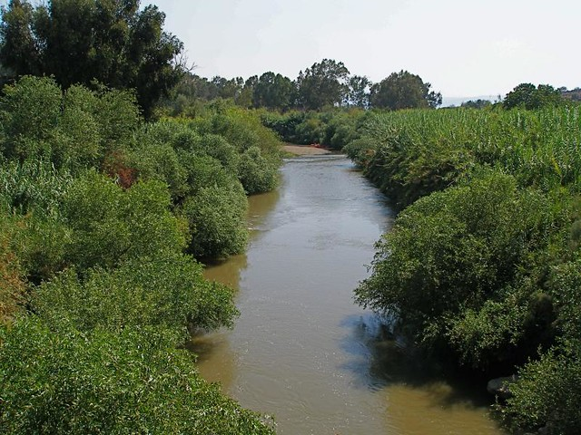
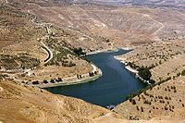
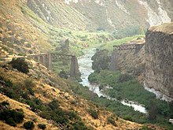
WHAT ARE WE CHANGING?
#1
#2
#3
Surface water resources provide approximately 37% of Jordan's total water supply.
Jordan has three primary surface water sources:
The Jordan river
Zarqa river
Yarmouk river

Slide 6
OUR IDEA
c

Slide 7
OUR IDEA
Our idea consists of two parts:
Evaporating water
Condensing water
Firstly, water will be collected from Jordan's primary sources of water (like rain water and river water) and this water will be stored in water storages.
Next, energy (heat) will be used to heat up the water. When the water is done evaporating, the steam will move through condensation tubes which will turn the water vapor into distilled water. This distilled water will be stored and passed to all houses.

Slide 8
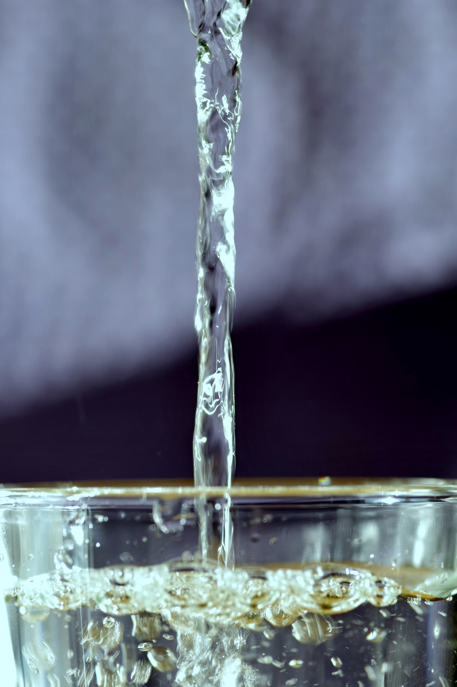
WHY DISTILLED WATER
Water distillation is a powerful method for removing pollutants from drinking water. Distilled water is almost devoid of pollutants such as pesticides and microorganisms, which may be especially beneficial to people with compromised immune systems.
Moreover, distilled water, like certain other purification procedures, successfully eliminates chlorine from drinking water, which can enhance the flavor of water while reducing your exposure to chlorine.
Those with HIV/AIDS and certain malignancies, for example, are at a higher risk of falling ill from contaminants in food and water and may benefit from drinking distilled water.

Slide 9
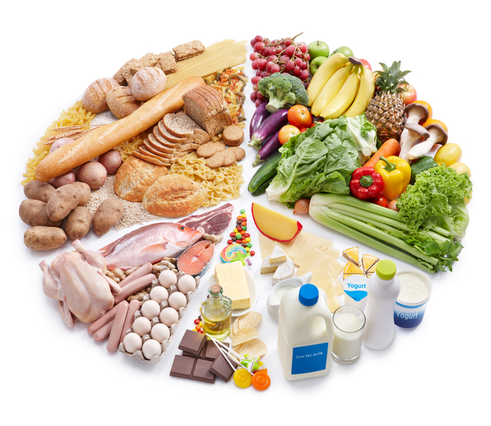
SAYING NO TO CONS
While distillation is quite good at eliminating potentially dangerous impurities, it also eliminates the natural minerals and electrolytes contained in water.
Distillation, in fact, often eliminates 99.9% of all minerals present in tap water. Any factor that leads to a drop in important micronutrient consumption might have a detrimental influence on your health.
It is important to note, however, that for most individuals, tap water is not a major source of mineral consumption, and consuming distilled water should be reasonably safe as long as a well-balanced diet is maintained.
Distillation, like other techniques of purification, eliminates fluoride from drinking water, which may raise the risk of cavities in individuals who drink distilled water. As a result, persons who consume distilled water must practice good tooth care.

Slide 10
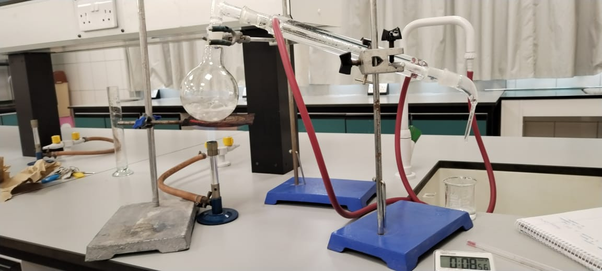
Our experiment
We have took the time to make an experiment to find:
How much energy is needed to evaporate and condense water.
How much time it takes for the water to reach a certain volume.
If the volume of water will change after condensing.
We used 100ml of tap water and these were our results:
226000J/g of energy was used in our experiment to evaporate water.
Time (min) | Amount of distilled water (ml)
2.37 | 20
6.35 | 40
10.55 | 60
14.41 | 80
24.24 | 96

Slide 11
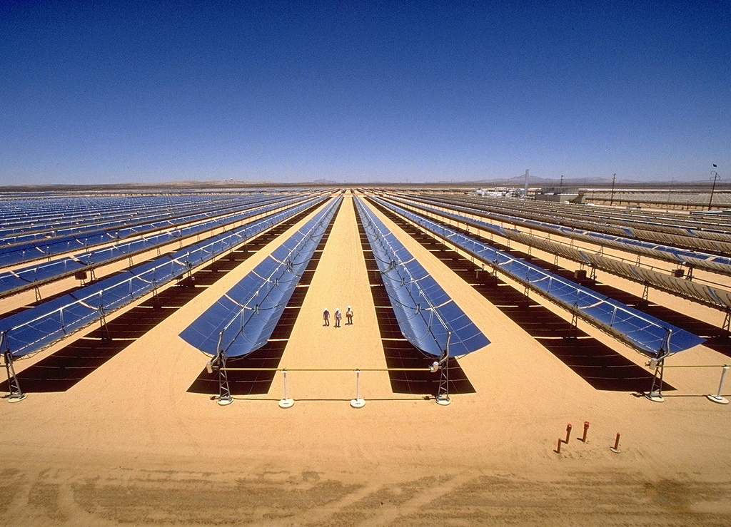
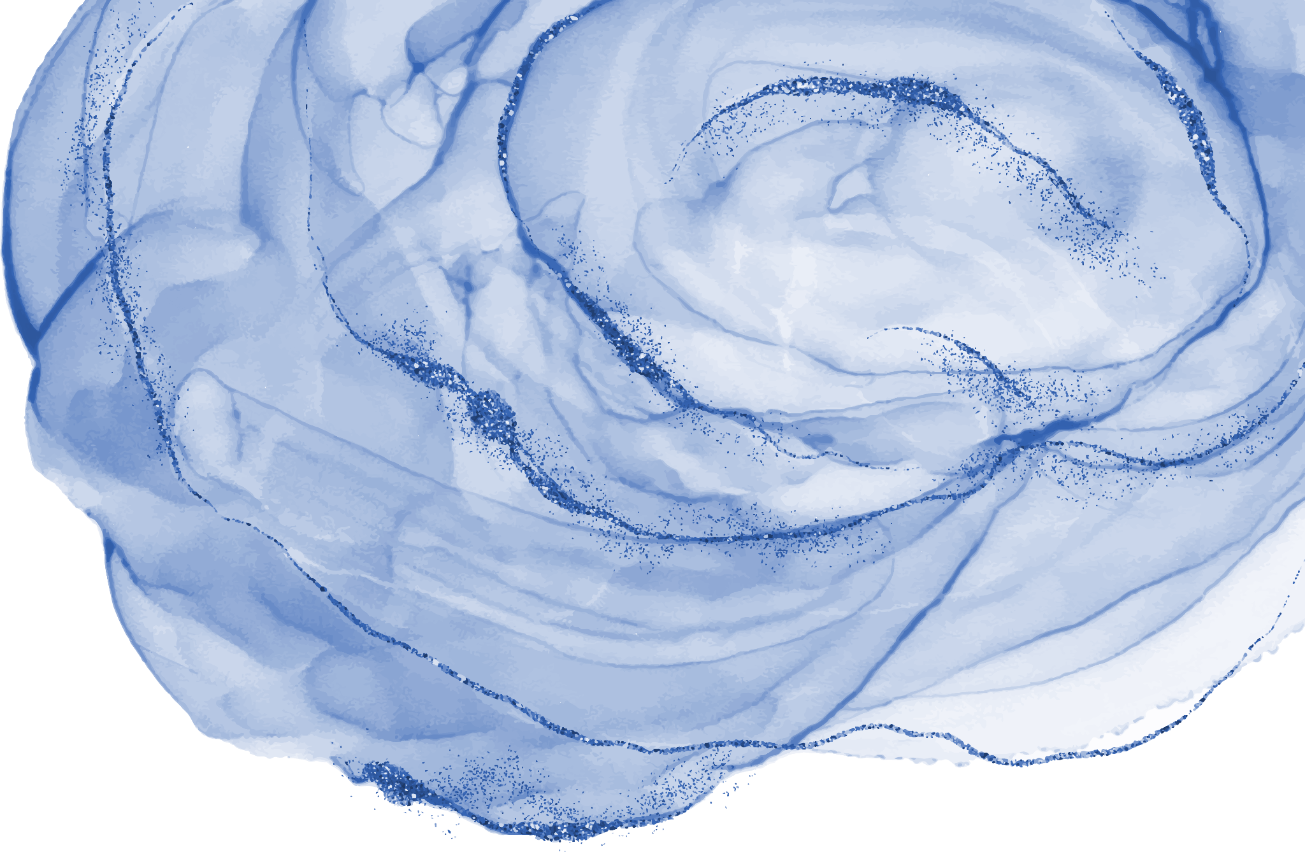
Methods to collect energy:-
Concentrated solar power
https://www.youtube.com/watch?v=rO5rUqeCFY4
Photovoltiaic solar panels
https://www.youtube.com/watch?v=gl5tY5Noacc

Slide 12
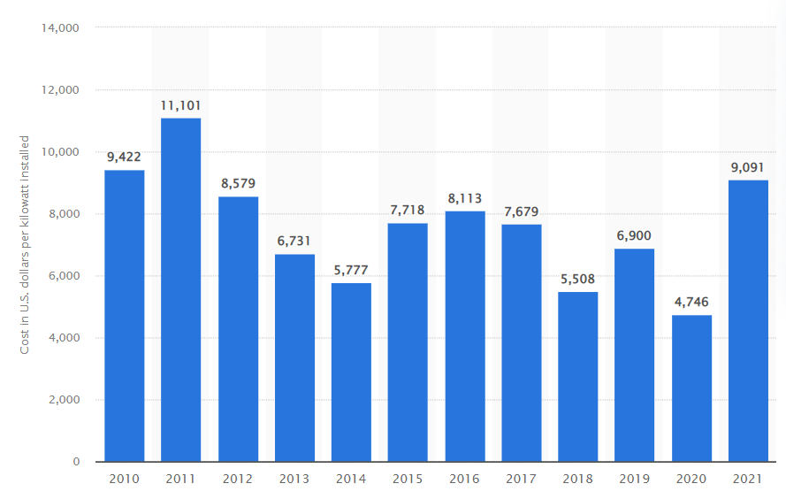
FINANCE
Concentrated solar power
From 2010 and 2021, the global average installation cost for concentrated solar power (CSP) achieved a new low of $4,746 USD per kilowatt in 2020. Nevertheless, CSP installation prices will rise again in 2021, reaching $9,091 USD per kilowatt installed.
Condensing water
Water may be produced in huge amounts at 20-year amortized costs ranging from 10 to 20 cents per gallon, or $100 to $200 per thousand gallons.

Slide 13
CONCLUSION
There has been many technology's to clean water and be able to prevent any water wastage. Our idea will not only cover all aspects that are needed to make water accessible to Jordan, but for all country's too.
With work, the government, specialized workers and dedication, this project will not stay a necessity is the mother of ingenuity, but it will pay its function of need and fill in the gaps of water scarcity.

Slide 14
RESORCES
file:///C:/Users/DELL/Downloads/pap_wasess4a3jordan%20(2).pdf
https://alghad.com/
https://www.alfalaval.com/globalassets/documents/media/stories/alfa-laval-systems-makes-operating-costs-evaporate.pdf
https://www.watertechonline.com/water-reuse/article/15549699/professor-poupoe-condensing-water-vapor-from-air-for-drinking-and-bulk-water
https://www.energy.gov/
https://www.youtube.com/watch?v=gl5tY5Noacc

Slide 15
THANK YOU

