Slide 1
Algebra
8th Grade
By: Muna ishnaneh, Martina jarjoura

Slide 2
Table of contents
01
02
03
Introduction
Examples
Quote
04
Exercise

Slide 3
Introduction
The area of mathematics known as algebra aids in the representation of circumstances or problems as mathematical expressions. To create a meaningful mathematical expression, it takes variables like x, y, and z together with mathematical operations like addition, subtraction, multiplication, and division.
https://youtu.be/5Q0FlxcEEIw

Slide 4
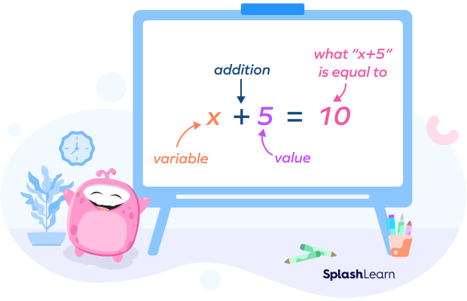
Y×10=20
Example of algebra

Slide 5
By: Ingvi ómarsson
"Dear math: I'm so tired of always trying to find "y" your "x" left you"

Slide 6
Do these exercises
Solve: | Result
Yx4=12 | Y=?
X-6=3 | X=?
m÷10=5 | M=?
÷i+5=14 | i=?
6=j+3 | j=?

Slide 7
Resourses
https://www.cuemath.com/algebra/
https://www.splashlearn.com/math-vocabulary/algebra/algebra
https://www.brainyquote.com/topics/algebra-quotes

Slide 8
Thanks!
Do you have any questions?

