Slide 1
TRACK AND FIELD
By: Naya Al shami, Kareem Al Abdallat

Slide 2
CONTENTS
INTRODUCTION
01
02
WHAT IS TRACK AND FIELD
03
WHAT ARE THE BENEFITS OF TRACK AND FIELD?
WHAT ARE THE DIMENTIONS OF A TRACK FIELD?
04
05
WHO WAS THE FIRST PLAYER TO PLAY TRACK AND FIELD?
06
WHAT WOULD THE SCHOOL BENEFIT FROM HAVIING A TRACK FIELD?
07
TRACK AND FIELD EVENTS
08
FINANCE
09
FUN FACTS

Slide 3
01
Introduction

Slide 4
01
INTRODUCTION
Track and field is one of the oldest sports, featured at the 776 B.C. Olympic games in Greece. It is comprised of numerous activities.Running, leaping, and throwing-based athletic competitions are a part of the sport .The name of the sport comes from the venue, which consists of a running track and a grass field for throwing and some jumping events. Athletics, which encompasses track and field as well as road running, cross-country running, and racewalking, is a team sport.

Slide 5
02
What is track and field

Slide 6
What is track and field?
02
Athletic events centered on the skills of running, jumping, and throwing make up the sport of track and field. The facility, which includes a running track and a grass field for throwing and some jumping events, gave rise to the sport's name. Track and field, as well as road running, cross-country running, and racewalking, are all included in the broad category of athletics.

Slide 7
03
What are the benefits of track of field?

Slide 8
What are the benefits of track and field?
03
Track and field has several advantages. such an action. maintains a healthy body weight. improved coordination is encouraged. enhances balance focuses the mind. teaches how to block off distractions. works with simple coaching directives during training. increases spirits and concentrates behavioral behaviors.

Slide 9
04
What are the dimentions of track and field ?

Slide 10
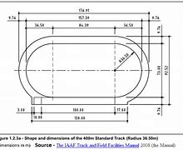
04
What are the dimensions of track and field ?
A typical sports track is 400 meters long with two equal-radius curves and two parallel straights. Normally, all throwing events and a normal 68 by 105 meter soccer field are held within the track. Two semicircles with a combined radius of 36.5 meters make up the track.
.

Slide 11
05
Who was the first player to play in track and field?

Slide 12
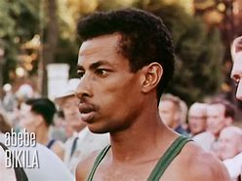
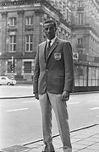
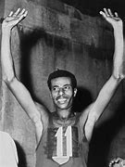
05
SHAMBEL ABBEBE BIKILA
Shambel Abebe Bikila
Abebe Bikila, an Ethiopian marathon runner who won a gold medal and set a world record while competing in bare feet at the 1960 Olympic Games in Rome, then broke his own record at the 1964 Summer Olympics in Tokyo, was born on August 7, 1932, in Mont, Ethiopia, and passed away on October 25, 1973, in Addis Abeba. The first sportsperson to win two Olympic marathons was him.

Slide 13
06
What would the school benefit from track and field?

Slide 14
What would the school benefit from track and field?
06
The school would benefit a lot like getting good reviews and getting more people to like the school and enrolling there kids in the school. there would be a track team the school could go to other school and compete however, not always the school benefits there are gonna start to be a competition between the other and the nos they are gonna want to start competing with the school.

Slide 15
07
Track and fielld events

Slide 16
Track and field events
07
Field events, which are trained in a more open environment, use throwing or leaping drills to gauge athletes' strength and stamina. Popular field events include the long jump, high jump, triple jump, pole vault, shot put, and discus, hammer, or javelin throw.

Slide 17
08
FINANCE

Slide 18
How are we going to raise the money to build a track field and where are we going to build it?
08
from my calculation i suggest that we should do a fundraiser or a bake sale in school so we can raise the 100JD to build a track field or we can use the schools fundings to get the money and build the track field.
We are going to build the track field in the nos school national orthodox school. in the play ground for grades 6-12

Slide 19
09
Fun facts

Slide 20
10 facts about track and field
09
Betty robinson Was the first girl to in the olyimpics
The first track and field event was the stadion
Track and field style events are among the oldest of all sporting competitions
It was created alongside religious events and celebrations for the Greek gods where men
The first modern college track meet was held between Oxford and Cambridge in England in 1864
Usain Bolt became the first man ever to win three consecutive gold medals in the 100-meter race.
The steeplechase event originated in Ireland.
The first Olympic race was in Greece in 776 B.C.
john Taylor was the first African-American man to win an Olympic gold medal, running the 400 meters in the 1,600-meter team medley relay.
In 1984, Al Joyner and Jackie Joyner-Kersee became the first siblings to win track and field medals at the same Olympics.

Slide 21
10
Results

Slide 22
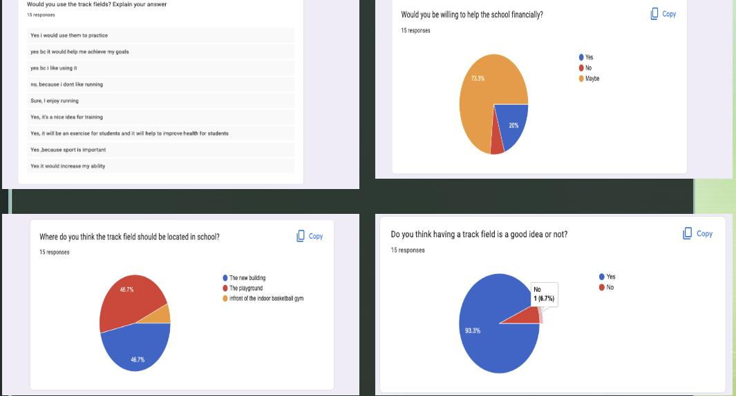
Results
10
.

Slide 23
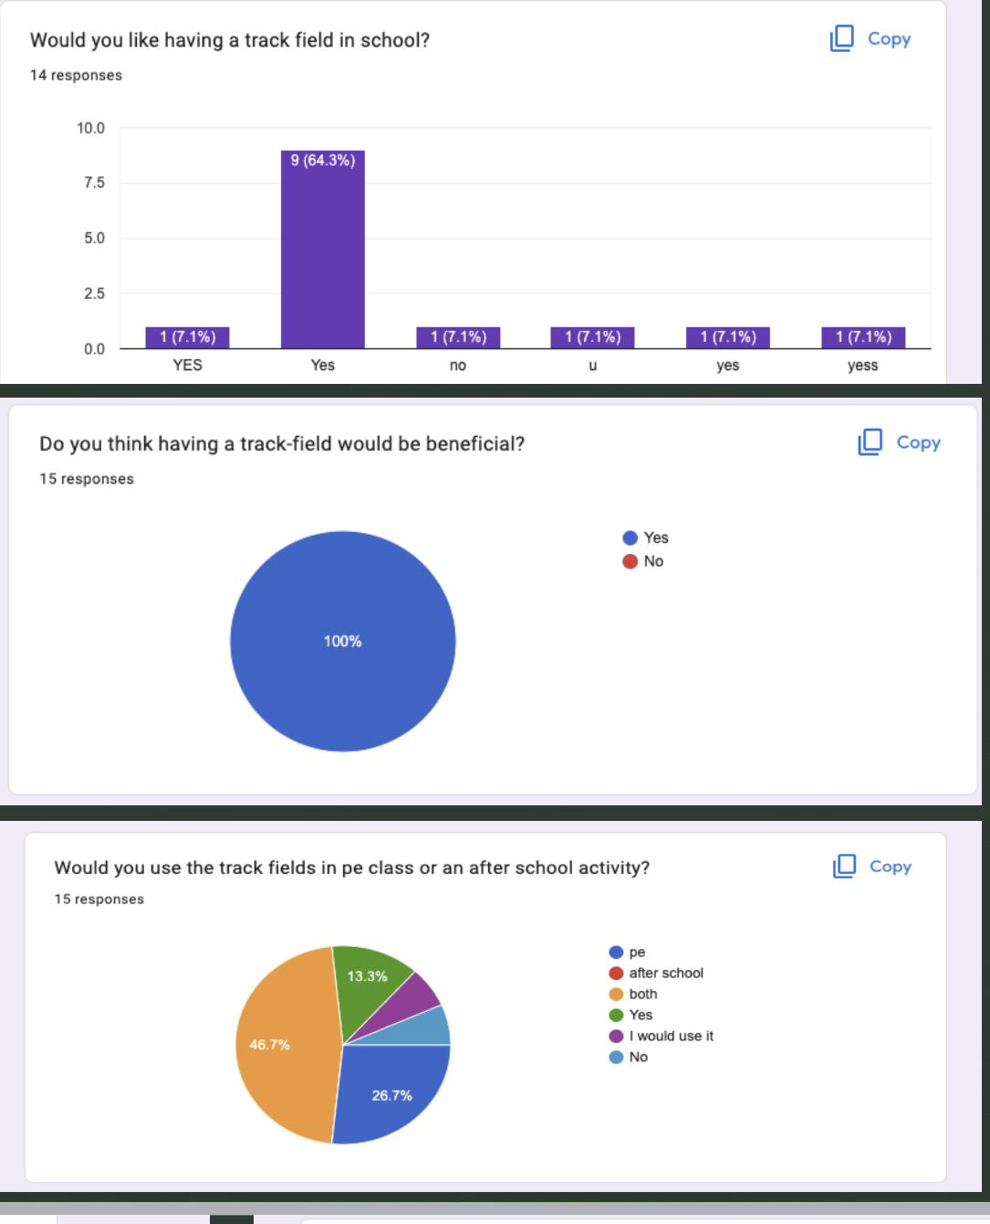
Results
10
.

Slide 24
THANK YOU

