Slide 1

Sports For All
Created from: Maya Wardat, Cynthia Nino and Katia Haddad

Slide 2
What did we do in this project?
We interviewed some students and we asked them questions about their opinion on the school’s sports equipment.

Slide 3

What was the idea of it?
The idea was to see how many students enjoy the sports or who don’t and to find out the reason why they don’t enjoy them.

Slide 4
What are the causes?
Lack of equipment
They don’t like the sports available
They don’t get along with their teammates
Health issues
They feel too much pressure to perform their skills

Slide 5
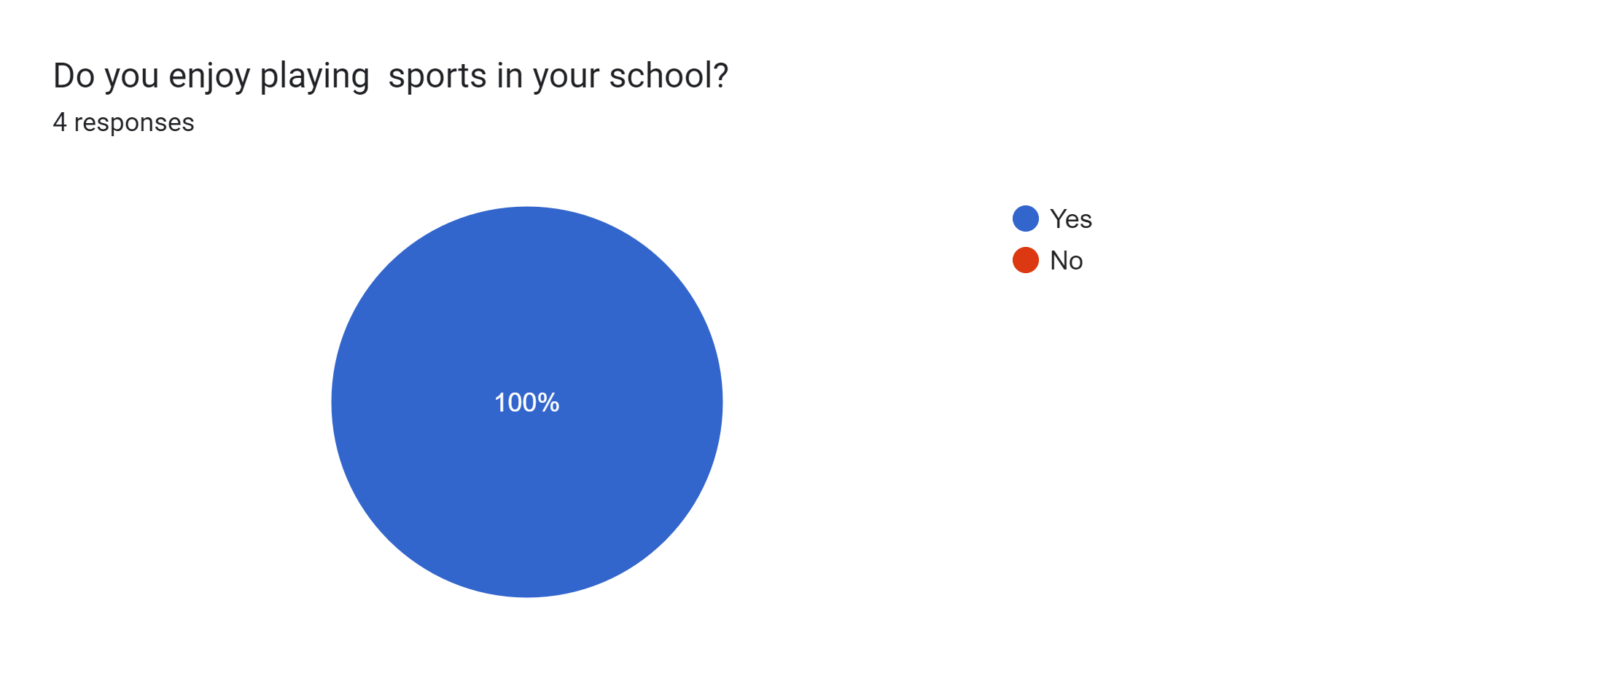
Here are our Google form responses from students:

Slide 6
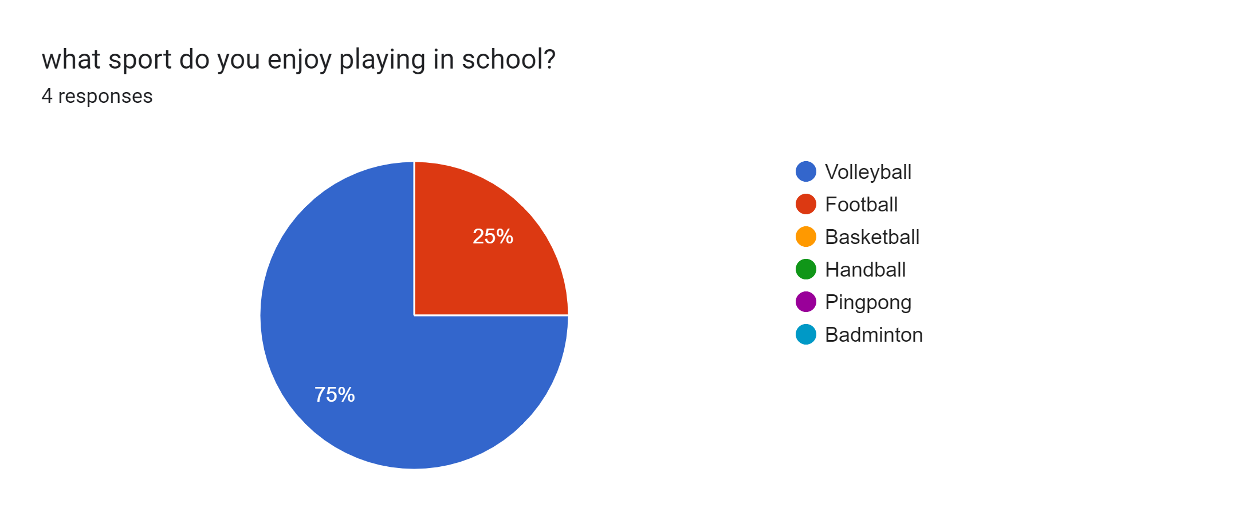

Slide 7
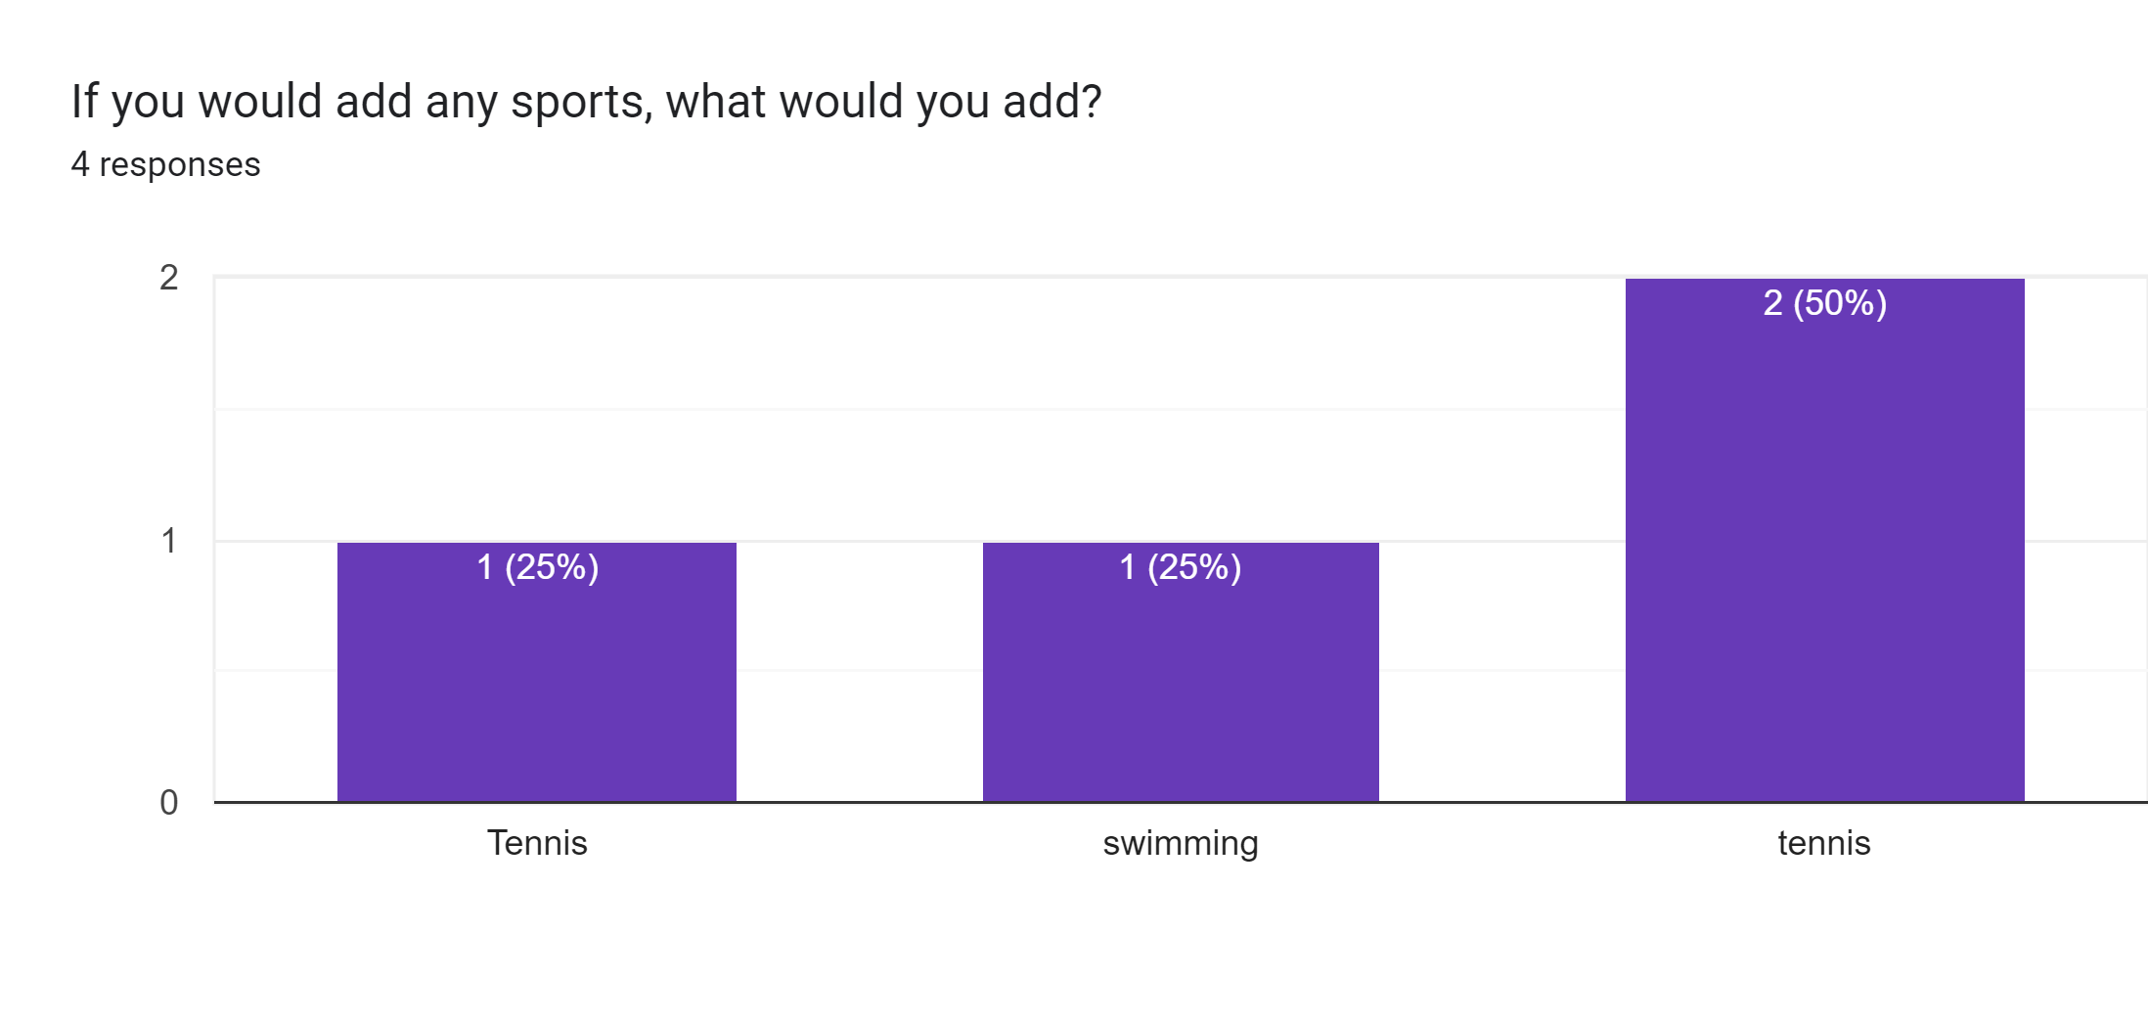

Slide 8
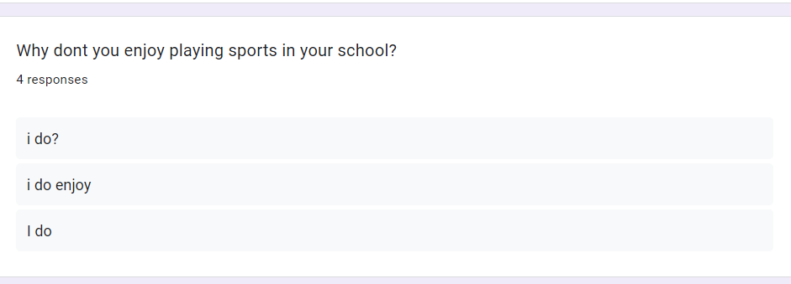

Slide 9
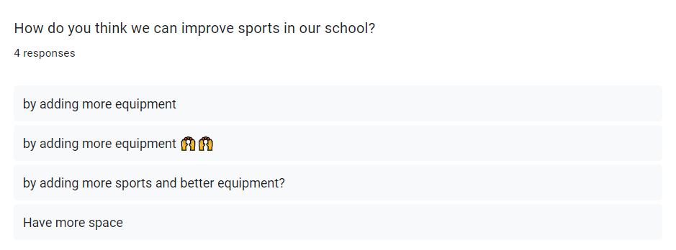

Slide 10
A summary of the students’ answers:
It seemed like most of the students like to play sports and have no complaints overall.

Slide 11
THANK YOU

