Slide 1
Gym At School☺
By: Carla Seleme, Tala Tadros

Slide 2
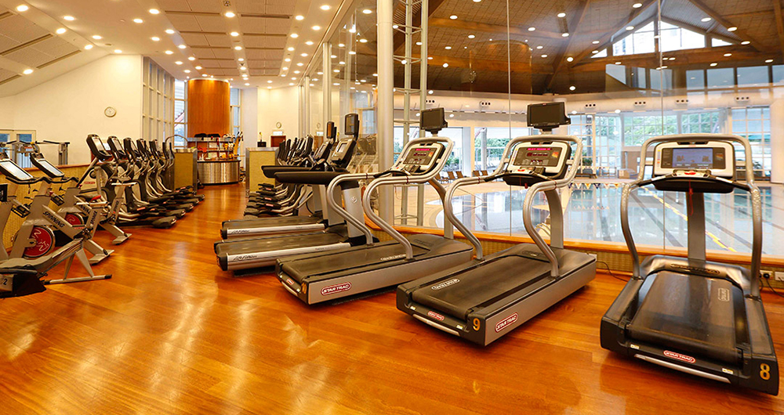
Introduction
Have you ever wished about having a gym in your school? Well, first of all, it wouldn't’t be miles away and you wouldn't’t bother about how you are going to get there. Not only that, it would be a safe community and you would find your friends there that ca motivate you through your fitness journey. What an amazing experience!

Slide 3


Why?
It would make students fit and healthy.
It would be great as an extra circular activities.
Increases your stamina
An opportunity to work out.
More motivation
Prevents bullying towards weak students.
Decrease obesity and health problems (like diabetes).
An opportunity to hangout with your friends.
A great way of making money since membership is open to people out of school

Slide 4
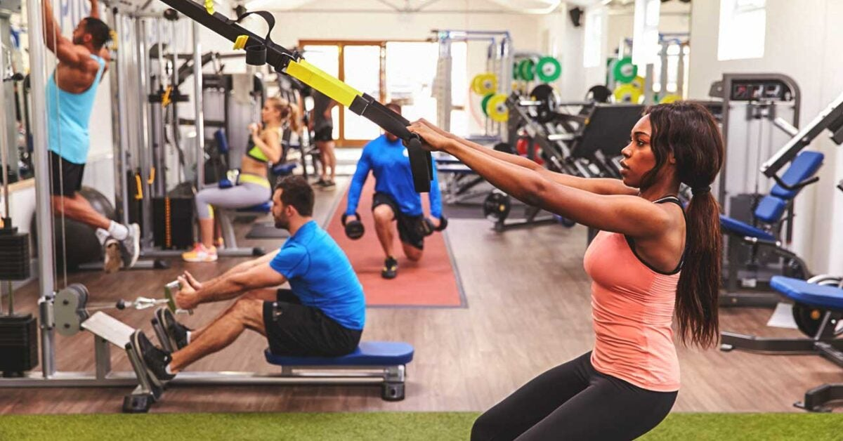
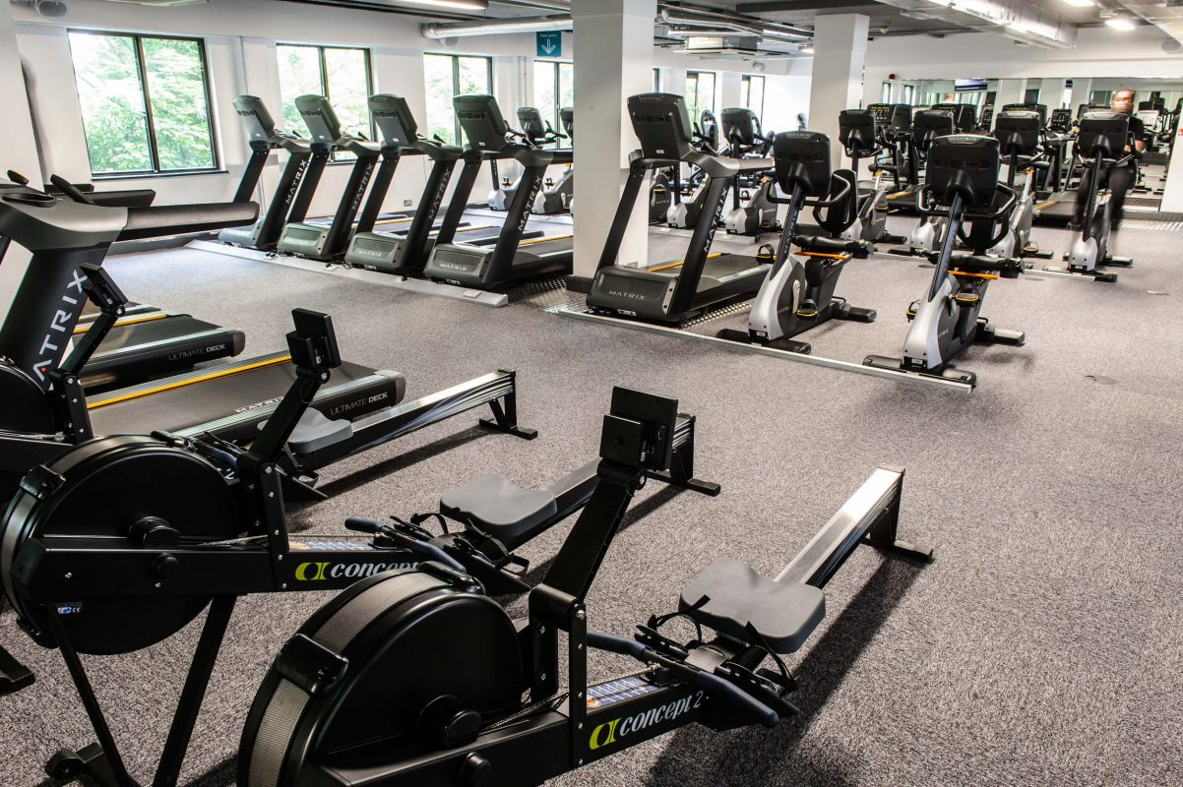
Consequences
This would need a lot of school finance and hard work. It will take months to build and construction would distract students and teachers. It would also need advertising and news about the gym in school, which will take a lot of effort. But after all the hard work it will be worth it!

Slide 5
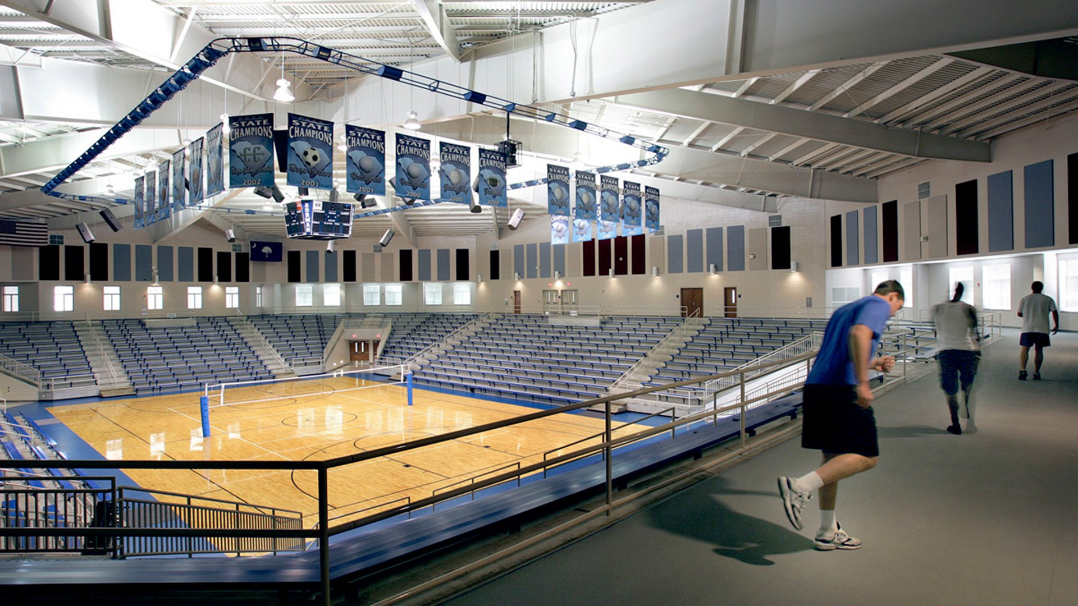

Finance
Location
This will be funded by:
School extra money
Bake sales
Plays
And donations (many students are wiling
to donate)
Finance will be paid back by memberships profit
Above the school stadium

Slide 6

Interview Brief
Thank you for listening
https://youtu.be/-aIoC1yT7ao

