Slide 1
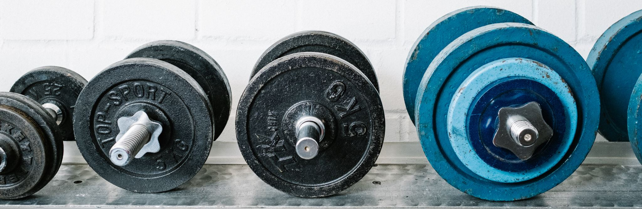

School gym
By: Abdullah Abujaber and Zaid Haddad

Slide 2
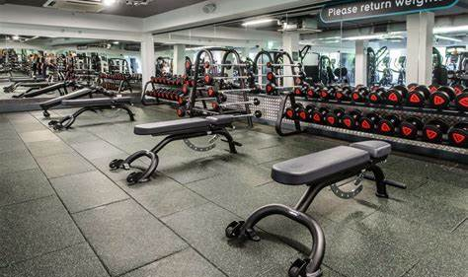
Introduction
We chose a gym because we believe that students should have a healthy and more fit lifestyle and that most people agree that going to the gym relieves stress levels and increases concentration

Slide 3
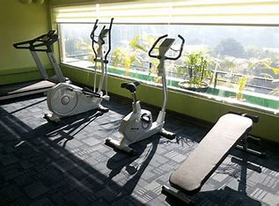
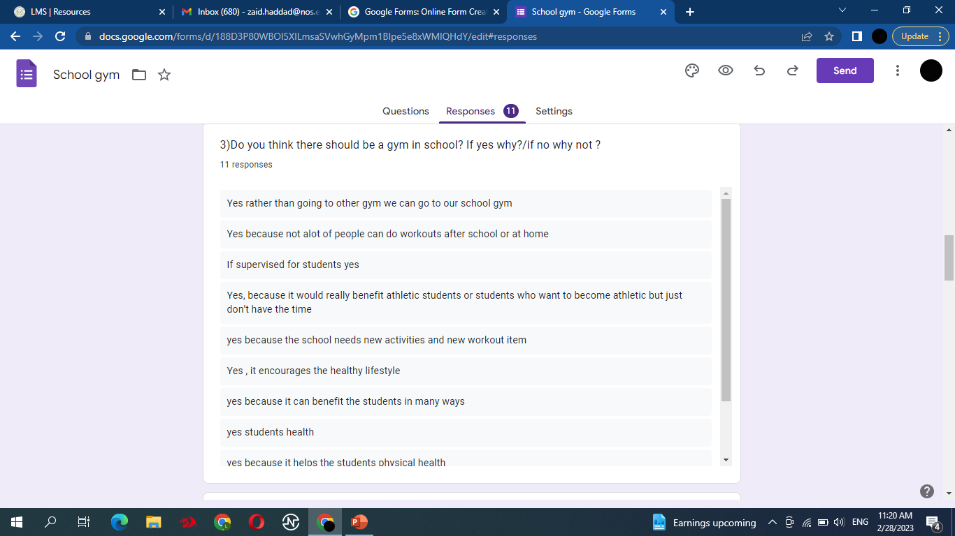
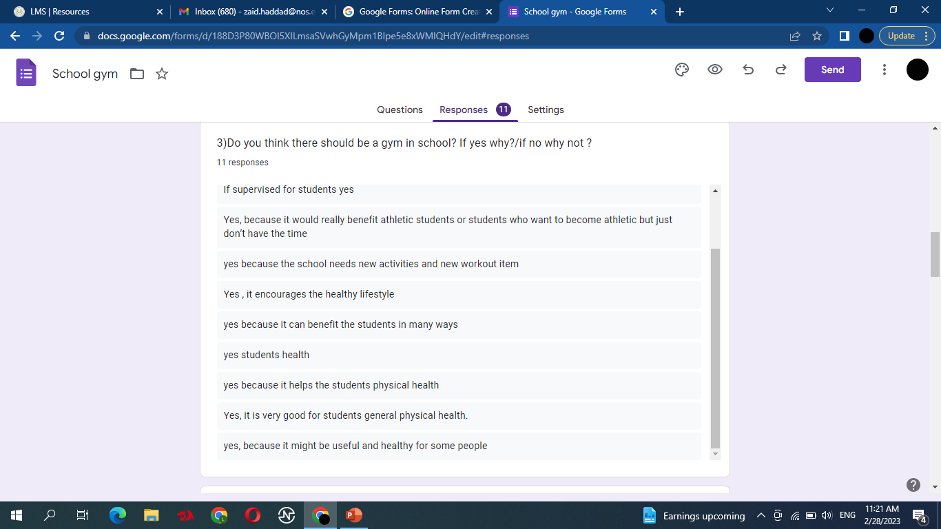
Causes for school gym:
SPARKS LIFELONG HABITS
REDUCES STRESS
REDUCES FUTURE RISK OF CHRONIC DISEASE
IMPROVES COLLABORATION
Mental HEALTH

Slide 4
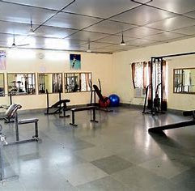
consequences
Gyms require quite a bit of capital to launch, then purchase enough high-quality equipment to keep your clients satisfied.
The most common examples of complaints are a lack of staff, maintenance issues.

Slide 5
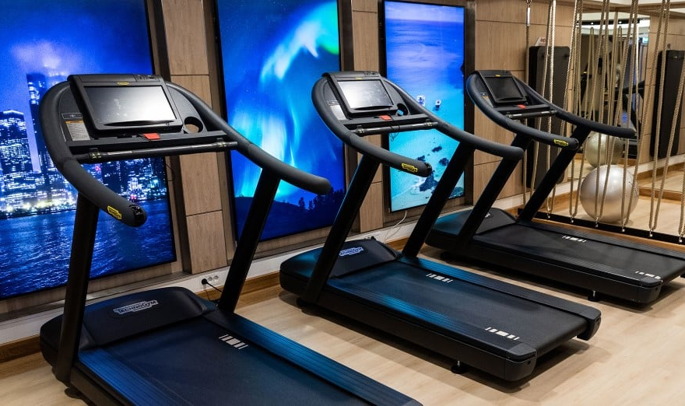
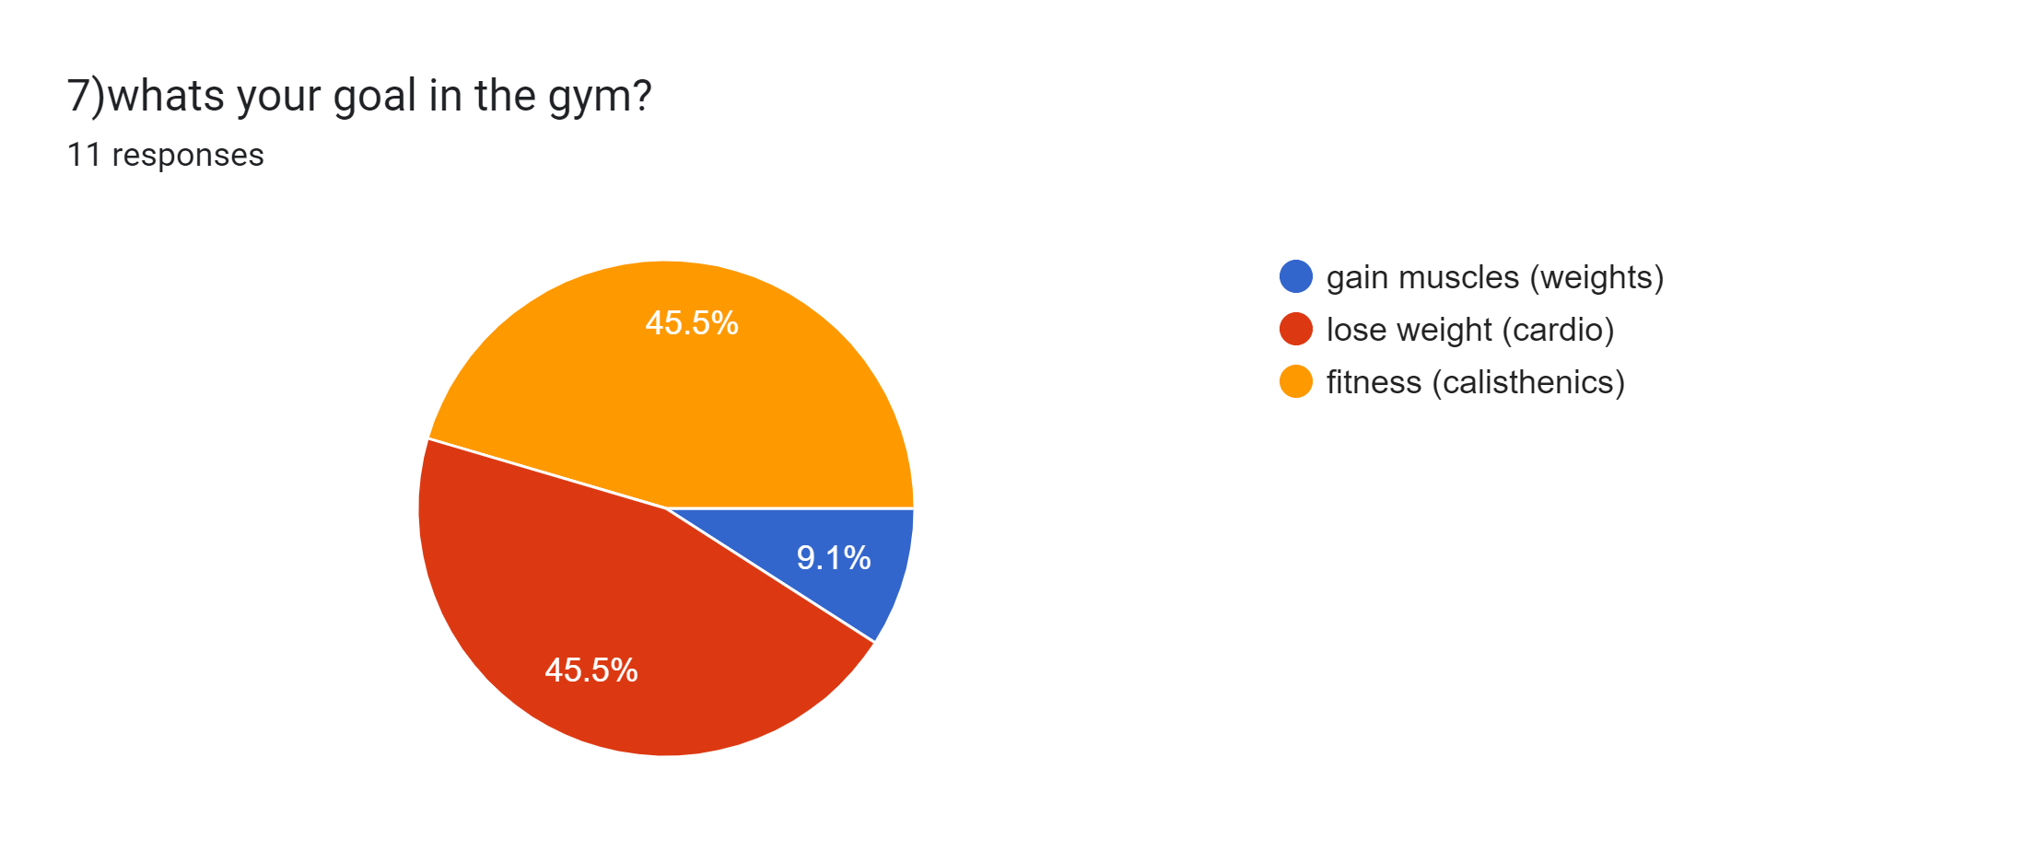
Advantages
Gives the chance for a healthier lifestyle
lose weight
gain muscle
relieves stress
helps gain concentration

Slide 6
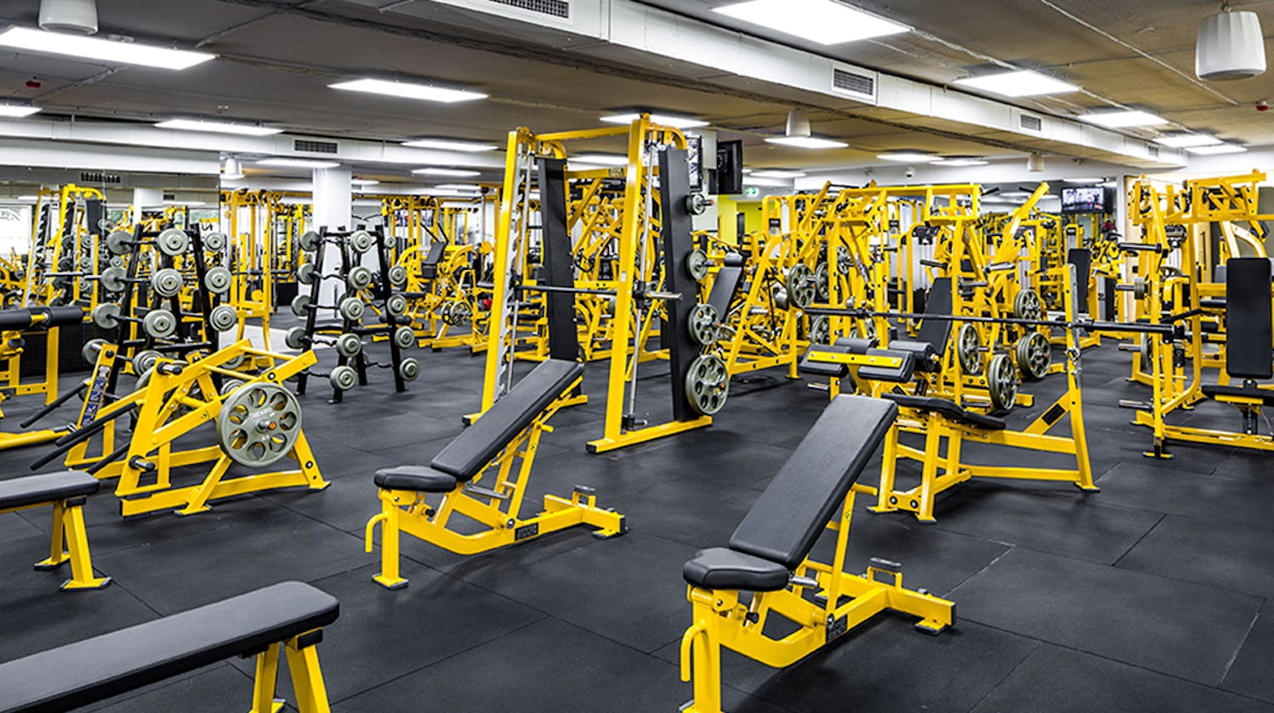
Disadvantages
1)cost of equipment
2)high risk of injuries
3)high maintenance cost
4)could get over crowded

Slide 7
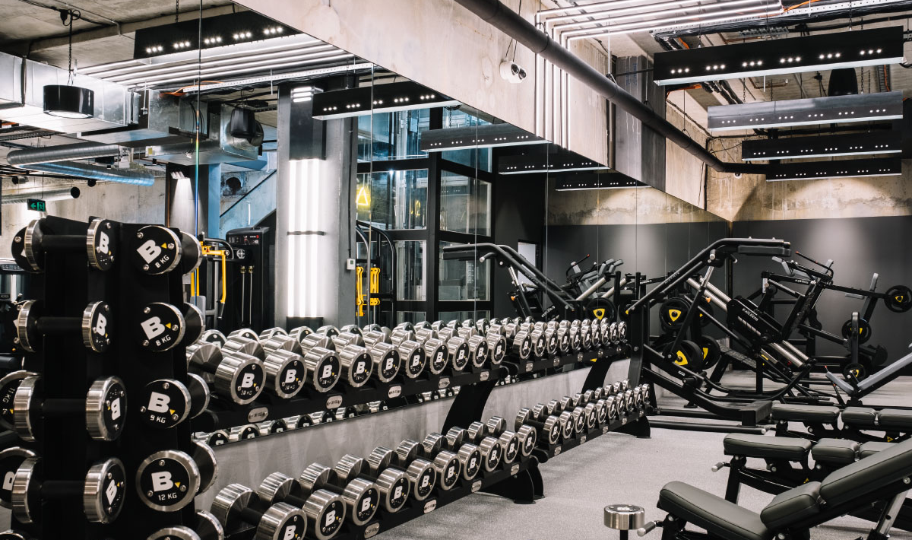
Fundings
We can get the money for the gym equipment by holding bake sales
school plays
Donations from students that are interested in this idea

Slide 8
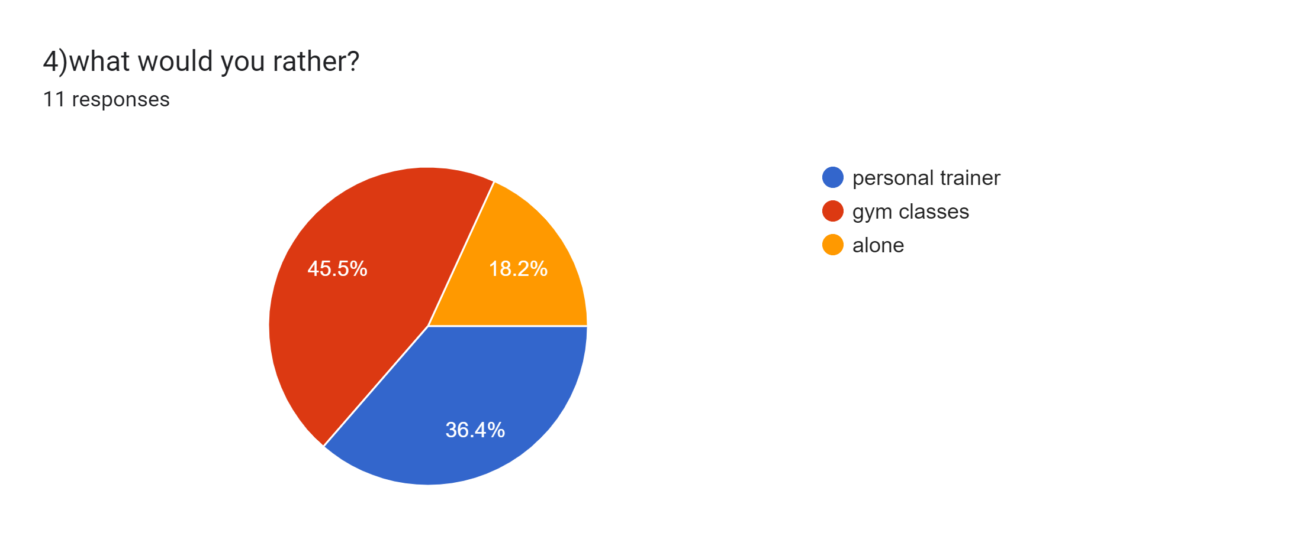

Slide 9
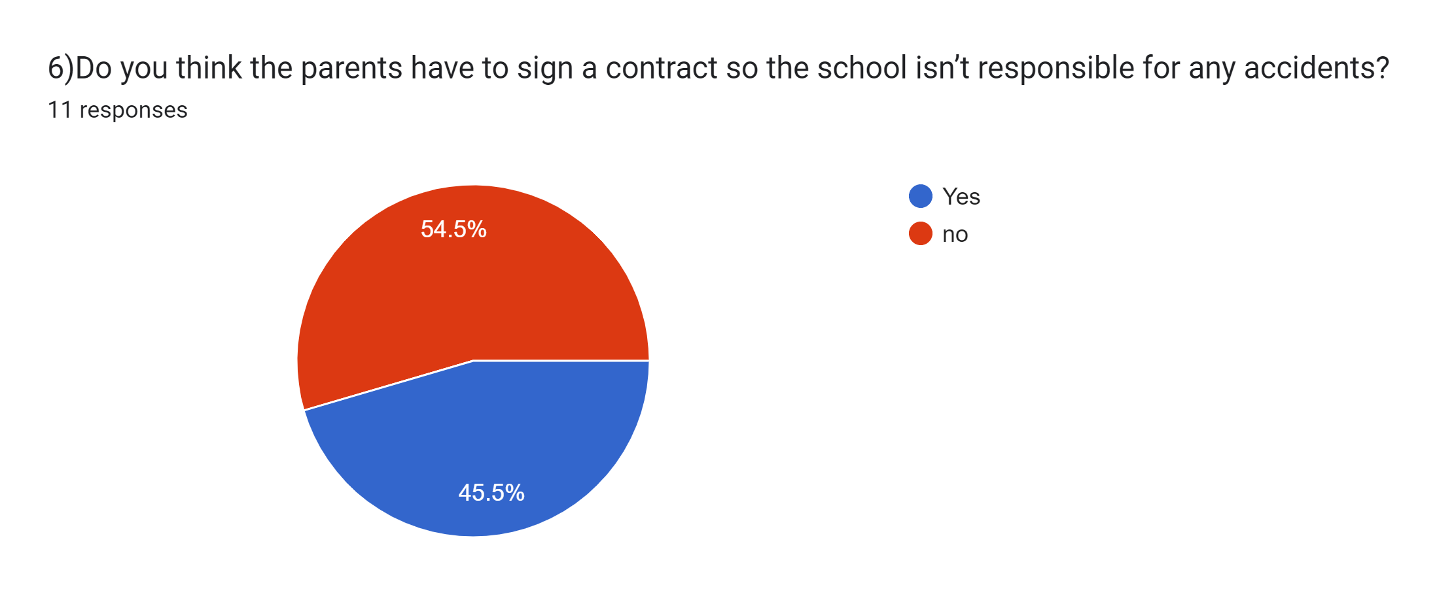

Slide 11


Slide 12
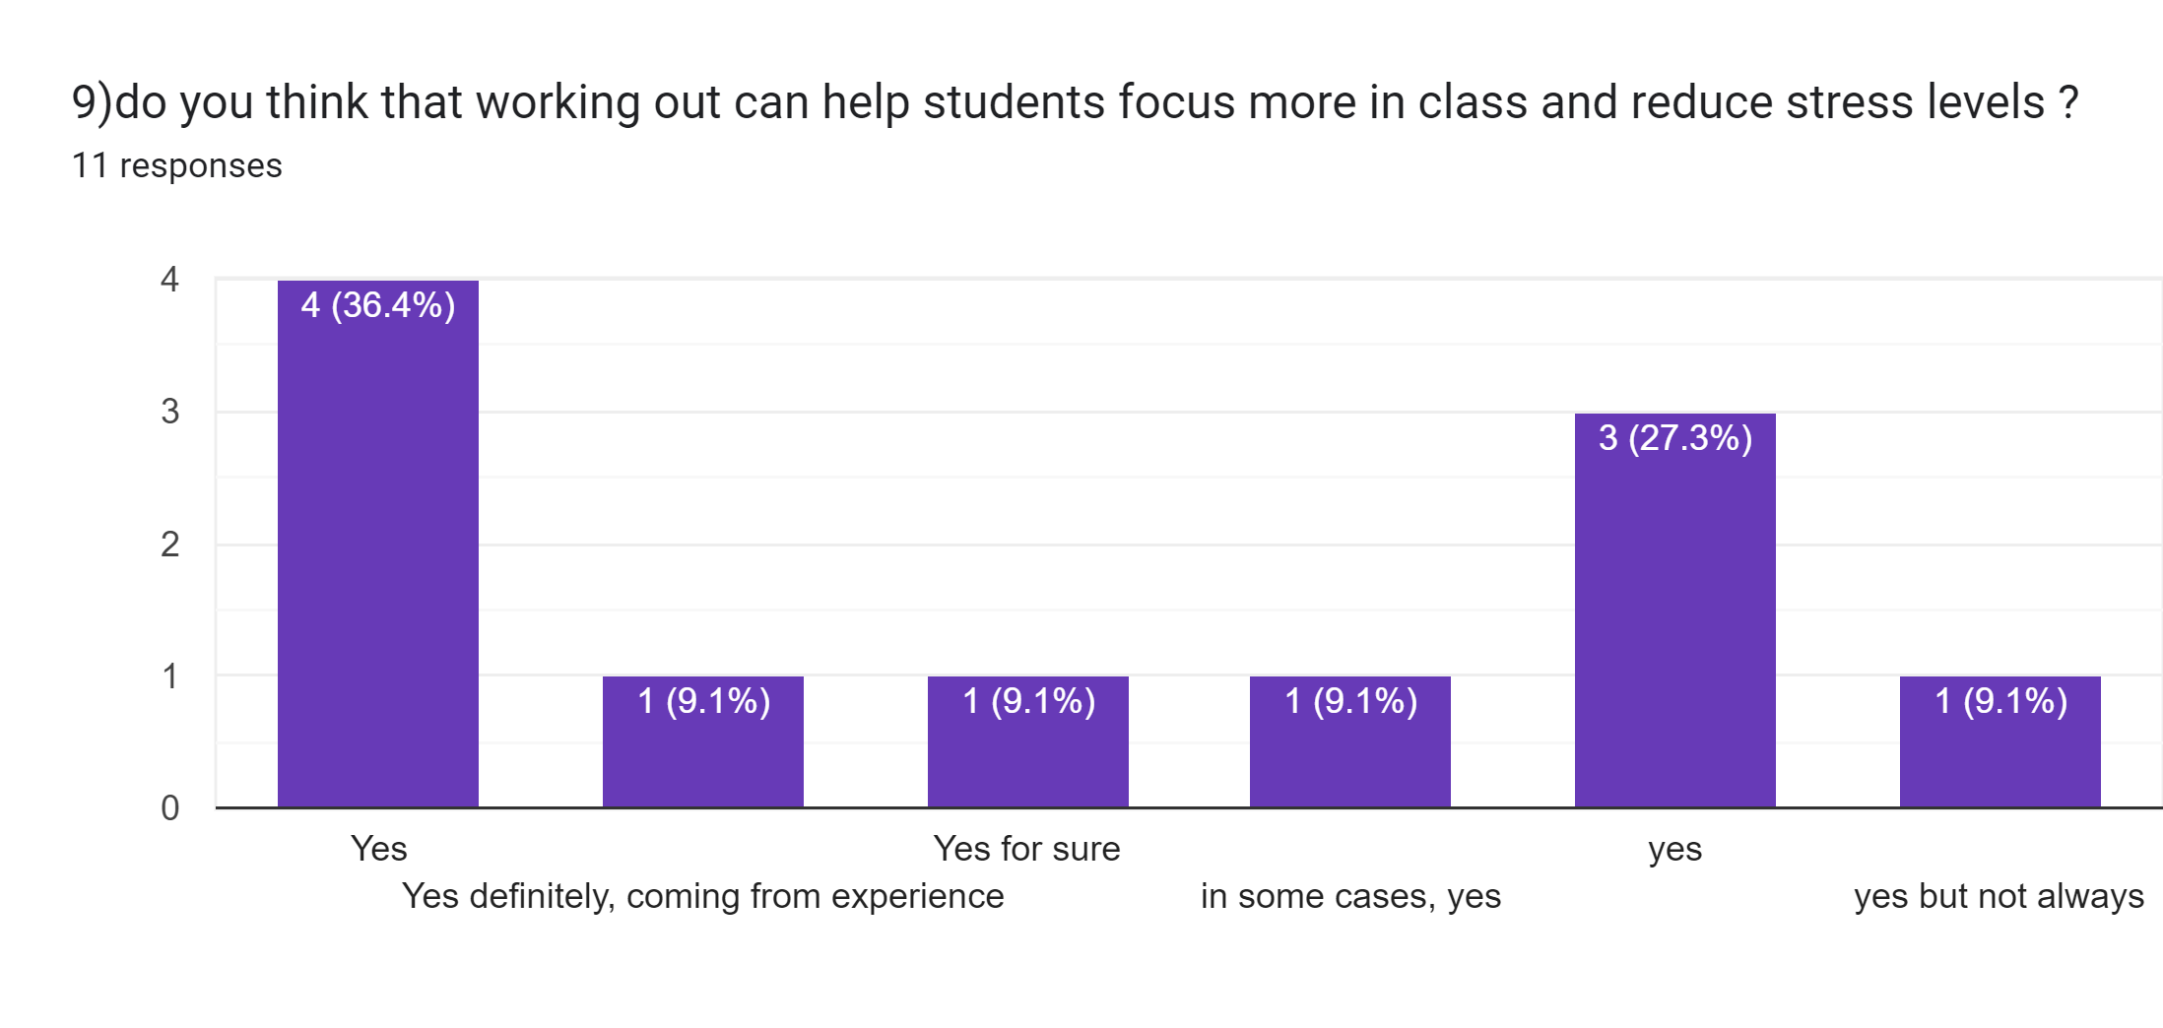

Slide 13
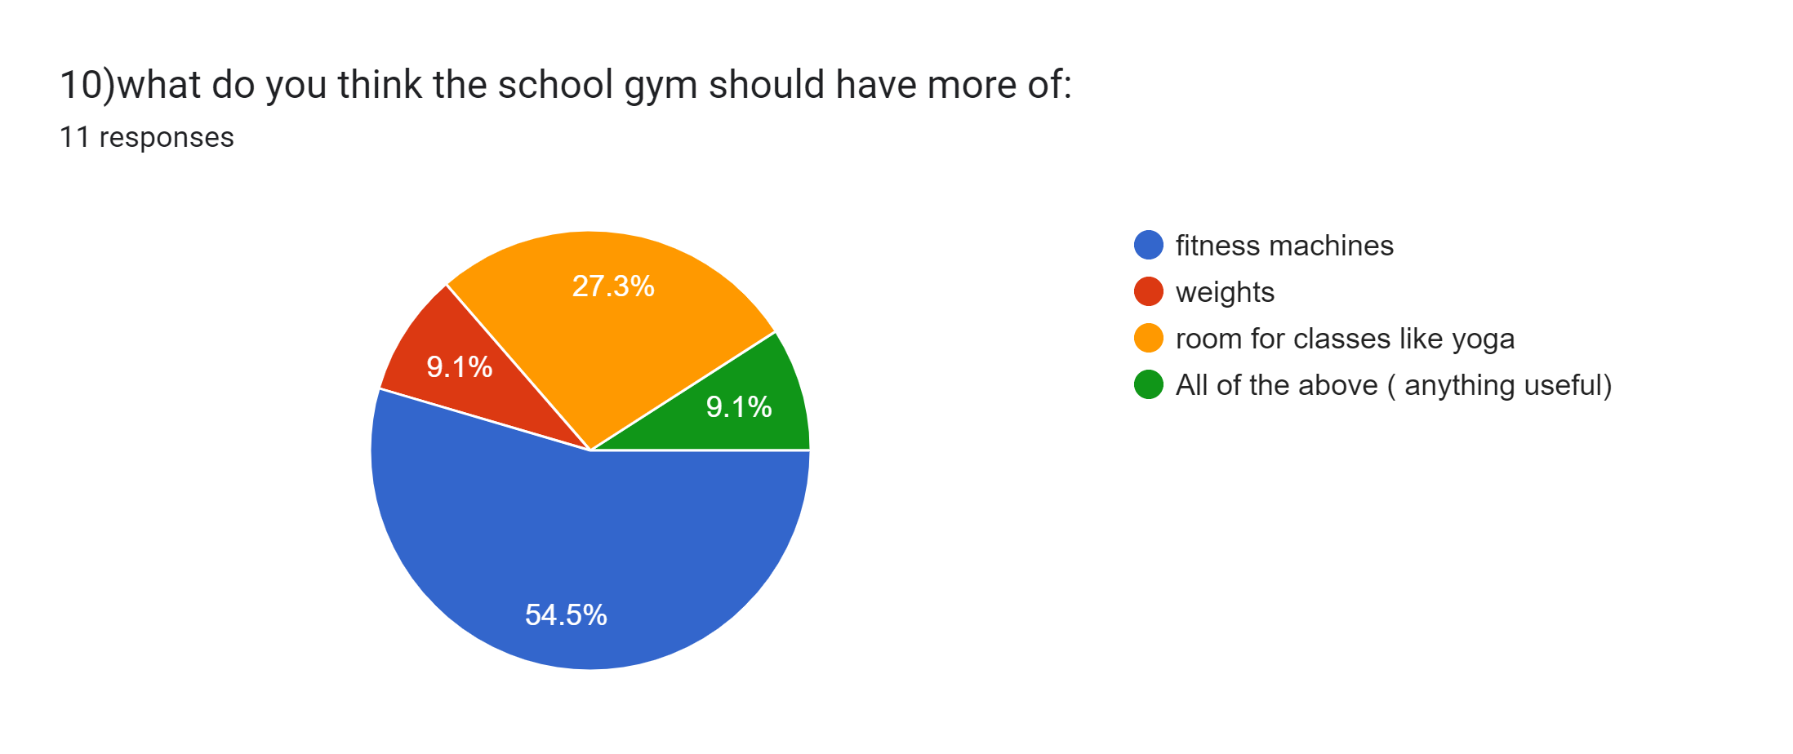

Slide 14


Thank
you

