Slide 1
Adding a gym to the school
Christina Batshone, Carol Oufi 8d
Global project

Slide 2
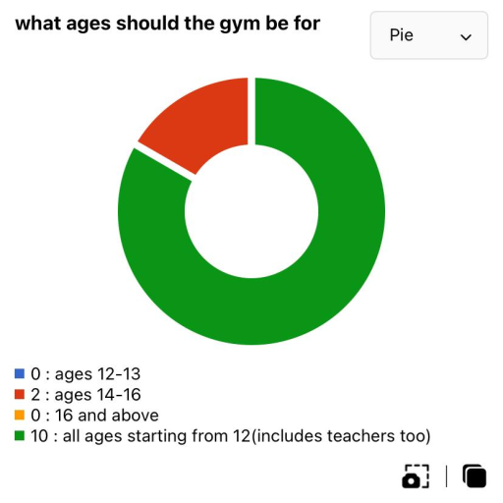
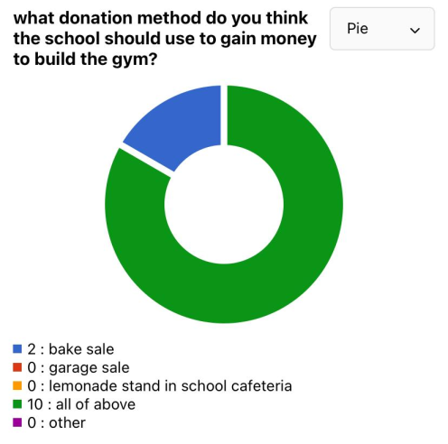
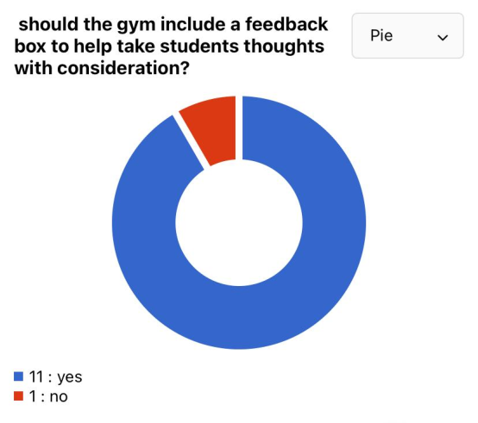
Introduction
When my teammate and I conducted a survey to find out how people felt about adding a gym to the school, it turned out that everyone was in favor of the idea. The gym would improve students' physical education, and the school would hire specialized trainers to teach them how to use all sports equipment safely. In addition, the gym would be secure with floor mats and security to keep an eye on things. Everyone would feel comfortable in the setting, which would have speakers, posters, LED lights, a juice bar to rehydrate the students and teachers, and a vending machine stocked with nutritious snacks. The gym would hand out membership cards to individuals willing to pay a nominal price to use the facility; this would prevent overcrowding and allow for optional gym time in PE courses and after school. Of course, everyone over the age of 12 (including teachers) is now welcome to participate and use the gym. The school would raise money for the gym by holding fundraisers like bake sales, garage sales, lemonade stands in the cafeteria, and more! Last but not least, the gym would have a comment section where users could share their opinions on the gym.

Slide 3
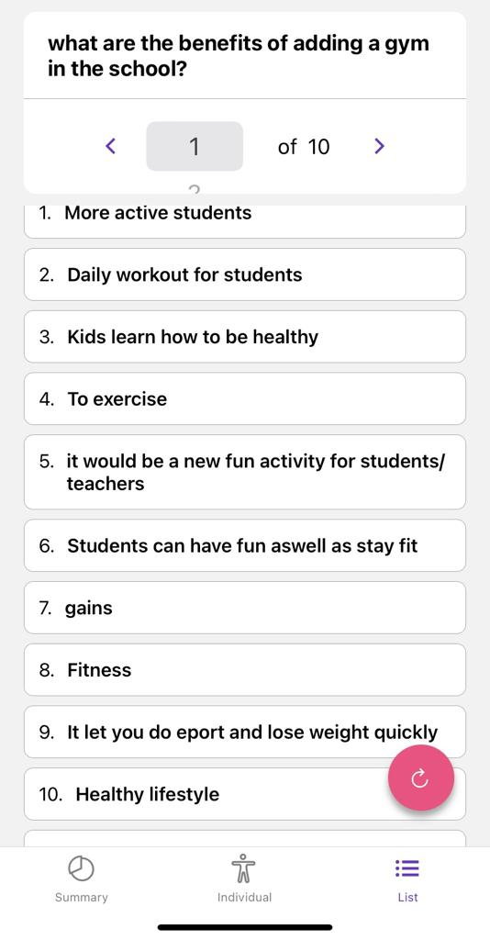
statistics
These are a few of the peoples opinions of adding a gym in the school

Slide 4
finance
The school would offer an option for students and teachers to pay a small fee for gym participation like a bake sale, garage sale, lemonade stand and more! For those willing to pay and participate, the gym would give out memberships for each semester of the school years.

Slide 5
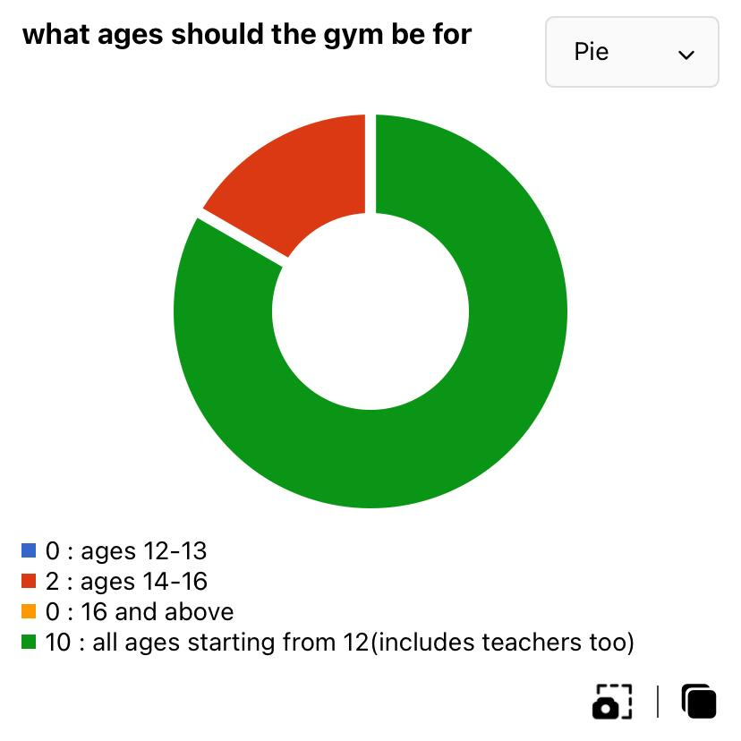
Supervision and who am I targeting
the school would hire specialized trainers to keep an eye on students to ensure that there safe by all causes and the trainers would help the students use all sports equipment properly without harming there selves, the gym would include a floor matting so no harm would be caused.

Slide 6
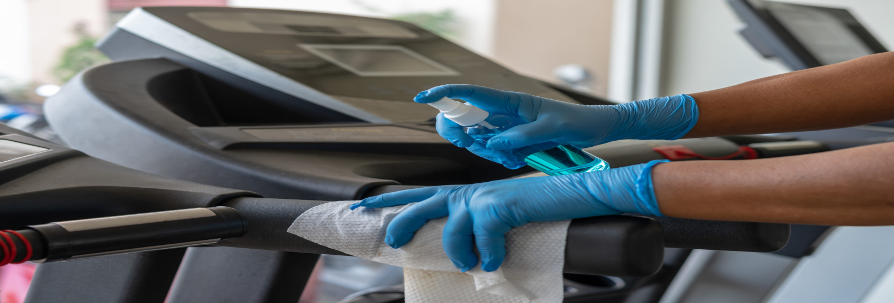
hygiene
Having a hygienic environment is a real importance to people these days this is why the gym would offer a caretaker for the gym to keep all sports equipment clean this way people wouldn’t have to worry about the sanity of the gym, in addition to that the gym would have a girls only and boys only changing room to allow access for the privacy needed.

Slide 7
location
The school would add the gym next to the new school cinema where there is an empty room no one uses and has a perfect space for a gym

Slide 8
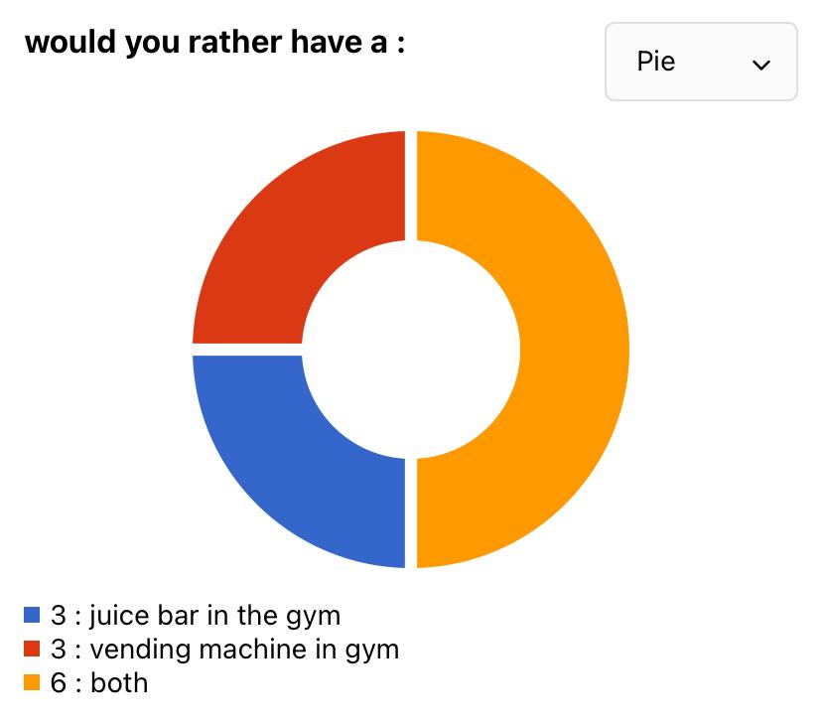
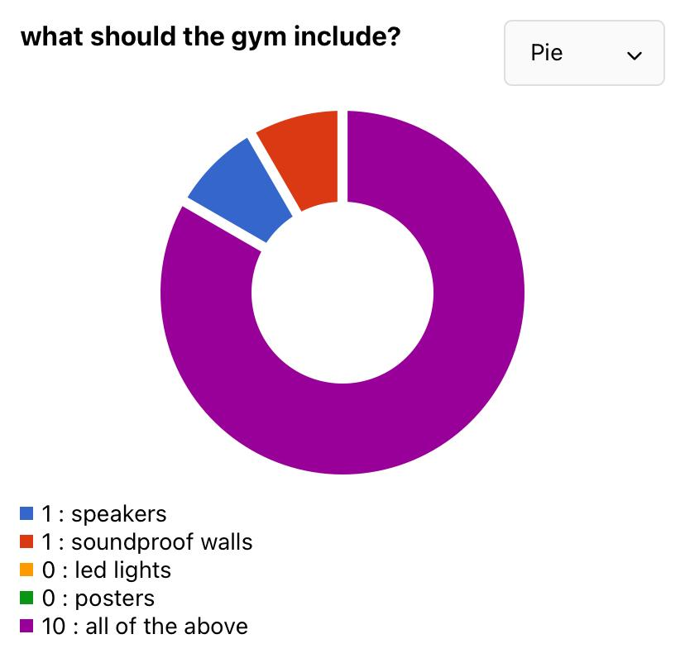
Environment of gym
The gyms environment will be suitable for everyone and would fit their desire, it would include speakers, posters, led lights, a juice bar to freshen up the students and a vending machine which would include healthy snacks!

Slide 9
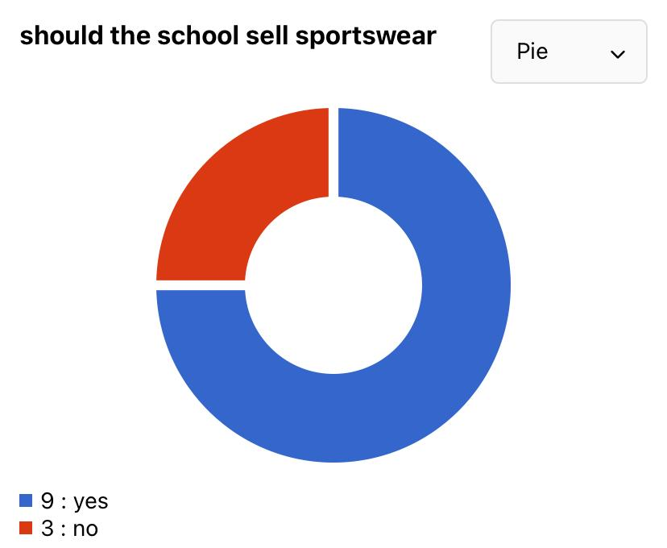
Sportswear
Adding an option to sell sportswear in the school takes a load of parents to go find the specialized sportswear needed. the school would sell it for a cheap price, which makes it affordable for everyone, it would also include all sizes.

Slide 10
Causes
Causes:
Enhancing students physical education prevents them from being inactive.
It will help the student have a healthier lifestyle.
It will help relief students stress.
It will encourage students to come to school.

Slide 11
Consequences
The consequences of adding a gym to the school has a positive and negative side lets start with the positive one,
Students would relieve their stress during gym hours instead of class hours.
Students would live of a healthy lifestyle
Instead of going to other gyms they would go to the schools one
Paying for the gym in school would be cheaper and would save money from going to a different one.
The school would make sure all the equipment are clean after every class
Having a trainer in the schools gym would insure students and teachers that no harm would be caused.
There will relief there energy during the gym hours this will make students concentrate less since they would be tired.
Having member cards in the gym prevents the gym from getting crowded.

Slide 12
consequences
Now lets talk about the negative side of adding a gym in the school,
The students and teachers would relieve there energy during the gym hours this will make students concentrate less since they would be tired.
Students might get injured
The school may not have enough finance to get all sports equipment the students desire.
Students may get in a fight on who to use the equipment first.
The school might not find enough security to guard the gym
Even though there are member cards in the gym students may fight over who should go in first since the gym allows small sections to go in at a time.

