Slide 1
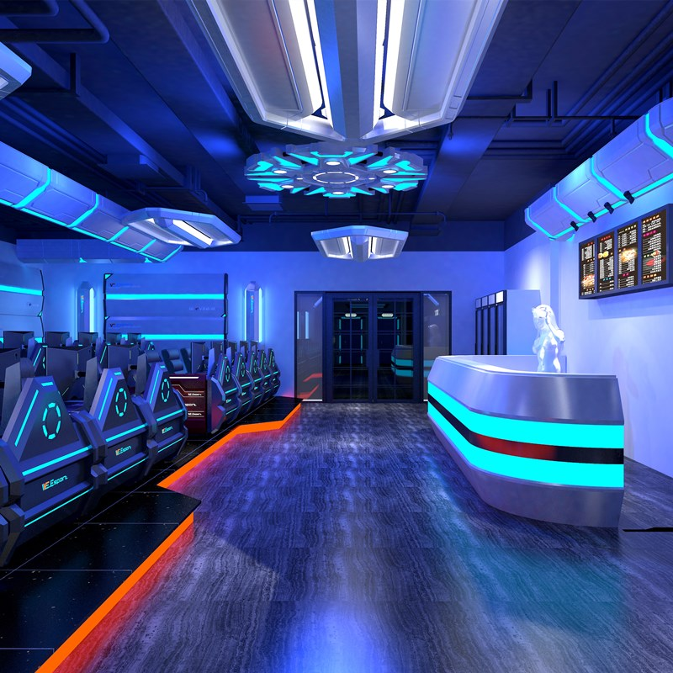
Simbas Gaming Center
By: Abdulrahman Tubeileh

Slide 2
Business idea (Description &Name)
Idea: My idea is to have a famous and successful gaming center that satisfies people’s interests.
Goods or Services: My business is a service.
Objectives: My vision and mission is to be the most trustful gaming center in the world.
Name: My business name will be easy to pronounce since almost every gaming centers have several names, the name of the business will be memorable if the business becomes successful and famous all around the world.

Slide 3
Target market & Demographics
Costumers: The costumers are going to be teenagers and men.
Competitors: The competitors are going to be other gaming centers such as aliens gaming, compu gaming.
Business Location: The business should be in a serviced area, the products will reach our costumers when they play and enjoy there time on our special devices.

Slide 4
Financial Information
Sources Of Capital: if you're looking for raising capital for your gaming startup, there are three main types of capital that can be raised: debt, equity, and venture capital. Debt is the most common type of capital raised for gaming startups.
How much will you charge: since all the gaming industries are similar to each other, the prices will be the same.
Predicated Profit: 750,000 – 500,000=250,000

Slide 5
What you will do with the money you make if it was profitable?
I will donate to different charities, I will save money so I can secure my money if I face any difficulty, and invest in a new business.

