Slide 1
Trusty Insurers
Business Plan

Slide 2
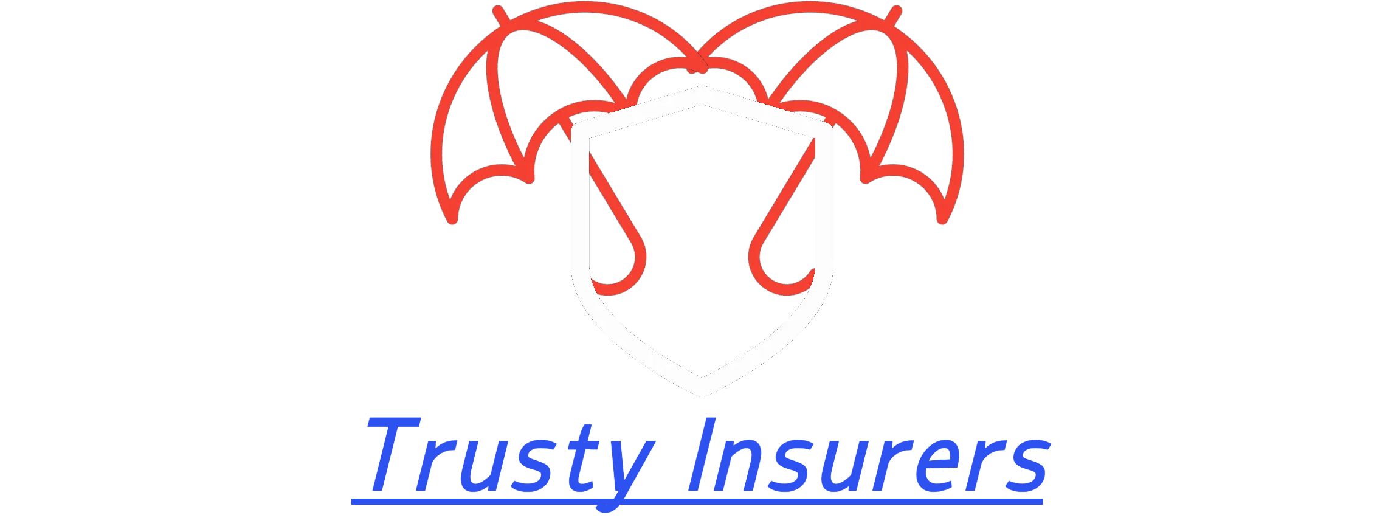
Business Idea
Company Name: Trusty Insurers We're a American Insurance Company Insurance company is a company the insurer offers a guarantee for a certain risk that may or may not occur then another party the insured pays the insurer in exchange for protection against that risk Our company is a Service Why should people buy insurance? It covers your day-to-day costs larger expenses "Trusty Insurers" name represent a safe insurer. The name isn't somewhat unique. It's name is memorable and is little hard to pronounce.

Slide 3
Target Market
Our market is focused on adults both men and women. It's competitors are Farmers Insurance, Liberty Mutual Insurance, GEICO, State Farm, and Allstate. We're in all 50 States in the U.S.A. the products will reach customers by directly through an insurer or through independent agents and commercial brokers.

Slide 4
Financial Information
Our sources of capital are:
Investors from all the states. Financial support from Bank of America. Support from the goverment. Property Insurance cost $1,090 per year, Farmers Insurance property cost $2,066 per year, and Allstate Property insurance cost $1,313 per year, Life insurance cost $160 per year, Disability insurance cost $1,320 per year, Health Insurance cost $6,300 per year, Automobile insurance cost $1,160 per year and Many others. $2,000,000 profit per year - $150,000 Total cost = $1,850,000 Predicated profit.

Slide 5
Owner Details
CEO of Trusty Insurance Majd Shkukani became CEO in 2040.

Slide 6
What we will do with the money?
We reinvest back into our comapny. Invest in other companies. Expand the company.

