Slide 1
Maria’s Cosmetics
Maria Kandah 7D

Slide 2
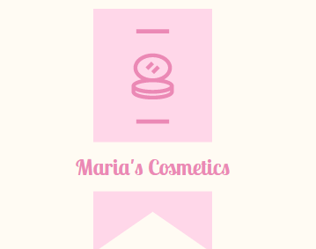
What is Maria’s Cosmetics?
Maria’s Cosmetics is a company that produces makeup and skincare products.

Slide 3
Our Mission And Vision
Our vision is to become the innovative beauty brand that is closest to women.
Our mission is to offer a wide range of high quality products based on women’s expectations.

Slide 4
What makes our products unique?
Where will our products be sold?
The thing that makes our products unique is that they are suitable for all skin types and it has a larger variety of products than our competitors (MAC , Kylie’s Cosmetics and Florence).
Our products are dermatologically tested and have really reasonable prices.
Our products will be sold online with worldwide shipping and we will open two branches in Amman in Dabouq and Sweifieh.

Slide 5
For who do we sell our products?
Our products are sold for women.

Slide 6
From where will our capital will be taken?
What is the average price for our products and how much do they cost?
Our capital will be taken from the bank as a loan.
The average price for our products is between JOD 25 and JOD 20 and the cost varies between JOD 12 and JOD 15.
25-15=10 JOD.
20-12=8 JOD.

Slide 7
What is the purpose of Maria’s Cosmetics?
The purpose of this business is to save money for studying at a good university and for charity.

Slide 8
Owners Details
Name : Maria Kandah.
Age : 12 years old (about to turn 13).
Birthdate : 27th August 2010.
Any company partners : There are no partners and only one owner.

