Slide 1
TENNIS FEILD
BY:farah ayed, melissa kilani

Slide 2
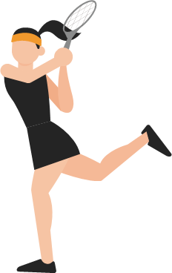
Why would a tennis field be necessary
Our school only provides courts for football, volleyball and basketball and some people don’t find any interest in these sports, based off of our survey the majority found interest in tennis rather than the brought up sports and said that they would use the tennis field. it can also improve students talents and grow their curiosity into starting a new sport.

Slide 3
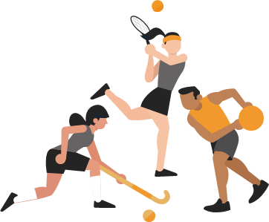
Placement
The results of the survey have showed that the clear majority think that the best place for the court to be placed is in the gym

Slide 4
How to raise money
We will start a fundraiser such as:
Sausage sizzle or BBQ fundraiser.
A movie night or an outdoor movie event.
A trivia night.
Food fundraiser.
Bake Sale.
Selling raffle tickets.

Slide 5
The advantages of tennis
1:Tennis is incredibly helpful in losing body weight in people due to its intense physical nature.
2: it lowers resting heart rate and blood pressure.
3: it improves metabolic function.
4: it increases bone density.
5: improving muscle tone, strength and flexibility.
6:You improve your stamina.

Slide 6
THANK YOU

