Slide 1
Best Auto Craft
Business Plan
Hashem Abdul Razik
Grade 7 Section G
NOS

Slide 2
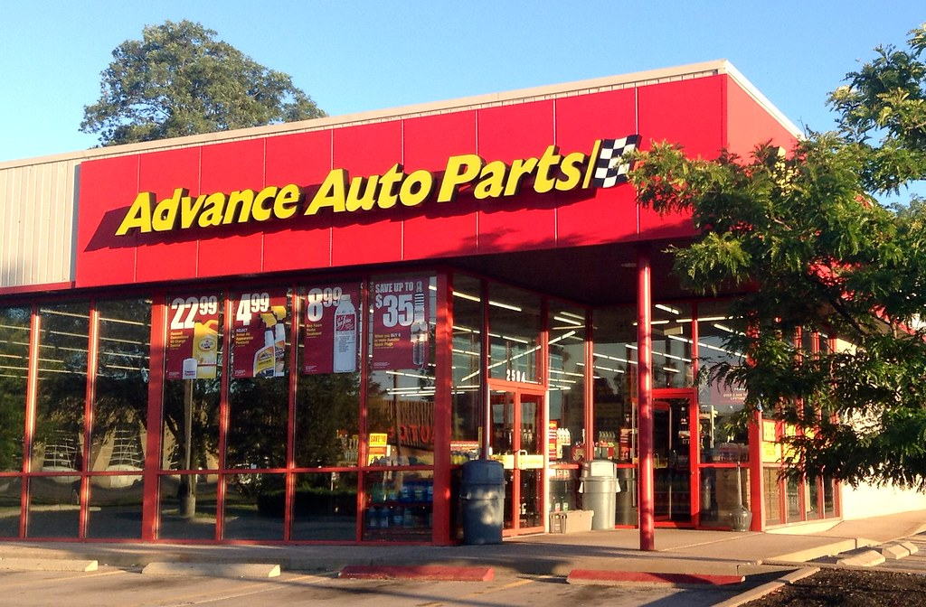
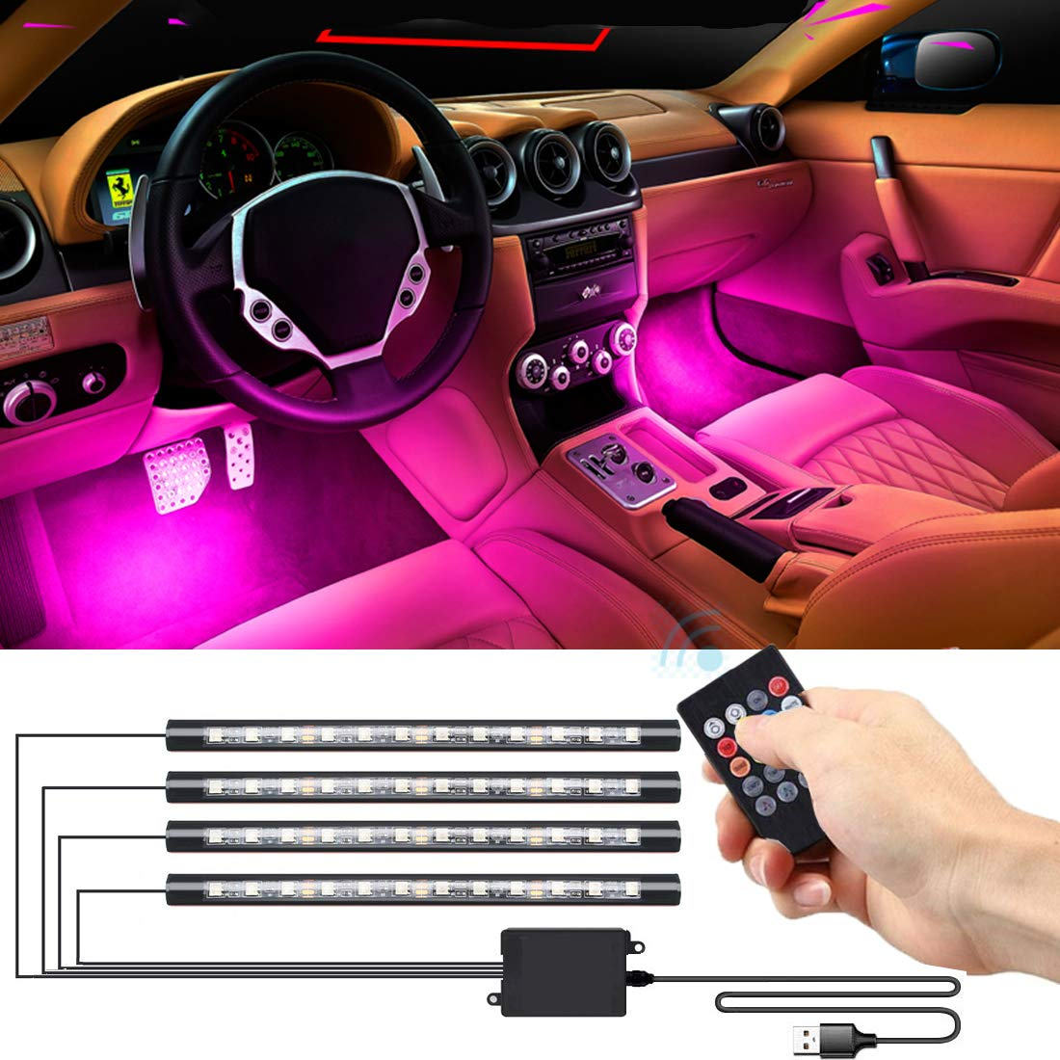
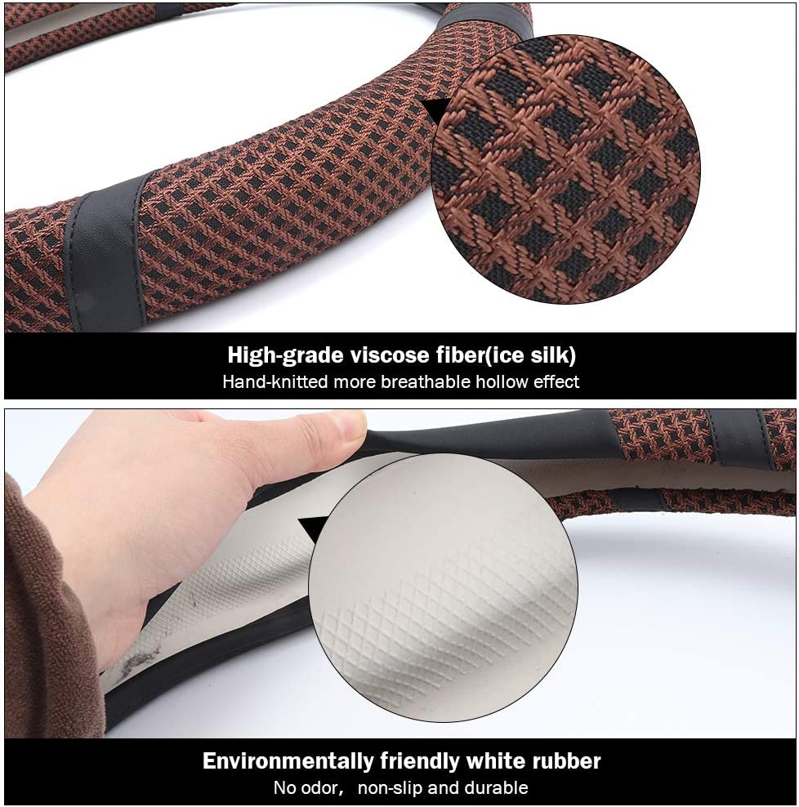
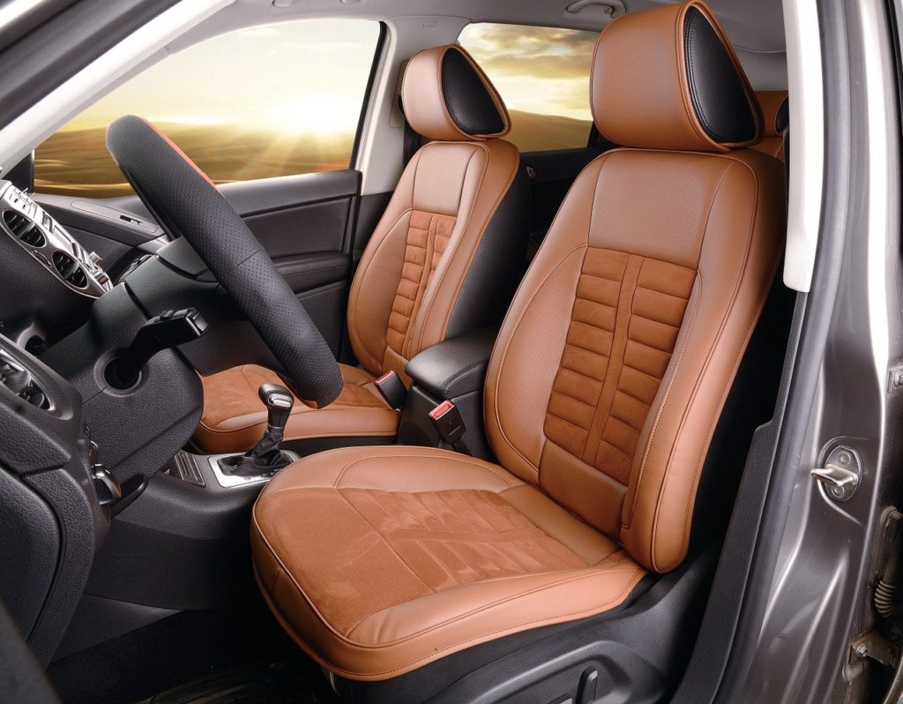
idea
To open a car shop for providing maintenance services and selling vehicles accessories (goods), considering best quality and affordable prices.

Slide 3
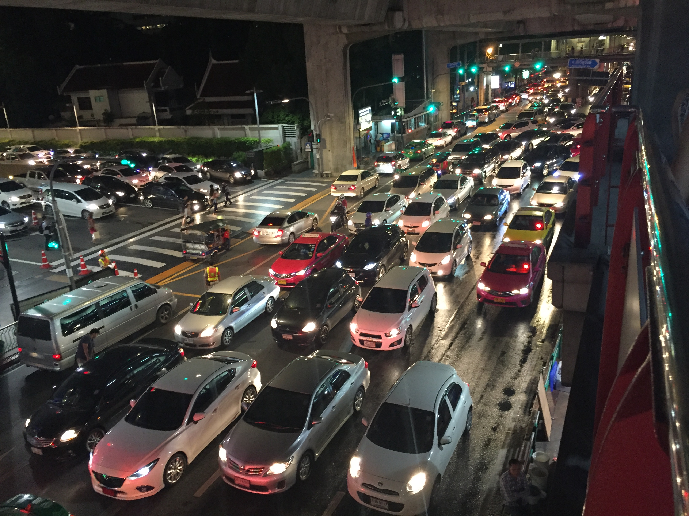
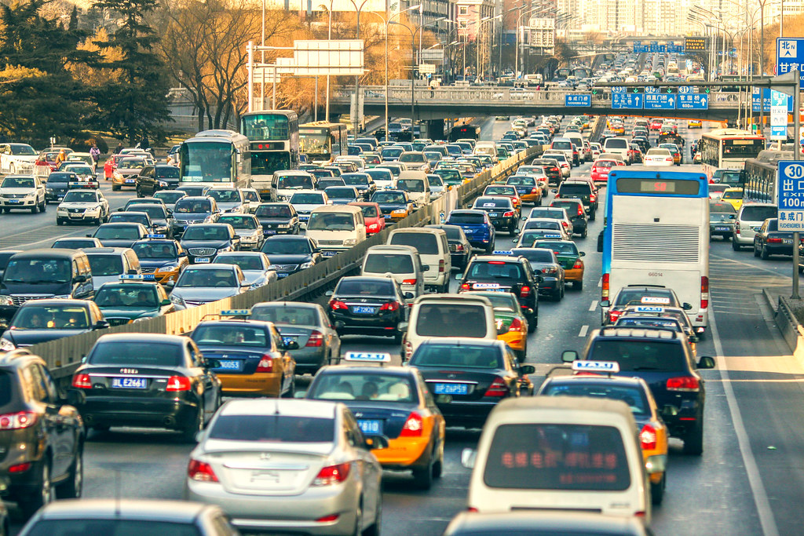
Why people want to buy
Considering the increase in the numbers of vehicles owned by people, there is a demand to have more car shops providing maintenance services and also accessories that are needed and trending.
This Photo by Unknown Author is licensed under CC BY-NC-ND

Slide 4
Objective
Our objective is to provide high quality services and goods that will lead us to have the trust of our customers; which will make us have more clients, gain profits then expand and grow moving forward.

Slide 5
Mission and vision
MISSION
Our mission is to provide unique and high quality services and goods.
VISION
Our vision is to spread all over the country with opening more branches.

Slide 6
Business name (Company Name)
I choose “BEST AUTO CRAFT” as a name for my business (company) since it is describing the value and offer.
Craft stands for an activity involving skill in making things by hands and we are highly skilled in our business and services we provide.
The name is easy to pronounce, memorable and unique as well.

Slide 7
Targeted market & Demographics
Total population of our city is more than two million persons, including around 600,000 labor force with more than 200,000 cars owned by persons and companies.
The average monthly income per person is estimated at $ 650.
Knowing that in the city, there are 500 registered and operational car shops serving more than 200,000 cars , so each car shop has an average of 400 customers.
Our target is to obtain a portion of the total estimated customers.

Slide 8
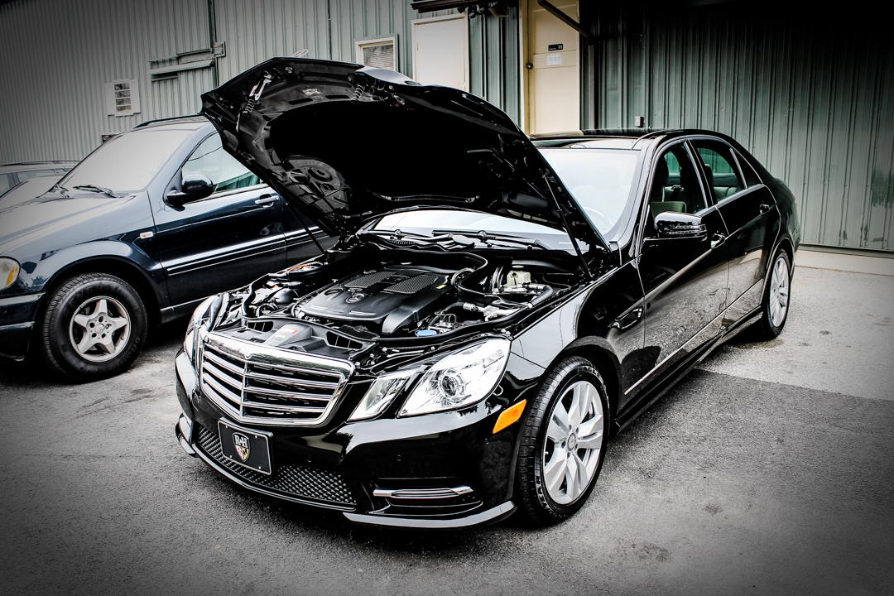
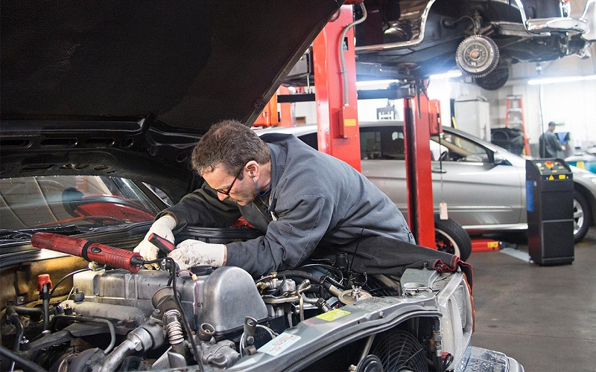
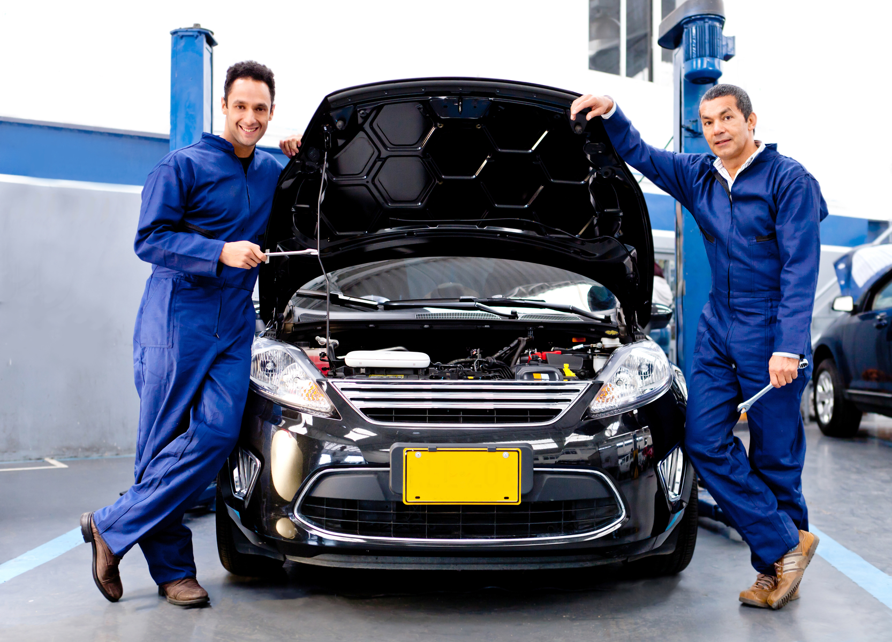
Customers and competitors
Our customers will be the car owners in the city (men and women).
Current competitors are 500 car shops, ranging from small to medium and large shops.

Slide 9
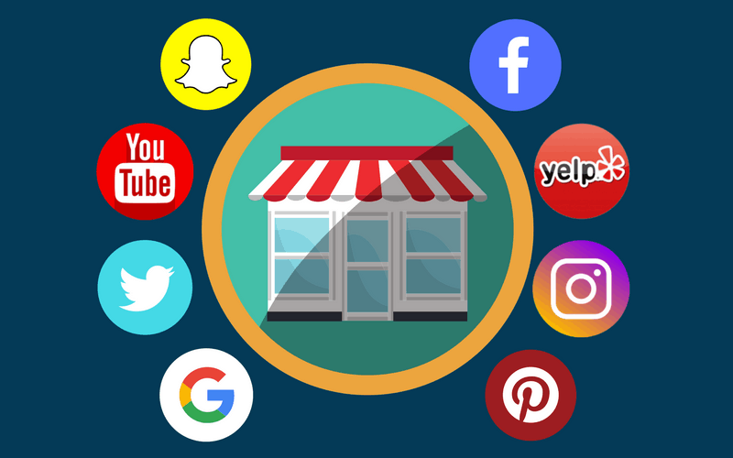
Location, marketing and supply
Our shop needs to be opened in the center of the city to be reachable for all customers.
We will market our shop through printing brochures, Facebook , Instagram and other social media apps.
Our goods will be available for supply in our physical shop and online as well; a specialized online service (application) will be available for customer to order the goods and/or to schedule and book a maintenance appointment as well.

Slide 10
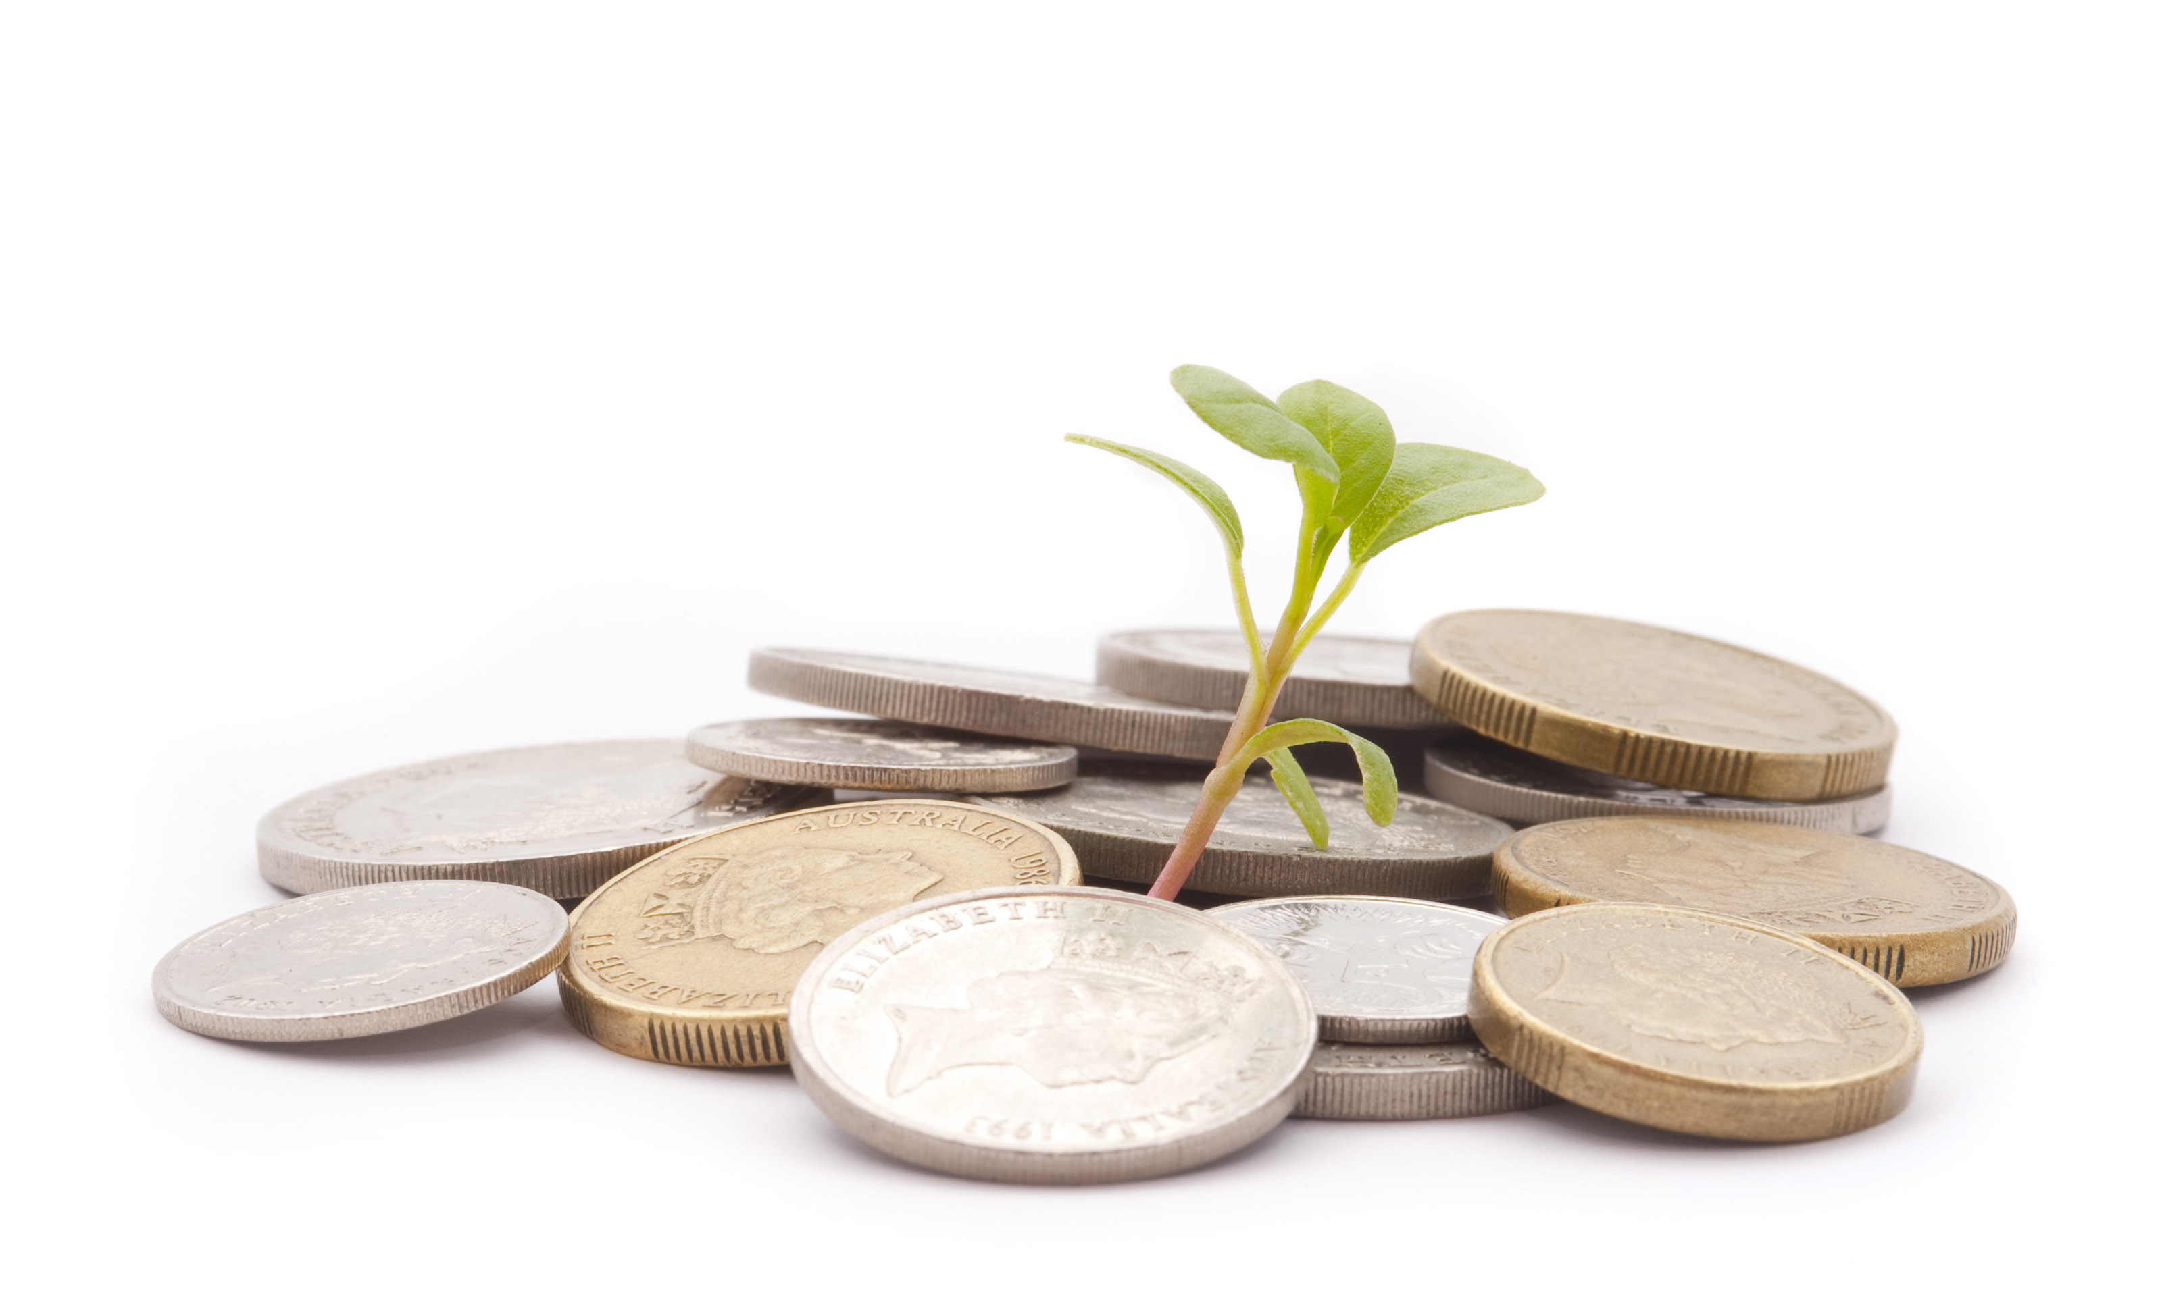
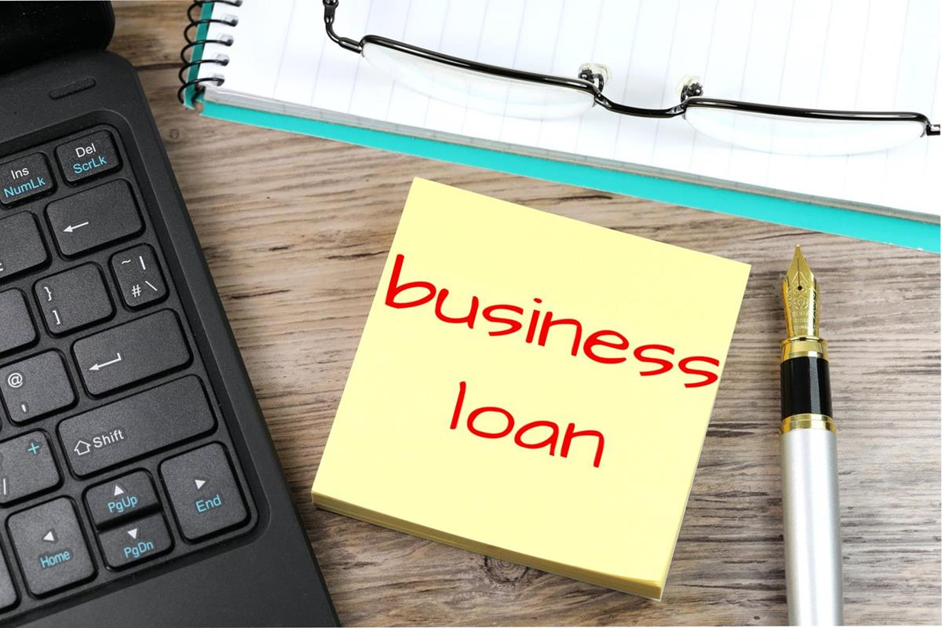
Financial information source of capital
The source of capital for my business will be from family available saving as option one , were I might go for a loan option as second one if needed.

Slide 11
Financial information cost
Total costs includes cost of machinery and monthly running expenses.
Monthly running expenses include utilities, suppliers and other material providers bills which will cost around $550 per month, in addition to monthly rent which will cost around $ 800 per month, plus labor costs of around $ 1,200 per month, all totaling $ 2,550 per month.
I also need machinery and equipment which cost around $3,300 which will be paid for one time in the beginning of the project.
For the first year, the cost will equal $ 2,550 * 12 months + $ 3,300 = $ 33,900, which equals $ 2,825 per month.

Slide 12
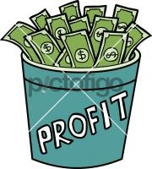
Financial information profit
Monthly sales includes:
Estimated maintenance clients of 40 clients per week, 160 clients per month, each to be billed an average of $ 50, totaling $ 8,000 per month
Estimated sales volume of accessories of $ 1,200 per month
Total = $ 9,200 per month
Our monthly profit in the first year = $ 9,200 - $ 2,825= $ 6,375 per month.

Slide 13
Owners details
The owners of business are Razik’s family ;
Hashem Abdul Razik, Maya Abdul Razik and Faris Abdul Razik as partners.

Slide 14
revenue tactics and strategy
My plans for the money gained based on profitability of the business are directed towards the reinvestment in the business; maybe launching new services like car washing for example.
I would also invest in my learning, in order to maintain the standard and even go for higher one.
Donating will be always in my plans as well, since I’m a strong believer, were giving to others will always return back with more success and accomplishment.

