Slide 1
How a gym benefits the NOS
By :
Abdullatif Sabri Rbeihat / Raad Omar Azar / Odeh Saed Dababneh

Slide 2
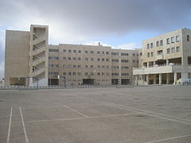
“An athlete cannot run with money in his pockets. He must run with hope in his heart and dreams in his head.” —Emil Zatopek
In this presentation we will talk about, after doing a survey, why we need a gym in the National Orthodox School, we’ll talk about the causes, the the consequences and how the school can provide the money to build the indoor gym.

Slide 3
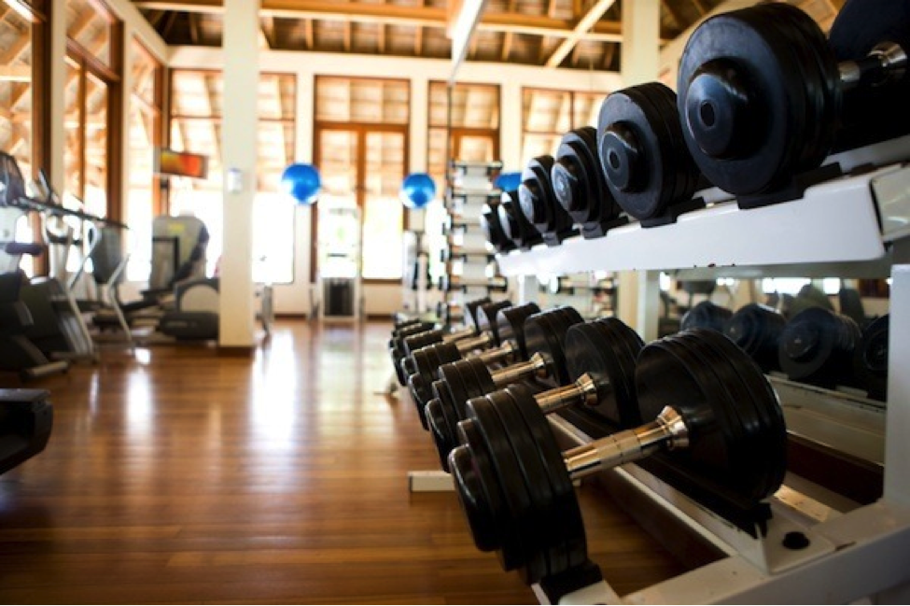
Why the NOS needs a gym
Exposing students to fitness early in life provides them with skills they can use to maintain a healthy lifestyle throughout their lives. Skills such as good form, how to use the gym equipment, and training discipline are all useful tools that can be carried into adulthood and will prevent injuries later in life.

Slide 4
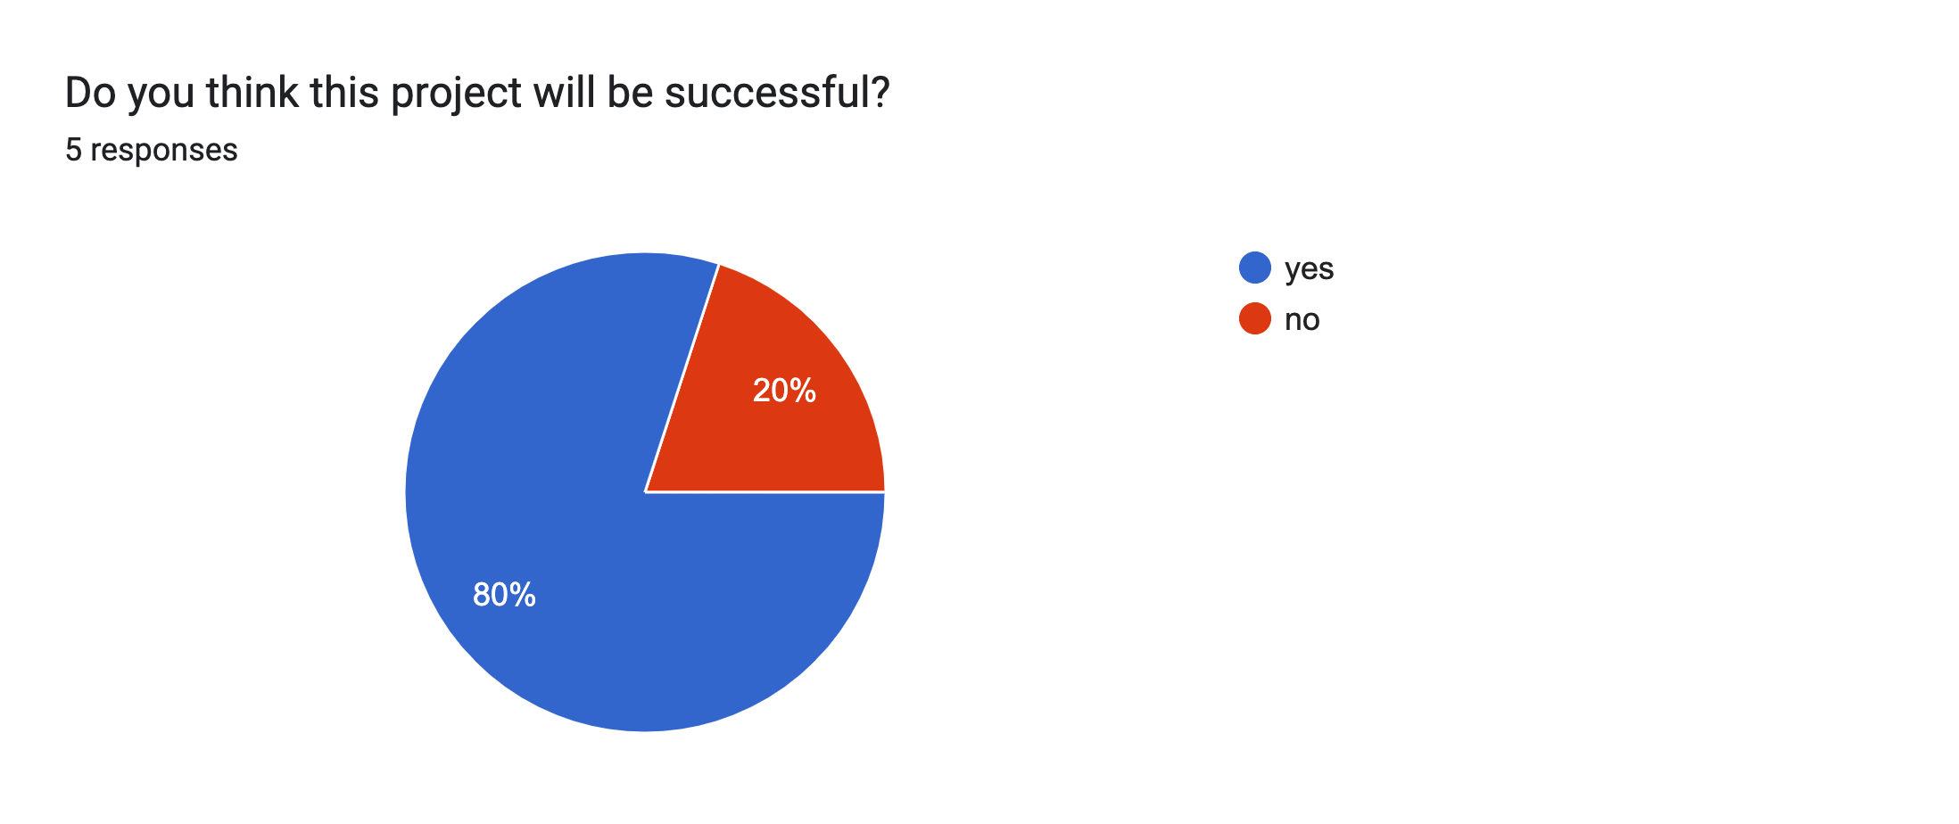
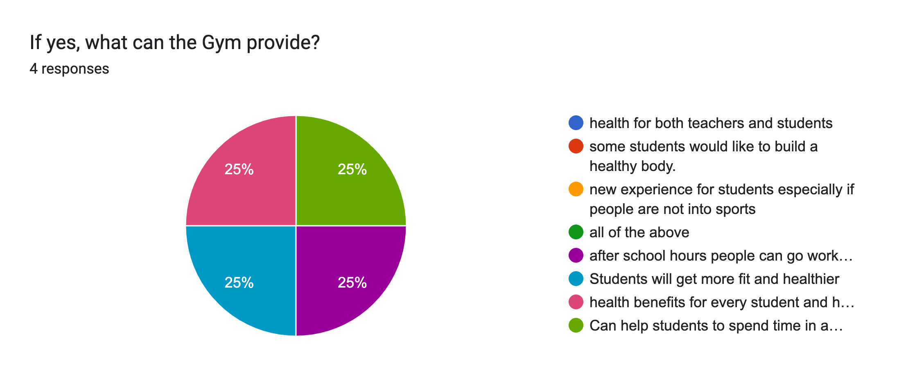
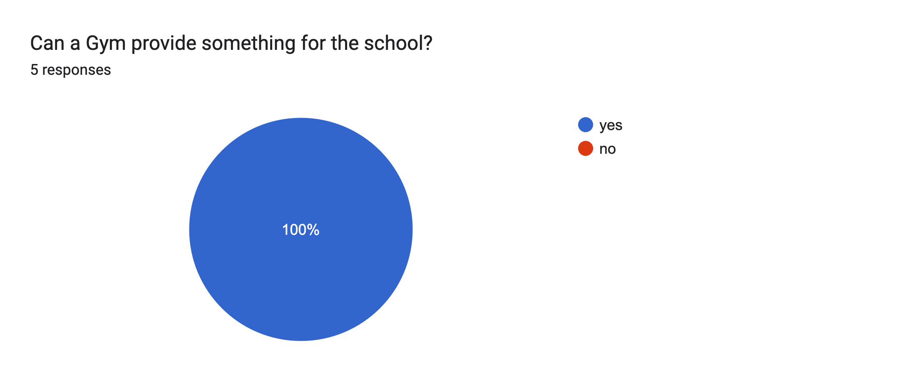
Out of 10 responders:

Slide 5
Advantages and disadvantages of having a gym in the National Orthodox School
Advantages:
It's good for your mind.
It's a great stress buster.
Access to equipment.
Access to knowledge.
It keeps you motivated.
Disadvantages:
May do more harm than good if workouts are not done properly.
Some people take it too far.
Gym memberships can be costly.
Injuries can be a problem for the environment.

Slide 6
Gym expenses on the National Orthodox School
We will kindly ask the NOS to provide us with a good amount of money so we can complete this project successfully.
However, we have our full trust in this project and we promise our beloved school that the money will be given back fully in the start of the year 2024.

Slide 7
Resources https://environmental-conscience.com/joining-a-gym-pros-cons/ https://myadvancefitness.com/7-benefits-of-a-gym-membership/ https://aperformance.co.uk/2019/09/20/the-benefits-of-training-facilities-in-schools-and-colleges/ Survey https://docs.google.com/forms/d/1QpLgoDAPD5KIzbDuaFRLPU6ptCJSxGF_mEsTtXok6eI/edit

